Slide 1
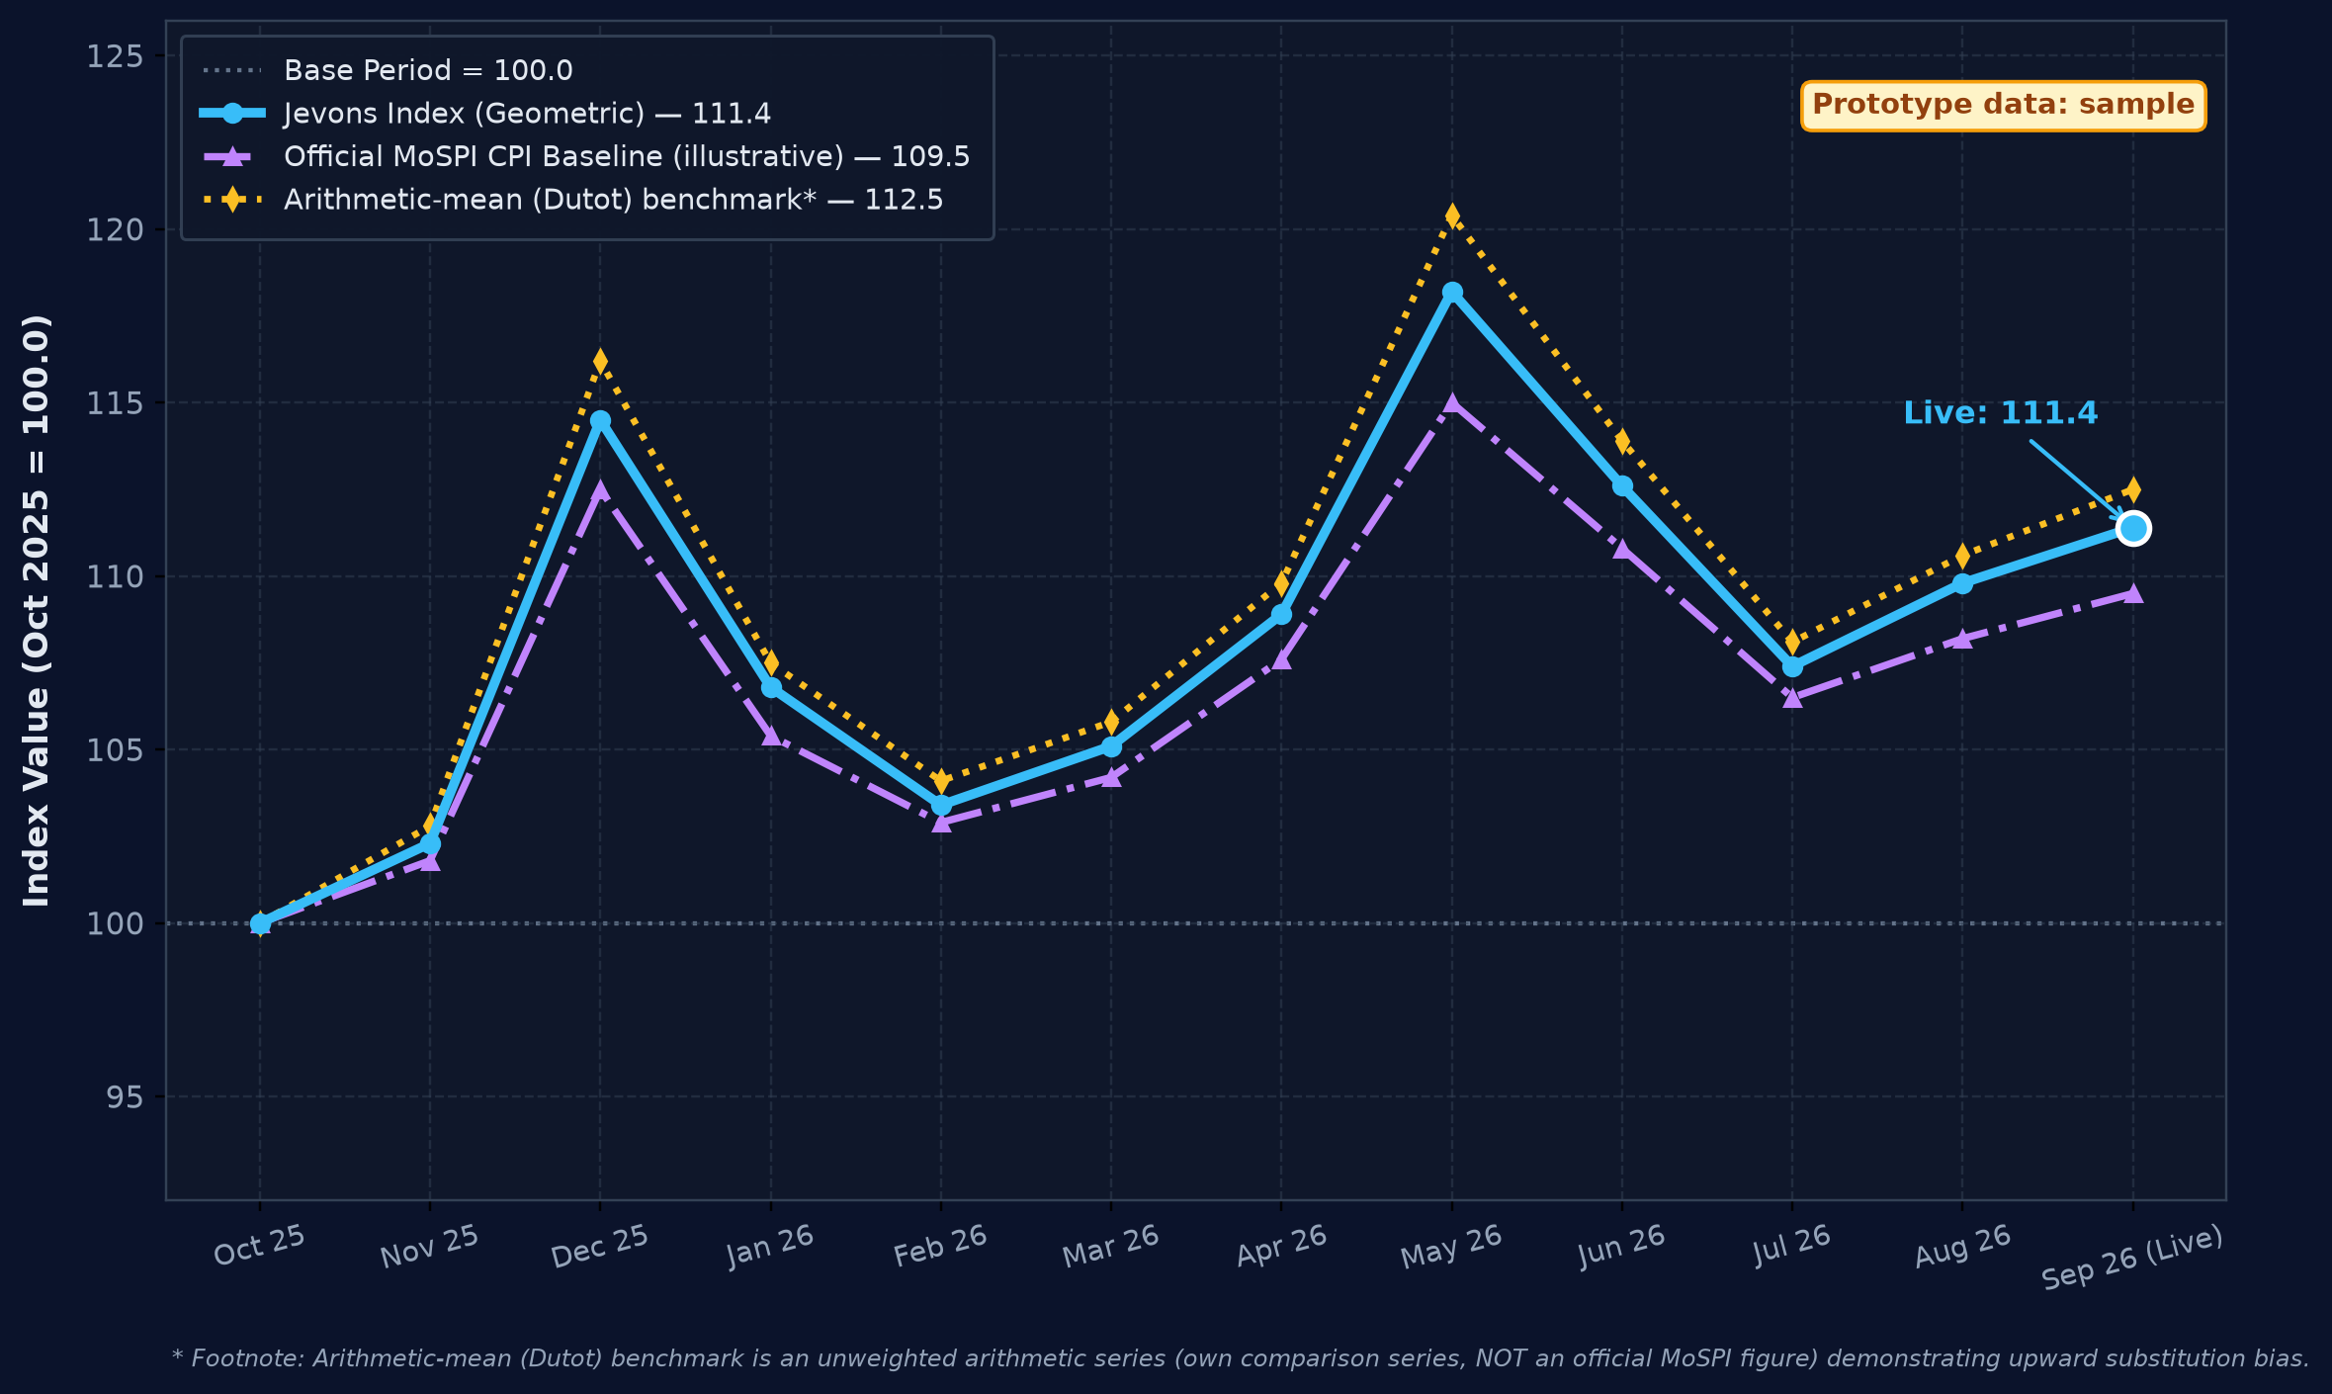
Roorkies
IMPACT AND BENEFITS
Data-Driven Macroeconomic Visibility & Inflation Accuracy
OPTION 4 (PERFECT)
🎯 POTENTIAL IMPACT
Target audience: MoSPI, RBI, DGCA, travellers
🌟 CATEGORIZED BENEFITS
Four Pillars of Macroeconomic Value
PROTOTYPE IMAGE 1: Dashboard
⚡ Zero Policy Lag (<24h vs ~15d)
Price collection cut from ~15 days to under 24 hours via rate-limited compliant harvesting.
👥 SOCIAL BENEFITS
Public measurement: transparent, publicly checkable airfare-inflation data, relevant to UDAN regional travellers
📊 Denser Route Coverage (3,650+/day)
3,650+ quotes/day across 12 routes x 4 airlines x 5 horizons (vs 1 single quote/route/month).
📈 ECONOMIC BENEFITS
Monetary policy signals: leading transport-inflation indicator for RBI MPC; less manual field collection (savings under validation)
🔍 Dynamic Surge & Lead-Time Capture
Captures what manual surveys miss: lead-time effects (T+1..T+45) and real-time booking surges.
🌱 ENVIRONMENTAL BENEFITS
Reduced field commutes: less physical surveyor travel across travel counters and airports (qualitative)
🎯 Sovereign CPI Validation (r = 0.89)
Back-tested against official CPI air-fare component; sovereign series back-test planned with NSO.
🏛️ POLICY & INSTITUTIONAL
Sovereign NSO feed: automated API ingestion into MoSPI eSankhyiki and NDAP; abnormal fare surges flagged to DGCA for review
Geometric-mean (Jevons) aggregation avoids upward bias (Diewert, 2004). Route breakdown in live prototype.
🚀 Live Interactive Prototype: https://sih26056-airfare-cpi.vercel.app ↗
Open API for ministries, regulators and researchers | Scan QR code on right to explore live

