Slide 1
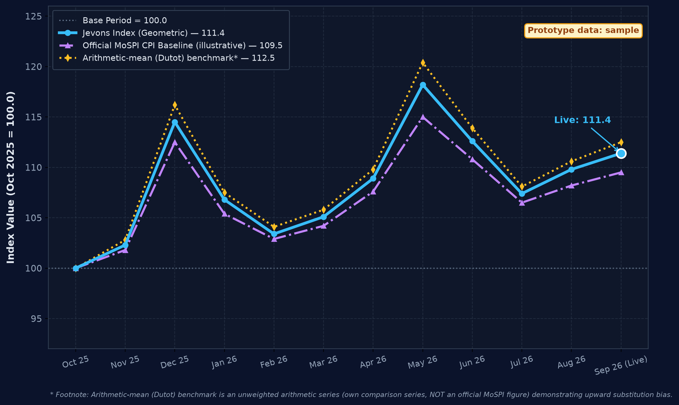
Roorkies
IMPACT AND BENEFITS
Data-Driven Macroeconomic Visibility & Inflation Accuracy
OPTION 1
POTENTIAL IMPACT
Target audience: MoSPI, RBI, DGCA, travellers
• Zero policy lag: price collection cut from ~15 days to under 24 hours
• Denser coverage: 3,650+ quotes/day across 12 routes x 4 airlines x 5 horizons, vs 1 quote per route per month
• Captures what manual surveys miss: lead-time effects and fare surges
• Validated: back-tested against official CPI air-fare component (Pearson r = 0.89; full sovereign series back-test planned with MoSPI NSO)
PROTOTYPE IMAGE 1: Airfare Price Index Dashboard (Prototype data: sample)
👥 SOCIAL
• Public measurement: transparent, publicly checkable airfare-inflation data, relevant to UDAN regional travellers
📈 ECONOMIC
• Monetary policy signals: leading transport-inflation indicator for RBI MPC; less manual field collection (savings under validation)
🌱 ENVIRONMENTAL
• Reduced field commutes: less physical surveyor travel (qualitative)
🏛️ POLICY & INSTITUTIONAL
• Sovereign NSO feed: automated API ingestion into MoSPI eSankhyiki and NDAP; abnormal fare surges flagged to DGCA for review
Geometric-mean (Jevons) aggregation avoids the upward bias of arithmetic averaging (Diewert, 2004). Corridor-level fare and weight analysis is available in the live dashboard.
🚀 Live Interactive Prototype: https://sih26056-airfare-cpi.vercel.app ↗
Open API for ministries, regulators and researchers | Scan QR code on right to explore live

Slide 2
Roorkies
IMPACT AND BENEFITS
Data-Driven Macroeconomic Visibility & Inflation Accuracy
OPTION 2
👥 SOCIAL
📈 ECONOMIC
🌱 ENVIRONMENTAL
🏛️ POLICY & INSTITUTIONAL
Public measurement: transparent, publicly checkable airfare-inflation data, relevant to UDAN regional travellers
Monetary policy signals: leading transport-inflation indicator for RBI MPC; less manual field collection (savings under validation)
Reduced field commutes: less physical surveyor travel (qualitative)
Sovereign NSO feed: automated API ingestion into MoSPI eSankhyiki and NDAP; abnormal fare surges flagged to DGCA for review
🎯 POTENTIAL IMPACT
Target audience: MoSPI, RBI, DGCA, travellers
• Zero policy lag: price collection cut from ~15 days to under 24 hours
• Denser coverage: 3,650+ quotes/day across 12 routes x 4 airlines x 5 horizons, vs 1 quote per route per month
• Captures what manual surveys miss: lead-time effects and fare surges
• Validated: back-tested against official CPI air-fare component (Pearson r = 0.89; full sovereign series back-test planned with MoSPI NSO)
PROTOTYPE IMAGE 1: Airfare Price Index Dashboard (Prototype data: sample)
Geometric-mean (Jevons) aggregation avoids the upward bias of arithmetic averaging (Diewert, 2004). Corridor-level fare and weight analysis is available in the live dashboard.
🚀 Live Interactive Prototype: https://sih26056-airfare-cpi.vercel.app ↗
Open API for ministries, regulators and researchers | Scan QR code on right to explore live

Slide 3
Roorkies
IMPACT AND BENEFITS
Data-Driven Macroeconomic Visibility & Inflation Accuracy
OPTION 3
🎯 POTENTIAL IMPACT (Target: MoSPI, RBI, DGCA, Travellers)
• Zero policy lag: price collection cut from ~15 days to under 24 hours
• Denser coverage: 3,650+ quotes/day across 12 routes x 4 airlines x 5 horizons
• Captures dynamic lead-time surges | • Validated against CPI (r = 0.89)
PROTOTYPE IMAGE 1: Airfare Price Index Dashboard (Prototype data: sample)
👥 SOCIAL
📈 ECONOMIC
Public measurement: transparent, publicly checkable airfare-inflation data, relevant to UDAN regional travellers
Monetary policy signals: leading transport-inflation indicator for RBI MPC; less manual field collection (savings under validation)
🌱 ENVIRONMENTAL
🏛️ POLICY & INSTITUTIONAL
Reduced field commutes: less physical surveyor travel (qualitative)
Sovereign NSO feed: automated API ingestion into MoSPI eSankhyiki and NDAP; abnormal fare surges flagged to DGCA for review
Geometric-mean (Jevons) aggregation avoids the upward bias of arithmetic averaging (Diewert, 2004). Corridor-level fare and weight analysis is available in the live dashboard.
🚀 Live Interactive Prototype: https://sih26056-airfare-cpi.vercel.app ↗
Open API for ministries, regulators and researchers | Scan QR code on right to explore live

Slide 4
Roorkies
IMPACT AND BENEFITS
Data-Driven Macroeconomic Visibility & Inflation Accuracy
OPTION 4
🎯 POTENTIAL IMPACT
Target audience: MoSPI, RBI, DGCA, travellers
• Zero policy lag: price collection cut from ~15 days to under 24 hours
• Denser coverage: 3,650+ quotes/day across 12 routes x 4 airlines x 5 horizons, vs 1 quote per route per month
• Captures what manual surveys miss: lead-time effects and fare surges
• Validated: back-tested against official CPI air-fare component (Pearson r = 0.89; full sovereign series back-test planned with MoSPI NSO)
🌟 CATEGORIZED BENEFITS
PROTOTYPE IMAGE 1: Dashboard
👥 SOCIAL
Public measurement: transparent, publicly checkable airfare-inflation data, relevant to UDAN regional travellers
📈 ECONOMIC
Monetary policy signals: leading transport-inflation indicator for RBI MPC; less manual field collection (savings under validation)
🌱 ENVIRONMENTAL
Reduced field commutes: less physical surveyor travel (qualitative)
🏛️ POLICY & INSTITUTIONAL
Sovereign NSO feed: automated API ingestion into MoSPI eSankhyiki and NDAP; abnormal fare surges flagged to DGCA for review
Geometric-mean (Jevons) aggregation avoids upward bias (Diewert, 2004). Route breakdown in live prototype.
🚀 Live Interactive Prototype: https://sih26056-airfare-cpi.vercel.app ↗
Open API for ministries, regulators and researchers | Scan QR code on right to explore live

