Slide 1


SMART INDIA HACKATHON 2026
• Problem Statement ID – SIH26056
• Problem Statement Title- Development of a Real-time Airfare Price Index for India through Automated Web Scraping of Airline and Online Travel Aggregator Portals for Augmentation of the Consumer Price Index (CPI)
• Theme- Smart Governance / Miscellaneous
• PS Category- Software
• Team ID- Team Rookie
• Team Name- Team Rookie
• Team Members- Nikhil Kanse, Shivish Kumar, Tejas Patil, Pranav Pawale, Harsh Narkar, Blessy
Team Rookie | [ Nikhil Kanse , Shivish Kumar , Tejas Patil , Pranav Pawale , Harsh Narkar , Blessy ]

Slide 2
Team Rookie
AIRINTEL INDIA
Augmenting CPI through High-Frequency Algorithmic Web Scraping
PROBLEM
• Manual Survey Bottleneck: Field staff manually query airline portals once a month for single spot quotes.
• Blind to Dynamic Pricing: Fails to capture algorithmic yield spikes, peak hour surges, and holiday load factors.
• Lead-Time Neglect: Completely ignores booking curves (1-day emergency surge vs. 45-day advance booking).
• 15-Day Policy Lag: Lagging data limits the responsiveness of RBI monetary policy and aviation regulators.
1. Ingestion
2. Cleanse
3. Jevons GM
4. Laspeyres
Why different
• Captures real-time dynamic yield algorithms, not single monthly static quotes.
• Mathematically proven Jevons GM eliminates upward substitution bias over Dutot.
• Cryptographic SHA-256 vault guarantees legal & statistical reproducibility.
Our solution
An automated high-frequency pipeline that:
• Scrapes raw fares across IndiGo, Air India, SpiceJet & OTAs via scheduled Playwright crawlers.
• Samples 5 forward lead times (1d, 7d, 15d, 30d, 45d) for complete horizon capture.
• Applies automated Z-score outlier filtering (|Z| > 3.0) to flag dynamic surges.
• Calculates UN/ILO Jevons Elementary Geometric Mean to eliminate substitution bias.
• Aggregates National Laspeyres Index weighted by DGCA monthly passenger volume.
• Generates cryptographic SHA-256 provenance hashes for official MoSPI auditability.
Key Value Proposition
• >95% reduction in recurring survey costs across 12 metro airports.
• Empowers RBI MPC with zero-lag transportation inflation leading indicators.
• Equips DGCA with instant surge anomaly alerts to detect regional price gouging.
Team Rookie | [ Nikhil Kanse , Shivish Kumar , Tejas Patil , Pranav Pawale , Harsh Narkar , Blessy ]

Slide 3
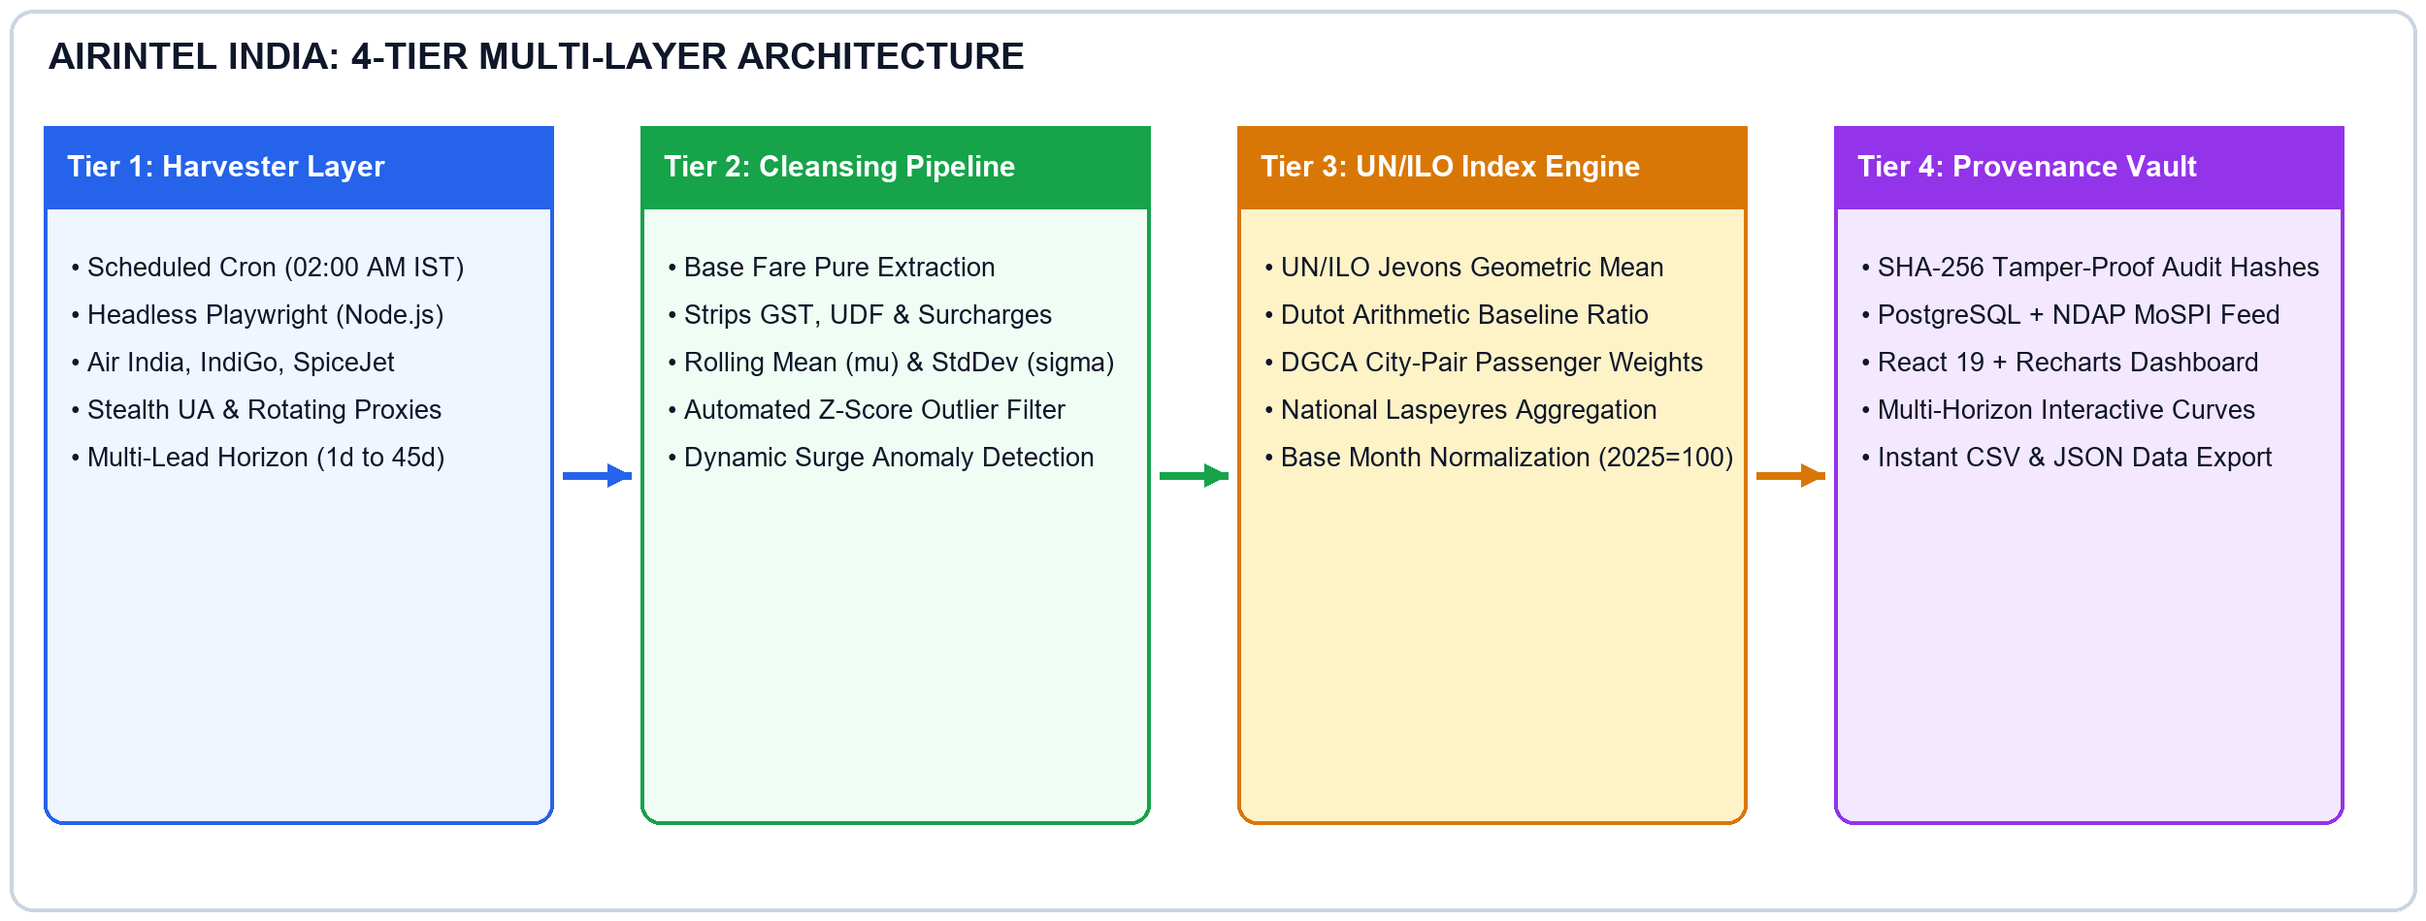
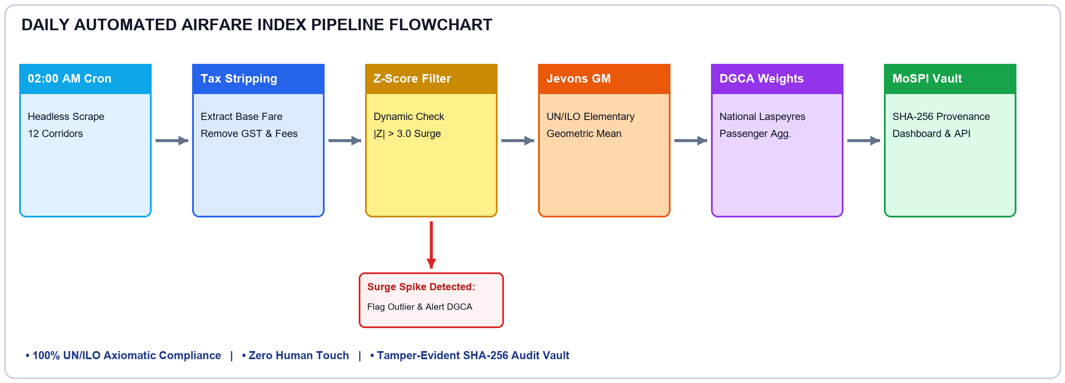
Team Rookie
TECHNICAL APPROACH
System Architecture
Tech Stack Used:
• Python 3.13
• Playwright
• Pandas & NumPy
• SciPy (Z-score)
• UN/ILO Jevons Engine
• PostgreSQL
• React 19
• TypeScript
• Tailwind CSS
• Recharts SVG
• FastAPI & Node.js
• Docker & Vercel Edge
Process Flowchart
Team Rookie | [ Nikhil Kanse , Shivish Kumar , Tejas Patil , Pranav Pawale , Harsh Narkar , Blessy ]

Slide 4
Team Rookie
FEASIBILITY AND VIABILITY
Risk assessment and mitigation
Problem: Anti-Scraping / IP Blocks ➔ Solution: 02:00 AM off-peak cron + residential proxy rotation + jitter delays
Problem: OTA DOM Layout Changes ➔ Solution: Multi-selector schema (ARIA / data-test) + cached baseline fallbacks
Problem: Dynamic Surge & Outliers ➔ Solution: Automated ±3.0σ Z-score truncation + UN/ILO Jevons geometric damping
Technical feasibility
• Automated headless Playwright extraction across Air India, IndiGo, SpiceJet & MakeMyTrip.
• 5 standard forward lead-times (1d, 7d, 15d, 30d, 45d) capturing full yield curves.
• Mathematical UN/ILO Jevons geometric mean & DGCA passenger volume Laspeyres weighting model.
Resource Requirements
• Lightweight serverless cloud cron runner / VPS (Python & Node.js).
• Open source statistical tools (Playwright, Pandas, SciPy, PostgreSQL, React 19).
• Secure cloud database to store flight quotes, formula IDs & SHA-256 provenance hashes.
Proven Frameworks
✔ UN/ILO CPI Manual (2020)
✔ DGCA Traffic Statistics
✔ MoSPI CPI (2012=100)
✔ MIT Billion Prices Project
Economic Approach
• Slashes manual airport survey collection costs by >95% across major Indian metros.
• Extremely low operational cloud footprint (< ₹3,500 / month).
• High ROI: 30x increase in price sampling frequency at a fraction of manual survey costs.
• Scales easily across 250+ UDAN regional routes with zero additional hardware.
Team Rookie | [ Nikhil Kanse , Shivish Kumar , Tejas Patil , Pranav Pawale , Harsh Narkar , Blessy ]

Slide 5
Team Rookie
IMPACT AND BENEFITS
“FROM SCATTERED AIRFARES TO SOVEREIGN REAL-TIME INFLATION INTELLIGENCE”
IMPACTS
FUTURE PROSPECTS
Macroeconomic Policy Impact
Eliminates 15-day CPI lag; empowers RBI MPC with real-time transport inflation metrics.
• UDAN Route Expansion: Scale from current 12 metro corridors to 250+ Tier-2 and Tier-3 regional airports nationwide.
• Cabin Tier Differentiation: Segregate economy, premium economy, and business class into granular sub-indices.
• Intraday Time-of-Day Yield: Model peak departure rush hours (06:00-09:00, 17:00-20:00) vs off-peak red-eye rates.
• Central MoSPI NDAP Integration: Establish direct automated API pipelines feeding real-time indices into the official CPI release.
• Autonomous AI Analyst: Deploy LLM agents to draft automated weekly inflation briefs and alert DGCA of pricing anomalies.
Regulatory & Aviation Impact
Enables DGCA to detect route monopolies, festival fare surges & predatory pricing.
Statistical Rigor Impact
Replaces single monthly spot checks with 10,000+ daily observations obeying UN/ILO standards.
National Governance Impact
Builds India's first sovereign high-frequency price aggregation platform.
Technical & Digital Impact
Demonstrates how automated scraping & cryptographic provenance modernize national statistics.
Team Rookie | [ Nikhil Kanse , Shivish Kumar , Tejas Patil , Pranav Pawale , Harsh Narkar , Blessy ]

Slide 6
RESEARCH AND REFERENCES
SUPPORTING RESEARCH PAPERS
• Cavallo, A., & Rigobon, R. (2016). 'The Billion Prices Project: Using Online Data for Measurement and Research.' Journal of Economic Perspectives.
• UN, ILO, IMF, OECD, Eurostat, World Bank (2020). Consumer Price Index Manual: Concepts and Methods, Chapter 10 (Elementary Indices).
DATA SOURCES
https://www.dgca.gov.in/ (DGCA Monthly Scheduled Domestic Passenger Traffic)
https://www.mospi.gov.in/ (CSO Consumer Price Index Manual & Guidelines)
https://www.airindia.com/ & https://www.goindigo.in/ (Direct Carrier Portals)
https://www.makemytrip.com/ (Online Travel Aggregator Non-Stop Domestic Flight Rates)
MARKET RESEARCH
• Indian domestic air passenger traffic is projected to grow at >15% CAGR (2024–2030).
• Algorithmic dynamic pricing creates massive intraday and lead-time fare dispersion.
• Zero automated tools currently exist in India for daily algorithmic CPI airfare tracking.
• AirIntel India fills the critical 15-day MoSPI manual survey lag with zero latency.
TECHNICAL DOCUMENTATION
• Index Formulations: UN/ILO Jevons Geometric Mean vs Dutot Arithmetic Comparison.
• Scraper Framework: Playwright Chromium Headless with Random UA & Stealth Evasion.
• Provenance Architecture: SHA-256 Hash Manifest conforming to NDSAP open standards.
• Deployment: Dockerized serverless cron (02:00 AM) + Vercel Edge Web Portal.
Team Rookie | [ Nikhil Kanse , Shivish Kumar , Tejas Patil , Pranav Pawale , Harsh Narkar , Blessy ]

