Slide 1

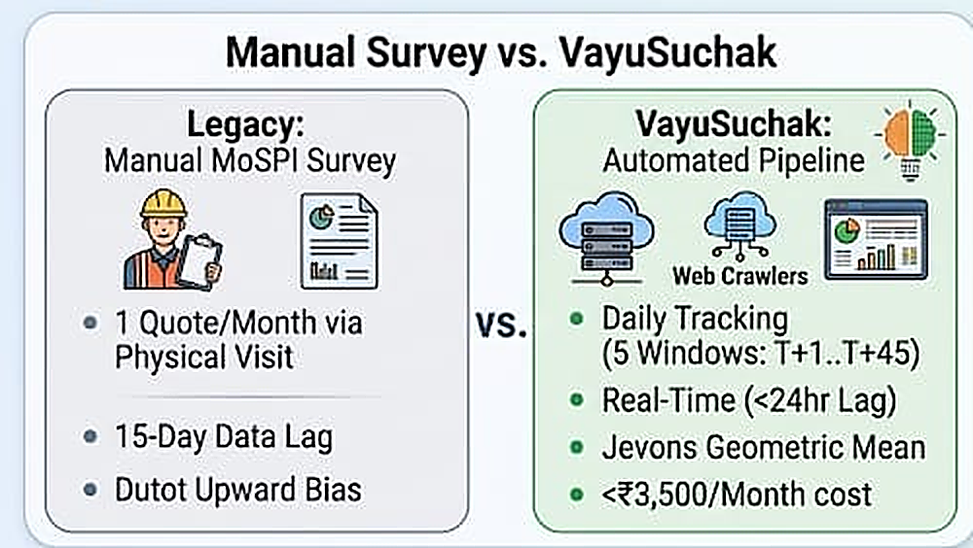
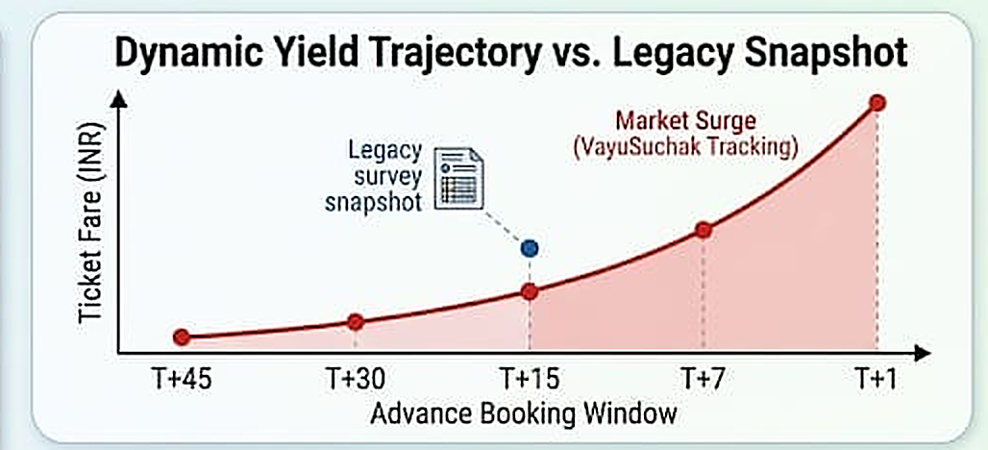
Team Rookie
VayuSuchak: Real-Time Airfare Price Index
Augmenting CPI Transport Inflation
❖ Proposed Solution
Uniqueness of Solution:
• Dynamic Yield Sensitivity: Captures high-frequency intraday algorithmic surges across T+1..T+45 advance windows vs 15-day delayed manual visits.
• Zero Upward Substitution Bias: Employs UN/ILO Chapter 10 Jevons geometric mean, mathematically eliminating Dutot distortion.
• Cryptographic Legal Audit: SHA-256 batch fingerprints ensure tamper-proof evidentiary standards for MoSPI NSO & RBI.
Core Mechanism: Automated daily crawlers capture live ticket quotes across T+1..T+45 advance booking windows. An intelligent dynamic IQR filter eliminates cache anomalies and phantom pricing, feeding a UN/ILO Jevons geometric mean index that eliminates Dutot upward substitution bias for sovereign CPI publication.
DATA HARVESTING > IQR OUTLIER TRUNCATION > JEVONS GEOMETRIC INDEX > SHA-256 PROVENANCE > MoSPI & RBI CPI INTEGRATION

