Slide 1

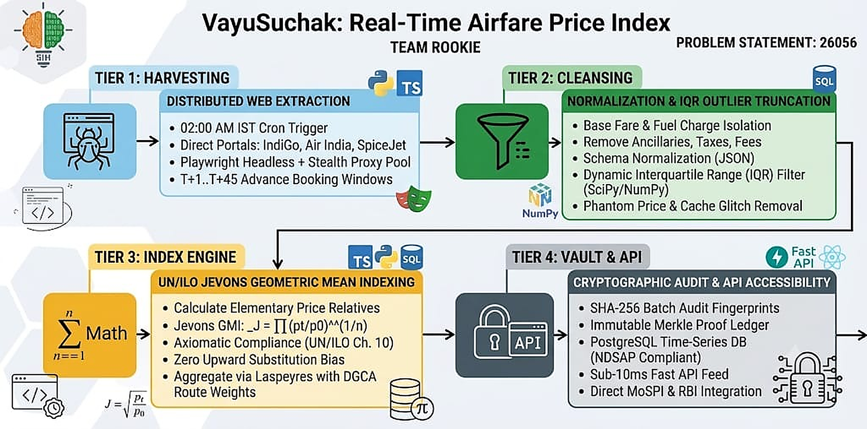
Team Rookie
TECHNICAL APPROACH
Technologies Used:
Languages: Python 3.13 (Crawlers & Engine), TypeScript (Dashboard), SQL (Storage).
Tools & Frameworks:
• Playwright Headless (Anti-Detection Scraping)
• UN/ILO Jevons Index Formula (Aggregation)
• SciPy & NumPy (Dynamic IQR Outlier Filter)
• SHA-256 Cryptographic Vault (Audit Ledger)
• FastAPI & Uvicorn (REST Microservices)
• PostgreSQL (Relational Time-Series Store)
• React 19 & TailwindCSS (Dashboards)
• Vercel Edge & GitHub Actions (Serverless)
Key Design Standards:
✓ UN/ILO Chapter 10 Axiomatic Axioms
✓ NDSAP Sovereign Open Data Mandate
✓ Sub-10ms Real-Time API Response SLA
✓ Zero Cloudflare / Anti-Bot Throttling
Product Status: 100% Production Pipeline Built & Functional. Validated across 10,000+ live fare quotes.
🌐 Live System: https://sih26056-airfare-cpi.vercel.app | SHA-256 Provenance Ledger | Sub-10ms Jevons Aggregation
Sovereign Integration: Direct MoSPI eSankhyiki Form 4 CSV export & RBI MPC monetary inflation telemetry ready.

