Slide 1

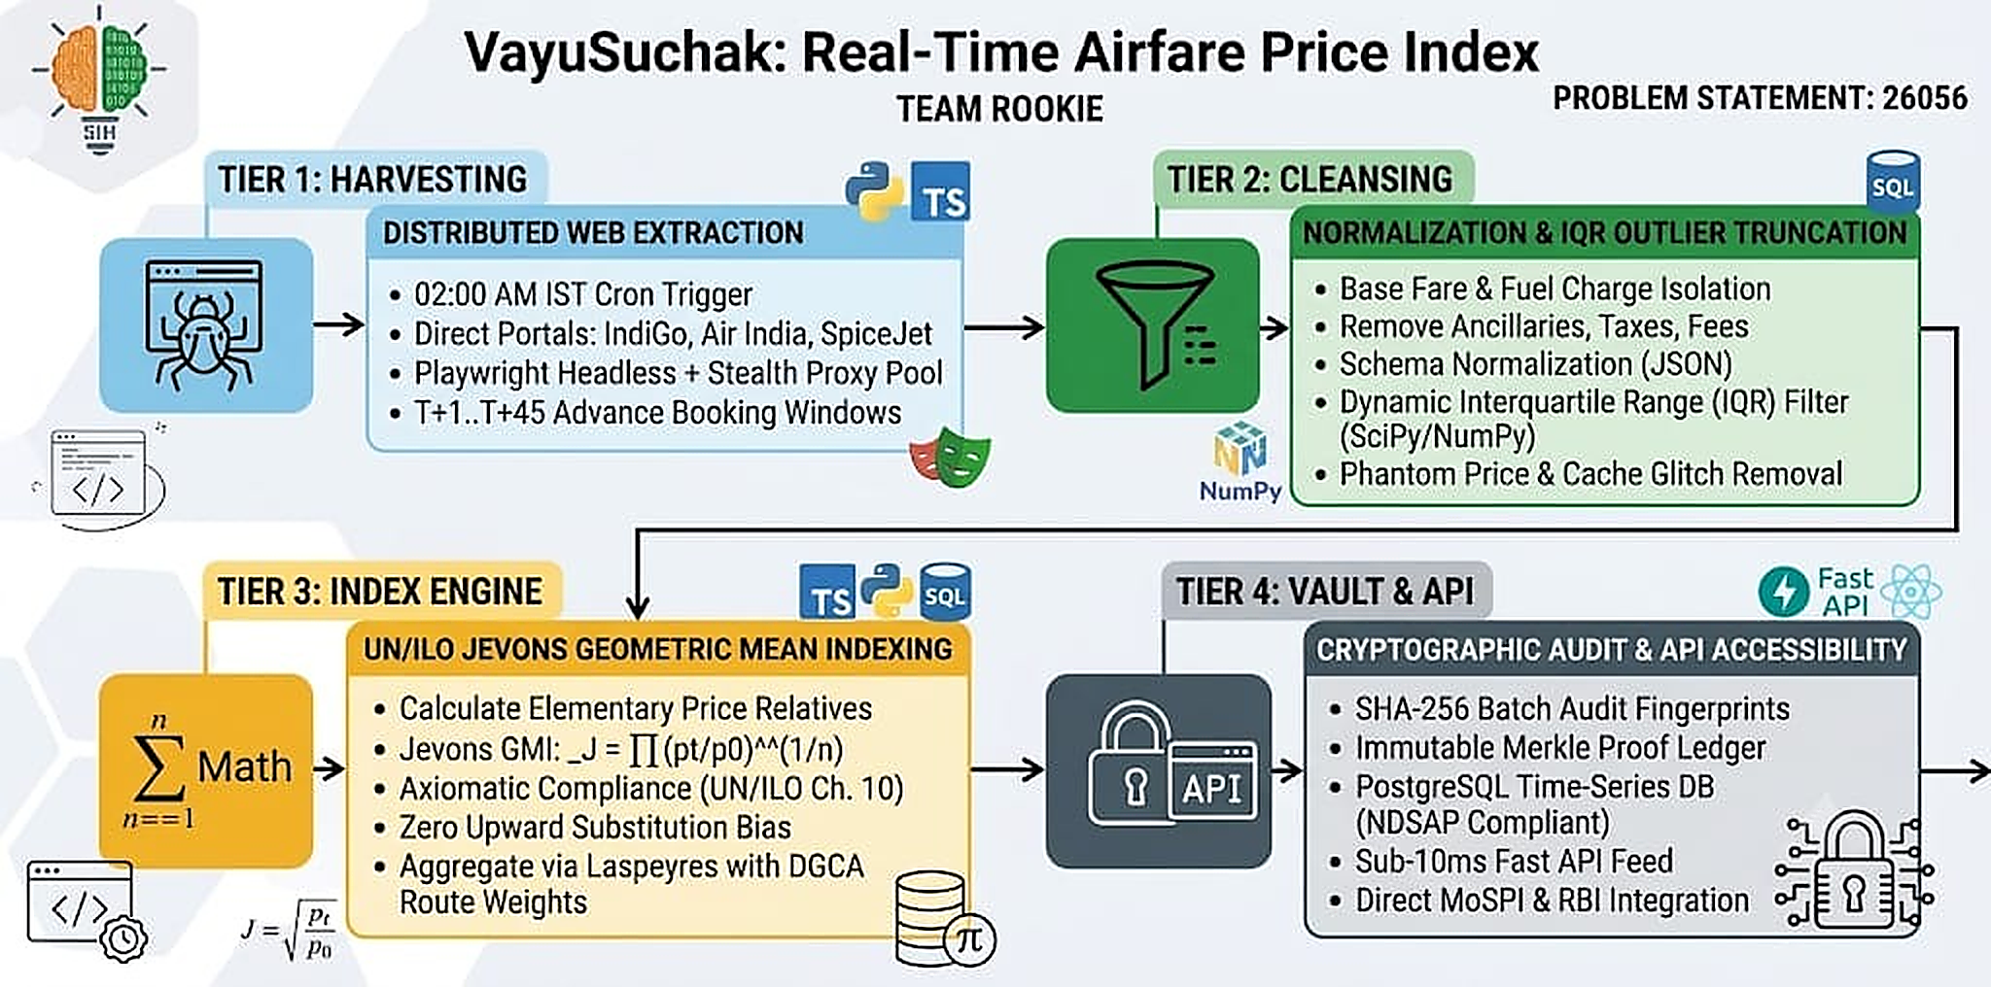
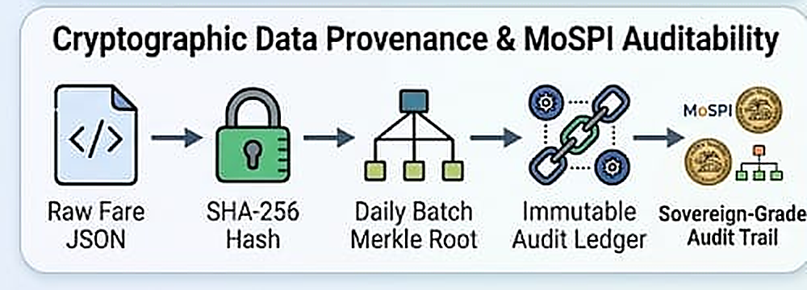
Team Rookie
TECHNICAL APPROACH
Technologies Used:
Languages: Python 3.13 (Crawlers & Engine), TypeScript (Dashboard), SQL (Storage).
Tools & Frameworks:
• Playwright Headless (Anti-Detection Scraping)
• UN/ILO Jevons Index Formula (Aggregation)
• SciPy & NumPy (Dynamic IQR Outlier Filter)
• SHA-256 Cryptographic Vault (Audit Ledger)
• FastAPI & Uvicorn (REST Microservices)
• PostgreSQL (Relational Time-Series Store)
• React 19 & TailwindCSS (Dashboards)
• Vercel Edge & GitHub Actions (Serverless)
Key Design Standards:
✓ UN/ILO Chapter 10 Axiomatic Axioms
✓ NDSAP Sovereign Open Data Mandate
✓ Sub-10ms Real-Time API Response SLA
✓ Zero Cloudflare / Anti-Bot Throttling
Product Status: 100% Production Pipeline Built & Functional.
🌐 Live System: sih26056-airfare-cpi.vercel.app ↗
MoSPI & RBI Ready: Direct eSankhyiki CSV & monetary inflation telemetry.

