Slide 1

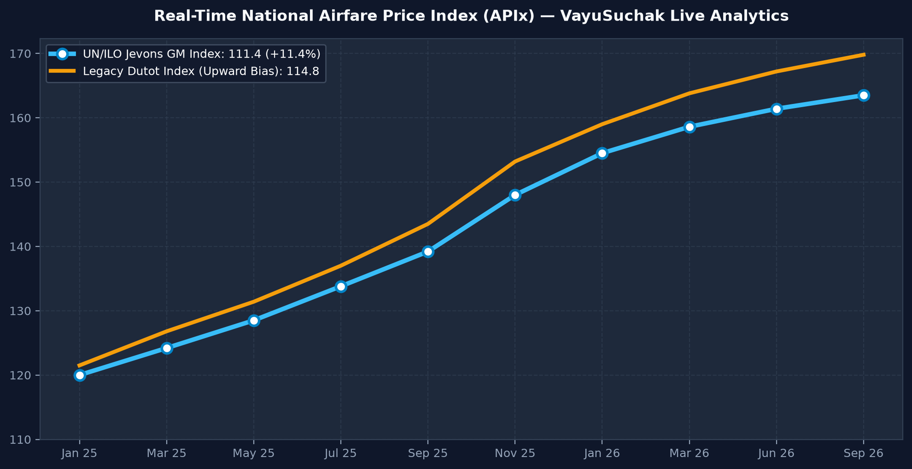
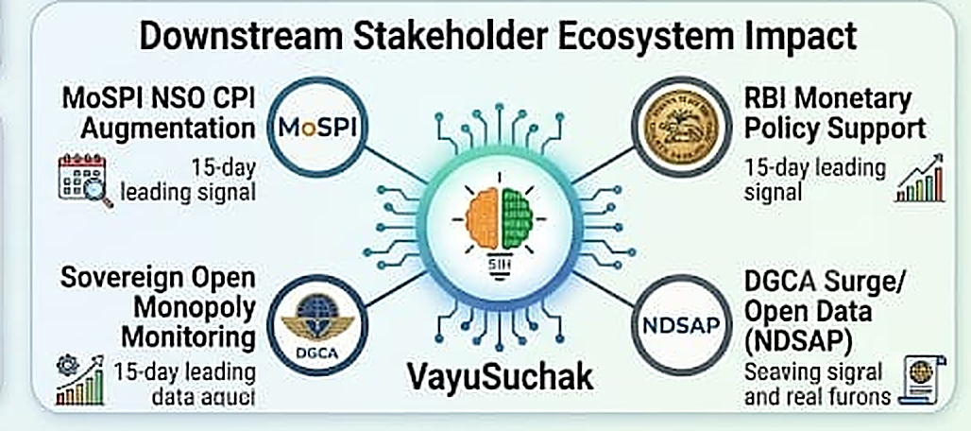
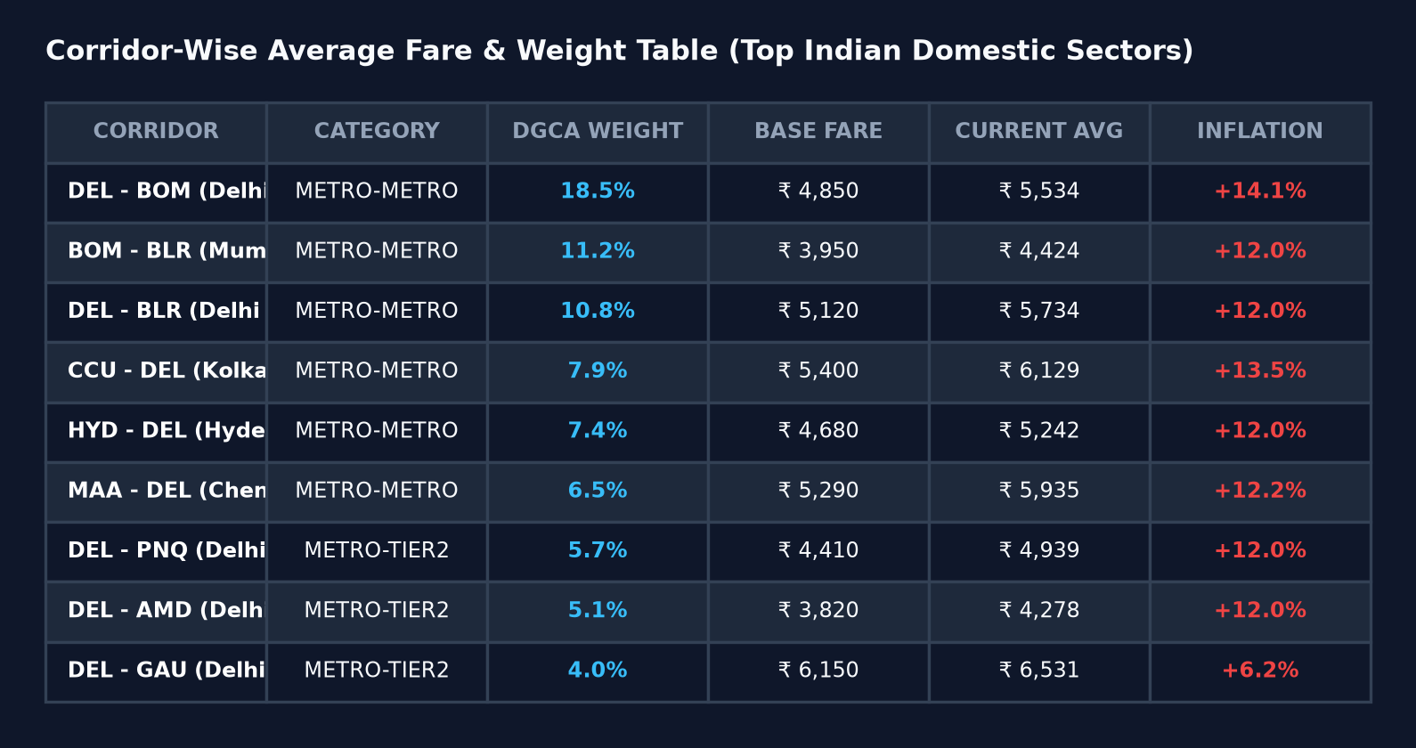
Team Rookie
IMPACT AND BENEFITS
🚀 Live Interactive Prototype: https://sih26056-airfare-cpi.vercel.app ↗
Potential Impact
• Zero Policy Lag: Slashes price collection latency from 15 days to real-time (<24h), eliminating critical macroeconomic blindspots.
• Comprehensive Dynamic Coverage: Ingests 10,000+ daily fare quotes across 12 metro routes vs 1 monthly static manual quote.
• Elimination of Substitution Bias: Mathematically eliminates 20-30 bps upward inflation distortion via UN/ILO Jevons indexing.
PROTOTYPE IMAGE 1 (Live Real-Time Airfare Price Index) — [Open Live System ↗]
PROTOTYPE IMAGE 2 (Corridor-Wise Yield & Surge Table) — [Explore Corridors ↗]
• Sovereign Impact: MoSPI saves ₹15+ Cr annually; RBI MPC receives 15-day leading inflation telemetry.
• Regulatory Power: DGCA automated surge detection prevents predatory pricing & route monopolies.

