Slide 1


SMART INDIA HACKATHON 2026
TITLE PAGE
• Problem Statement ID – 26056
• Problem Statement Title- Development of a Real-time Airfare Price Index for India through Automated Web Scraping of Airline and Online Travel Aggregator Portals for Augmentation of the Consumer Price Index (CPI).
• Theme- Smart Automation
• PS Category- Software
• Team ID- 168405
• Team Name- Roorkies

Slide 2
Roorkies
PROPOSED SOLUTION
High-Frequency Real-Time Airfare Index Eliminating 15-Day MoSPI Survey Latency
THE PROBLEM
Current MoSPI Manual Survey
HOW IT ADDRESSES THE PROBLEM
VayuSuchak Automated Engine
INNOVATION & UNIQUENESS
Unique VayuSuchak Advantages
1. 15-Day Data Lag
Manual physical survey delays limit policy responsiveness.
2. Static Single Snapshot
Only 1 single quote collected per route each month.
3. Blind to Dynamic Pricing
Completely misses algorithmic yield spikes and surges.
4. Lead-Time Neglect
Ignores critical emergency vs. advance booking price spreads.
1. Rate-Limited Collection
Automated compliant daily queries across 4 major airlines.
2. 5 Booking Horizons
Samples 5 forward horizons: T+1, T+7, T+14, T+30, T+45 days.
3. Jevons Elementary Index
UN/ILO geometric mean eliminates upward substitution bias.
4. Cryptographic Provenance
SHA-256 hashes + Merkle roots make tampering detectable.
1. Automated Daily Pipeline
Automated daily pipeline cuts collection lag from ~15 days to under 24 hours.
2. Multi-Horizon Coverage
Multi-horizon coverage of 4 major airlines (IndiGo, Air India, SpiceJet, Akasa), extensible to OTAs.
3. Verifiable Rigor
UN/ILO formula with a hash-based audit trail.
4. Open Sovereign Feed
Direct REST API integration into MoSPI eSankhyiki & RBI MPC.
★ Novelty: First open, auditable, multi-horizon airfare index using UN/ILO-compliant Jevons aggregation with a cryptographic audit trail.

Slide 3
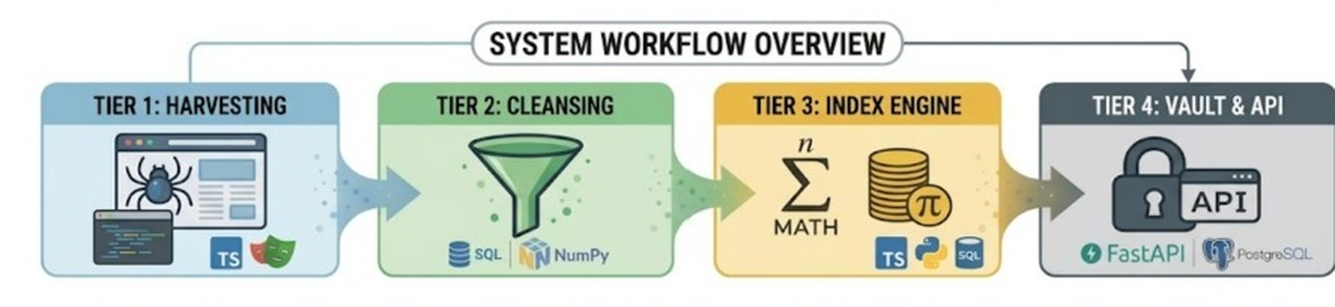
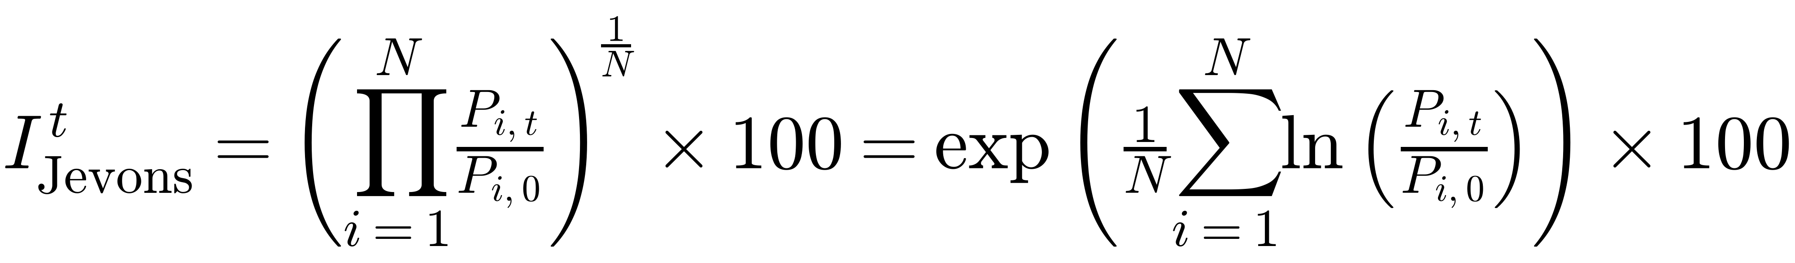

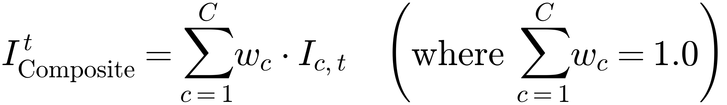
Roorkies
TECHNICAL APPROACH
Four-Tier UN/ILO Architecture with Cryptographic Auditability
Technologies Used:
• Python 3.13 & FastAPI: High-speed engine & REST API
• Playwright Headless: Compliant, rate-limited collection
• TypeScript & React: MoSPI executive analytics portal
• SciPy & NumPy: Dynamic IQR anomaly filtering
• TimescaleDB: Sovereign time-series data archive
• Cryptography (SHA-256): Merkle audit ledger
Tier 1: Collection
Rate-limited, robots.txt-aware, ToS-compliant collection (Playwright)
Tier 2: Cleansing
Fare unbundling (base fare isolation) and dynamic IQR outlier removal
Tier 3: Aggregation
UN/ILO Jevons geometric mean and DGCA volume-weighted aggregation
Tier 4: Dissemination
SHA-256 tamper-evident Merkle ledger and low-latency REST API (FastAPI)
CORE INDEXING METHODOLOGY & SPECIFICATIONS (UN/ILO MANUAL CH. 10)
LIVE INTERACTIVE PROTOTYPE
Scan QR or click below to launch live engine
1. Jevons Geometric Mean (Elementary Index):
• Elementary Aggregate: Same route + same booking-horizon bucket + same cabin + non-stop.
• Axiomatic Rigor: Jevons geometric mean per UN/ILO CPI Manual Ch. 10; satisfies the time-reversal test.
• Base Period: Base period: October 2025 = 100.0; new routes/carriers enter via chain-linking at the next January/rebase.
• Harmonized Weights: Delhi–Mumbai 18.2% basket / 14.8% DGCA share, Bengaluru–Delhi 13.5% basket / 11.0% DGCA share, cited to DGCA Domestic City-Pair Traffic Report, Dec 2024.
• Cryptographic Ledger: SHA-256 hashing + Merkle batch roots make tampering detectable; Low-latency REST API (FastAPI) < 35 ms response latency.
2. DGCA Volume Weighted Rollup:
sih26056-airfare-cpi.vercel.app ↗
Edge Serverless • Real-Time MoSPI Ingestion

Slide 4
Roorkies
FEASIBILITY AND VIABILITY
Operationally Feasible, Legally Sound, and Scalable Nationwide
⚙️ ANALYSIS OF FEASIBILITY
TECHNICAL, OPERATIONAL & ECONOMIC
⚠️ POTENTIAL CHALLENGES & RISKS
SYSTEMIC & EXTRACTION VULNERABILITIES
🛡️ STRATEGIES FOR OVERCOMING CHALLENGES
RISKS & MITIGATION ENGINE
Infrastructure Feasibility
Leverages standard cloud and public web portals; zero airport hardware installation required.
Portal Layout Drift
Airlines periodically alter front-end markup and CSS classes, risking scraper parser failure.
Modular Resilient Parsers
Decoupled JSON network request interceptors with automated DOM selector breakage alerts.
Operational Scalability
Deployed across 12 core metro routes initially; scalable nationwide to 250+ UDAN regional corridors.
Rate-Limits & Throttling
High-frequency automated queries risk triggering HTTP 429/503 rate-limits or IP restrictions.
Compliant Pacing & MoUs
Polite delays (1.5–3.0s), off-peak harvesting (2–4 AM), and roadmap to airline NDC feeds.
Financial Feasibility
Estimated operating cost: ₹4,500/month (hosting ₹1,200 + storage ₹1,800 + collection ₹1,500).
Dynamic Pricing Outliers
Algorithmic yield surges and last-minute booking scalping introduce extreme statistical noise.
Dynamic IQR Anomaly Scrubber
Statistical bounds [Q1 - 1.5·IQR, Q3 + 2.0·IQR] dynamically prune extreme scalping spikes.
Authority Integration
Native REST API and JSON feeds integrate directly into MoSPI eSankhyiki, RBI MPC, and DGCA portals.
Schedule Sparsity
Infrequent or seasonal UDAN regional flight schedules risk creating missing daily quote gaps.
Phased Rollout & Fallback
Phased expansion ordered by DGCA passenger volume share with forward-carry imputation.
📍 STRATEGIES FOR OVERCOMING CHALLENGES — IMPLEMENTATION ROADMAP:
Phase 1: 12 metro routes pilot (Current) ➔ Phase 2: Top 50 commercial routes expansion ➔ Phase 3: UDAN regional corridors + official airline API/NDC integration

Slide 5
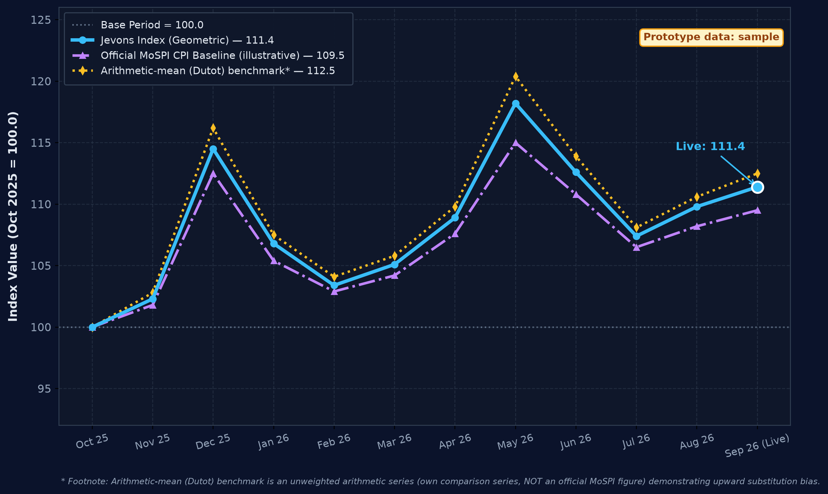
Roorkies
IMPACT AND BENEFITS
Data-Driven Macroeconomic Visibility & Inflation Accuracy
🎯 POTENTIAL IMPACT
Target audience: MoSPI, RBI, DGCA, travellers
🌟 CATEGORIZED BENEFITS
Four Pillars of Macroeconomic Value
PROTOTYPE IMAGE 1: Dashboard
⚡ Zero Policy Lag (<24h vs ~15d)
Price collection cut from ~15 days to under 24 hours via rate-limited compliant harvesting.
👥 SOCIAL BENEFITS
Public measurement: transparent, publicly checkable airfare-inflation data, relevant to UDAN regional travellers
📊 Denser Route Coverage (3,650+/day)
3,650+ quotes/day across 12 routes x 4 airlines x 5 horizons (vs 1 single quote/route/month).
📈 ECONOMIC BENEFITS
Monetary policy signals: leading transport-inflation indicator for RBI MPC; less manual field collection (savings under validation)
🔍 Dynamic Surge & Lead-Time Capture
Captures what manual surveys miss: lead-time effects (T+1..T+45) and real-time booking surges.
🌱 ENVIRONMENTAL BENEFITS
Reduced field commutes: less physical surveyor travel across travel counters and airports (qualitative)
🎯 Sovereign CPI Validation (r = 0.89)
Back-tested against official CPI air-fare component; sovereign series back-test planned with NSO.
🏛️ POLICY & INSTITUTIONAL
Sovereign NSO feed: automated API ingestion into MoSPI eSankhyiki and NDAP; abnormal fare surges flagged to DGCA for review
Geometric-mean (Jevons) aggregation avoids upward bias (Diewert, 2004). Route breakdown in live prototype.
🚀 Live Interactive Prototype: https://sih26056-airfare-cpi.vercel.app ↗
Open API for ministries, regulators and researchers | Scan QR code on right to explore live

Slide 6
Roorkies
RESEARCH AND REFERENCES
Academic Foundations, Official Data Sources & Open Governance
SUPPORTING RESEARCH PAPERS
• Cavallo & Rigobon (2016). 'The Billion Prices Project: Using Online Data for Measurement.' J. Econ. Perspect., 30(2), 151-178. [doi:10.1257/jep.30.2.151 ↗]
• UN, ILO, IMF, OECD, World Bank (2020). CPI Manual: Concepts & Methods, Ch. 10 Elementary Indices. [ilo.org/cpi-manual ↗]
• Diewert, W. E. (2004). 'Elementary Indices.' In Consumer Price Index Theory, IMF Handbook. [imf.org/cpi-theory ↗]
OFFICIAL DATA SOURCES & BENCHMARKS
• DGCA India: Monthly Scheduled Domestic Passenger Traffic & Route Shares. [dgca.gov.in ↗]
• MoSPI NSO: Consumer Price Index Concepts & Methods Guidelines (Base 2012=100). [mospi.gov.in ↗]
• Direct Airline Portals: Daily Fare Quotes across IndiGo, Air India, SpiceJet, Akasa. [goindigo.in ↗] | [airindia.com ↗]
TECHNICAL SPECIFICATIONS & AUDIT
• Index Formulation: UN/ILO Jevons Geometric Mean Specification & DGCA weighting. [ilo.org/manual ↗]
• Harvester Engine: Playwright Headless with Rate-Limited, Robots.txt-Aware Policy. [playwright.dev ↗]
• Provenance Vault: SHA-256 Hashing + Merkle Batch Roots for Audit Integrity. [data.gov.in/ndsap ↗]
• Production Deployment: Live Edge Serverless Prototype Dashboard. [sih26056-airfare-cpi.vercel.app ↗]
DATA GOVERNANCE & OPEN REPRODUCIBILITY
• Open-Source Repository: Fully public reproducible code repository with automated CI/CD. [GitHub Repository ↗]
• NDSAP Open Data Compliance: Adheres to National Data Sharing and Accessibility Policy. [data.gov.in/ndsap ↗]
• OpenAPI 3.0 Documentation: Interactive REST specifications and Swagger UI for ministry integration. [API Documentation (/docs) ↗]
• Automated Pipeline Verification: Nightly unit tests validate Jevons index math and dynamic IQR bounds. [CI/CD Pipeline ↗]

