Slide 1
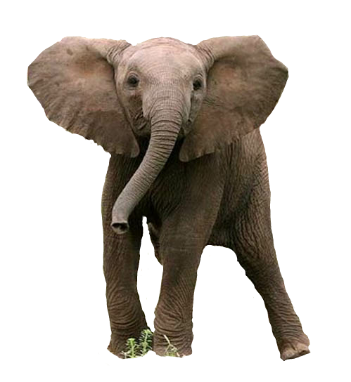


Conservation AI
Adam Benzion, CXO at Edge Impulse
Co-founder of Hackster.io
@adambenzion

Slide 2
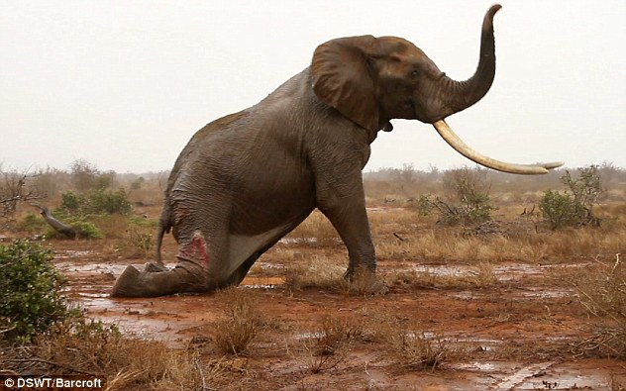
BAD HUMANS DO THIS, EVERY SINGLE DAY

Slide 3
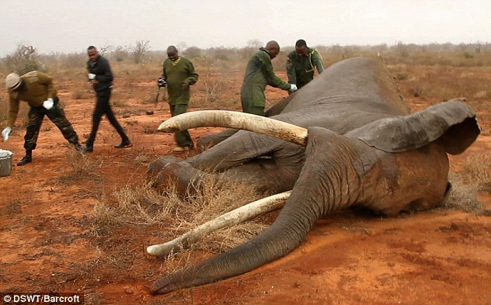
GOOD HUMANS DO THIS, EVERY CHANCE THEY GET

Slide 4
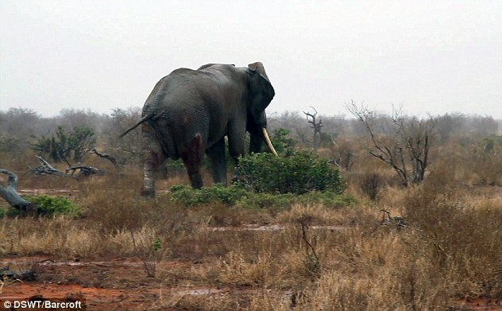
DO MORE TO HELP THE GOOD, AND STOP THE BAD

Slide 5


In January 2020, Hackster & Smart Parks Created Project ElephantEdge.

Slide 6

MEET

Slide 7
What does it take to design the world’s most advanced wildlife tracker, powered by advanced ML, assisted by a community of developers, AND ACTUALLY SHIP IT?

Slide 8
$150,000

Slide 9

GOOD HUMANS WORK HERE. THEY MADE IT HAPPEN.

Slide 10
We’re on!

Slide 11
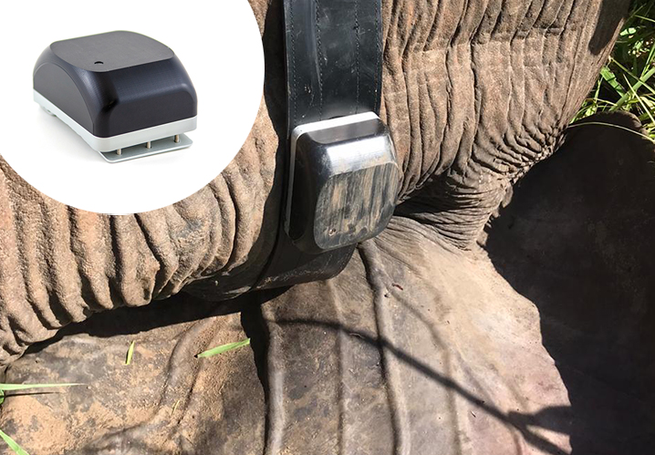


1
Irnas.eu, an expert in the design and manufacturing of wildlife trackers
Deliver working prototypes by Q4 2020
Ship 10 working collars to Smart Parks by Q2 2021
Smart Parks to deliver the trackers to select parks in Africa by Q4 2021

Slide 12
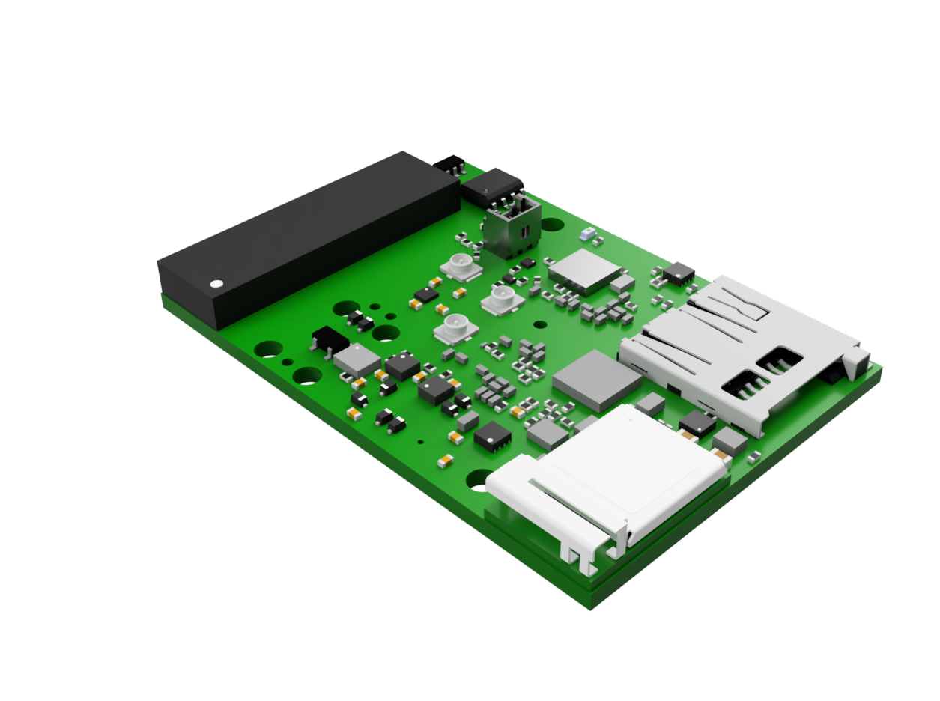
Nordic Semiconductor nRF52840 Bluetooth 5 SoC
Western Digital
16G microSD storage
ElephantEdge Gets A Spec
STMicroelectronics LSM303AGR ultra-compact eCompass module
u-blox NINA-B30x BLE GPS module
Semtech LR1110 ultra-low-power LoRaWAN transceiver
STMicroelectronics MP23ABS1 audio sensor with microphone
STMicroelectronics LIS2DW12 ultra-low-power MEMS accelerometer
Edge Impulse tinyML inferencing engine running on MCUs and Sensors, plus Avnet IoTConnect cloud

Slide 13

1
We needed the community to build ML models and IoT dashboards
Hackster.io delivered state of the art engineering challenge
241 participants started working on the collar’s software
31 models and dashboards were delivered at the end of the challenge

Slide 14
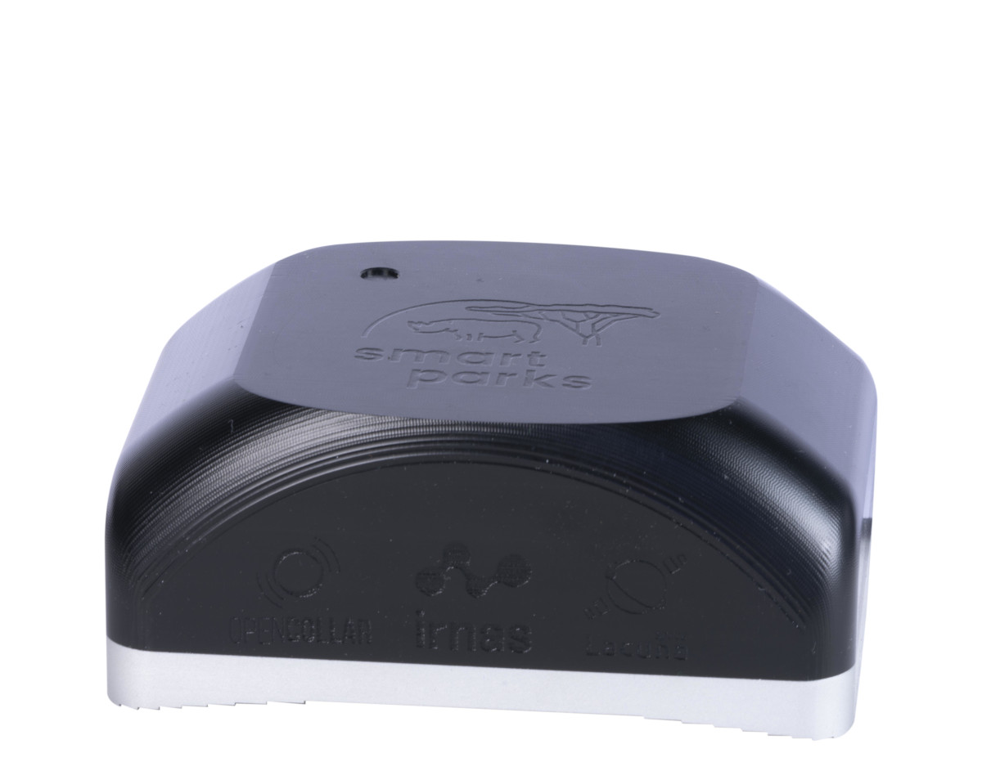
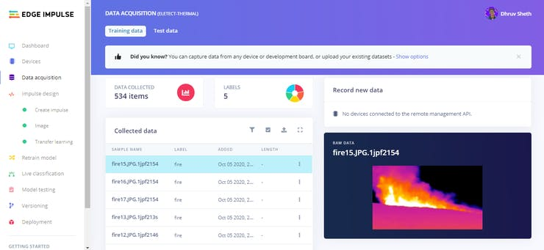
Work On Models, Not Hardware
Human Conflict Monitoring
Poaching Risk Monitoring
Elephant Activity Monitoring
Elephant Communication Monitoring

Slide 15
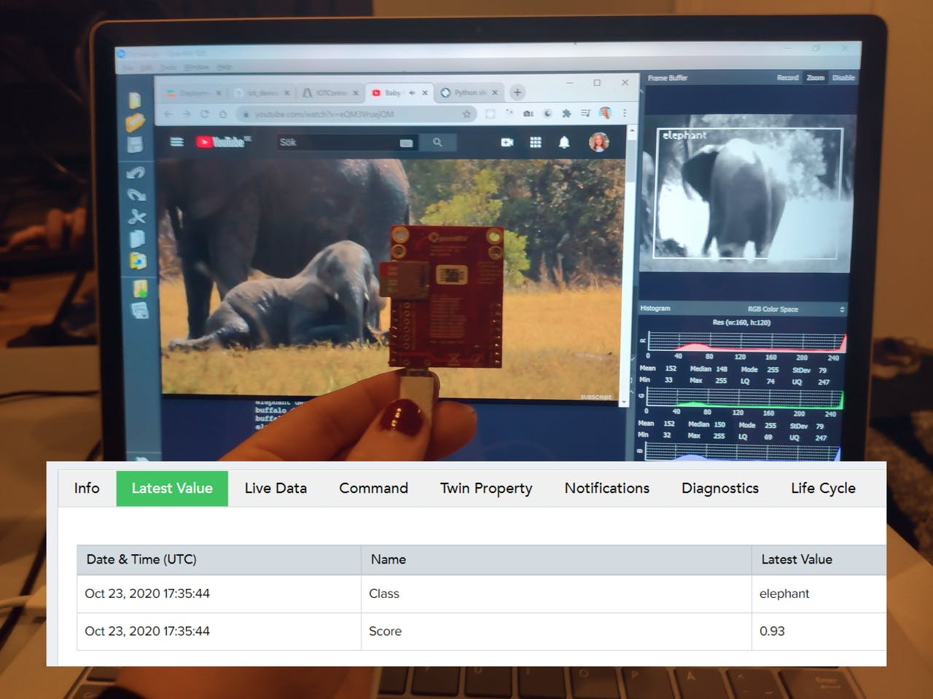
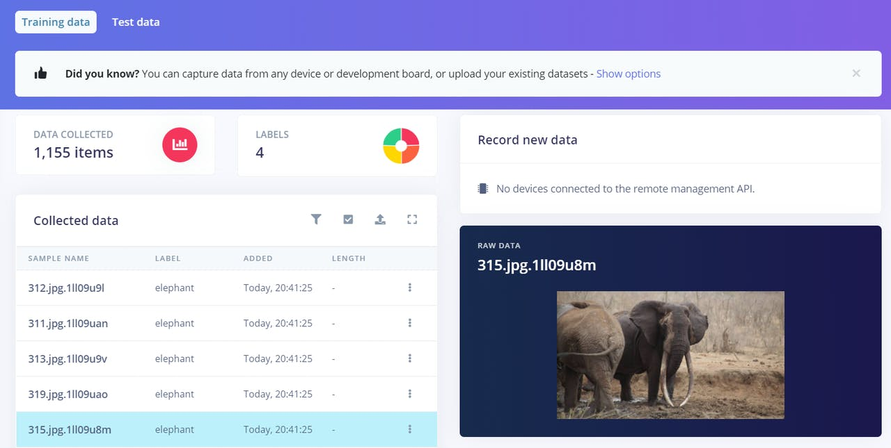

Slide 16
Oh wait, just one more thing…

Slide 17


WE’RE OPEN-SOURCING EVERYTHING!
OpenCollar is a conservation collaboration to design, support
and deploy open-source tracking collar hardware and software
for environmental and wildlife monitoring projects.
https://opencollar.io/

Slide 18
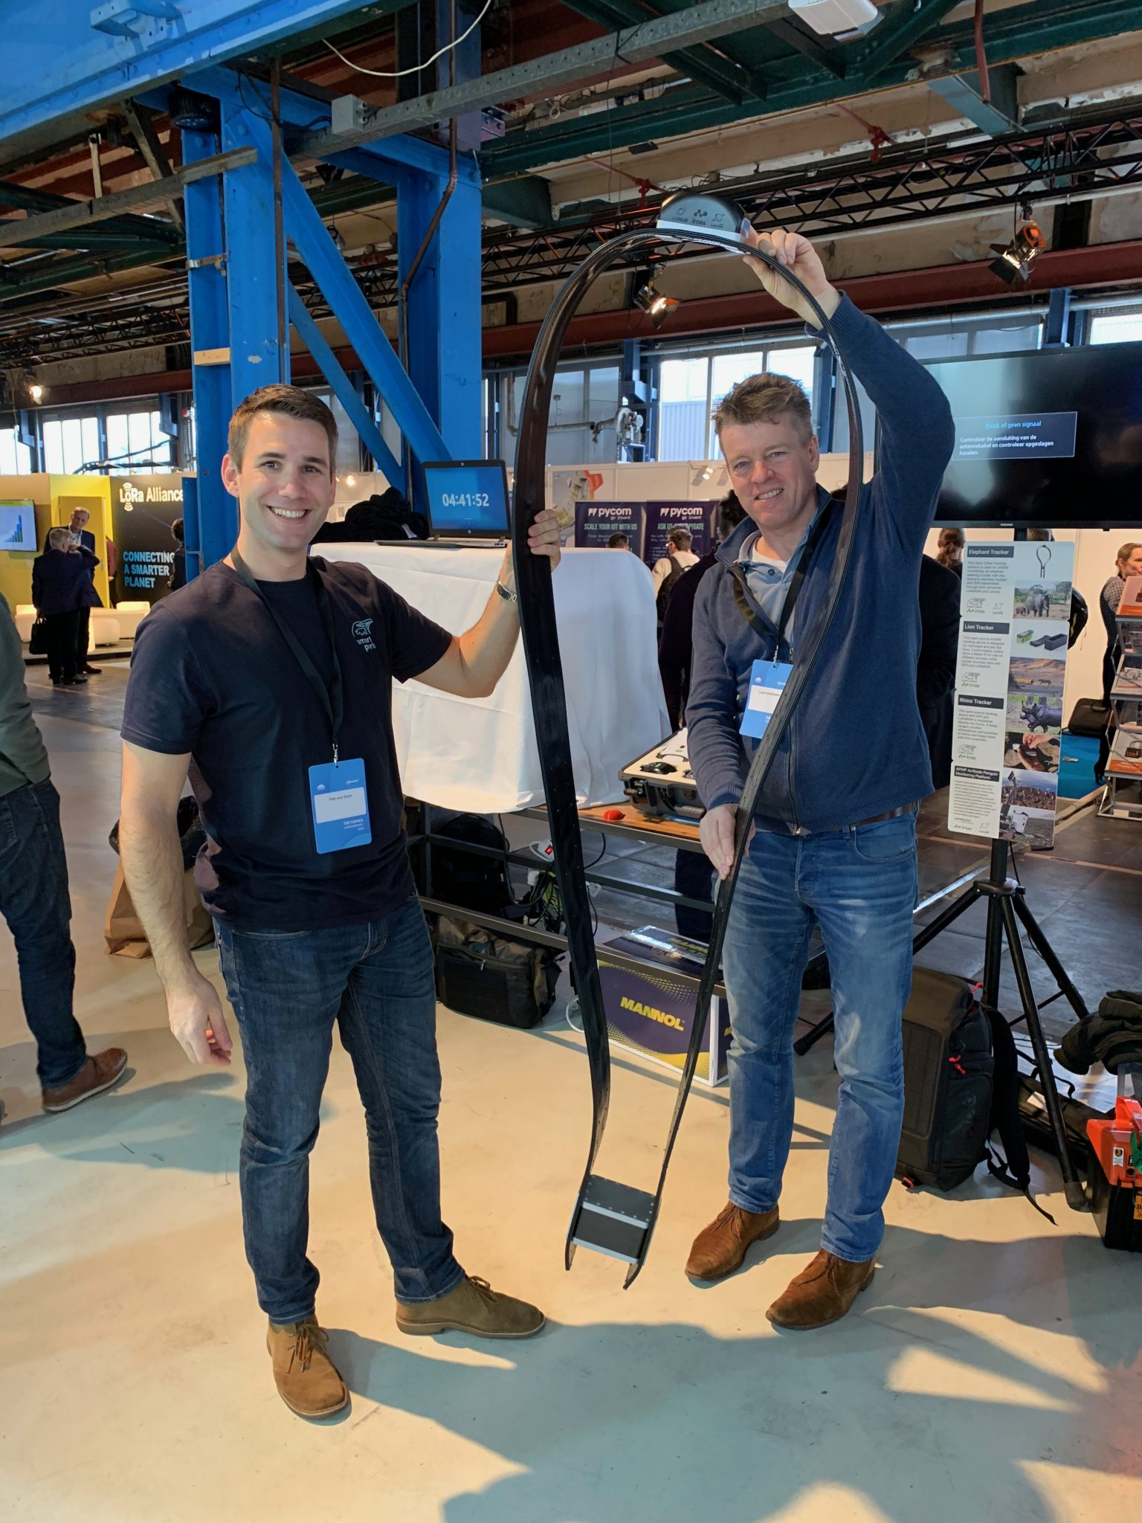
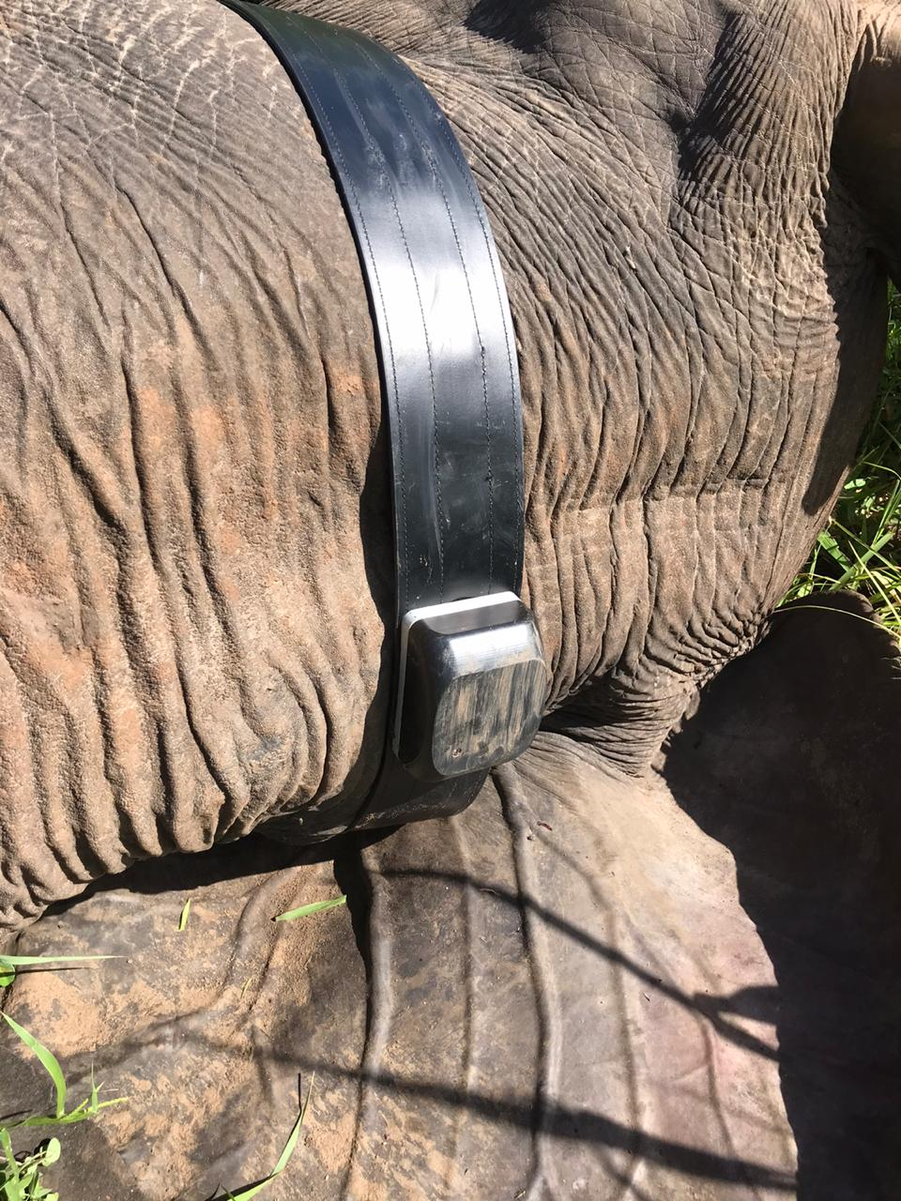
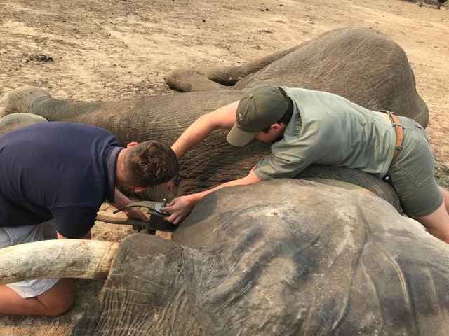

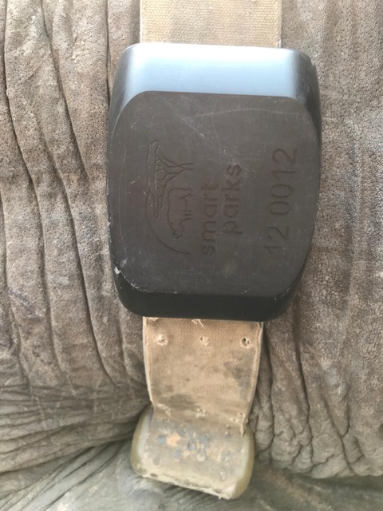

Slide 19

Thank you, Open-Source Hardware Summiteers!
adam@edgeimpulse.com

