Slide 1

Making open hardware the default everywhere, one project at a time!
This presentation: bit.ly/OSHWA-MAKERS | CC-BY-SA 4.0 | slide carnival template
Notes:
Open Hardware Makers mentorship program: making open hardware the default everywhere, one project at a time!

Slide 2
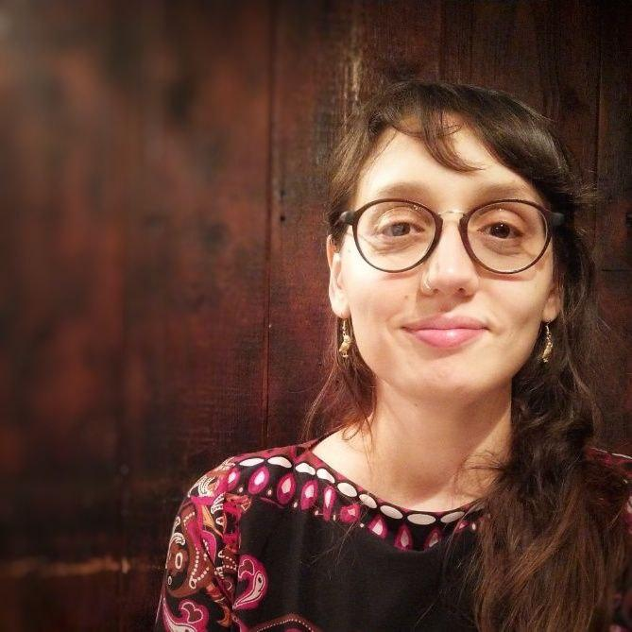
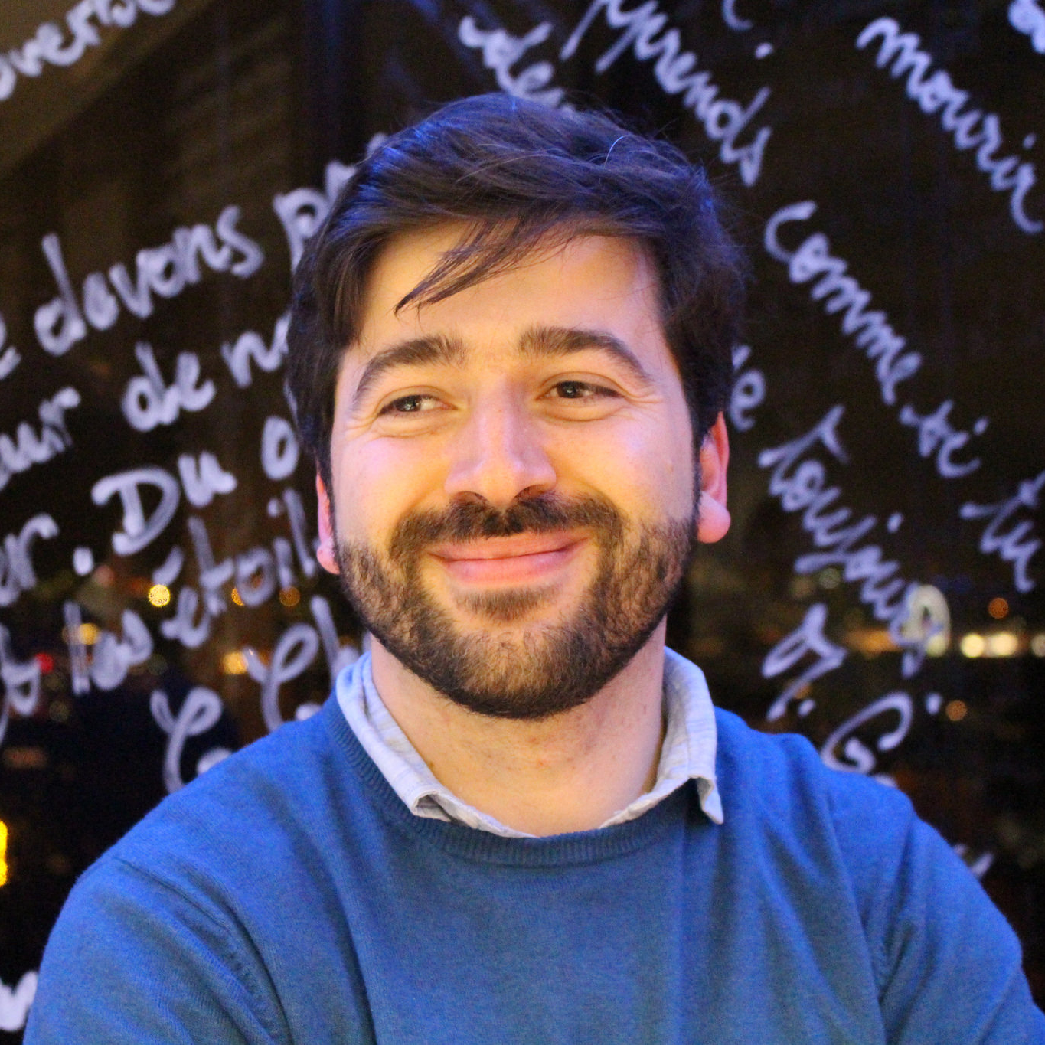

Hello!
OHM organizers
Julieta Arancio
Alex Kutschera
Andre M Chagas

Slide 3
Summary
Why?
What?
How?
Join!
Acknowledgments
This presentation: bit.ly/OSHWA-MAKERS

Slide 4
Why?
“I have built this, now I have to spend hours answering users”
“I want to contribute, but do not know how”
“It is open, but not for commercial purposes”
“I tried to replicate it, but it was missing crucial files”
“We will release the source code after we clean it up”
“I have built it, but no one knows about it!”
“Yay, we are making yet another air quality monitor from scratch”
Notes:
If you have been on the Open Source space, you certainly heard one, or many of these phrases before. Some relate to poor documentation, some to not knowing how to foster a community, some relate to not understanding the benefits of going “all in” in the Open Source ethos. We believe that a lot of this is related to misinformation, rather than poor intentions. Therefore we want to make sure every open source hardware project out there has a body of knowledge they can start from to learn/implement best practices. We believe that this will lead to OH projects that are actually properly open, reusable and where its developers learn how to work in a way to welcome others, so they can share the load and foster a diverse community
Comments on the slide (pasted below)
Make sure every OH project is ahn, well actually open/reusable, no matter the platform being used. For that we created OSH best practices
Add example of project that claims open source, but does not share properly? - lack editable files, licenses, community guidelines etc? Eg https://www.instructables.com/OPEN-SOURCE-AIR-PURIFIER/

Slide 5
What?
A mentorship program sharing best practices in open hardware
Notes:
Open hardware makers is a mentoring program to share best practices on how to build an open source hardware project. Simply put we want people to avoid the mistakes that were mentioned in the beginning of the presentation and build awesome projects that others can contribute, use and fork. We hope that once through the program developers will be confident to say “this is so well documented, that if I dropped out of it tomorrow, anyone could start from where I left off”.
Comments that were on the slide are pasted below:
I'd stress here again that we have worldwide projects. Sth like "many wonderful projects around the world that make it hard to..."

Slide 6


How?
Notes:
Comments that were on the slide are pasted below:
Well, as we are all open sourcerers, we are starting from the excellent Open Leaders, a retired, openly licensed leadership development program from Mozilla, developed by Abigail Cabunoc Mayes and managed by Abigail and Chad Sansing. So we forked the program idea and we are now heavily adapting it for Open Source hardware. It will look like this:
Adapting Mozilla Open Leaders program to hardware
15 week mentorship program → projects gain insight from weekly meetings (group or mentor) plus a global sprint and a expert revision
short phrases to sum this up:
A fork of Mozilla Open Leaders, in 15 weeks:
- 1:1 mentor support
- experts assessment
- peer review
- public demo

Slide 7
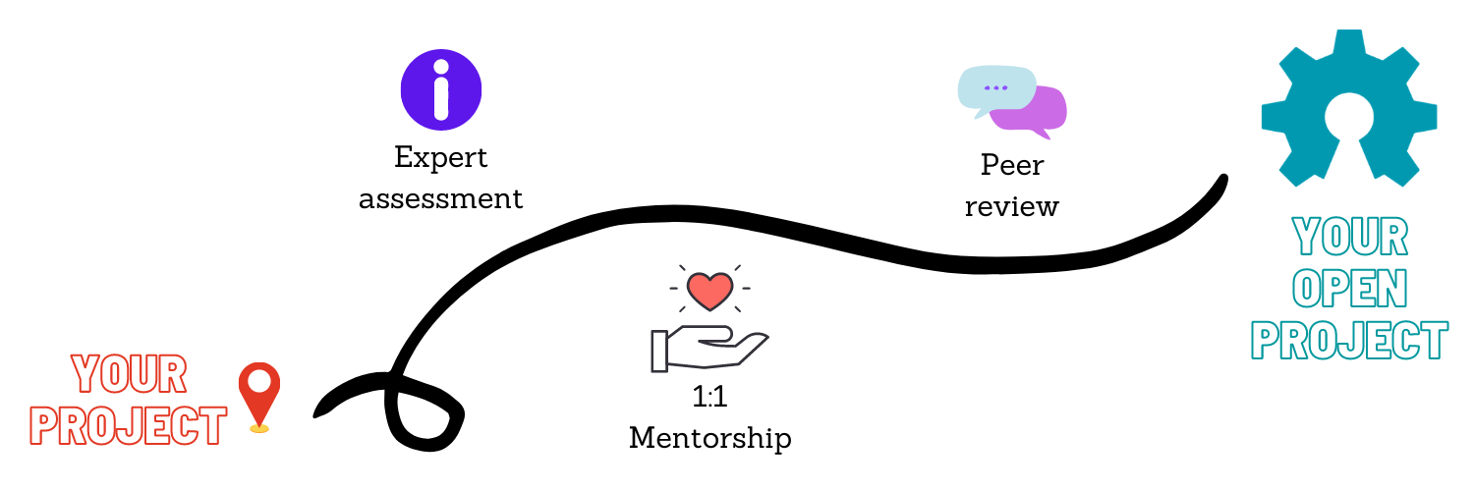
How?
Notes:
This is a 15 week long program. Projects can start from their very initial phases in any platform (github, instructables, hackaday.io etc). During the program time, we will:
match projects with a mentor
Have alternating weekly calls. One week mentor, one week with the cohort
Towards the end of the program, experts will be invited to do one time assessment of the state of the project and suggest improvements, points to be worked on.
participants will also have the opportunity to routinely peer-review their fellow projects
We will end the 15 weeks with a public demo of the projects, generating attention and getting participants to interact with the wider community.
Comments that were on the slide are pasted below:
Adapting Mozilla Open Leaders program to hardware
15 week mentorship program → projects gain insight from weekly meetings (group or mentor) plus a global sprint and a expert revision
short phrases to sum this up:
A fork of Mozilla Open Leaders, in 15 weeks:
- 1:1 mentor support
- experts assessment
- peer review
- public demo

Slide 8





How is it different?
Notes:
Cool, simple enough, but you mentioned that you are trying to do things differently. How so?
Based on a pilot we ran in 2019/20 (the three of us plus Jose Urra), the three of us went back to the drawing board and re-developed the outline for the program, we then made an open call to the community so it could make suggestions, comments and criticisms. With support from the Mozilla foundation we paid experts in the field to dedicate some hours and make comments, suggestions to improve it. Our expert panel was well balanced with similar numbers from people coming from different continents and from different backgrounds.
12 experts: 3 from Africa, 3 from Asia, 2 from Europe, 1 north america, 1 central america, 2 south america 5 women 6 men
Working in different fields, therefore bringing more than “just” tech knowhow
Now, based on these great community and experts input we are working on the curriculum and preparing it for the first cohort :
Comments that were on the slide are pasted below:
Adapting Mozilla Open Leaders program to hardware
15 week mentorship program → projects gain insight from weekly meetings (group or mentor) plus a global sprint and a expert revision
short phrases to sum this up:
A fork of Mozilla Open Leaders, in 15 weeks:
- 1:1 mentor support
- experts assessment
- peer review
- public demo

Slide 9


How is it different?
Notes:
We provide value to the projects, by having a group of mentors and experts that come from different parts of the world. They have different backgrounds and different previous experiences. We are explicitly bringing in expertise and mentorship beyond tech. Tackling the technical aspects of Open Source projects is normally the “easy bit”. “Engineers have been engineering for a long time”, so we want to make sure the often overlooked aspects of projects are taken care of. And properly taken care of. Community building, documentation, easiness of access and visibility are some of these aspects.
A program with strong community input:
Curriculum with public and expert consultation
Public and expert consultation for comments/suggestions/criticism on curriculum
Mentors & experts from everywhere
Diversity of expertise beyond the technical
Comments that were on the slide are pasted below:

Slide 10
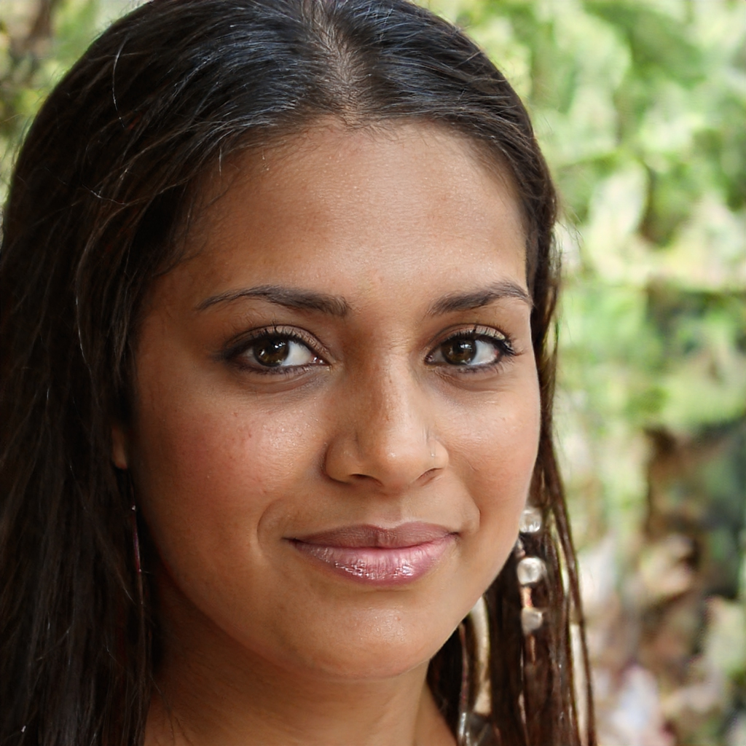
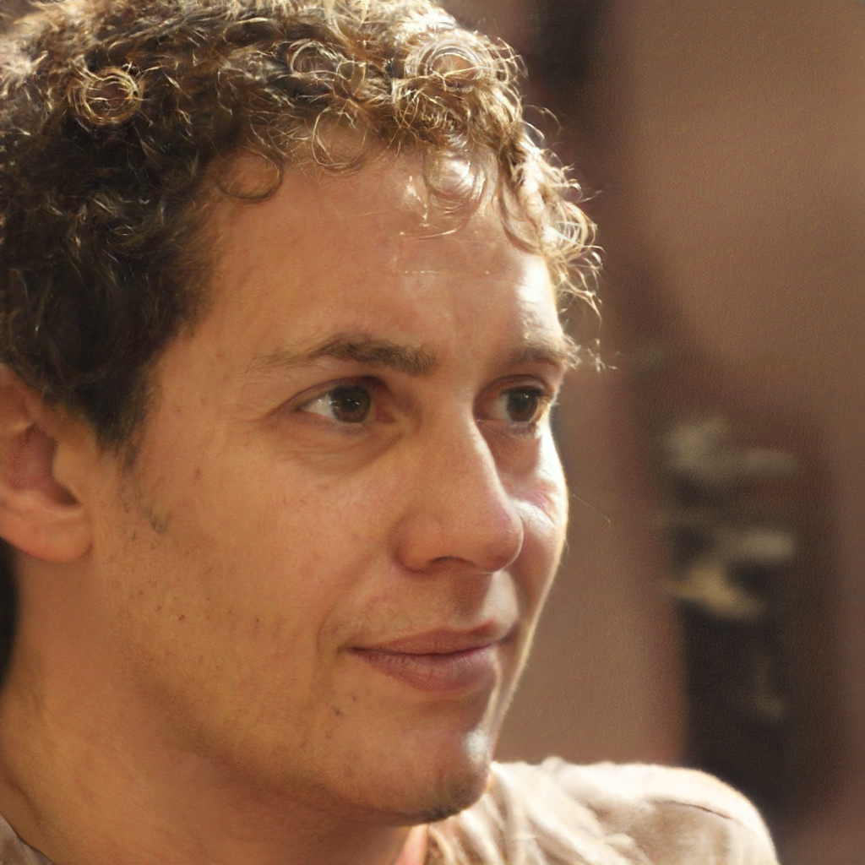
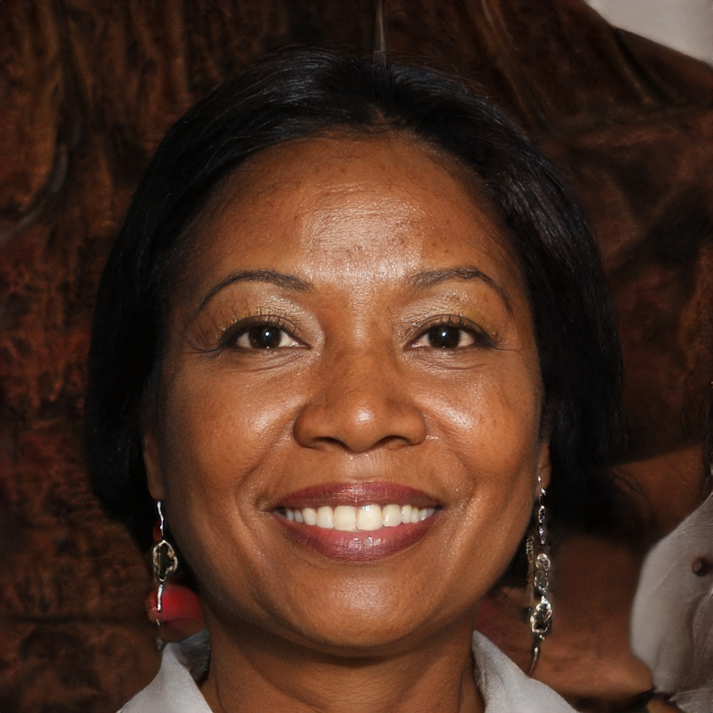

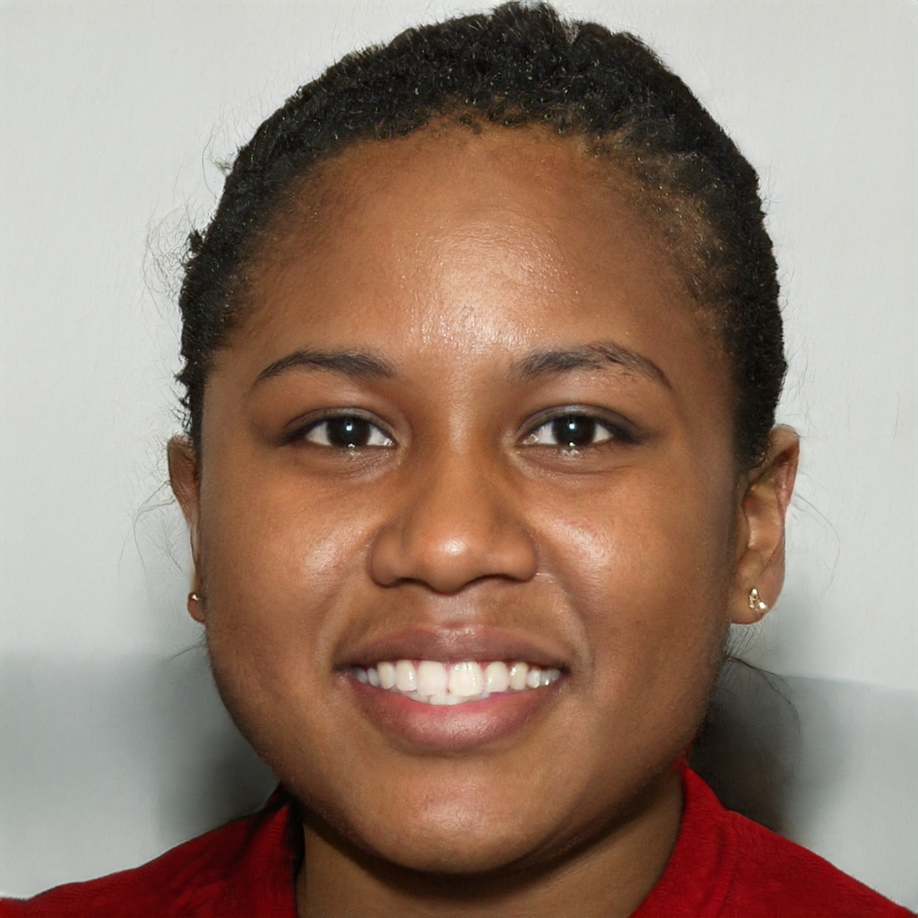
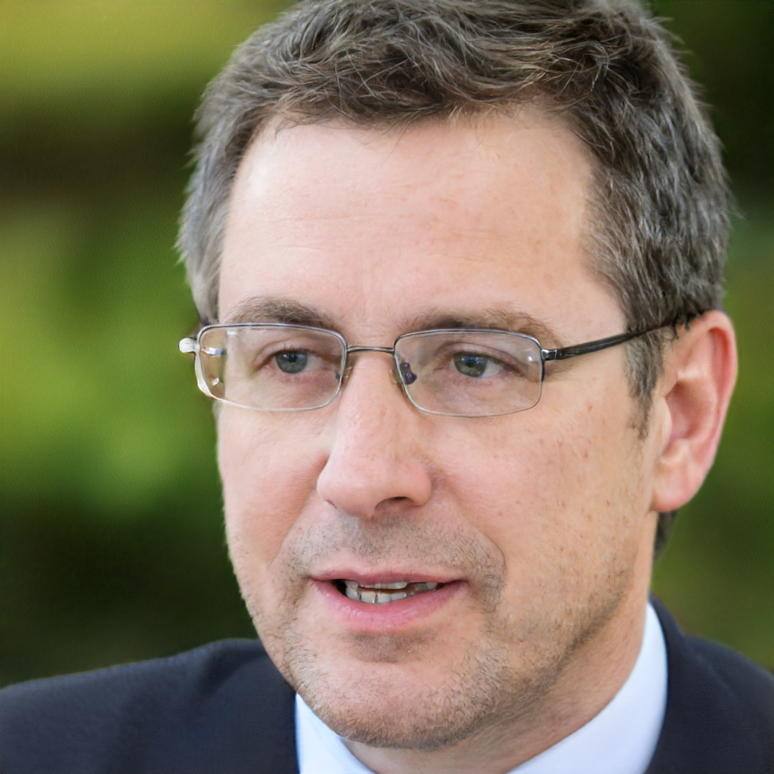
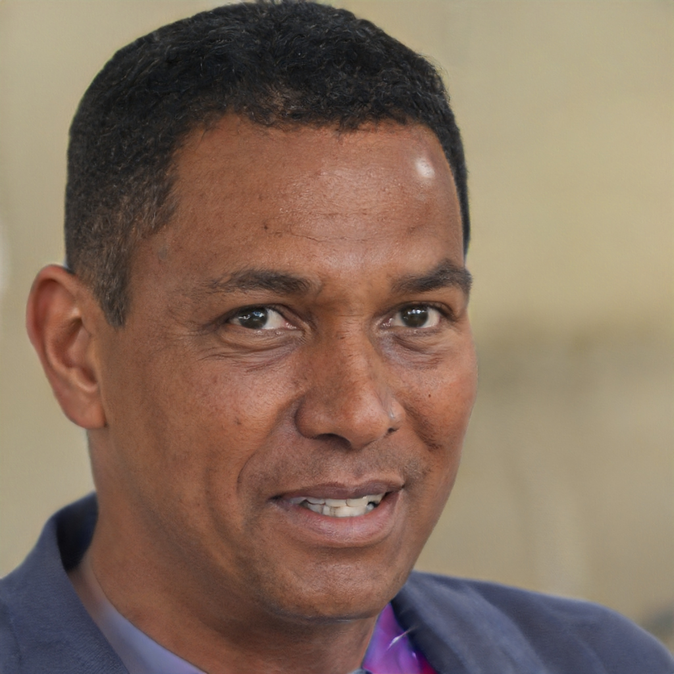


How?
All faces generated by https://thispersondoesnotexist.com/
Notes:
Open hardware is built by people all over the world. We are in all continents, we come in all sorts of shapes, colours and ages. But as with many other things in the world, the space is still “dominated” by a smaller group within this community. So we are trying to make things differently and we are going to see details on how in a bit, but we hope that by sharing best practices and onboarding people from these many, normally underrepresented spaces, and creating a diverse community around open hardware makers, we are able to contribute to improve things in OSH.
I think you are all probably thinking, sure, the spirit is great, but how are you going to do it????
Comments that were in the slides are pasted below:
I like it but (sorry to insist) I feel our greatest selling point is the community diversification... So I'd mention sth like "building a bridge between newcomers to OSH around the world and OSH communities", IMHO sharing best practices is the how

Slide 11
Join/Support!
Calling for Mentors and Experts:
https://forms.gle/6RPHXvHwwPiJ5E2a7
Calling for partners/sponsors:
https://forms.gle/E97Qw9HDwX2W58Lb9
Support our work financially:
https://opencollective.com/open-hardware-makers

Slide 12





Thank you for your attention!
https://openhardware.space
@openHWmakers
ohwmakers@gmail.com
Notes:
INDIVIDUALS
Support our coffee/mate addiction pay as much as you want
MORE COMMITMENT (up to the amount)
Support infrastructure (web, designer) 100USD
Sponsor weeks in a project
1 week 200USD
Full program, 120 hours in 15 weeks mentor, mentee, expert) @25 dollars/hour 3000 USD
Support part of organizers’ time 6h per week @25 USD/h 2250 USD
Support a cohort of 5 projects
15000USD

Slide 13
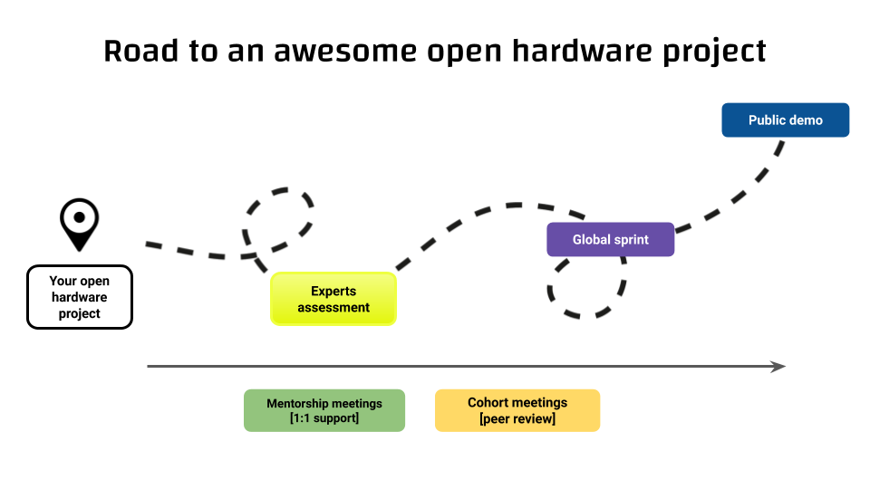
How?
Notes:
This is a 15 week long project. Projects can start from their very initial phases in any platform. During the program time, we will:
match projects with a mentor
Have alternating weekly calls. One week mentor, one week with the cohort
Towards the end of the cohort, experts will be invited to do one time assessment of the state of the project and suggest improvements, points to be worked on.
participants will also have the opportunity to peer-review their fellow projects
We will end the 15 weeks with a public demo of the projects, generating attention and preparing participants to interact with the wider community.
Comments that were on the slide are pasted below:
Adapting Mozilla Open Leaders program to hardware
15 week mentorship program → projects gain insight from weekly meetings (group or mentor) plus a global sprint and a expert revision
short phrases to sum this up:
A fork of Mozilla Open Leaders, in 15 weeks:
- 1:1 mentor support
- experts assessment
- peer review
- public demo

Slide 15
Thank you!
Time for your questions
@openHWmakers
ohwmakers@gmail.com
https://openhardware.space
Notes:
INDIVIDUALS
Support our coffee/mate addiction pay as much as you want
MORE COMMITMENT (up to the amount)
Support infrastructure (web, designer) 100USD
Sponsor weeks in a project
1 week 200USD
Full program, 120 hours in 15 weeks mentor, mentee, expert) @25 dollars/hour 3000 USD
Support part of organizers’ time 6h per week @25 USD/h 2250 USD
Support a cohort of 5 projects
15000USD

