Slide 1




Website
REMONTADA

Slide 2
Make a “Remontada” to your level

Slide 3
REMONTADA
“Remontada”is a football site that help you to:

Slide 4
Increase your fitness and football skills
01
Make booking football courts easier and make a tournaments
04
Give some tricks in football tactics
02
Give some hints in healthy food system
03
REMONTADA
Removids platform
05

Slide 5


01
Increase your fitness and football skills
Discover a variety of fitness workouts with optimal exercise timings on our website.
Tailored for all levels, our routines help you achieve your fitness goals efficiently.
REMONTADA

Slide 6

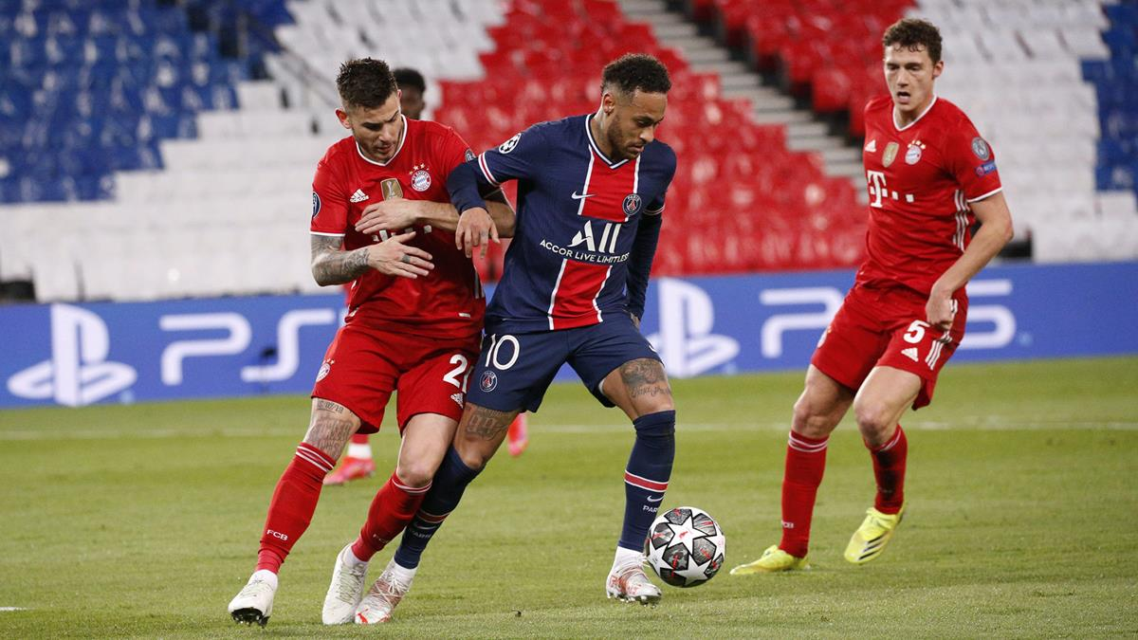
01
Increase your fitness and football skills
Enhance your skills with targeted workouts and instructional videos available on our website.
Perfect for all levels, our resources guide you to improve efficiently and effectively.
REMONTADA

Slide 7
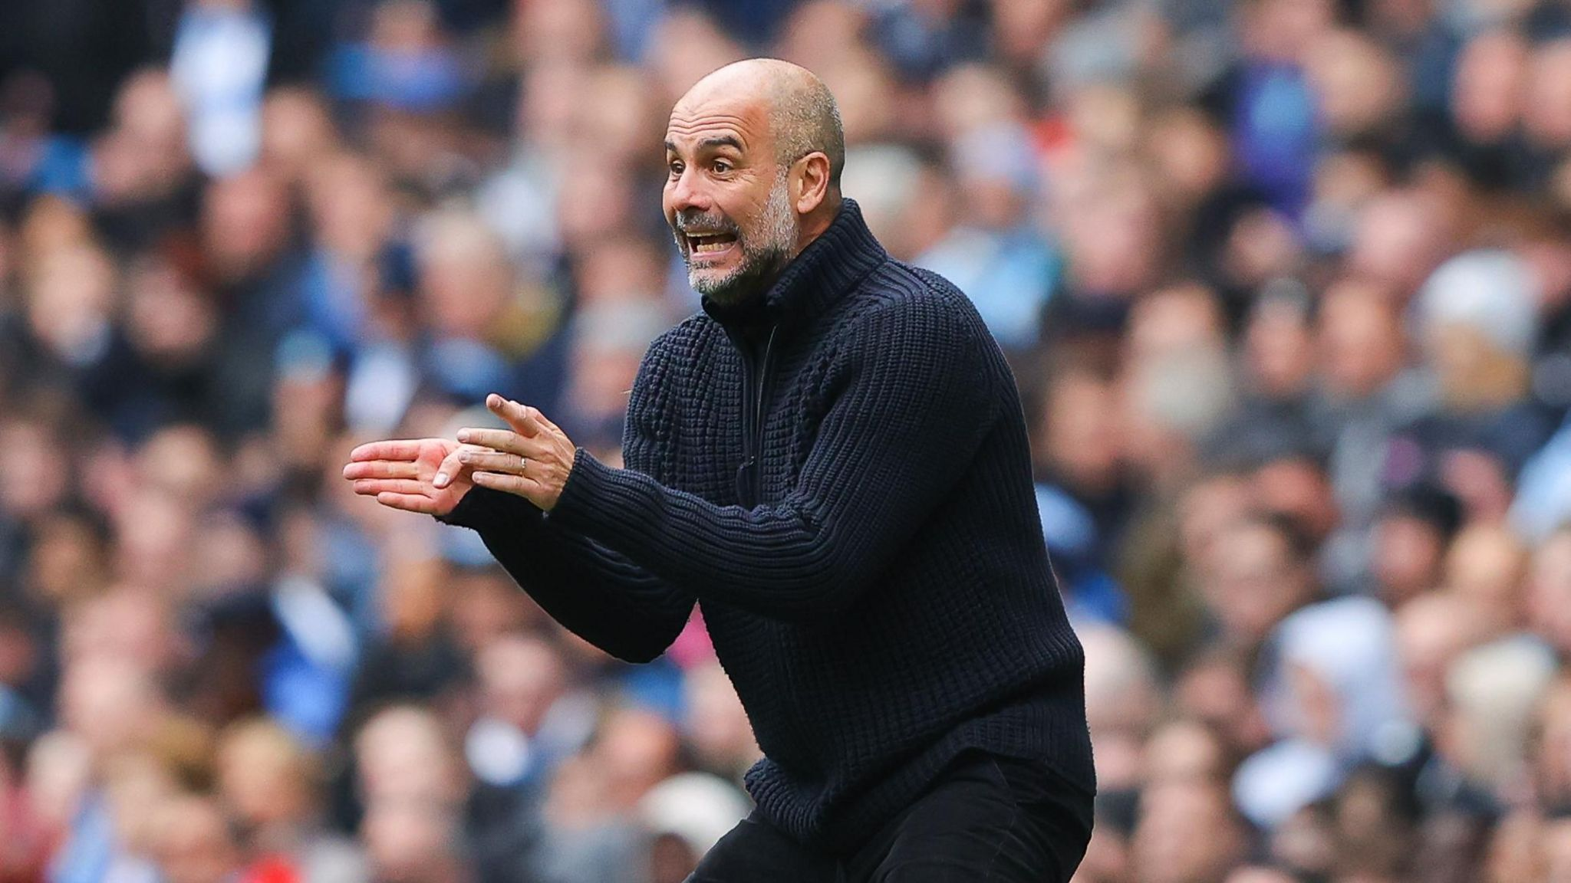
Give some tricks in football tactics
02
Our website offers innovative plans and increases tactical awareness for users.
Stay ahead with our latest strategies and improve your tactical skills effectively.
REMONTADA

Slide 8

Give some hints in healthy food system
03
02
Our website provides nutrition plans tailored to build a healthy body, with options for both high and low MBI needs.
Achieve your fitness goals with our expert meal plans.
REMONTADA

Slide 9

Get Fit with Our Custom Nutrition Plans
03
Our website offers personalized nutrition plans to help you build a healthy body.
Tailored to your specific needs and goals, our expert meal plans support weight loss, muscle gain, or fitness maintenance.
REMONTADA

Slide 10
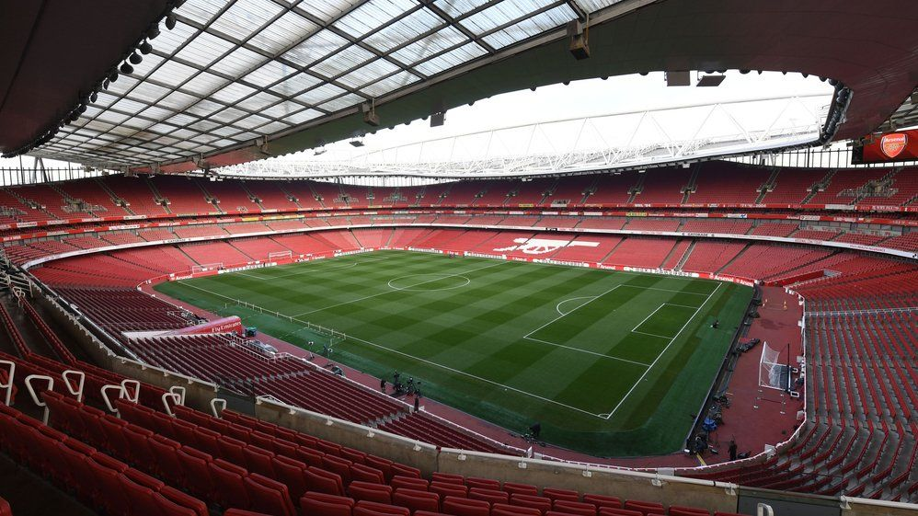
Make booking football courts easier and make
a tournaments
04
Our website enhances your football experience by offering an easy way to book football fields.
REMONTADA

Slide 11
Make booking football courts easier and make
a tournaments
04
We've partnered with various courts to allow reservations directly through our site.
REMONTADA

Slide 12
Make booking football courts easier and make
a tournaments
04
Before booking, you can access detailed information such as prices, available times, field locations, and more.
REMONTADA

Slide 13

Removids
platform
05
Our website features an integrated platform for users to enhance their fitness and skills through interactive video sessions.
Engage with other players, perform workouts, and improve your skills. The more you interact, the more points you earn!
REMONTADA

Slide 14
Rating System
Every user had rating System made of points
After any exercise you do you will take some points (10-50) depends on the difficulty of this exercise
The main reason for this is to know the progress of the user after using the app
The tournaments are also use the rating System, there are three types of tournaments:
REMONTADA

Slide 15
Rating System
The beginners tournaments
This type made for beginner on app
The rating (400-1200) points
REMONTADA

Slide 16
Rating System
The experts tournaments
This type made for the good player that uses the app for a long time and when a lot of games
The rating (1200-4000)
REMONTADA

Slide 17
Rating System
The legends tournaments
This type of tournament are made for the best user that can you name a “legends”
The rating (4000-Infinity)
REMONTADA

Slide 18
Rating System
After each tournament, you are evaluated by the players participating in the tournament, and according to how well your team is ranked, if you are good, you increase your score, and if it’s bad, you get points off.
REMONTADA

Slide 19
Marketing
How the user will know our website:
Creating ads on all the social media ads and creating pages to publish about the website and the tournaments.
Cooperate with some football pages to make advertisements for our website
REMONTADA

Slide 20
Marketing
Our website features the Removideo platform, where users can showcase their skills and interact with others.
Clubs can scout for potential players through registered videos and the leaderboard.
The more you engage, the higher your chances of getting noticed!
REMONTADA

Slide 21
Profits
The website is free with included ads.
The site takes 15% of booking money.
Players pay fees to participate in tournaments.
REMONTADA

Slide 22
Profits
Premier Monthly Subscription:
Access to more exercises and tips.
Ability to communicate with a private coach online.
Partnerships with Sports Equipment Companies: Paid advertisements on the Removideo platform.
REMONTADA

Slide 23


Made by
Omar Nader
Abdelrahman saeed
Thanks

