Slide 1
Chapter 8
Troubleshooting Fundamentals

Slide 2
You Will Learn…
How to protect yourself, your hardware, and your software while solving computer problems
What tools are needed to support personal computers
How to isolate computer problems and devise a course of action
continued

Slide 3
You Will Learn…
The importance of good recordkeeping
How to take a computer apart and put it back together

Slide 4
Troubleshooting Perspectives
PC support technician
  Works on-site; responsible for ongoing maintenance
  Closely interacts with users
  Is responsible for the PCs before trouble occurs
PC service technician
  Goes to customer site in response to a service call
continued

Slide 5
Troubleshooting Perspectives
Bench technician
  Works in a lab environment
  May/may not interact with the PC user
  Is not permanently responsible for the PC
Help-desk technician
  Provides telephone support

Slide 6
Essential Troubleshooting Tools
Bootable rescue disk
Ground bracelet and/or ground mat
Flat-head screwdriver
Phillips-head or cross-head screwdriver
Torx screwdriver
Tweezers
Chip extractor
Extractor

Slide 7
Convenient Troubleshooting Tools
Multimeter
Needle-nose pliers
Flashlight
AC outlet ground tester
Small cups or bags
Antistatic bags
Pen and paper
Diagnostic cards and diagnostic software
Utility software
Virus detection software on disks

Slide 8
Bootable Rescue Disk
Allows you to boot the PC even when hard drive fails
Assures a “clean” boot
For DOS:
  A floppy disk that can upload the OS files necessary for computer startup
  Must have the two hidden system files IO.SYS and MSDOS.SYS, and also COMMAND.COM
For Windows 9x
  Rescue disk

Slide 9
Diagnostic Cards
POST diagnostic cards
  Designed to discover and report computer errors and conflicts at POST
  Examples
    POSTcardV3 (Unicore Software, Inc.)
    Post Code Master (MSD, Inc.)
    POSTmortem Diagnostics Card (System Organization, Inc.)

Slide 10
Diagnostic Software
Used to identify hardware problems
Examples
  PC-Technician (Windsor Technologies, Inc.)
  PC-Diagnosys (Windsor Technologies, Inc.)

Slide 11
General Purpose Utility Software for Updates and Fixes
Diagnoses problems
Repairs and maintains the software on a PC
Recovers corrupted or deleted data on the hard drive or floppy disks
Provides security
Monitors system performance
Downloads software updates from the Internet
Might use installed operating system or might provide its own

Slide 12
Examples of Utility Software
First Aid 2000 (McAfee)
McAfee Utilities Deluxe
Nuts & Bolts (Network Associates)
Norton Utilities (Symantec)
CheckIt98 Diagnostic Suite (Touchstone Software)
PartitionMagic (PowerQuest)
EasyRestore (PowerQuest)
Drive Image, Drive Image Pro, and DriveCopy (PowerQuest)
Norton Ghost (Symantec)

Slide 13
Virus Detection Software
Searches hard drives and disks
Informs you of the presence of a virus
Asks permission before deleting it
Sometimes called antivirus software

Slide 14
Warning Signs that a Virus Is Present
Program takes longer than normal to load
Disk access times seem excessive for simple tasks
Executable files that once worked no longer work and give unexpected error messages
Unusual error messages occur regularly
Less memory than usual is available
Files disappear mysteriously
continued

Slide 15
Warning Signs that a Virus Is Present
There is noticeable reduction in disk space
Executable files have changed size
Access lights on hard drives and floppy disk drives turn on when there should be no activity on those devices
You can’t access a drive
The system won’t boot
Print services are not working properly

Slide 16
Virus Detection Software
F-Protect (PROT)
  High-quality antivirus product with excellent scanning and removal ability
McAfee Virus Scan (SCAN)
  Best-known
Norton AntiVirus (NAV)
  Popular because of its ease of use and graphical interface

Slide 17
Reducing the Threat of a Virus
Write-protect original software disks and backup copies
Boot from your hard disk or a write-protected disk only
Avoid downloading from the Internet or a bulletin board, or always use a virus scan program when you do
Use a scan utility on a regular basis

Slide 18
How to Isolate Computer Problems and Devise a Course of Action
How to approach a troubleshooting problem
How to interact with the user
How to handle an emergency

Slide 19
Fundamental Rules for PC Troubleshooting
Approach the problem systematically
Divide and conquer
Don’t overlook the obvious
Check the simple things first
Make no assumptions
Become a researcher
continued

Slide 20
Fundamental Rules for PC Troubleshooting
Write things down
Reboot and start over
Establish your priorities
Keep your cool
Don’t assume the worst
Know your starting point

Slide 21
Devising a Course of Action
Interact with the user
  Gain as much information as you can before investigating the hardware and software
Isolate the problem
  Eliminate the unnecessary
  Trade good for suspected bad

Slide 22
Troubleshooting Guidelines
Isolate the problem into one of two categories
  Problems that prevent the PC from booting
  Problems that occur after a successful boot

Slide 23
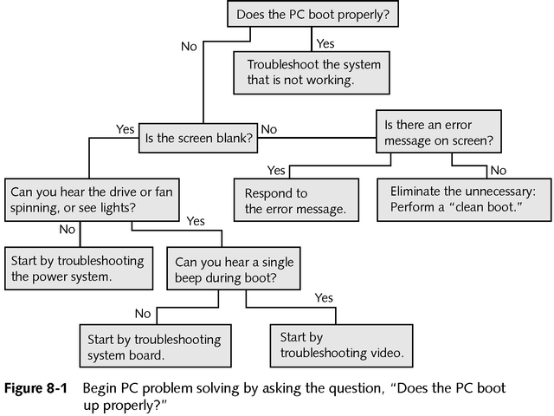

Slide 24
Troubleshooting the Power System
Any burnt parts or odors?
Everything connected/turned on? Any loose cable connections? Computer plugged in?
All switches turned on? Wall outlet good?
If fan is not running, turn off computer, open case, check connections to the power supply. Are they secure? All cards securely seated?

Slide 25
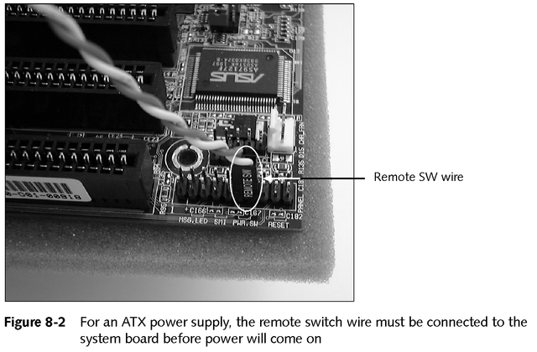
Troubleshooting the Power System

Slide 26
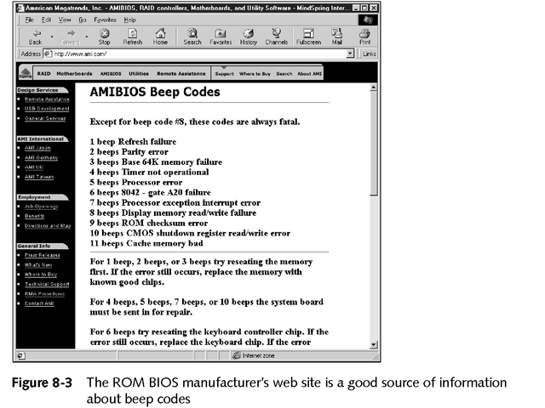
Troubleshooting the System Board
POST reports errors as beep codes

Slide 27
Troubleshooting the System Board
Is the system in Doze or Sleep Mode?
If fan is running, reseat or replace the CPU, BIOS, or RAM
Disassemble and reseat cables, adapter cards, socketed chips, SIMMS, and DIMMs
Check jumpers, DIP switches, CMOS settings
Reduce the system to essentials
Exchange the system board

Slide 28
When Computer Does Not Recog-nize All Installed RAM or SIMMs
Check CMOS settings
Run diagnostic software to test memory
Are SIMM or DIMM modules properly seated?
Look for bent pins or chips installed the wrong way on cache memory
Are individual chips hotter than others?
Make sure SIMMs have correct or consistent part numbers
Replace memory modules one at a time
Check sockets and traces

Slide 29
Troubleshooting the Operating System and Hard Drive
Try a hard boot
Use the Windows 9x Startup Menu
Can you boot from an A prompt when booting from a floppy?
  If yes, the problem is in the hard drive subsystem and/or the software on the drive
Can you access the hard drive from the A prompt?
  If yes, the problem is in the software used on the hard drive to boot
Run diagnostic software

Slide 30
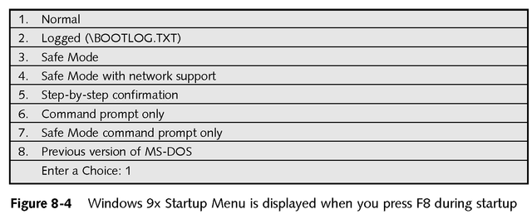
Windows 9x Startup Menu

Slide 31
Problems after the Computer Boots
If you suspect the software
  Try diagnostic software before reloading the software package
If you suspect the hardware
  Isolate the problem by removing devices and substituting good components
Check voltage output from the power supply
Check jumpers, DIP switches, CMOS settings
Suspect a corrupted device driver; reinstall it
Suspect applications software using the device

Slide 32
Problems with the Software
Reinstalling software
Problems caused by other software
Intermittent problems

Slide 33
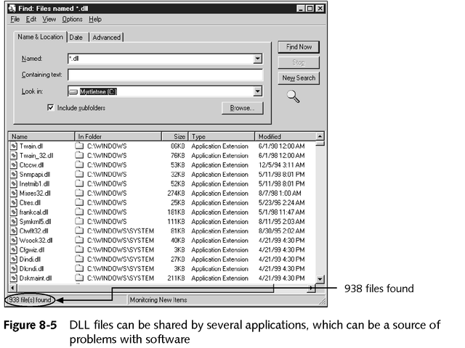
Problems Caused by Other Software

Slide 34
Problems with the Keyboard and Monitor
Does the device work in situations other than the current one?
Has the device ever worked? Will another device work in this same situation?

Slide 35
Troubleshooting Keyboard Problems
A few keys don’t work
The keyboard does not work at all
Key continues to repeat after being released
Keys produce wrong characters
Major spills on the keyboard

Slide 36
Troubleshooting Monitor Problems
Power light (LED) does not go on, no picture
Power LED light is on, no picture on power-up
Power on, but monitor displays wrong characters
Monitor flickers and/or has wavy lines
continued

Slide 37
Troubleshooting Monitor Problems
No graphics display or screen goes blank when loading certain programs
Screen goes blank 30 seconds or one minute after keyboard is left untouched
Poor quality color display
Picture out of focus or out of adjustment
Crackling sound
continued

Slide 38
Troubleshooting Monitor Problems
Configure or change monitor settings and drivers in Windows 9x
Change the video driver configuration
Return to standard VGA settings

Slide 39
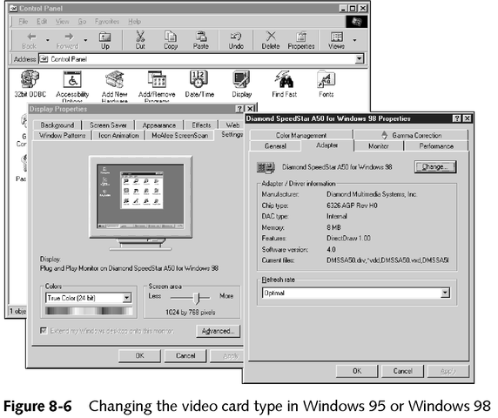
Changing the Video Driver Configuration

Slide 40
Troubleshooting Laser Printer Problems
Is the printer turned on and online?
Is the correct printer selected as the default?
Can an applications software program other than the current program use the printer?
Is the printer using the correct driver? Does the driver need updating? Is the driver correctly installed?
Can you move the printer to another computer and print from it? Will another printer work on this computer?

Slide 41
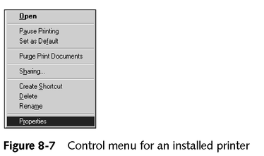
Troubleshooting Laser Printer Problems

Slide 42
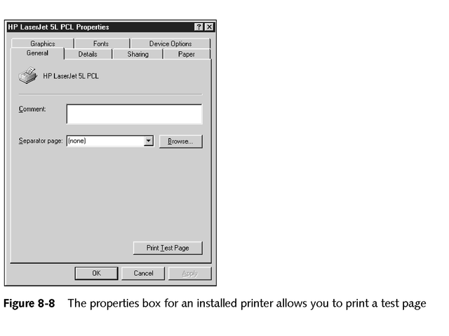
Troubleshooting Laser Printer Problems

Slide 43
Laser Printer Problems
Printer never leaves warm-up mode
Paper Out message is displayed
Toner Low message is displayed, or print is irregular or light
Paper Jam message is displayed
White streaks appear in the print
Print appears speckled
Printed images are distorted

Slide 44
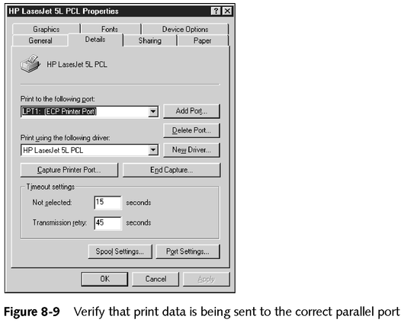
Laser Printer Problems

Slide 45
Dot Matrix Printer Problems
Print quality is poor
Printer self-test works, but printing from a computer application does not work
Print head moves back and forth, but nothing prints

Slide 46
Ink-jet Printer Problems
Print quality is poor
Printing is intermittent or absent

Slide 47
When a PC Is Your Permanent Responsibility
Keep accurate records of configuration data
Keep documentation
Prepare a bootable disk
Organize the hard drive

Slide 48
Organize the Hard Drive Root Directory
Store only startup files and necessary initialization files in the root directory
Keep applications software and their data in separate directories

Slide 49
Create a Boot or Rescue Disk
Bootable system disk for DOS
Rescue disk for Windows 9x

Slide 50
Documentation
Manuals, tutorials, and Help files that provide information that a user needs in order to use a computer system or software application

Slide 51
Record of Setup Data
Keep a record of CMOS on a floppy disk or use print screen key to print setup screens

Slide 52
Practical Precautions to Protect Software and Data
Before installing new software, back up configuration files for DOS
Back up entire \Windows\System directory if space
Don’t compress your hard drive
Don’t store data files in same directory as the software
Back up Windows 9x files that are likely to be altered

Slide 53
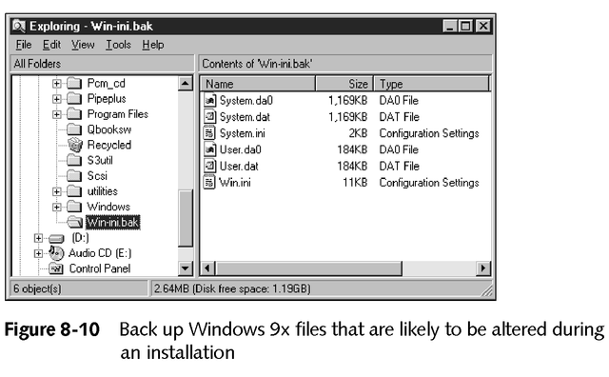
Practical Precautions to Protect Software and Data

Slide 54
Back Up Original Software
Request a copy of the software on floppy disks and make a backup copy of the original disks

Slide 55
Back Up Data on the Hard Drive
Use utility software designed for this purpose on a regular basis

Slide 56
Chapter Summary
Safety precautions
Essential troubleshooting tools
Resolving problems after the source has been isolated
Defensive procedures that minimize losses if hardware or software fails:
  Backing up hardware and software
  Write-protecting application disks
  Keeping records and documentation

