Slide 1
1
Word Processing
Part I

Slide 2
Overview
Definition of Word Processing
Advantages of Using a Word Processor
Word Processing Terminology

Slide 3
Definition of Word Processing
Manipulates text data to produce a letter, report, memo or any other type of correspondence
Grouping of related words, sentences and paragraphs is a document
Create, modify, store, retrieve and print all or part of document

Slide 4
Advantages of Using a Word Processor
It won’t improve your typing speed
Does make it easier to correct and modify the document
Word wrap eliminates concern about where to end a line
Particularly powerful for editing a document

Slide 5
Advantages of Using a Word Processor
Easy insertion and deletion of text
Ability to combine text from two or more documents
Additional support with spelling and grammar checkers
Easy to modify to the output formatting

Slide 6
Word Processing Terminology
Bold - produces dark or heavy print
Center - centering text evenly between the margins
Edit - change or modify the document
Font - type style and size

Slide 7
Word Processing Terminology
Format - defines how printed document will appear; e.g. underline, boldface, print size, margin settings, line spacing, etc.
Grammar checker - checks for grammar, phrasing, capitalization
Justified - text is evenly aligned on both left and right margin

Slide 8
Word Processing Terminology
Spelling checker - checks words or entire document for spelling
Text data - any number, letter or symbol you can type on the keyboard

Slide 9
Word Processing Terminology
Word wrap - automatic adjustment of the number of characters or words on a line; eliminates need to press Enter key

Slide 10
Loading Word 97
Start, Programs, Microsoft Word or
Double-click on Word shortcut on the desktop
From the Microsoft Office Shortcut Bar, click on New Office Document, then Blank Document

Slide 11
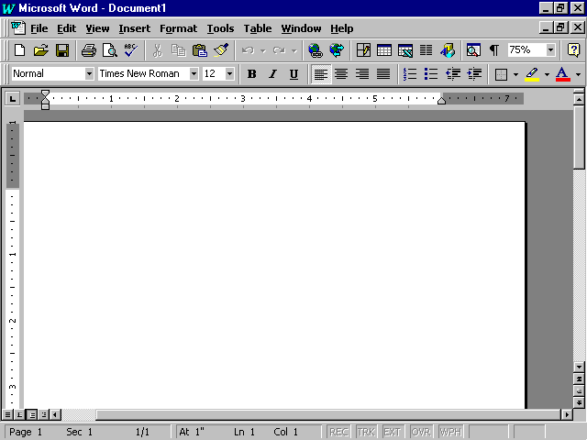
menu bar
Minimize, Restore/Maximum Close buttons
Standard tool bar
Formatting tool bar
ruler
document window
scroll bars
Status bar

Slide 12
Using Office Assistant
Automatically suggests help topics as you work
Anticipates your actions and responds with suggestions on performing related tasks
Can activate the Office Assistant any time its needed

Slide 13
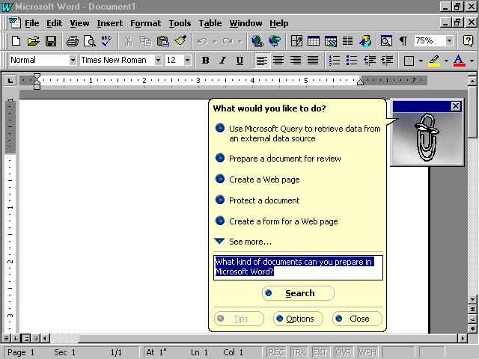

Slide 14
Creating a New Document
Planning - understand document’s purpose and what it will say
Entering - entering contents by typing into word processor
Editing - making changes to document, to correct errors and enhance content

Slide 15
Creating a New Document
Formatting - enhancing to make more readable and attractive, such as boldface text, italics and bullets
Previewing and Printing - displaying onscreen how document will look printed, allows for final changes before printing

Slide 16
Entering and Editing Text
New Word document like a blank piece of paper, but with many predefined or default settings
Default settings contained in the document template

Slide 17
Document Template
Every Word document based on a document template
Settings are stored in the Blank document template
Other templates can be used to create different styles of memos, letters and reports

Slide 18
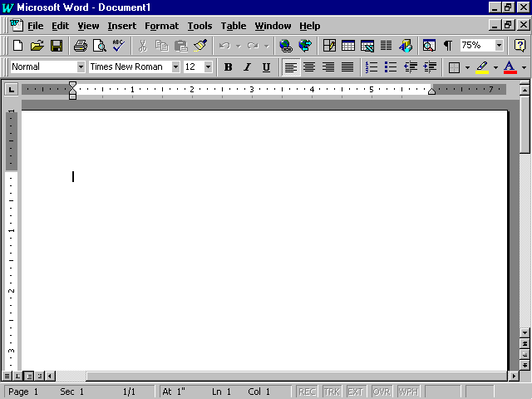
Document Template
.5 inch tap stops
left paragraph indent
right paragraph indent
document page number
vertical position of insertion point
horizontal position of insertion point
Line position of insertion point
Document section

Slide 19
AutoCorrect
Part of Office 97 IntelliSense feature
Makes basic assumptions about text user is typing
Uses assumptions to automatically identify and correct an entry

Slide 20
AutoCorrect
Corrects for capitalization and spelling
Can prompt user by finishing common phrases

Slide 21
Spelling and Grammar Checkers
Automatically advises user of misspelled words or incorrect grammar
Spelling Checker compares typed words to those in a main dictionary
  Those failing to match are identified as misspelled
  User can then correct herself or choose from menu of suggested words

Slide 22
Spelling and Grammar Checkers
Grammar Checker looks for incorrect verb and tense agreements, verb forms, commonly confused words and others
  Words and phrases identified with a wavy green line
  User can then edit, or choose from a menu of suggested changes

Slide 23
Inserting and Deleting Blank Lines
If insertion point is on a line above another line, and at the beginning or end of the line, press Enter key to
Two ways of deleting a blank line
  Pressing the delete key
  Click on Edit, Clear

Slide 24
Inserting Characters
Move your cursor to the insert area
Type in the text desired
Add spaces if necessary

Slide 25
Deleting Words
Position your insertion cursor and press the Control Delete key

Slide 26
Word Wrap
Feature that automatically decides where to end a line
Text is “wrapped” to next line based on margin settings
Saves time - pressing Enter key only when starting new paragraph or inserting blank line

Slide 27
Moving Around the Document Window
Closing and Saving Files
Moving Through a Document

Slide 28
Opening, Closing and Saving Files
Closing
  File, Close menu command
  File Close button
Saving
  File, Save and Save menu commands
  Diskette file save icon

Slide 29
Moving Through a Document
Moving mouse
PgUp and PgDn keys
Vertical scroll bar and buttons
Horizontal scroll bar and buttons

Slide 30
Editing Key Summary
Key
Ctrl + Delete
Action
Deletes word to the right of insertion point

Slide 31
Editing Key Summary
Key
Ctrl + Delete
Enter
Action
Deletes word to the right of insertion point
Ends a line and moves insertion point to next line or inserts a blank line

Slide 32
Editing Key Summary
Key
<-Backspace
Action
Deletes character to the left of insertion point

Slide 33
Editing Key Summary
Key
<-Backspace
Delete
Action
Deletes character to the left of insertion point
Deletes character to right of insertion point

Slide 34
Editing Key Summary
Key
<-Backspace
Delete
Ctrl + <-Backspace
Action
Deletes character to the left of insertion point
Deletes character to right of insertion point
Deletes word to left of insertion point

Slide 35
Editing Key Summary
Key
Edit, Undo
Action
Reverses your last action or command

Slide 36
Editing Key Summary
Key
Edit, Undo
Edit, Redo
Action
Reverses your last action or command
Reverses the effects of Undo

Slide 37
Displaying Special Characters
Normally hidden characters that display text characteristics
Examples
  Paragraph symbol
  Dots for spacebar

Slide 38
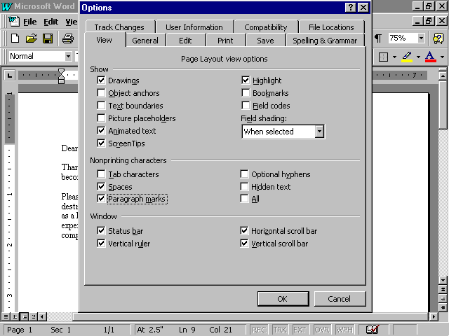

Slide 39
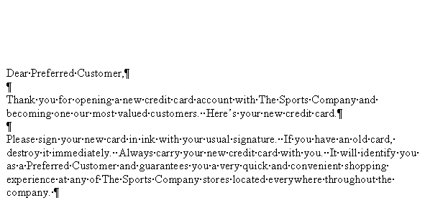

Slide 40
Selecting Text
To select a word:
Multiple paragraphs
Procedure:
Drag in the selection bar next to the paragraphs

Slide 41
Selecting Text
To select a word:
Multiple paragraphs
Document
Procedure:
Drag in the selection bar next to the paragraphs
Triple-click in the selection bar or press Ctrl and click in the selection bar

Slide 42
Selecting Text
To select a word:
Word
Procedure:
Double-click in the word

Slide 43
Selecting Text
To select a word:
Word
Sentence
Procedure:
Double-click in the word
Press Ctrl and click within the sentence

Slide 44
Selecting Text
To select a word:
Word
Sentence
Line
Procedure:
Double-click in the word
Press Ctrl and click within the sentence
Click in the selection bar next to the line

Slide 45
Selecting Text
To select a word:
Multiple lines
Procedure:
Drag in the selection bar next to the lines

Slide 46
Selecting Text
To select a word:
Multiple lines
Paragraph
Procedure:
Drag in the selection bar next to the lines
Triple-click on the paragraph or double-click in the selection bar next to the paragraph

Slide 47
Undoing Editing Changes
Delete the change
Click on the Undo button
Click on the Edit, Undo menu

Slide 48
Documenting and Printing a Document
Documenting a File
Previewing and Printing a Document
Document Preview
Exiting Word

Slide 49
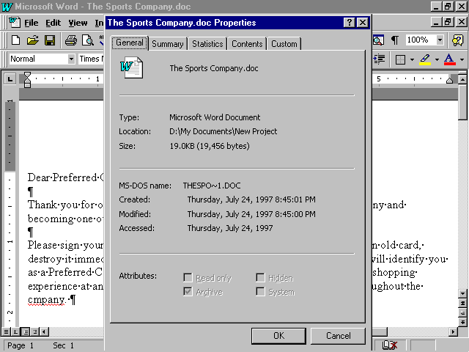
general document properties

Slide 50
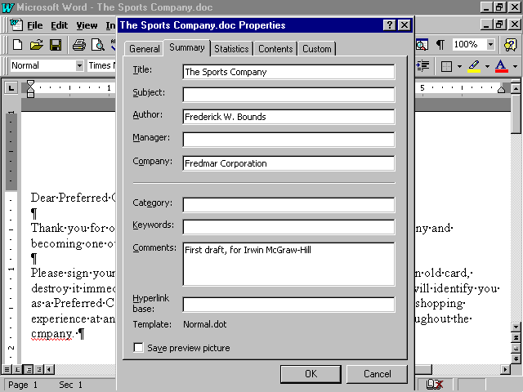
summary document properties

Slide 51
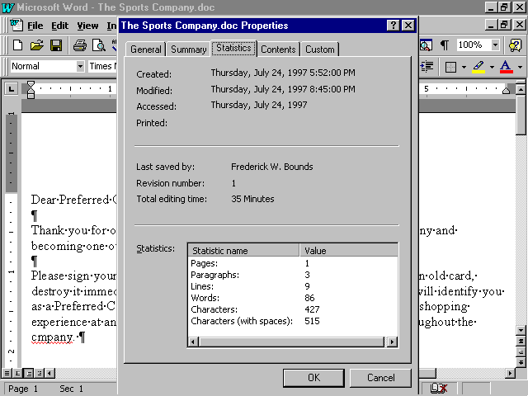
document statistics

Slide 52
Previewing the Document
View onscreen how document will look printed out
Each page displayed in a reduced sized so that you can see the layout

Slide 53
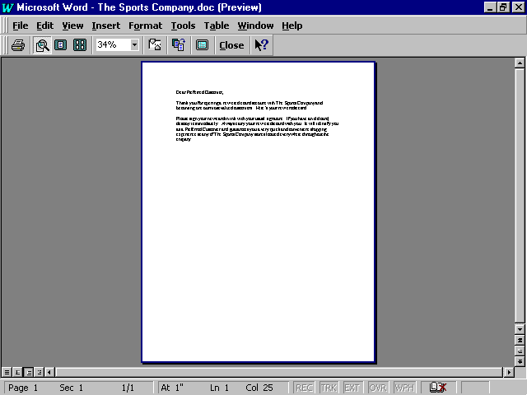
Print Preview

Slide 54
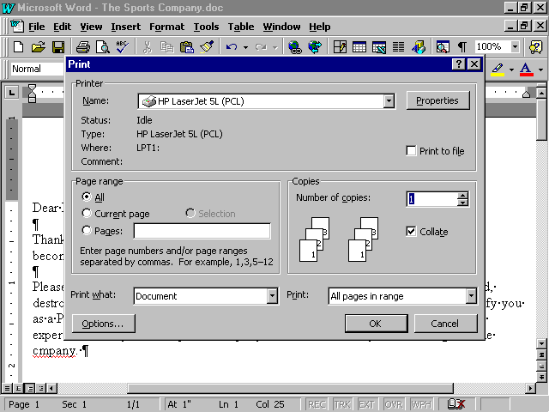
Print options
Print window

