Slide 1
Systems Development Life Cycle
The Analysis Phase
Introduction to process modelling

Slide 2
What is the System Development Cycle?
What is an information system (IS)?
Hardware, software, data, people, and procedures that work together to produce quality information
System—Set of components that interact to achieve common goal
Businesses use many types of systems
Next

Slide 3
What is the System Development Cycle?
What are the phases of the system development cycle?
Phase 2. Analysis
Conduct preliminary investigation
Perform detailed analysis activities:
  Study current system
  Determine user requirements
  Recommend solution
Phase 1. Planning
Phase 3. Design
Review project requests
Prioritize project requests
Allocate resources
Identify project development team
Acquire hardware and software, if necessary
Develop details of system
Phase 5. Support
Phase 4. Implementation
Conduct post-implementation system review
Identify errors and enhancements
Monitor system performance
Develop programs, if necessary
Install and test new system
Train users
Convert to new system
Next

Slide 4
What is the System Development Cycle?
What are guidelines for system development?
Arrange tasks into phases (groups of activities)
Involve users (anyone for whom system is being built)
Develop clearly defined standards (procedures company expects employees to follow)
Next

Slide 5
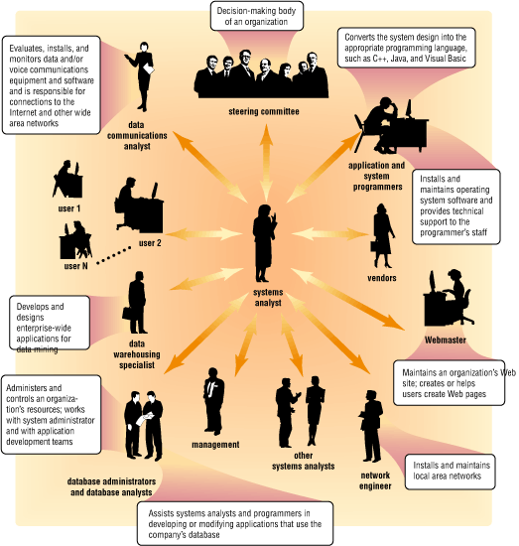
What is the System Development Cycle?
Who participates in the system development life cycle?
Next

Slide 6
What is the System Development Cycle?
What is a systems analyst?
Responsible for designing and developing information system
Liaison between users and IT professionals
Next

Slide 7
What is the System Development Cycle?
What is the project team?
Formed to work on project from beginning to end
Consists of users, systems analyst, and other IT professionals
Project leader—one member of the team who
manages and controls project budget and schedule
Next

Slide 8
What is the System Development Cycle?
What is project management?
  Process of planning, scheduling, and controlling activities during system development cycle
  Project leader identifies elements for project
Goal, objectives, and expectations, collectively called scope
Required activities
Time estimates for each activity
Cost estimates for each activity
Order of activities
Activities that can take place at same time
Next

Slide 9
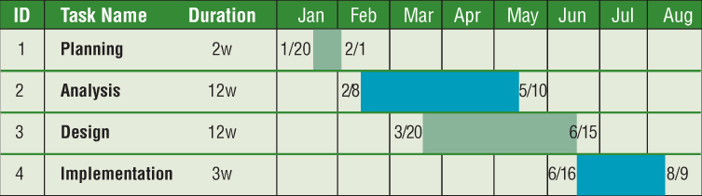
What is the System Development Cycle?
What is a Gantt chart?
  Popular tool used to plan and schedule time relationships among project activities
Next

Slide 10
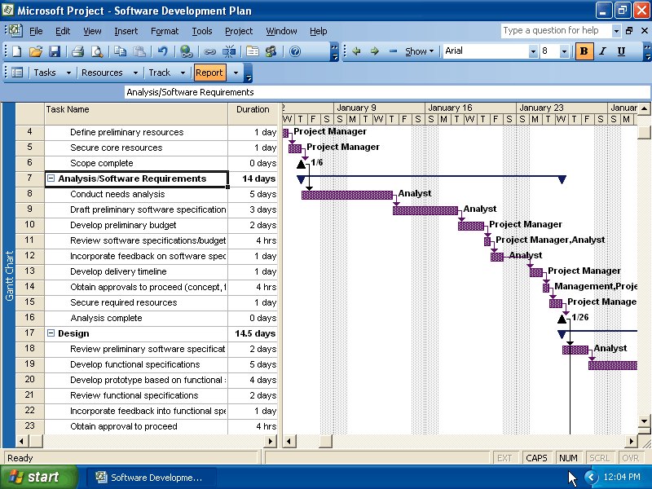
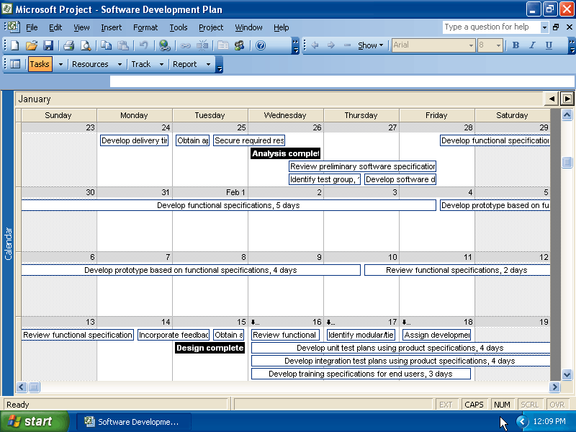
What is the System Development Cycle?
What is project management software?
  Program (such as Microsoft Office Project 2003) used by project leaders to plan, schedule, and control projects
Next

Slide 11
What is the System Development Cycle?
Operational feasibility
What is feasibility?
Four feasibility tests:
Measure of how suitable system development will be to the company
Schedule feasibility
Economic feasibility (also called cost/benefit feasibility)
Technical feasibility
Next

Slide 12
What is the System Development Cycle?
What is documentation?
Collection and summarization
of data and information
Includes reports, diagrams,
programs, and other deliverables
Project notebook contains all documentation for single project
Next

Slide 13

What is the System Development Cycle?
What are six data and information gathering techniques?
  Review documentation
  Observe
  Questionnaire
  Interview
  Joint-application
  design (JAD) session
  Research
Next

Slide 14
What Initiates the System Development Cycle?
What are some reasons to create or modify an information system?
To correct problem
in existing system
To improve
existing system
Outside group may
mandate change
Competition can
lead to change
Next

Slide 15
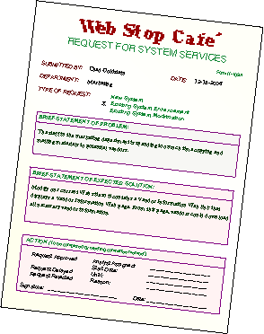
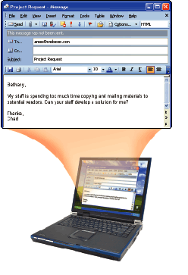
What Initiates the System Development Cycle?
What is a request for system services?
  Formal request for
  new or modified
  information system
    Also called
    project request
Next

Slide 16
Planning Phase
What is the planning phase?
Begins when steering committee receives project request
Steering committee—decision-making body for the company
Function of committee:
Review and approve project requests
Prioritize project requests
Allocate resources
Form project development team for each approved project
Next

Slide 17
Analysis Phase
What is the analysis phase?
Conduct preliminary investigation, also
called feasibility
study
Perform detailed analysis
Next

Slide 18
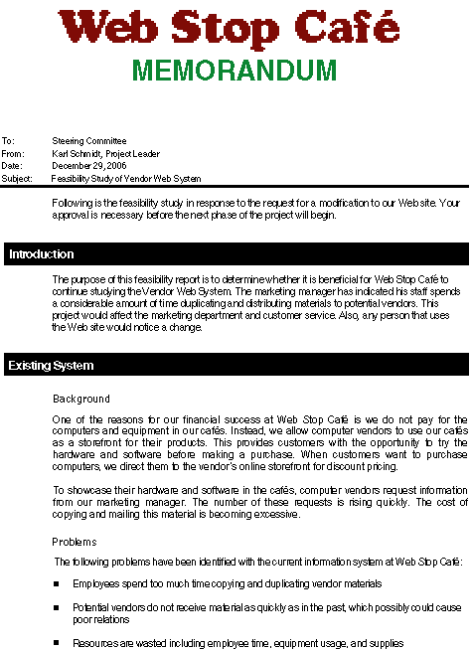
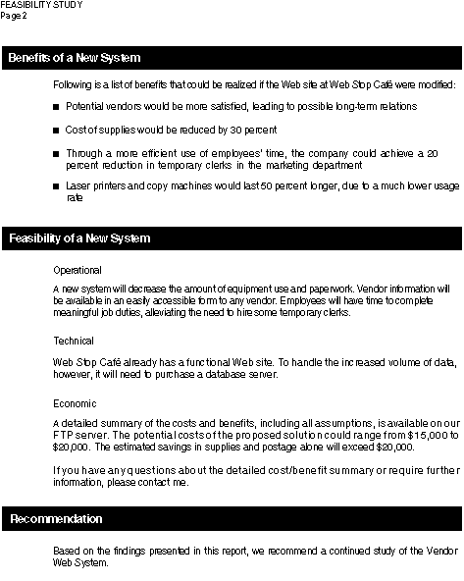
Analysis Phase
What is the preliminary investigation?
Determine exact nature of problem or improvement and whether it is worth pursuing
  Findings are presented in feasibility report, also known as a feasibility study
Next

Slide 19
Analysis Phase
What is detailed analysis?
1. Study how current system works
2. Determine user’s wants, needs, and requirements
3. Recommend solution
Sometimes called logical design
Next

Slide 20
Analysis Phase
What is process modeling?
Technique that describes processes that transform inputs into outputs
Also called structured analysis and design
Three tools used for process modeling
Entity-relationship diagrams
Data flow diagrams
Project dictionary
Next

Slide 21
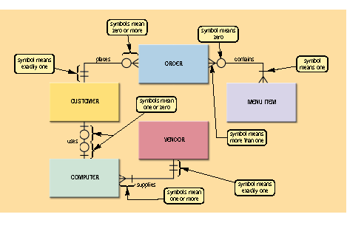
Analysis Phase
What is an entity-relationship diagram (ERD)?
  Tool that graphically shows connections between entities in system
Next

Slide 22
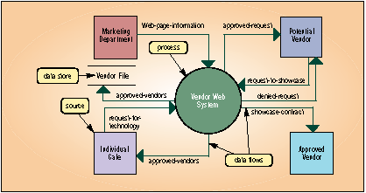
Analysis Phase
What is a data flow diagram (DFD)?
  Tool that graphically shows flow of data in system
Next

Slide 23
Analysis Phase
What is a project dictionary?
Contains all
the documentation
and deliverables
of project
Helps keep track
of huge amount
of details in
system
Variety of
techniques to
enter items in
project dictionary
Structured English
Decision tables
Decision trees
Data dictionary
Next

Slide 24
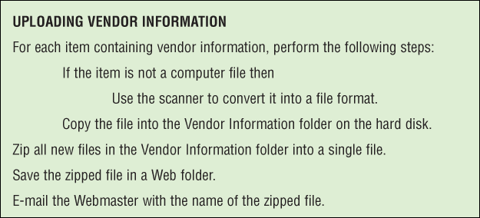
Analysis Phase
What is Structured English?
  Used to explain details of process in project dictionary
Next

Slide 25
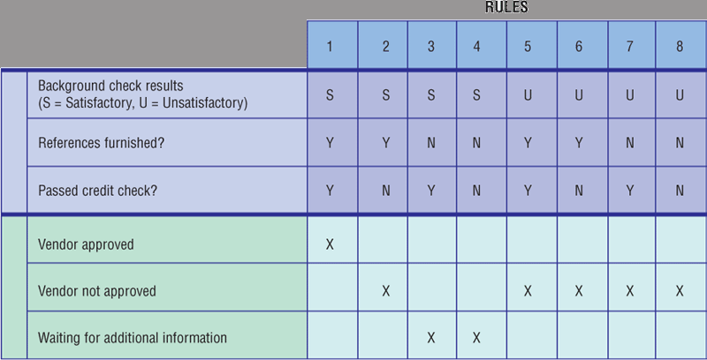
Analysis Phase
What is a decision table?
  Lists variety of conditions and actions that correspond to each condition
Next

Slide 26
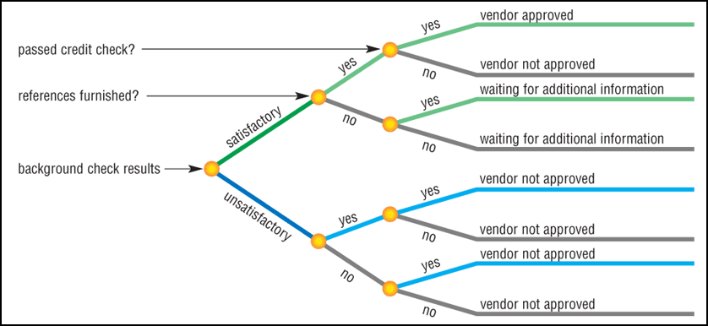
Analysis Phase
What is a decision tree?
  Shows conditions and actions graphically
Next

Slide 27
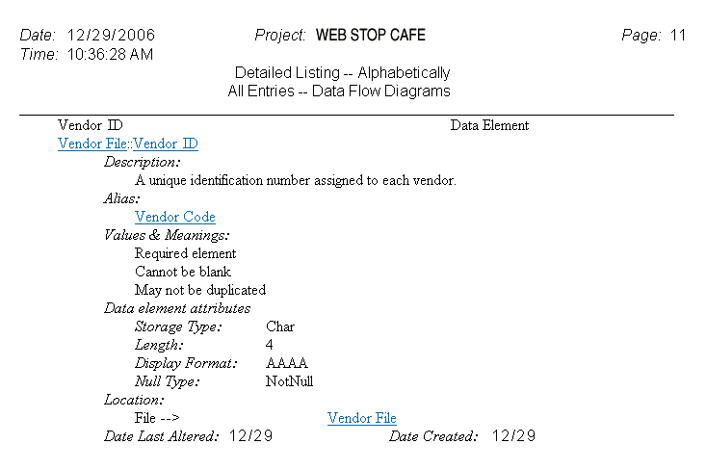
Analysis Phase
What is a data dictionary?
  Stores name,
  description, and
  other details
  about each data
  item
Next

Slide 28
Analysis Phase
What is object modeling?
Combines data with
the processes that act
on data into single
unit called an object
Object—an item that can contain both data and procedures that read or manipulate the data
Sometimes called
object-oriented (OO)
analysis and design
Uses Unified
Modeling Language
(UML)—graphical tool
for documenting system
Next

Slide 29
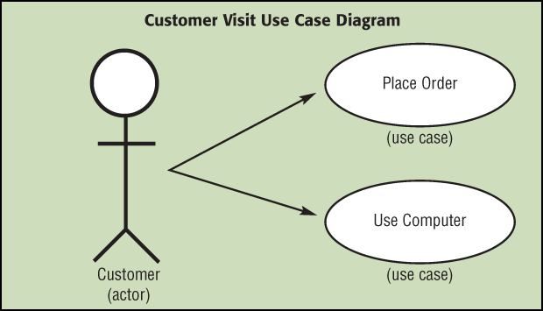
Analysis Phase
What is a use case diagram?
  Graphically shows how actors
  interact with information system
    Actor—user or other entity
    Use case—
    function that
    actor can
    perform
Next

Slide 30
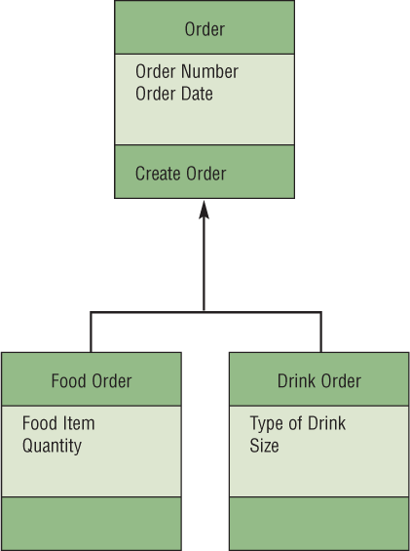
Analysis Phase
What is a class diagram?
  Graphically shows classes and subclasses in system
    Class is group of objects—
    Can have lower levels
    called subclasses
Next

Slide 31
Analysis Phase
Assesses feasibility
of each alternative solution
What is the
system proposal?
Presented to steering committee, which decides how system will be developed
Recommends the most feasible solution for the project
Next

Slide 32
Analysis Phase
What are possible software solutions?
Horizontal market software—meets needs of many companies
Buy packaged software—prewritten software available for purchase
Vertical market software—designed for particular industry
Write own custom software—software developed at user’s request
Outsource—have outside source develop software
Next

