Slide 1
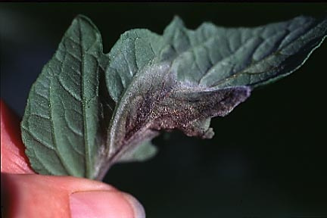
Plant Diseases
Joan Young, Lyon Co. Master Gardener

Slide 2
Fungus
Anthracnose
Common in spring.
Shade Trees: ash, cottonwood, elm, maple, sycamore, black walnut. Rarely kills.
Fruit: tomato / cucumbers / cantaloupe / green beans/ green pepper.
Prevention – remove dead leaves, plant with adequate air circulation.
Treat with fungicides.

Slide 3
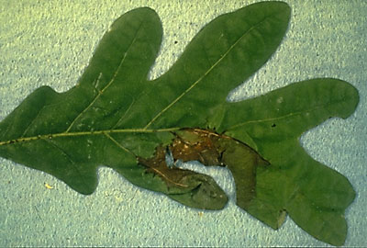
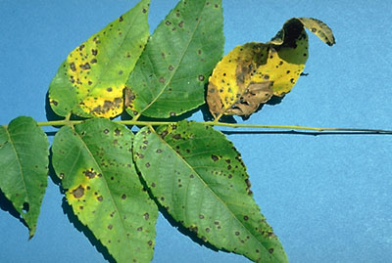
Fungus
Anthracnose
Oak
Walnut
http://ianrpubs.unl.edu
http://ianrpubs.unl.edu

Slide 4
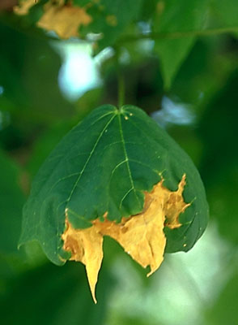
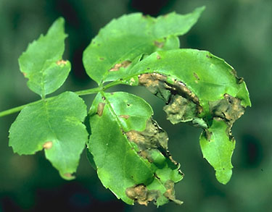
Fungus
Anthracnose
Maple
Ash
Ash
http://ianrpubs.unl.edu
http://ianrpubs.unl.edu

Slide 5
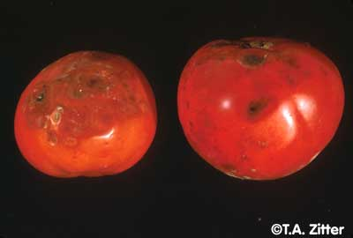
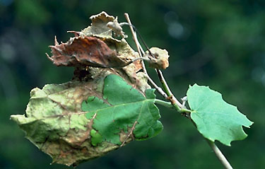
Fungus
http://vegetablemdonline.ppath.cornell.edu
Anthracnose
SYCAMORE
Twig dieback, brown spots/patches.
Clean up dead leaves.
Tomato
Circular, sunken lesions
Mulch, stake up for air.
Clean up debris at end of season.
http://ianrpubs.unl.edu

Slide 6
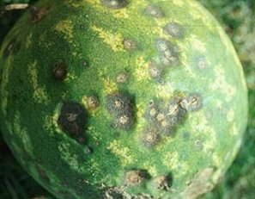
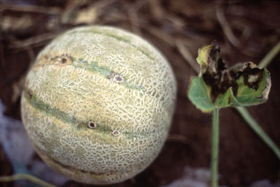
Fungus
http://www.oznet.ksu.edu
Anthracnose
Watermelon / Cantaloupe
Circular, sunken lesions
Mulch. Rotate location every 3 years.
Clean up debris at end of season.
http://ianrpubs.unl.edu

Slide 7
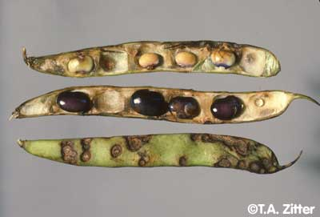
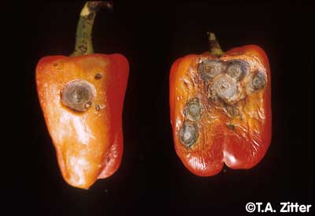
Fungus
http://vegetablemdonline.ppath.cornell.edu
Anthracnose
Pepper
Green Beans
http://vegetablemdonline.ppath.cornell.edu

Slide 8
Fungus / Bacteria
Cankers (fungus or bacteria)
Cankers are localized dead areas of bark in trees and shrubs caused by fungi and bacterial infection. They cause destructive tree diseases. Bark damage helps infection to start.
Can kill trees in a short time.
No cure.

Slide 9
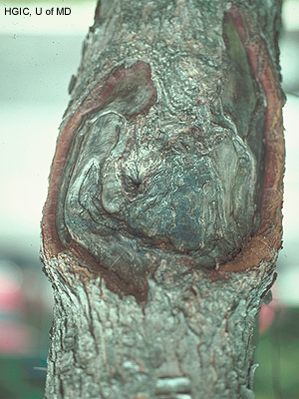
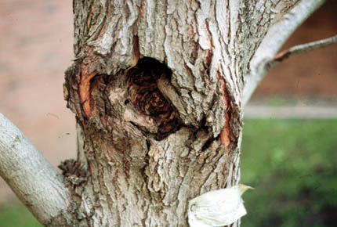
Fungus / Bacteria
Cankers
Maple
http://www.hgic.umd.edu
http://plantclinic.cornell.edu

Slide 10
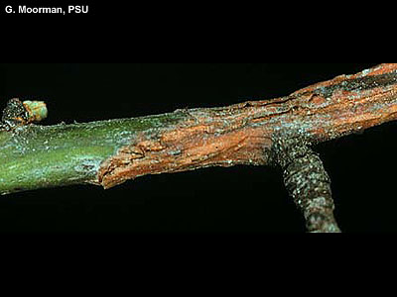
Fungus / Bacteria
Cankers
They can be caused by mechanical damage (especially weed whips and lawn mowers), environmental
conditions (frost
cracks, sunscald),
chemical injury,
insects, or micro-
organisms (fungi
and bacteria).
http://www.hgic.umd.edu

Slide 11
Fungus
Leaf Spot
Spread by splashing water. Wet heat is ideal.
Septoria leaf spot, sometimes called Septoria blight, appears on the lower leaves after the first fruits set. Fruits are not infected. Leaf loss reduces fruit yield and quality, and exposing fruits to sunscald. The fungus is spread by splashing water and by working among the plants when they are wet.

Slide 12
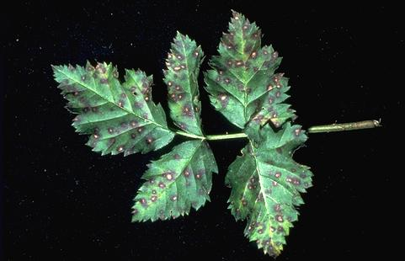
Fungus
Leaf Spot
Raspberry
www.ipm.ucdavis.edu

Slide 13
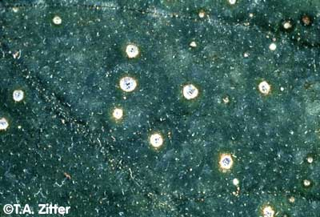
Fungus
Leafspot – Cucumber family
Cucumber, muskmelon, pumpkin, squash.
http://vegetablemdonline.ppath.cornell.edu

Slide 14
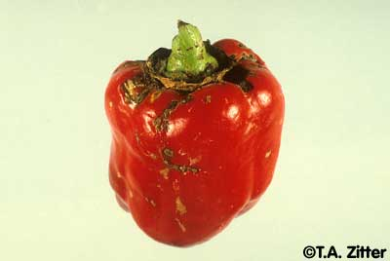
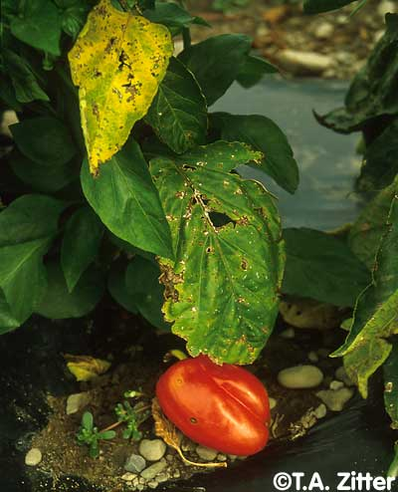
Bacterial Spot
Pepper
http://vegetablemdonline.ppath.cornell.edu

Slide 15
Fungus
Leafspot (fungus or bacteria)
Localized infections on leaves; requires moisture.
Can cause premature defoliation, reduced plant vigor, and increases susceptibility to other diseases and environmental stresses.
Remove plant debris each fall.

Slide 16
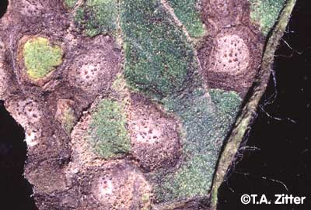
Fungus
Leafspot
The centers of the spots are gray/tan and have a dark brown margin In the center of the spots are many dark brown, pimple-like bodies of the fungus. The structures are large enough to be seen with the unaided eye or with the aid of a hand lens. Spots
may also appear on stems,
calyxes, and blossoms, but
rarely on fruit. Heavily infected
leaves will turn yellow, dry up,
and drop off. This will result in
sunscalding of the fruit.
http://vegetablemdonline.ppath.cornell.edu

Slide 17
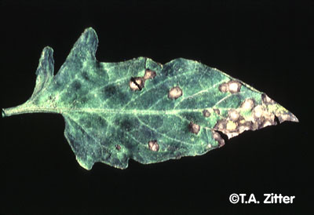
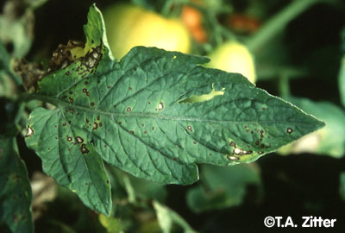
Fungus
Leafspot
Tomato/Potato/ Eggplant family
Use any fungicide labeled for control of Septoria leaf spot.
Fungus stays on debris, not in soil.
Mulch, stake up for air.
Clean up debris at end of season.
http://vegetablemdonline.ppath.cornell.edu
Tomato
Located on lower, older leaves and stems when fruits are setting
http://vegetablemdonline.ppath.cornell.edu

Slide 18
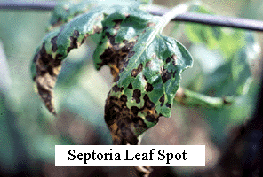
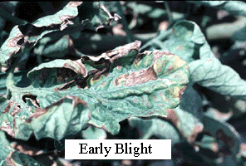
Tomato

Slide 19
Fungus
Blight
Three kinds: Septoria leaf spot, early blight and late blight
All spread by splashing water. Wet heat is ideal.
Early blight, appears on the lower leaves, usually after a heavy fruit set. The spots are dark brown to black. Concentric rings develop in the spot forming a bull’s eye. The leaf area around each target spot turns yellow, and soon the entire leaf turns yellow and drops. Early blight also infects stems and may produce stem cankers. It occasionally attacks the fruit, producing large sunken black target spots on the stem end of the fruit. Infected fruits often drop before they mature. This disease is most common late in the growing season.
Late blight occurs in moist weather with cool nights and moderately warm days. Dark-green to nearly black wet-looking spots begin spreading in from the leaf edge. In wet weather, the spots may have a downy, white growth on the lower leaf surface near the outer portion of the spot. Spots also develop on the fruits. At first, the spots are gray-green and water-soaked, but they soon enlarge and turn dark brown and firm, with a rough surface.
All overwinter on tomato and weed refuse. Remove dead debris. Rotate crops.

Slide 20
Fungus
Early Blight
Lesions are on lower, older leaves The lesions are dark brown and appear leathery with faint, concentric rings giving a "target-spot" effect. At first the spots are small (1 /8" in diameter), but later the spots can enlarge to about 1/2". In many cases they are bounded by the larger leaf veins At harvest time, spores from blighted vines may be deposited onto tubers. These spores germinate during wet and warm weather and invade the tissue, primarily through cuts, bruises, or wounded surfaces.
Tuber infections appear as generally small, irregular, brownish—black spots which are usually slightly sunken (approx. 1/16") Externally the spots resemble those caused by late blight, but internally they are shallower and darker in color. The rotted tuber tissue is firm, hard, and somewhat corky. EB tuber rot develops slowly and may not be severe until quite late into the storage period. This decay may allow the entry of secondary organisms soft rot bacteria.

Slide 21
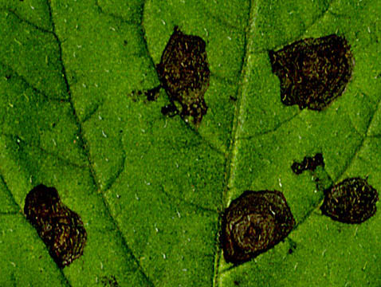
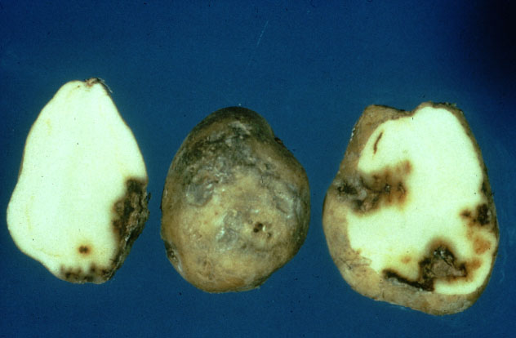
Early Blight
Fungus
Potato
www.ndsu.nodak.edu

Slide 22
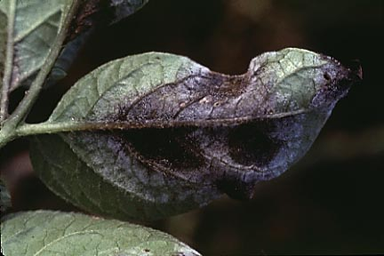
Fungus
Late Blight
Tomatoes and potatoes (Irish potato famine).
Survives only on old potato tubers.
Can travel through the air. Plant only
sound, blemish free tubers. Don't allow
any discarded tubers to sprout the next
year.
Wet, hot weather favors spread.
Late Blight Symptoms
Infected potatoes have shallow, brownish or purplish lesions on the surface. If you cut across the surface of these infected areas, you'll see a reddish-brown, dry, granular rot that extends up to half an inch into the flesh.
On potato plants: Lesions occur on both leaves and stems, commonly after periods of wet weather. Black lesions, whitish fungal spores are produced at the edge of the lesion, particularly on the underside of the leaf. Lesions turn brown when dried and are often surrounded by a halo of gray-green tissue. On stems, late blight causes brown, greasy looking lesions that frequently appear first at the junction between the stem and leaf, or at the cluster of leaves at the top of the stem.

Slide 23
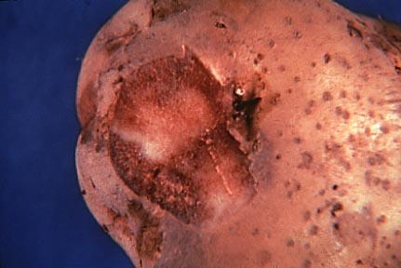
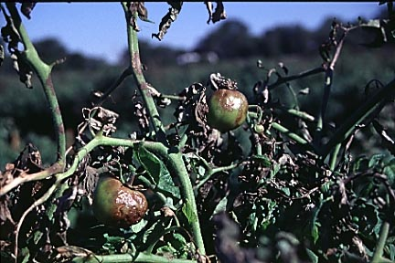
Late Blight
Fungus
Tomato
Potato
http://vegetablemdonline.ppath.cornell.edu

Slide 24
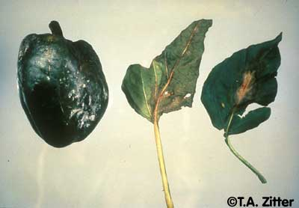
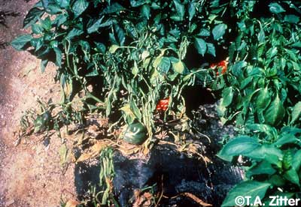
Fungus
Late Blight
Pepper
http://vegetablemdonline.ppath.cornell.edu

Slide 25
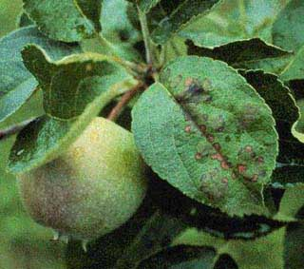
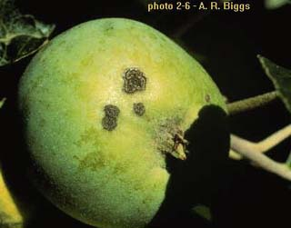
Apple Scab
Fungus
Use any fungicide labeled for control of
Clean up old apples, debris at end of season.
www.caf.wvu.edu

Slide 26
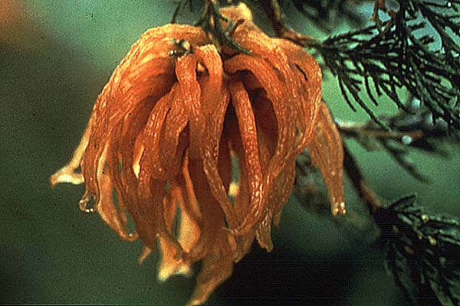
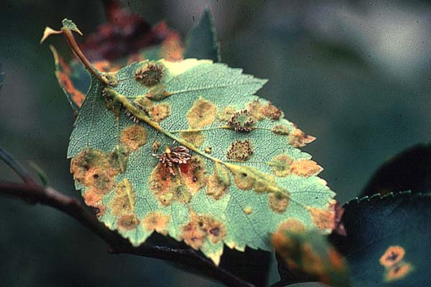
Cedar-Apple Rust
Fungus
Juniper
Use any fungicide labeled for control of rust.
Clean up old apples, debris at end of season.
Remove galls from junipers or remove junipers.
http://ianrpubs.unl.edu
Apple

Slide 27
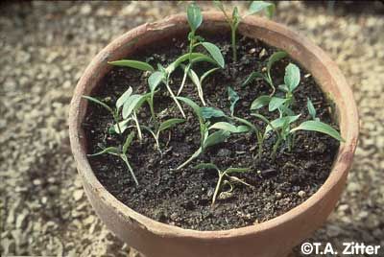
Damping off
Fungus
(Several fungus species)
http://vegetablemdonline.ppath.cornell.edu

Slide 28
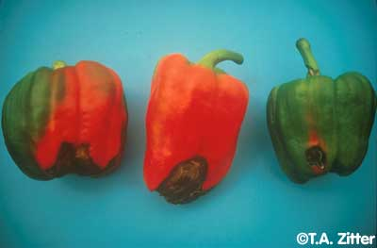
Blossom end rot (Calcium deficiency)
http://vegetablemdonline.ppath.cornell.edu

Slide 29
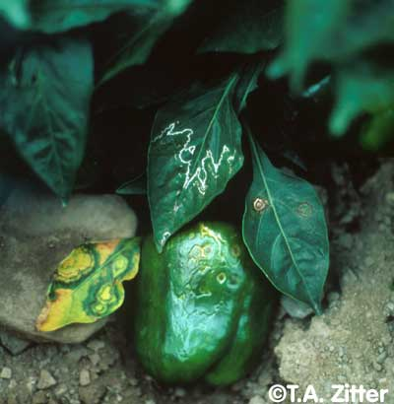
Aphids
http://vegetablemdonline.ppath.cornell.edu

Slide 30
Noninfectious Disorders
Scorch. (Drought, poor/damaged root system, toxic soil herbicides, high salts, excessive fertilizer.)
Iron chlorosis. Iron deficiency
Herbicide injury.

Slide 31
Disease Control
Select plant material adapted to Kansas.
Buy disease-free seed and healthy plant material.
Plant disease-resistant varieties when available.
Choose plants that fit the site.
Keep plants healthy.
Control insect pests.
Use chemical control with care.

