Slide 1
Jesus at the Temple
Luke 2:41-52

Slide 2
Where do we find this passage?
The story of the child Jesus at the Temple is found in chapter 2 of the Gospel of Luke.
No other author in the Second Testament has this story, which means it must have come from an oral source known only to Luke.
Notes:
Luke is a competent writer of Greek and this passage reads very like a Greek biographical insert about the hero in his youth. It serves a very important function because it fills the gap between the birth and the adult life of Jesus. We must be mindful however, that the story serves to reinforce many of Luke’s themes – in particular the theme of lost and found. Later in his gospel he will tell 4 stories about being lost and found (Lost sheep, coin, son and Zacchaeus) – this one is another.

Slide 3
What is the genre of this passage?
This passage is written as a recount – it tells of something Jesus did.
However, it has been written in the style of a narrative, so it follows a narrative structure…
and has lots of features common in narratives…
  A clear plot
  Defined characters
  Lots of action (verbs) and detail
  Dialogue
  A climax
Notes:
Whether this story is based on a real event or is created to develop Luke’s theology is unclear. What is important is that it teaches an important point.

Slide 4
How does this literary form convey meaning?
This story contains different sorts of truths.
  Because it is a narrative set in a real time and place it has some literal truths. (eg Jerusalem, The Temple, the Passover.)
  Because this is a narrative it tells other truths about attitudes and values, about life, about relationships, about people and about God.
  Because it was written to persuade people to know Jesus as God in human form, it contains truths of our faith – truths about Jesus.
Notes:
It is important to consider the purpose in writing. The author of this work, while recording historical details and facts, was not primarily interested in describing the situation of the day. Their purpose was to express something about Jesus; something that would encourage and invite people to know and follow him. So the ‘truths’ the author wished to convey are found in the message of the story and not the specific detail. However, like all historical works, an understanding of the historical and cultural setting is vital if the message the author was trying to convey is to be fully revealed.

Slide 5
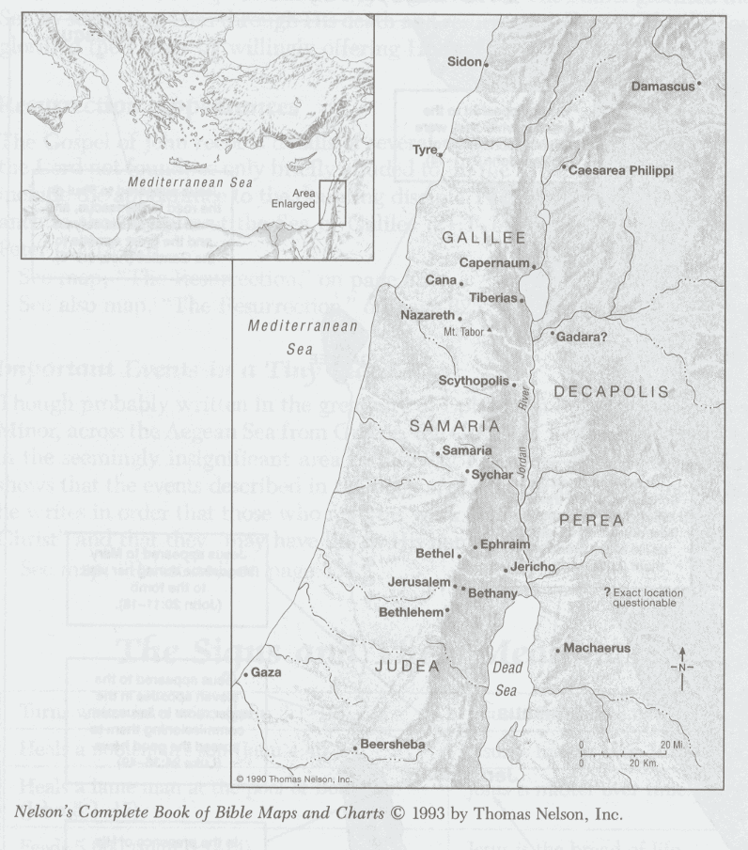
Terminology used in this text
Jerusalem
  The capital of Palestine.
  The Temple, heart of religious practice, was located in Jerusalem.
  Three times a year Jews were obliged to come to the Temple for religious festivals.
Notes:
Jerusalem has an important role in Luke’s writing: it is the centre from which the emerging Church will come in Acts.

Slide 6
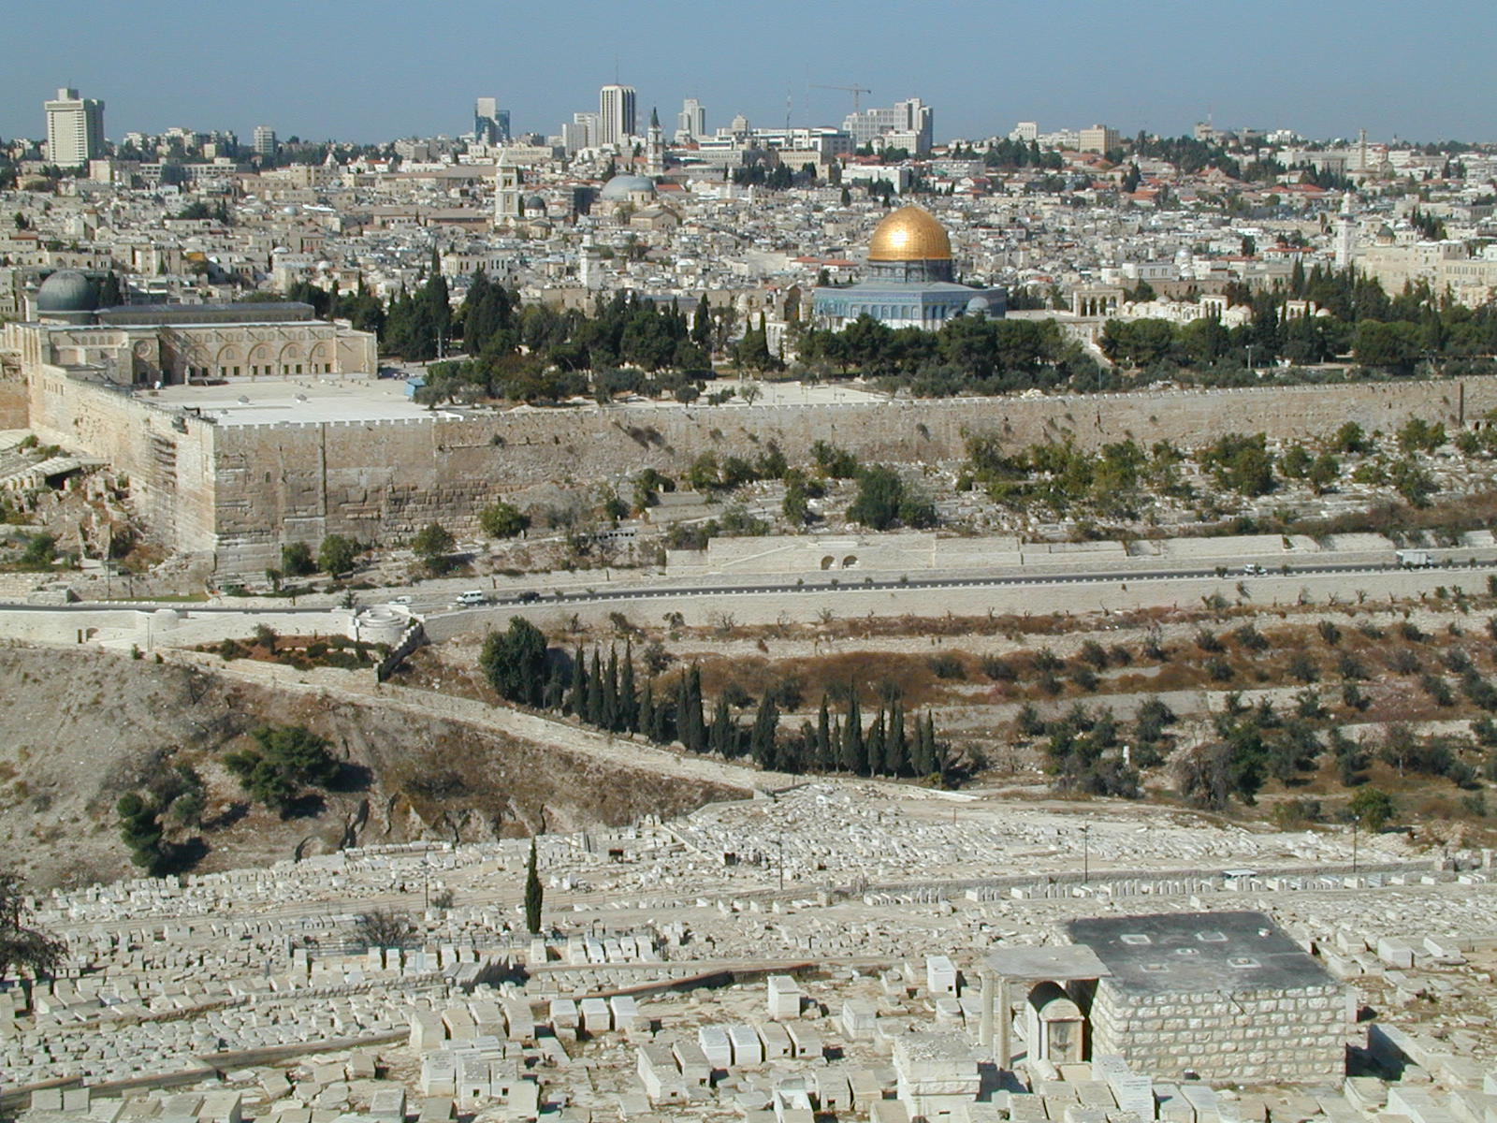

Slide 7
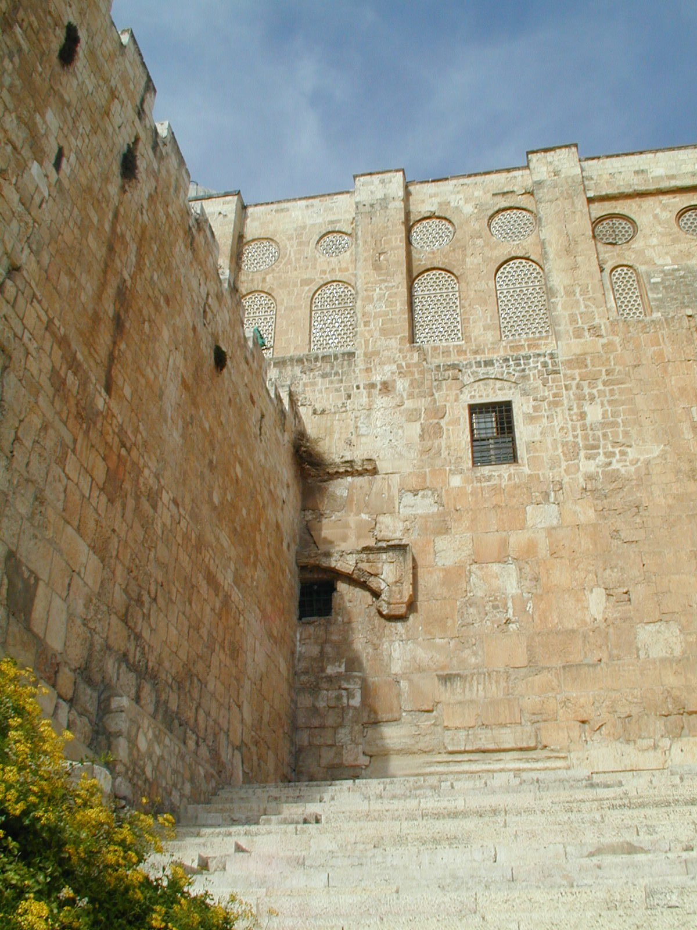

Slide 8
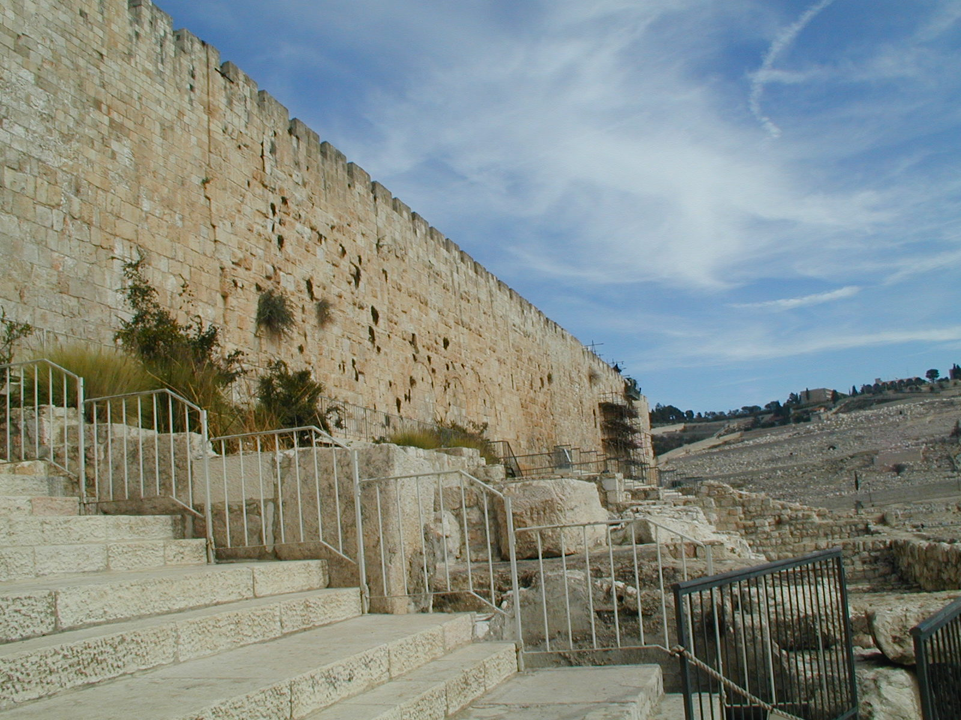

Slide 9
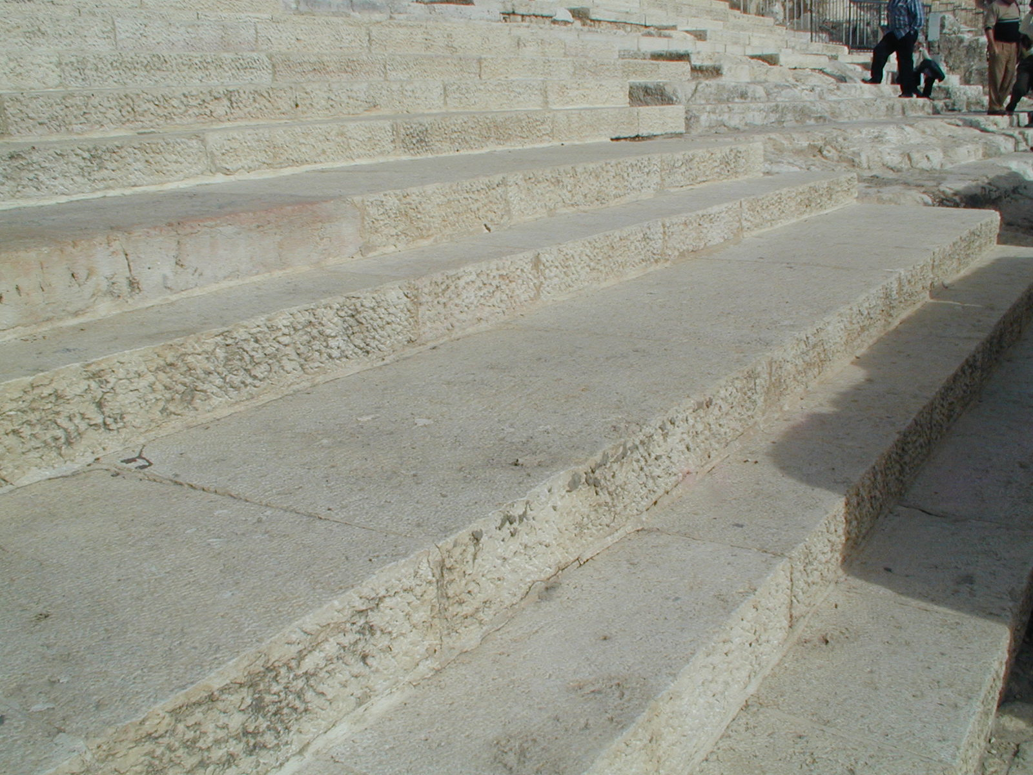

Slide 10
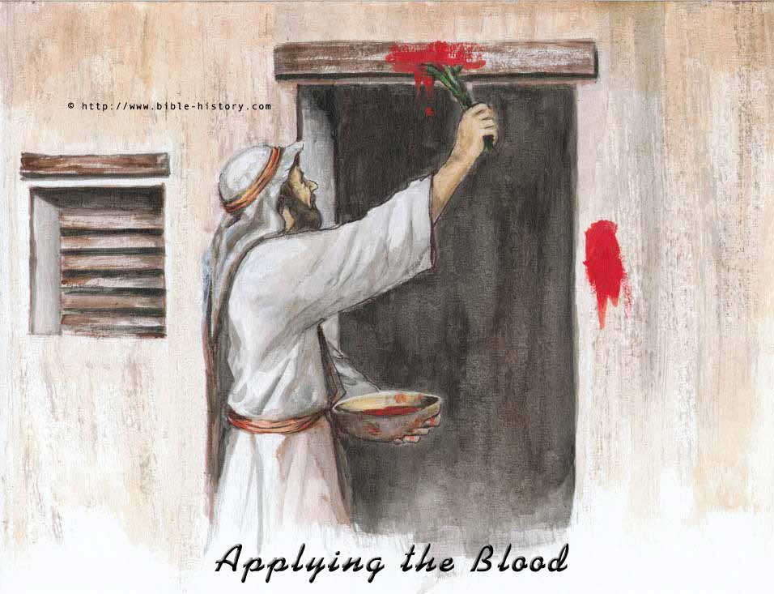
Terminology used in this text
Passover
  One of the three festivals which required the Jews to journey to the Temple in Jerusalem.
  The feast remembered the exodus from Egypt, in particular the ‘passing over’ of the angel of death on the Hebrews houses (Ex 12:13)

Slide 11
Terminology used in this text
  The family or a group of men would choose the sacrificial lamb and bring it to the Temple to be slaughtered. It had to be a perfect lamb, with no blemishes.
  The priest would slaughter the lamb and give the people bitter herbs and unleavened bread to eat. After evening prayers, meat would be taken from the cooked lamb. The people would be ready: loins girded, sandals on, staves in hand. They would eat… in haste…and anything found next morning would be burned.

Slide 12
Terminology used in this text
There are some interesting phrases and words in this passage.
  ‘12 years old’
    In Jewish law a child was ready to take responsibility for the observance of their faith between ten and thirteen.
  ‘the boy Jesus stayed in Jerusalem’
    Jesus was not left behind by careless parent – he chose to stay in Jerusalem. The words imply a deliberate action on the part of Jesus.
  ‘relatives and acquaintances’
    Those travelling to Jerusalem from the same village would have travelled together as a party or caravan. As a result, Jesus’ relatives and friends would have been with Mary and Joseph – it was therefore quite likely that the young man was with his friends.

Slide 13
Terminology used in this text
  ‘3 days later’
    At a literal level, the number indicates that Jesus was missing for some time. Symbolically, the number makes us think of the resurrection, when Jesus will again be lost for 3 days.
  ‘my father’s affairs’
    This passage may translated in different ways. Some Bible’s say ‘my father’s house’, others say ‘my father’s things’. The best translation makes it clear that Jesus is not just passively visiting God’s house, he is actually doing God’s work. Jesus is engaged in an activity – he is doing what he does best – answering questions.

