Slide 1
Soil
Dirt is simply misplaced soil!

Slide 2
SOIL: A RENEWABLE RESOURCE
Soil is a slowly renewed resource that provides most of the nutrients needed for plant growth and also helps purify water.
  Soil formation begins when bedrock is broken down by physical, chemical and biological processes called weathering.
Mature soils have developed over a long time are arranged in a series of horizontal layers,soil horizons.

Slide 3
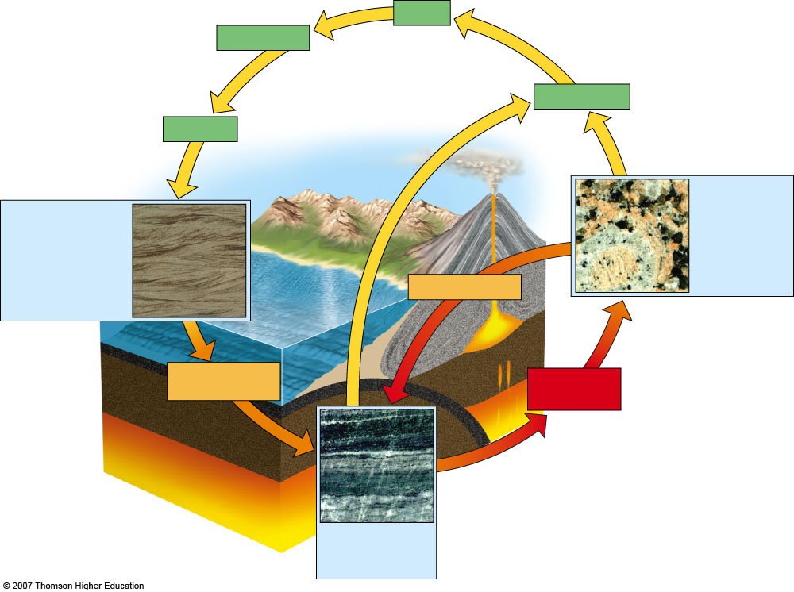
Erosion
Transportation
Weathering
Deposition
Igneous rock Granite, pumice, basalt
Sedimentary rock Sandstone, limestone
Heat, pressure
Cooling
Heat, pressure, stress
Magma (molten rock)
Melting
Metamorphic rock
Slate, marble, gneiss, quartzite
Fig. 15-8, p. 343

Slide 4
Layers in Mature Soils
Infiltration: the downward movement of water through soil.
Leaching: dissolving of minerals and organic matter in upper layers carrying them to lower layers.
The soil type determines the degree of infiltration and leaching.

Slide 5
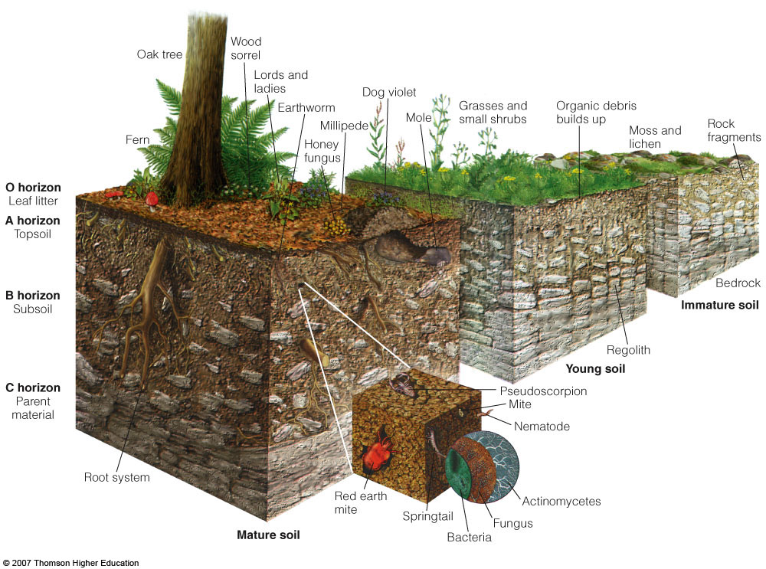
SOIL: Horizons
Figure 3-23

Slide 6
Soil Profiles

Slide 7
Soil Horizons
O horizon: leaf litter
A horizon: top soil
E horizon: eluviation zone;
  eluviation is the lateral or downward movement of dissolved or suspended material within soil when rainfall exceeds evaporation, a.k.a. infiltration.
  A & E horizons comprise the “zone of leaching”
B horizon: subsoil
C horizon: parent material
Bedrock

Slide 8
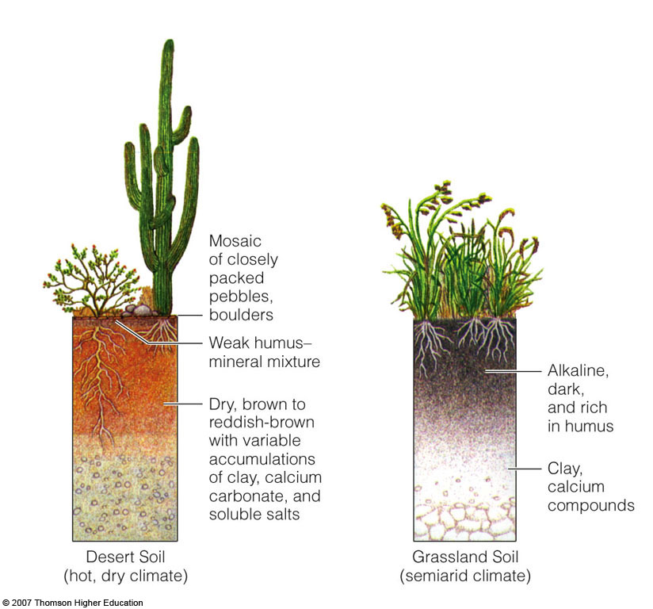
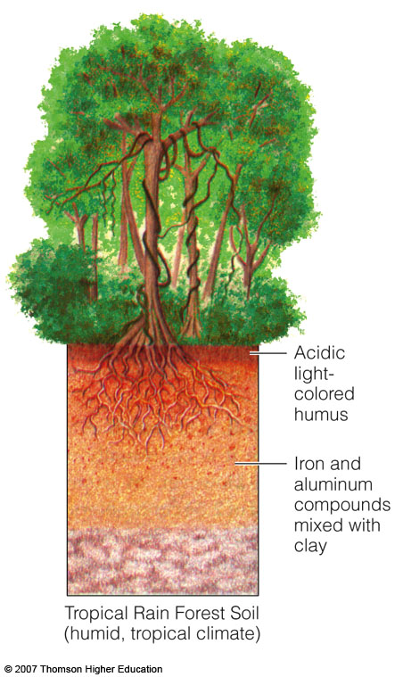
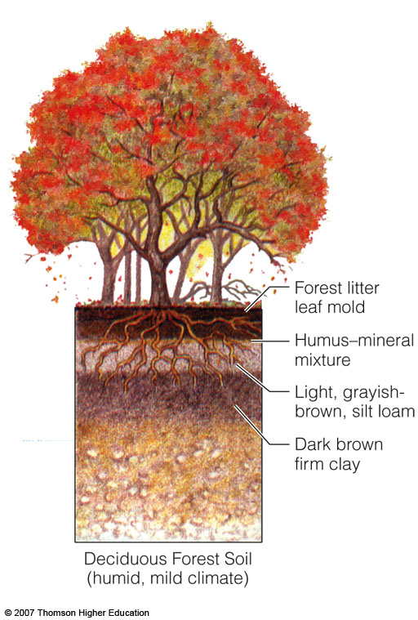
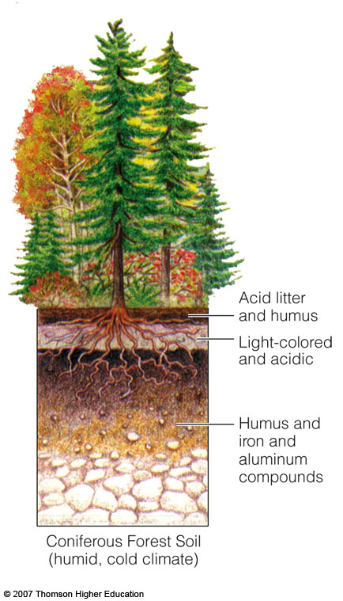
Soil Profiles of the Principal Terrestrial Soil Types
Figure 3-24

Slide 9
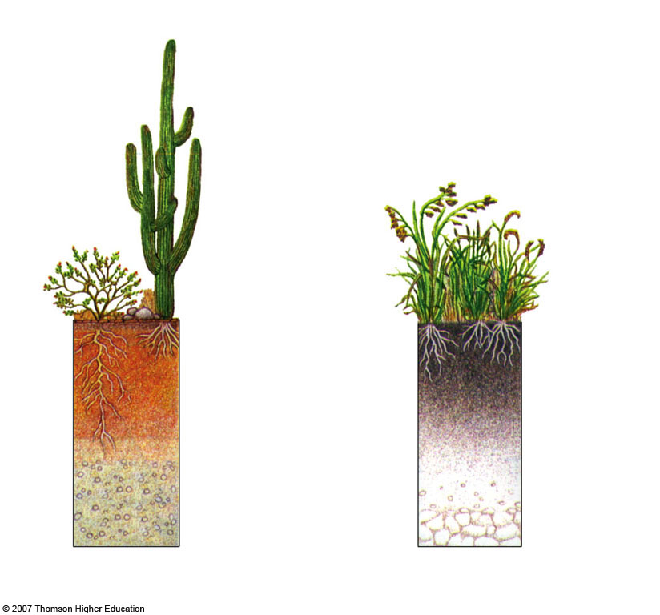
Mosaic of closely packed pebbles, boulders
Weak humus-mineral mixture
Dry, brown to reddish-brown with variable accumulations of clay, calcium and carbonate, and soluble salts
Alkaline,
dark,
and rich
in humus
Clay, calcium compounds
Desert Soil
(hot, dry climate)
Grassland Soil
semiarid climate)
Fig. 3-24a, p. 69

Slide 10
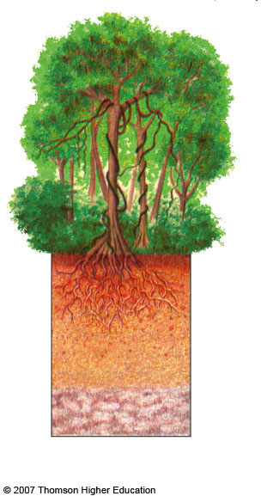
Tropical Rain Forest Soil
(humid, tropical climate)
Acidic
light-colored humus
Iron and aluminum compounds mixed with clay
Fig. 3-24b, p. 69

Slide 11
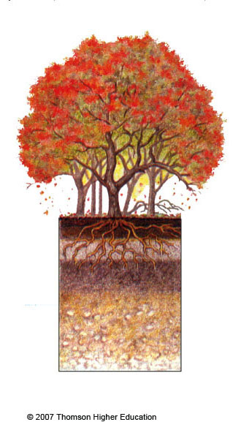
Forest litter leaf mold
Humus-mineral mixture
Light, grayish-brown, silt loam
Dark brown firm clay
Deciduous Forest Soil
(humid, mild climate)
Fig. 3-24b, p. 69

Slide 12
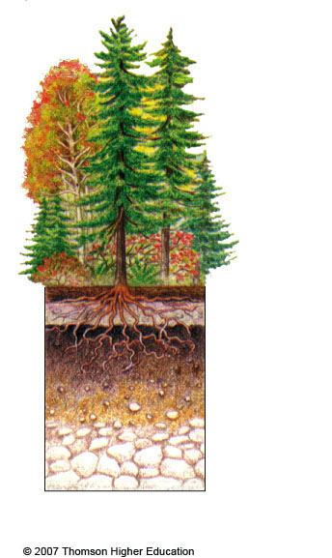
Coniferous Forest Soil
(humid, cold climate)
Acid litter and humus
Light-colored and acidic
Humus and iron and aluminum compounds
Fig. 3-24b, p. 69

Slide 13
Soil Color

Slide 14
All Soil is Brown, Right?
Wrong! Soils vary in color depending on material make-up and location.
The Munsell System of Color Notation is a color catalog.
  Soil scientists compare the soil next to the color chips to find a visual match and assign the corresponding Munsell notation with the soil.
The wide use and acceptance of the Munsell System allows for direct comparison of soils anywhere in the world.

Slide 15
The Munsell system
The system categorizes by three components: hue, value, and chroma.
Hue: the specific color
Value: the lightness or darkness of color
Chroma: the light intensity
Written: Hue Value/Chroma
      10 YR 3/2

Slide 16
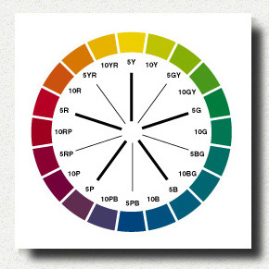
Hue Spectrum
“The Rainbow”

Slide 17
Value Spectrum
“Light to Dark”
0
10

Slide 18
Chroma Spectrum
“Intensity”
0
10

Slide 19
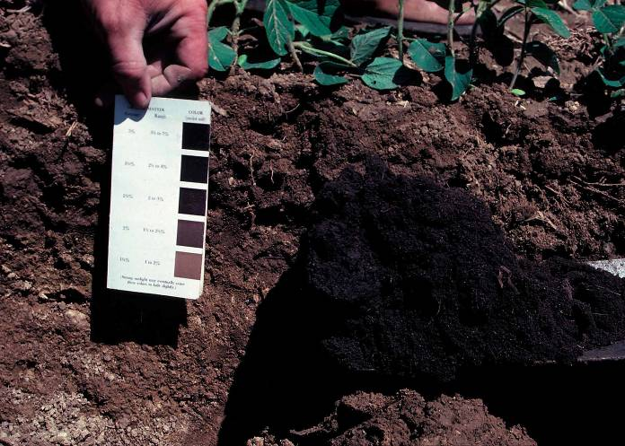
Color Chip Comparison

Slide 20
Soil Color Factors
Parent Material: Minerals relate to color
Age/Time: Older soil is often more red
Climate: May leach, remove coatings, or even enhance red
Topography: Uplands are more brown and red; low lands are more grey.
Vegetation : Conifers are more acid, more leaching, less color and Grasslands are more organic, darker colors

Slide 21
Diversity of Color
All soil in a specific area is not all the same color.
Soil within the same soil profile can have strong color variation.

Slide 22
What do the colors indicate?
Reddish, yellowish, or brownish: Iron oxides (variation from amount of:moisture)
  Hematite – red
  Goethite – yellowish brown
  Ferrihydrite – reddish brown
White: Carbonates, gypsum, other salts, or very leached
Black/very dark brown: Organic matter
Purple/black: Manganese oxides

Slide 23
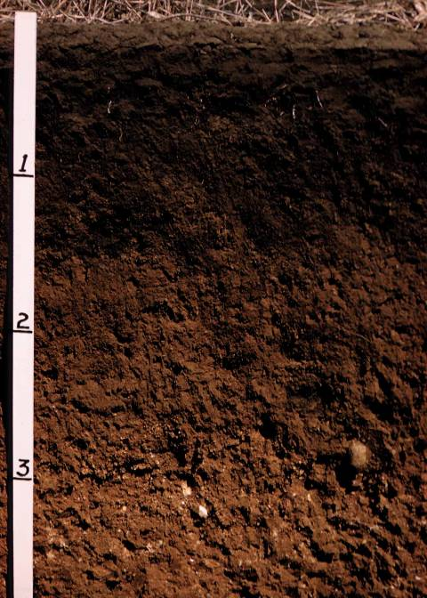
Soil Color
Variation

Slide 24
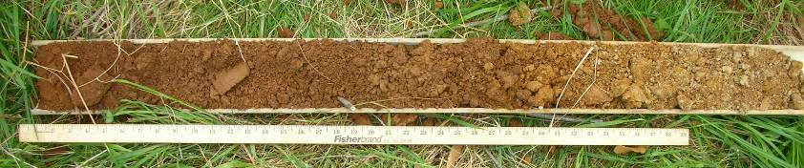
Soil Color Variation
A horizon: organic coatings
B horizon: Iron coatings
C horizon: little coating

Slide 25
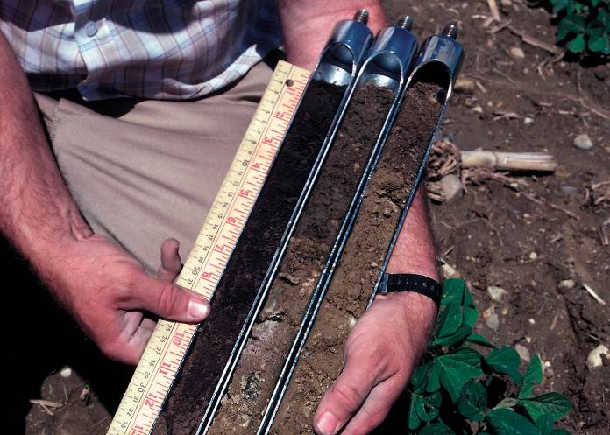
Soil Color Variation

Slide 26
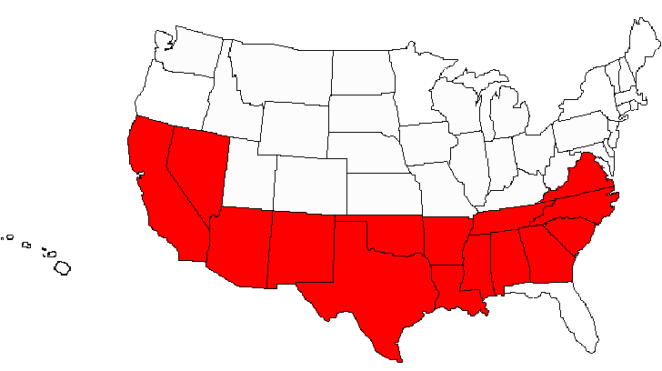
Colorful Soils
Red Soil in Southern U.S.

Slide 27
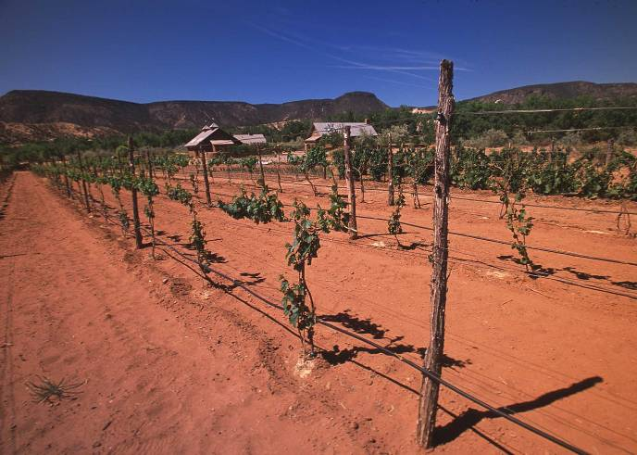
Red Sands in Arizona

Slide 28
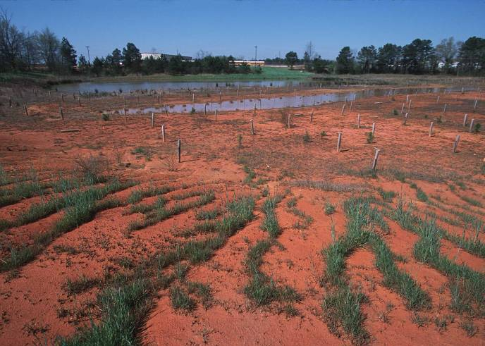
Red Georgia Soil

Slide 29
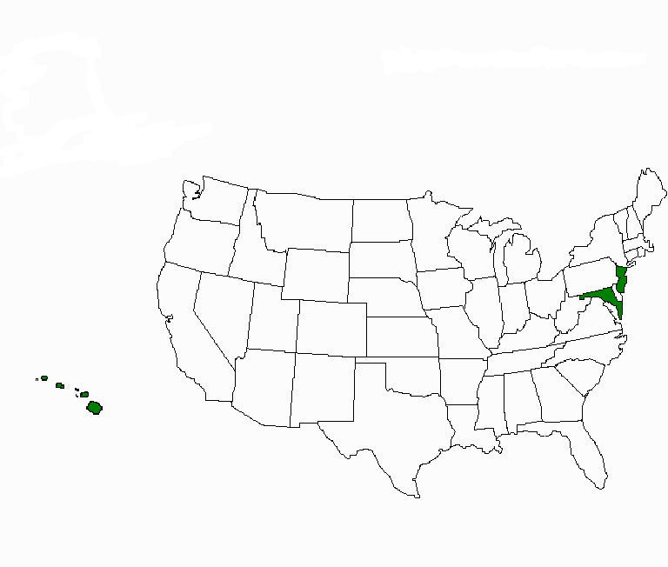
Colorful Soils
Green Soils & Sands in Maryland, New Jersey, & Hawaii

Slide 30
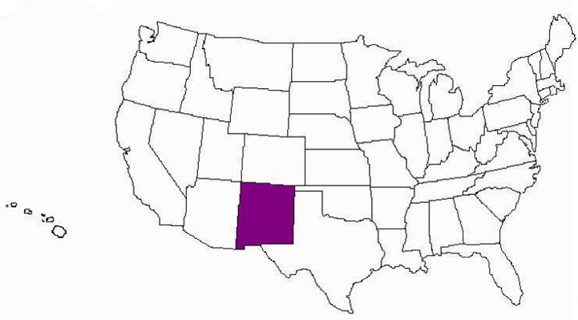
White Sands in New Mexico

Slide 31
Dark surface soils in the Great Plains & the Corn Belt are from rich organic matter.
Hwang Ho River in China carries yellow sediment creating a yellow river bed.

Slide 32
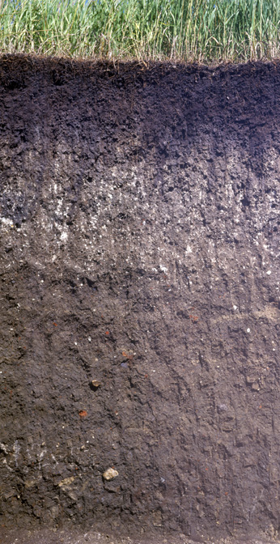
Mollisol
Profile

Slide 33
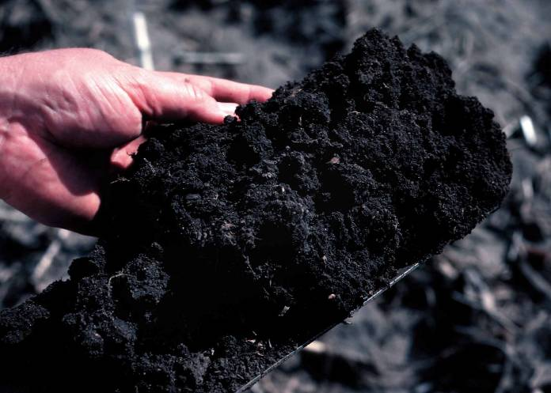
Surface Soil Rich in Organic Matter

Slide 34
Soil Texture

Slide 35
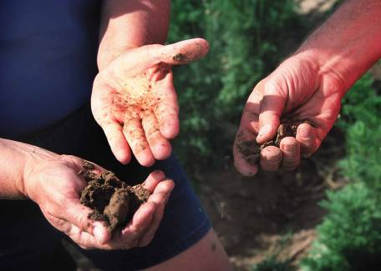
Particle Size Distribution (Texture)
Important for determining suitability for various uses
Considered a basic property because it doesn’t change

Slide 36
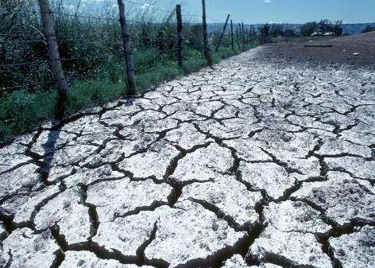
Properties Related to Texture
  Porosity
  Permeability
  Infiltration
  Shrink-swell
  Water holding Capacity
  Erodibility

Slide 37
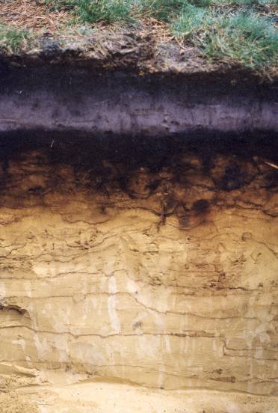
Soil Separates
Most soils have a combination of soil particles sizes
  Sand
  Silt
  Clay

Slide 38
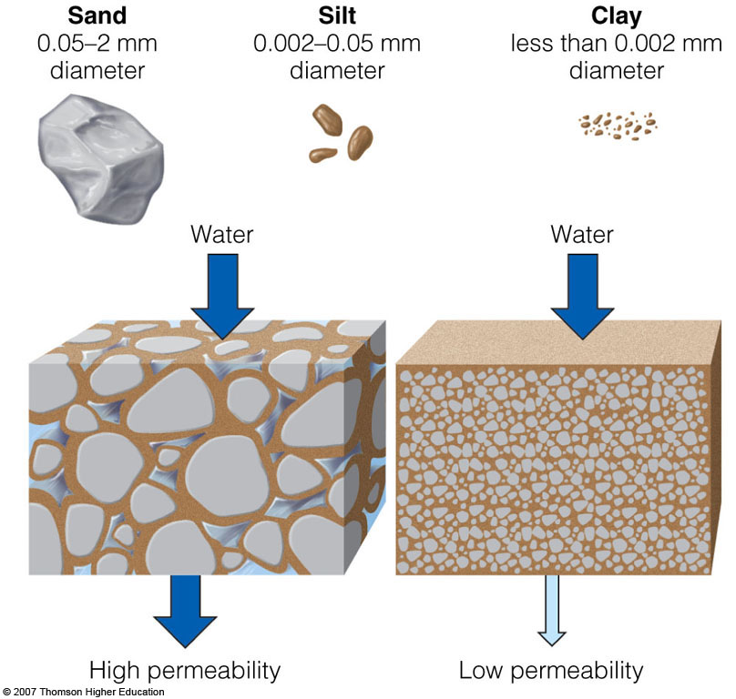
Soil Particles
Soils vary in the size of the particles they contain, the amount of space between these particles, and how rapidly water flows through them.
Figure 3-25

Slide 39
Sand
Gritty feel
Can be seen with the naked eye
Hand sampling:
  No residue left on hand

Slide 40
Silt
Dry: Powdery smooth feel, flour-like
Wet: Creamy slick, slippery feel
No sticky or plastic feel
Can be seen with a hand lens or microscope
Hand sampling:
  Coats hand, able to brush off

Slide 41
Clay
Dry: Hard feel
Wet: Sticky, plastic feel
Can be seen with an electron microscope
Hand Sampling:
  Sticks to fingers

Slide 42
Particle Sizes
  Clay: less than 0.002 mm
  Silt: 0.002-0.05 mm
  Sand: 0.05-2 mm
    0.05-0.24 mm fine
    0.25-0.49 mm medium
    0.5-0.99 mm coarse
    1- 2 mm very coarse
  Gravels: 2-75 mm
  Cobbles:75-250 mm
  Stones: 250-600 mm
  Boulders: >600 mm

Slide 43
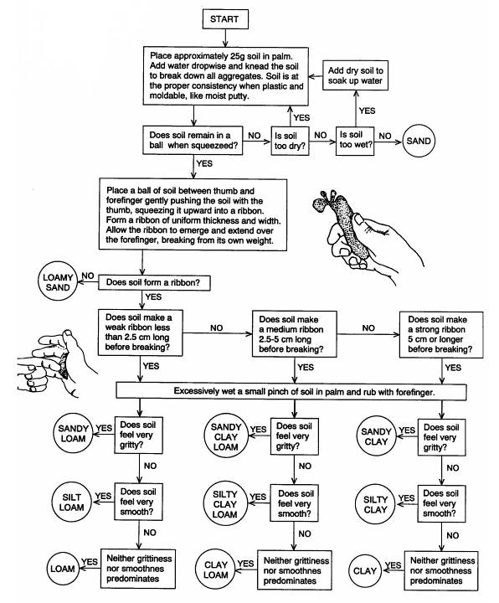
Texture by Feel

Slide 44
Fine Textured Soil
Large amounts of silt and clay, making it "muddy" when wet
Pore spaces are small, but numerous and hold more water
As clay soils begin to dry, they may still hold large quantities of water, but adhesive and cohesive properties of water make it unavailable for root uptake

Slide 45
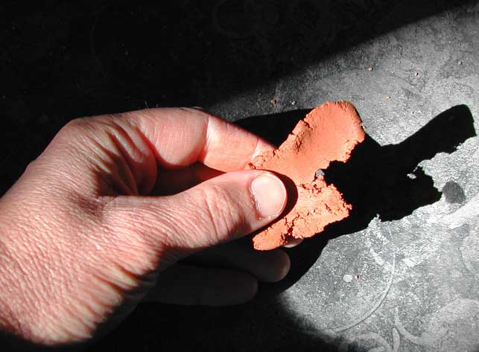
Fine Textured Soil

Slide 46
Coarse Textured Soil
  Large pore spaces and allows water to easily run through it beyond the reach of roots
  Drought-prone
  Little surface area for the particle volume, reducing fertility

Slide 47
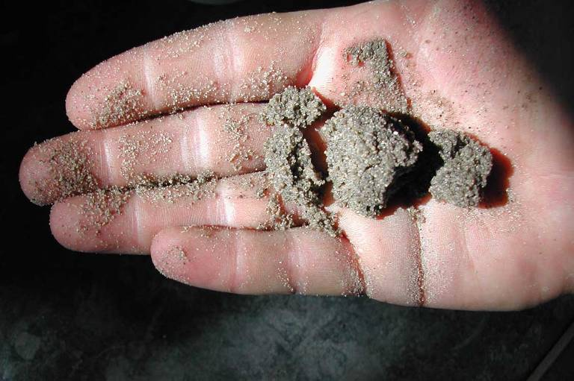
Coarse Textured Soil

Slide 48
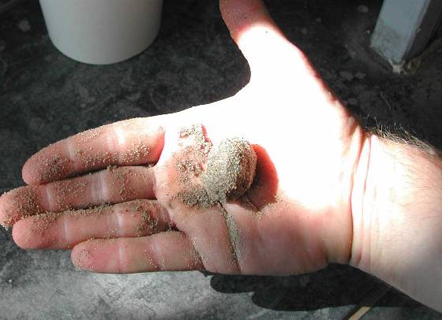
Loamy Soil
A mix of sand, silt, and clay that optimizes agricultural productivity

Slide 49
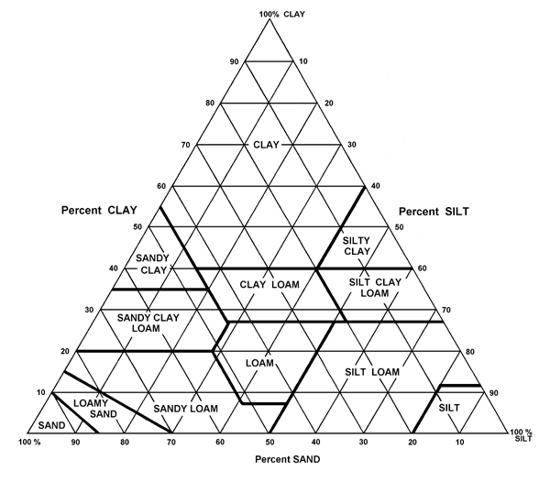
Sand + Silt + Clay = 100%
34 % Sand
Texture =
CLAY LOAM
33 % Silt
33 % Clay

Slide 50
General Influence of Soil Separates on Properties and Behaviors of Soils
Property/Behavior | Sand | Silt | Clay
Water holding | Low | Med-high | high
Aeration | Good | Med | Poor
OM decomposition | Fast | Med | Slow
Water erosion pot. | Low | High | Low
Compact-ability | Low | Med | High
Sealing (ponds) | Poor | Poor | Good
Nutrient supplying | Poor | Med-high | High
Pollutant leaching | High | Med | Low

Slide 51
Soil Texture and Surface Area
As particle size decreases, surface area increases
  Clay has about 10,000 times as much surface area as sand
Surface area has a big effect on:
  Water holding capacity
  Chemical reactions
  Soil cohesion
  Ability to support microorganisms

Slide 52
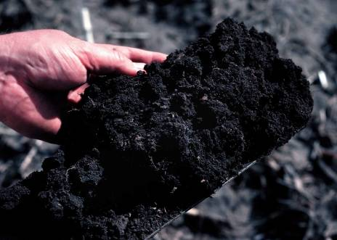
Influences of Soil Properties
Organic Matter is derived from decomposing plant and animal remains
Humus is the dark, moist layer found on the top of a soil profile. This is because it is made up of dead and decaying matter. It is fairly fertile in that the decay process adds nutrients to the soil that plants love to soak up

Slide 53
Influences of Soil Properties
Parent Material:
  Rock or original source of soil particles
  Effects soil quality
  Glacial outwash sands tend to be infertile, or hold few minerals and nutrients important for growth
  Soils derived from other sources may be relatively rich in minerals and nutrients
  Usually a combination of weathered parent materials and organic matter make a soil

Slide 54
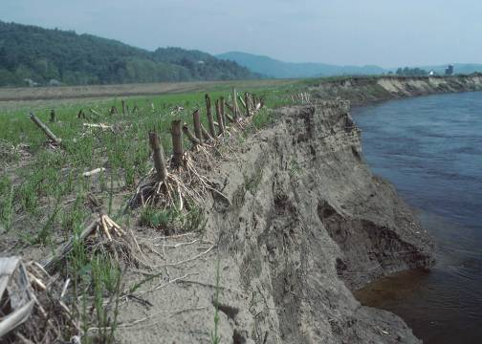
Sources of Parent Material
Weathering or erosive actions:
  heating/cooling
  freezing/thawing
  glaciers
  water
  wind
  chemistry
  plants & animals

Slide 55
Other Uses of Soil
Native North American cultures used earth colors as body paints.
Modern American culture uses colored earth in cosmetics and ceramics and as pigments for paints.

Slide 56
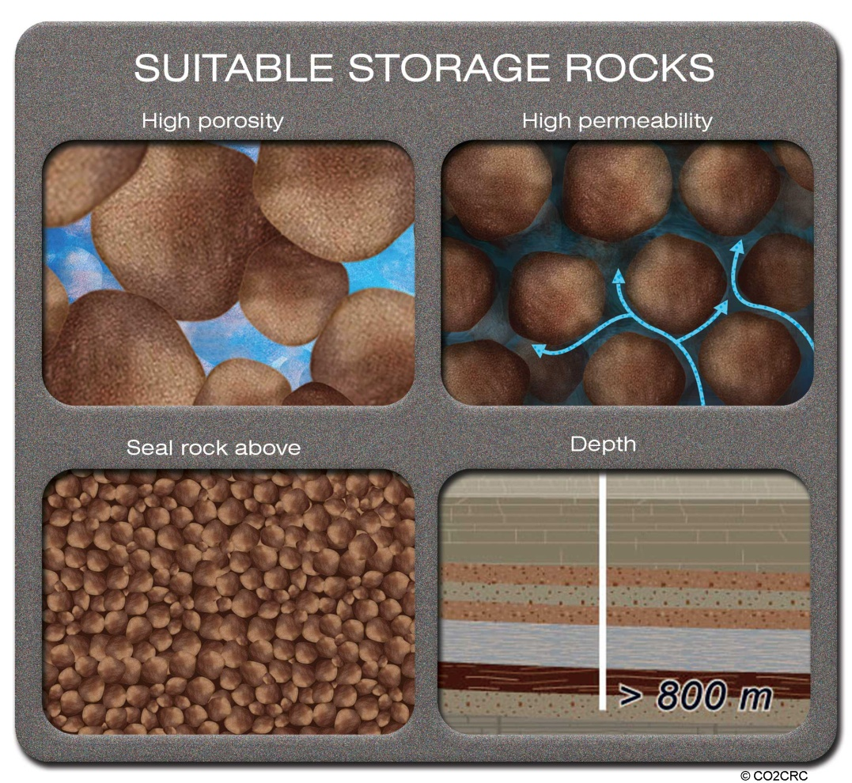
Porosity and Permeability

Slide 57
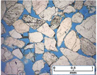
Porosity
A measure of the amount of pore space between grains; the ratio of the volume of openings (voids) to the total volume of material. Porosity represents the storage capacity of geologic material

Slide 58
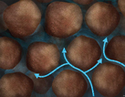
Permeability
A measure of the ability for fluid to pass through the pores.

Slide 59
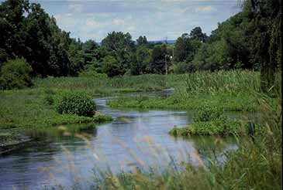
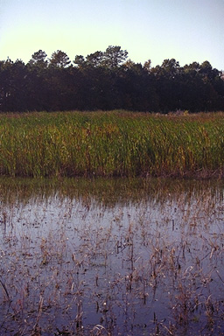
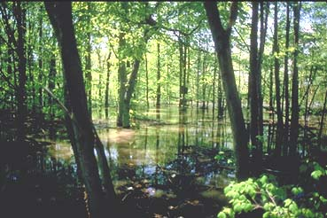
Wetlands- rich in humus and nutrients
Hydrology, Soil type, Species composition

Slide 60
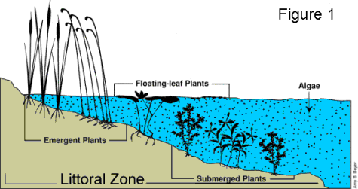
Pond
Littoral zone has soil where rooted plants live (water lillies, cattails)
Aides in reducing erosion

Slide 61
Soil Nutrition

Slide 62
Nutrients in Soil
Nutrients are chemical elements and compounds found in the environment that plants and animals need to grow and survive.
  Nitrate (NO₃-),
  nitrite (NO₂-),
  ammonia (NH₃),
  organic nitrogen (in the form of plant material or other organic compounds), and
  phosphates (PO₄³-)(orthophosphate and others)

Slide 63
MATTER CYCLING IN ECOSYSTEMS
Nutrient Cycles: Global Recycling
  Global Cycles recycle nutrients through the earth’s air, land, water, and living organisms.
  Nutrients are the elements and compounds that organisms need to live, grow, and reproduce.
  Biogeochemical cycles move these substances through air, water, soil, rock and living organisms.

Slide 64
The Big 13
The 13 mineral nutrients, which come from the soil, are dissolved in water and absorbed through a plant's roots. There are not always enough of these nutrients in the soil for a plant to grow healthy. This is why many farmers and gardeners use fertilizers to add the nutrients to the soil.

Slide 65
Macronutrients: Primary Nutrients
Macronutrients are those elements and compounds needed in large quantities for a plant to grow.
The primary nutrients are nitrogen (N), phosphorus (P), and potassium (K).
These major nutrients usually are lacking from the soil first because plants use large amounts for their growth and survival.

Slide 66
Macronutrients: Secondary Nutrients
The secondary nutrients are calcium (Ca), magnesium (Mg), and sulfur (S). There are usually enough of these nutrients in the soil so fertilization is not always needed.
  Large amounts of Ca and Mg are added when lime is applied to soils.
  Sulfur is usually found in sufficient amounts from the decomposition of soil organic matter.

Slide 67
Micronutrients
Micronutrients are those elements essential for plant growth which are needed in only very small (micro) quantities and are sometimes called minor elements or trace elements.
Micronutrients include boron (B), copper (Cu), iron (Fe), chloride (Cl), manganese (Mn), molybdenum (Mo) and zinc (Zn).

Slide 68
Soil pH is a factor
Soil pH (a measure of the acidity or alkalinity of the soil)
Soil pH is one of the most important soil properties that affects the availability of nutrients.
  Macronutrients tend to be less available in soils with low pH.
  Micronutrients tend to be less available in soils with high pH.

Slide 69
The pH can be changed
Lime can be added to the soil to make it less acidic and also supplies calcium and magnesium for plants to use.
  Lime also raises the pH to the desired range of 6.0 to 6.5. In this pH range, nutrients are more readily available to plants, and microbial populations in the soil increase.

Slide 70
Nitrogen
Nitrogen is a part of all living cells and is a necessary part of all proteins, enzymes and metabolic processes involved in the synthesis and transfer of energy.
Nitrogen is a part of chlorophyll, the green pigment of the plant that is responsible for photosynthesis.
Nitrogen is usable in the forms of NO₃⁻, NO₂⁻, and NH₃

Slide 71
Where does N come from
Helps plants with rapid growth, increasing seed and fruit production and improving the quality of leaf and forage crops.
Nitrogen often comes from fertilizer application whether it is industrial fertilizer or animal waste.
Bacteria can fix Nitrogen from the atmosphere (N₂) into a more usable form.
Decomposition of organic matter puts nitrogen back into the soil.

Slide 72
Phosphorus
Like nitrogen, phosphorus (P) is an essential part of the process of photosynthesis.
Involved in the formation of all oils, sugars, starches, etc.
Helps with the transformation of solar energy into chemical energy; proper plant maturation; effects rapid growth; and, encourages blooming and root growth.

Slide 73
Sources of Phosphorus
Phosphorus often comes from fertilizer, bone meal, and from rock.
Phosphorus is found in rock and is therefore a function of the rock cycle.
  P is in limited supply and is often a limiting factor because the rock cycle is so slow!
Phosphorus also comes from bird guano.

Slide 74
Potassium
Potassium is absorbed by plants in larger amounts than any other mineral element except nitrogen and, in some cases, calcium.
Helps in the building of protein, photosynthesis, fruit quality and reduction of diseases.
Potassium is supplied to plants by soil minerals, organic materials, and fertilizer.

Slide 75
Calcium
Calcium, an essential part of plant cell wall structure, provides for normal transport and retention of other elements as well as strength in the plant. It is also thought to counteract the effect of alkali salts and organic acids within a plant.
Sources of calcium are dolomitic lime and gypsum

Slide 76
Magnesium
Magnesium is part of the chlorophyll in all green plants and essential for photosynthesis. It also helps activate many plant enzymes needed for growth.
Soil minerals, organic material, fertilizers, and dolomitic limestone are sources of magnesium for plants.

Slide 77
Sulfur
Sulfur is essential plant food for production of protein. It promotes activity and development of enzymes and vitamins; helps in chlorophyll formation; improves root growth and seed production; helps with vigorous plant growth and resistance to cold.

Slide 78
Sulfur
Sulfur may be supplied to the soil from rainwater. It is also added in some fertilizers as an impurity, especially the lower grade fertilizers. The use of gypsum also increases soil sulfur levels.
The decomposition of organisms can add sulfur to the soil.
Sulfur is used by plants in the form of sulfates (SO₄²⁻) and sulfites (SO₃²⁻)

Slide 79
Micronutrients
Boron (B)
Helps in the use of nutrients and regulates other nutrients.
Aids production of sugar and carbohydrates.
Essential for seed and fruit development.
Sources of boron are organic matter and borax
Copper (Cu)
Important for reproductive growth.
Aids in root metabolism and helps in the utilization of proteins.

Slide 80
Chloride (Cl)
Aids plant metabolism.
Chloride is found in the soil.
Iron (Fe)
Essential for formation of chlorophyll.
Sources of iron are the soil, iron sulfate, iron chelate.
Manganese (Mn)
Functions with enzyme systems involved in breakdown of carbohydrates, and nitrogen metabolism.
Soil is a source of manganese.

Slide 81
Other Tests
Percolation (permeability)
Organic matter
Salinity
Ion Exchange
Heavy and Trace Metals

Slide 82
Soil Degradation
The breakdown of our most important resource.

Slide 83
Soil: The Final Frontier
Soil is a vital part of the natural environment. It influences the distribution of plant species and provides a habitat for a wide range of organisms.
It controls the flow of water and chemical substances between the atmosphere and the earth, and acts as both a source and store for gases (like oxygen and carbon dioxide) in the atmosphere.

Slide 84
Soil: The Final Frontier
Soils not only reflect natural processes but also record human activities both at present and in the past.
  They are therefore part of our cultural heritage.
  The modification of soils for agriculture and the burial of archaeological remains are good examples of this.

Slide 85
Without it, what would we do?
Soil helps to provide much of the food that humans consume.
  Only 25% of the Earth’s surface is made up of soil and only 10% of that soil can be used to grow food.
I.E., without soil, we cannot support primary producers.
  By the way, they are the base of the trophic levels!

Slide 86
Major Causes of Soil Degradation
Overgrazing 35%
Deforestation 30%
Other Agricultural Activities 27%
Other Causes
8%

Slide 87
Soil Exhaustion
Agricultural systems disrupt natural mineral cycling.
  The soil may become mineral deficient and lose fertility.
  Plants need minerals to grow and thrive such as nitrates, phosphates and sulfates.

Slide 88
Soil Erosion
The removal of trees that stabilize slopes result in erosion.
  Erosion is the removal of the top soil by physical means.
  Deforestation is one of the major causes of soil erosion.

Slide 89
Erosion from flooding
Floodplains and tropical rain forests are areas where there is a lot of erosion.
  most concerns about erosion are related to accelerated erosion, where the natural rate has been significantly increased mostly by human activity

Slide 90
Chemical Emissions
Industrial processes and vehicles release toxic substances which are heavier than air and settle on the soil.
  PCB’s, Heavy metals

Slide 91
Pesticides
Pesticides that are applied to fields can also destroy beneficial organisms in the soil.
  Bacteria that fix nitrogen, organisms that break down soil (worms)
  Bioaccumulation causes the concentrations of these pesticides to increase up the food chain.
  In the United States, farmers rely heavily on pesticides to maximize crop output.

Slide 92
Toxic Seepage and Chemical Contamination
Chemicals released into the environment from industrial discharges or improperly disposed chemicals seep into the soil and migrate or leach.
  These chemicals can impact the aquifer as well as the soil.

Slide 93
Brownfields
A Brownfield is underused or abandoned industrial site that is available for re-use that may or may not be contaminated
  Contamination would be mostly in the soil and due to the previous industrial process
    Heavy metals, organic by-products, acidic soil, etc.

Slide 94
Salinization
Salinization is an increase in salt (ionic compounds) in soil. Irrigation in areas where the bedrock contains high salt levels will cause these aqueous salts to be brought to the surface.
  This problem is compounded by clearing native vegetation.
  Irrigation of farmland and deforestation has in Western and South Eastern Australia has caused widespread salinization.

Slide 95
Desertificaion
Desertification is the expansion of dry lands due to poor agricultural practices, improper soil moisture management, salinization and erosion, forest removal, and climate change.
  Overuse of agricultural lands is the cause.
  10% of the world’s land has been desertified.
  25% is at risk.
  In Mali, the Sahara desert has expanded more than 650 km in less than 20 years.

Slide 96
Desalination
Desalination is used to remove ions from water.
  The Middle East has the least amount of freshwater than any other area on the planet and desalination is used to provide freshwater for agricultural and household purposes. This prevents salinization of the soil through agriculture.

Slide 97
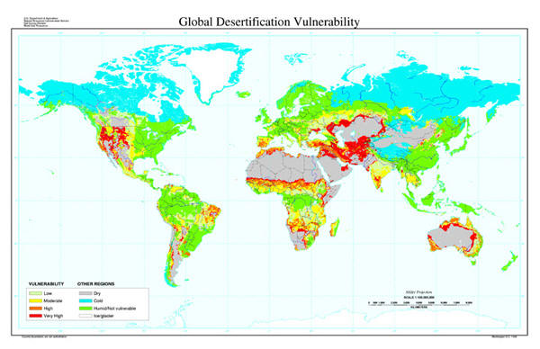

Slide 98
Contaminated Soil Cleanup
Site cleanup depends upon the pollutant
  Acid = neutralization
  Heavy metals = chelation, de-toxification
  Organic solvents = incineration
  Other = secure landfill
  Electrokinetic separation removes metals and organic contaminants from low permeability soil, mud, sludge, and marine dredging

Slide 99
Remediation
Biological organisms can be used to clean up
  Phytoremediation uses plants to remove pollutants from the soil; as the soil takes up water through the root systems, it takes up the pollution and incorporates it into the plant tissue.
  Bioventing introduces air into the soil which promotes biodegradation

Slide 100
Conservation
What is soil conservation?
  The protection of soil against erosion or deterioration
How can we do that?

Slide 101
The Laws
The U.S. Soil Conservation Act of 1935 established the Soil Conservation Service.
  This agency deals with soil erosion problems and was enacted following the Dust Bowl.
Soil & Water Resources Conservation Act of 1977
  This Act provides for a continuing appraisal of U.S. soil, water and related resources, including fish and wildlife habitats, and a soil and water conservation program to assist landowners and land users in furthering soil and water conservation

Slide 102
Agricultural Methods
No-till or minimum tillage methods protect the top soil
Shaping of the land decreases runoff
Windbreaks prevent erosion from wind
Crop rotation prevents nutrient depletion

Slide 103
Aquatic Protection
Protection along riparian zone
  Riprap
Lake zones with emergent plants protect sediment (littoral zone)
Wetlands are characterized by the type of soil present, the hydrology and the species of flora and fauna

Slide 104
Alternative Irrigation
Drip irrigation methods deliver water directly to the plant which
  Reduces water loss through evaporation
  Increases crop yield and efficiency
  Reduces erosion potential
  Protects the top soil

Slide 105
What have we done at JF?
Rain gardens and fast growing plants to secure the top soil and prevent erosion into the James River

