Slide 1
Introduction to computers
Chapter 1.0.0

Slide 2
COMPONENTS OF A COMPUTER SYSTEM
A system is anything that is made up of many parts all working together to meet a specific goal.
A computer is any electronic device that converts data (raw facts) into information (processed data).

Slide 3
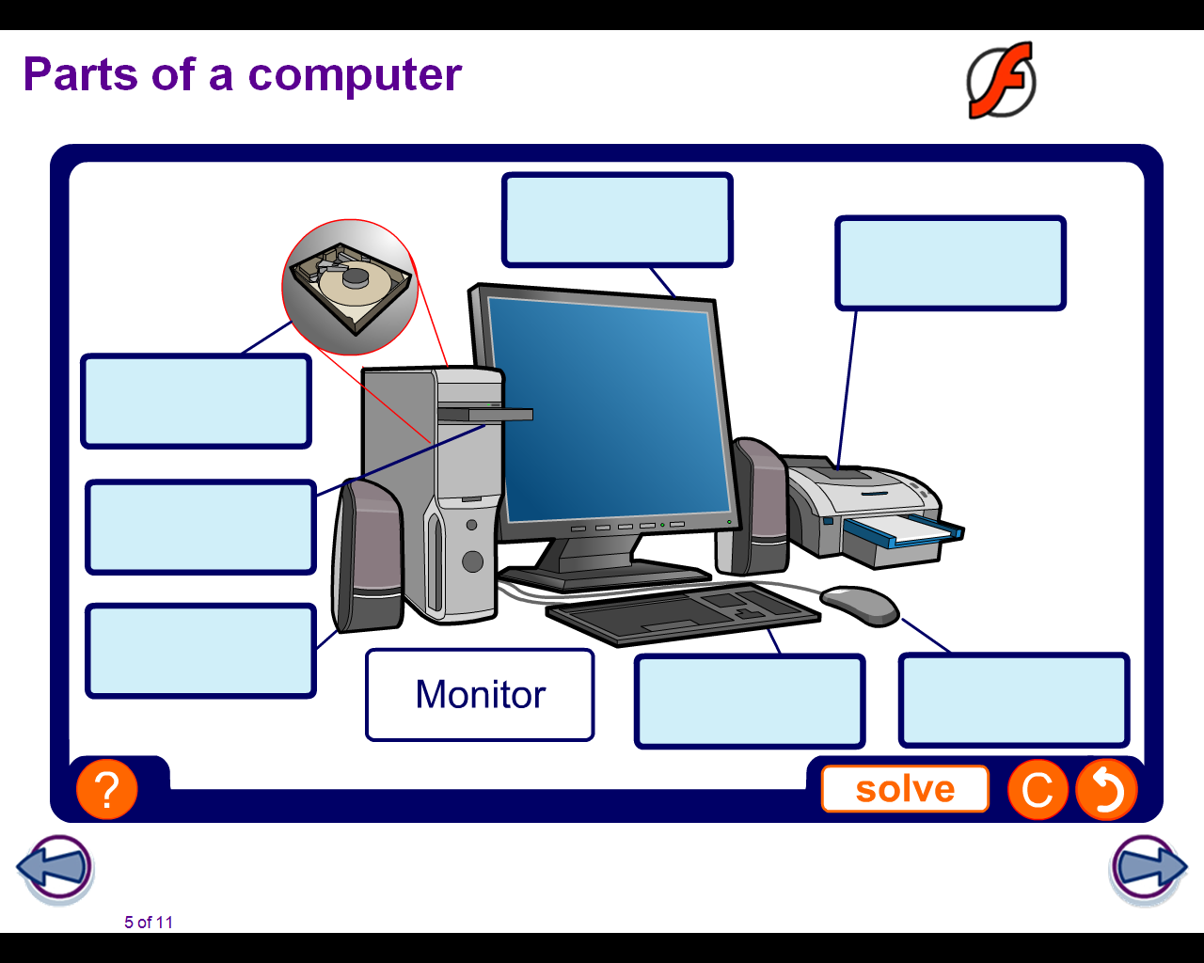
Name the following parts of a computer system:

Slide 4
A computer system is made up of two parts: Hardware and Software.
Hardware
These are the physical parts of the computer e.g printers, keyboard etc.
Software
These are the programs (sets of instructions) that are used to run the computer e.g.Word processor, spreadsheet, database, presentation software etc.

Slide 5
Parts of Hardware
Computer hardware is made up of three main parts, namely:
1. Input Devices
These are devices that are used to feed the computer with data for processing within. Examples include: Keyboard, mouse, scanners, digital cameras etc.
2. Output Devices
These are devices that are used to give out information (processed data) from the computer to the user. Examples include: Monitors, Plotters, speakers etc. The output could take any of the following forms:
  Soft copy-this is output that is shown on the screen.
  Hardcopy-this is information printed on paper e.g. from a plotter, printer.
  Machine readable form- this is output that can only be read using the computer e.g. information stored on disks.

Slide 6
3. Central Processing Unit (CPU)
This is the “brain” of the computer. It is where data is processed into information. The CPU contains the processor which comprises two parts: Arithmetic Logic Unit(ALU) and Control Unit(CU). However, there is a third part of the CPU, known as memory, though technically it can be considered as not being part of the CPU, since it is upgradeable.

Slide 7
Parts of the CPU.
As stated previously, the CPU is made up of three parts, namely:
Arithmetic Logic Unit
The work of the ALU is to perform mathematical functions as well as do comparisons between units of data presented to it.
Control Unit
The work of the CU is to take data from an input device, to the processor/memory, then to an output device.
Memory
The work of memory is to store data before, during and after processing.

Slide 8
Types of memory
Memory comes in three forms:
(a) Primary Memory.
It is also known as main memory or primary storage or RAM (Random Access Memory).
The work of this memory is to hold data, and processed information temporarily before it is saved onto hard disks, floppy etc. Therefore it only holds data at the time of processing only.

Slide 9
Characteristics of Primary Memory
1. This memory is volatile. This means that it depends on the supply of power to keep information. If power goes off, the contents of Ram also will disappear.
2. The user can read and write to this memory. This means that apart from reading what is there, you can also change, delete or manipulate the data in anyway you want. The user therefore has control over RAM.
3. Ram’s capacity is always small, that is why it has to be supported, or augmented with secondary memory like Hard disks.

Slide 10
(b)Read Only Memory.
Also simply known as ROM. This memory is used to store system programs (those programs which come already built into the computer) or simply firmware (programs that come hard wired in ROM).

Slide 11
Characteristics of ROM
It is not volatile. This means that whether power goes off, the contents of ROM will not disappear. They are held there permanently.
The user can only read the contents of ROM. He cannot delete, add or change anything stored in ROM.
Rom capacity, compared to that of RAM is smaller.

Slide 12
(c)Secondary Memory
This type of memory is sometimes known as backing storage, or auxiliary storage.
It is used to store processed information permanently for as long as the user wants to keep such information. The user can delete the contents of secondary memory and rewrite to it. Except in cases of CD’s which are recordable only (CD-R).

Slide 13
Divisions of Secondary Memory
Backing storage can be in the form of magnetic tapes or magnetic disks. The latter is mostly used because of its advantages over the former.
Examples of magnetic tapes include, Reel-to-reel tapes, audio cassette size tapes used for data storage.
Examples of magnetic disks include: hard disks, floppies, CD-R, CD-RW, flash disks, jazz disks, zip disks.

Slide 14
Parts of Computer Software
Computer software is made up of two main categories namely:
System Software
These are software that come already installed in your computer when you buy it. They are sometimes known as firmware. The following are the types of system software:
  Operating System
  These are sets of programs that take over the control of the usage of computer hardware and software. They are like the driver of a vehicle and the rest of the software installed are like the passengers! Without the OS, you cannot use the application programs such as ms-word etc.
  The operating systems are either single user or multi user systems.

Slide 15
(a) Single user systems
These are operating systems which can support only one user at a time. They cannot be used for simultaneous uses with more than one person at a time.
They are either DOS based or Windows based systems. Examples of DOS are Ms-Dos, PC-Dos and OS/2.Examples of windows are: WIN 95/98/2000/XP
(b) Multi-User Systems
These OS support more than one user at a time. They are used for networking computers for resource and information sharing.

Slide 16
ii. Translators
These are programs which convert human language instructions (Source code) into machine language (Object code) for the computer to understand.
They are mainly of two types:
  Compilers
  These translate a whole source program at once into object code. It is fast in translation, but only shows the errors after compilation. It is therefore not good at detecting errors.
  Interpreters
  These translate one line of source code to object code at a time. They are slow, but good at detecting errors.
iii DBMS- these are programs that are used to create, store and retrieve records from files.

Slide 17
(iv)Utilities- these are sometimes known as service programs. They include functions
such as copying disks, delete, formatting etc.
Application Programs
These are programs that the user purchases and installs in his computer. They are used to perform specific functions for the user.
They are divided into two types: General (Generic or off the shelf) and Tailor made (Specialized software or Bespoke).

Slide 18
Tailor made software
These are software that is specifically made for a particular purpose only.
They go by different names such as bespoke or specialized software.
Advantages of Custom Made Software
It is for a one off problem
It is used when there is no off the shelf software
Can be tailored to existing hardware
Will contain only desirable/useful routines
Disadvantages
Could contain many errors, takes long to perfect
It is costly to develop software
It is not immediately available and may take long to complete
Maintenance cost of such programs is very high
May not ultimately perform to expectations and may prompt several changes.

Slide 19
Generic Application Software
These are software which are purchased off the shelf by anyone. They can be used by anyone to do specific functions within their area.
Advantages of off-the shelf
Immediately available
The development costs are shared i.e. you don’t have to meet the cost of programming alone.
The program is fully tested and the bugs (errors) are eliminated.
Such programs are compatible with other software and do not create conflicts.
Training courses for such packages are available with well trained staff.
Disadvantages
May not contain all the routines wanted
Sometimes contains too many routines which are undesirable by the user.

Slide 20
There are many types under generic applications namely:
Word processors
These are programs that are used to process textual documents such as reports, letters etc.Examples are ms-word, word perfect, WordStar etc.
Spreadsheets
These are programs that are used to perform numerical computations such as additions, averaging etc.They are used to make projections or forecasting for the future. They are good at answering’ what if’ questions.
Examples are ms-excel, lotus 1-2-3, SuperCalc etc.
Databases
Also known as electronic filing cabinet. It is used to keep files, records in an orderly way. One can create files, forms, generate reports and also query the database.
Examples are: ms-access, DBASE, FoxPro etc.

Slide 21
Presentation
Used to create slides for presentation/demonstration purposes. Example is ms-PowerPoint.
Accounting
This package is used to perform all the functions of accounting within the computer. Examples of functions include, making of balance sheets, profit and loss accounts etc.Examples of such packages are: Sage, QuickBooks, and Ms-Money etc.
Desktop Publishers (DTP)
Programs used for designing purposes. Designs for magazines, birthday cards are done using DTP.Examples include: Adobe, Ms-Publisher, CorelDraw etc.
Webpage Design
Packages used for designing web sites. Examples are Dream weaver etc.
Programming
These are programs used to develop software. They are of different types. The general examples are: Pascal, Visual Basic etc.

