Slide 1
DTP- Desktop Publishing
Designing a publication
Notes:
Prepared By: Maurice Nyamoti

Slide 2
Launching Adobe PageMaker 7.0
Starting Adobe PageMaker with Windows 7
  Click the start button
  Select all programs
  Select Adobe folder
  Select PageMaker 7.0 folder
  Select ‘Adobe PageMaker 7.0’ executable file
Notes:
Prepared By: Maurice Nyamoti

Slide 3
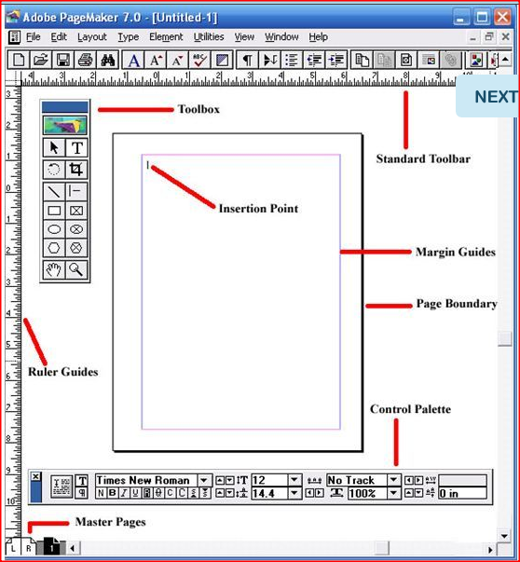
Launching Adobe PageMaker 7.0
PageMaker Screen Layout 1
Notes:
Prepared By: Maurice Nyamoti

Slide 4
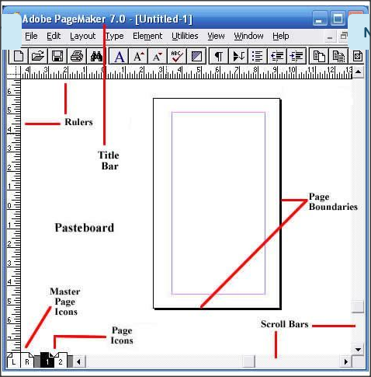
Launching Adobe PageMaker 7.0
PageMaker Screen Layout 2
Notes:
Prepared By: MK SOLUTIONS

Slide 5
The title bar
The title bar will display the name of your document. If you are working with a brand new document and have yet to name it, the title bar will simply read: Untitled-1.

Slide 6
Rulers
PageMaker provides two customizable rulers, which run horizontally and vertically along your screen. You can set the rulers to measure in either inches or picas (picas are a unit of measurement unique to typography. One pica is equivalent to 12 points, which is about 1/6 of an inch).

Slide 7
Pasteboard
This is the background that lies behind your PageMaker document. It is a handy element to use if you need to move text or images between pages. You can also place these items on the pasteboard until you decide where to position them on the page. Any text or images that you place on the pasteboard won't print.

Slide 8
Scroll Bars
Much like Word and other Microsoft programs, these are designed to enable you to move from one point to the other on the page you are working on. However, you won't use the scroll bars to move from one page to another.

Slide 9
Page Boundaries
These represent the edges of your paper. Any text or images that lie outside the boundaries or overlap them will not be printed.

Slide 10
Resize Box
This is located in the lower right-hand corner of the screen, and is used to adjust the size of the window. To resize the window, you will click and drag here to adjust the window to the size you desire.

Slide 11
Previous Size Box
Also called the "Refresh Box," this feature is in the upper right corner and is used to refresh your screen display. It is particularly useful if you are experimenting with different styles and sizes. Using this feature clears the screen of previous edits so you can start afresh.

Slide 12
The ToolBox
The Adobe PageMaker toolbox offers all the desktop publishing tools you need to design brochures, postcards, business cards, letterheads, or other publications in PageMaker. To display and access the Toolbox, click on the "Window" menu and click on "Tools." The toolbox will now be displayed. You can toggle between a visible and hidden toolbox as needed to maximize your workspace.

Slide 13
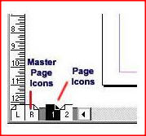
Launching Adobe PageMaker 7.0
PageMaker Screen Layout 3
The numbered page icons at the bottom left-hand corner of your screen each represent the pages of the document you are working on. The icon of the particular page that you are viewing will be highlighted.
The L and R icons in the extreme left represent your master pages. Any items on the master pages appear on all of the document's pages.
Page Icons
Page Icons
Notes:
Prepared By: Maurice Nyamoti

Slide 14
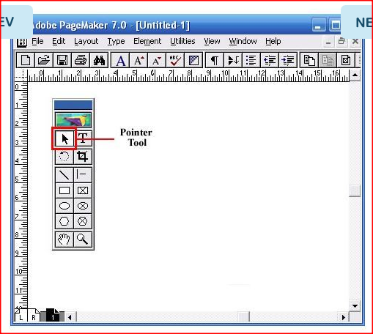
Launching Adobe PageMaker 7.0
PageMaker Screen Layout 4
The Pointer tool enables you to pick, drag and drop text boxes, images and other objects, which can then be resized, moved or can have their attributes changed.
The Pointer Tool
The Pointer Tool
Notes:
Prepared By: Maurice Nyamoti

Slide 15
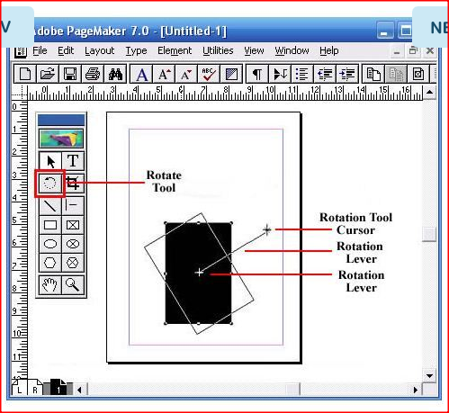
Launching Adobe PageMaker 7.0
PageMaker Screen Layout 5
The rotate tool enables you to rotate a text box or image to a desired angle. Select the rotate tool, and click on the object's reference point. Drag the object to the angle you want it to be.
Rotate Tool
Rotate Tool
Notes:
Prepared By: Maurice Nyamoti

Slide 16
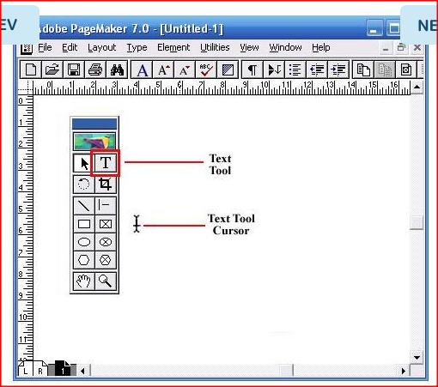
Launching Adobe PageMaker 7.0
PageMaker Screen Layout 6
The Text tool enables you to select and edit text, as well as insert text boxes. Click the text tool and then click on the document and start typing in text.
Text tool
Text tool
Notes:
Prepared By: Maurice Nyamoti

Slide 17
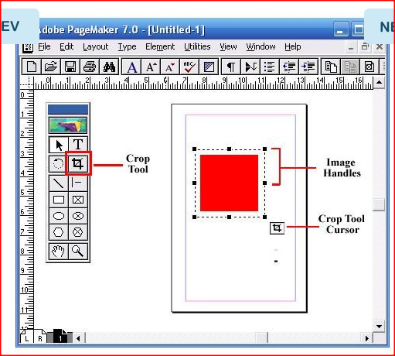
Launching Adobe PageMaker 7.0
PageMaker Screen Layout 7
Enables you to crop imported images down to size. You can only use this Pagemaker tool on .tiff images.
Crop Tool
Crop Tool
Notes:
Prepared By: Maurice Nyamoti

Slide 18
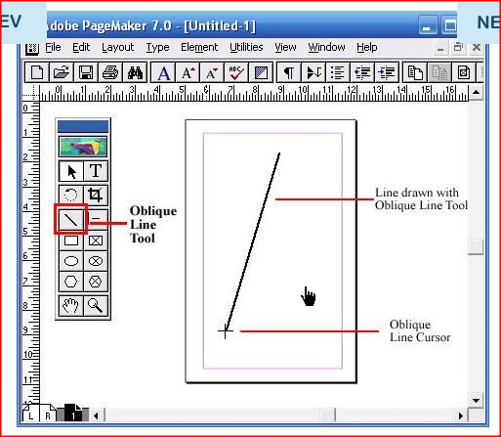
Launching Adobe PageMaker 7.0
PageMaker Screen Layout 8
Enables you to draw straight lines at an angle. Click on the oblique line tool, then click on the document. Drag in the desired direction to draw a line.
Oblique Line Tool
Oblique Line Tool
Notes:
Prepared By: Maurice Nyamoti

Slide 19
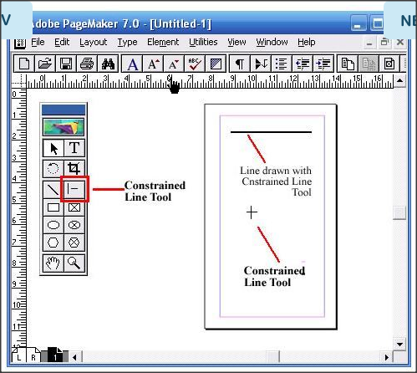
Launching Adobe PageMaker 7.0
PageMaker Screen Layout 9
The constrained line tool enables you to draw horizontal, vertical and 45-degree angle lines. Click on the constrained line tool, then click on the document. Drag in the desired direction to draw a line.
Constrained Line
Constrained Line
Notes:
Prepared By: Maurice Nyamoti

Slide 20
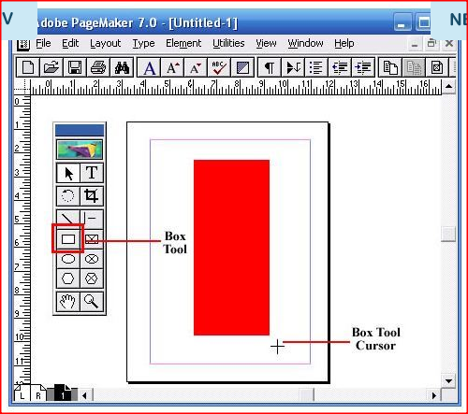
Launching Adobe PageMaker 7.0
PageMaker Screen Layout 10
The box tool enables you to create rectangular shapes. Select the box tool and click on the document. Drag to create a rectangular shape.
Box Tool
Box Tool
Notes:
Prepared By: Maurice Nyamoti

Slide 21
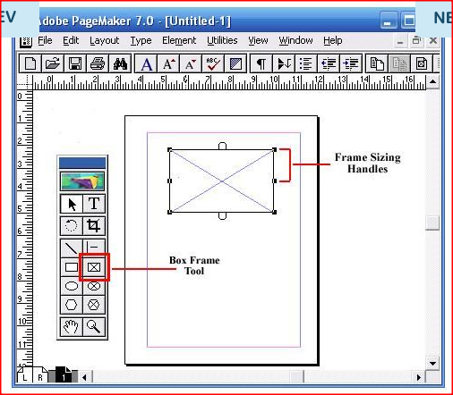
Launching Adobe PageMaker 7.0
PageMaker Screen Layout 11
The rectangle frame tool enables you to create a rectangular text box that you can type your text into. Select the rectangle frame tool, then click on the document. Drag to draw a rectangular frame. Select the Text tool from the toolbox and click inside the frame. Type in your text. The text will be confined within the text box.
Rectangle Frame Tool
Rectangle Frame Tool
Notes:
Prepared By: Maurice Nyamoti

Slide 22
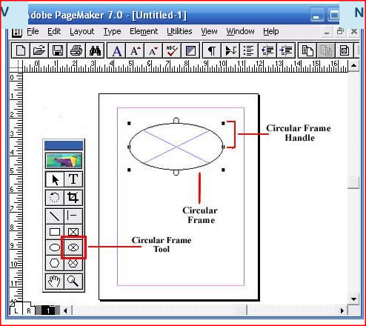
Launching Adobe PageMaker 7.0
PageMaker Screen Layout 12
The circular frame tool enables you to create a circular or oval-shaped text box that you can type your text into. Select the circular frame tool, then click on the document. Drag to draw the circular frame. Select the text tool from the toolbox and click inside the frame. Type in your text. The text will be confined within the text box.
circular frame tool
circular frame tool
Notes:
Prepared By: Maurice Nyamoti

Slide 23
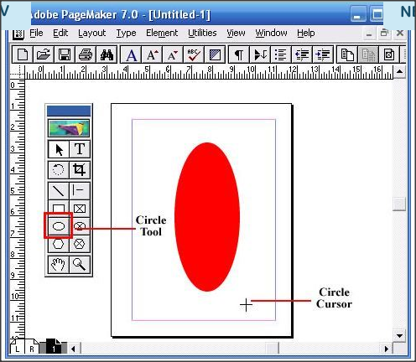
Launching Adobe PageMaker 7.0
PageMaker Screen Layout 13
The circle tool enables you to create a circular or oval shape. Select the circle tool, click on the document. Drag to draw a circle or ellipse.
Circle Tool
Circle Tool
Notes:
Prepared By: Maurice Nyamoti

Slide 24
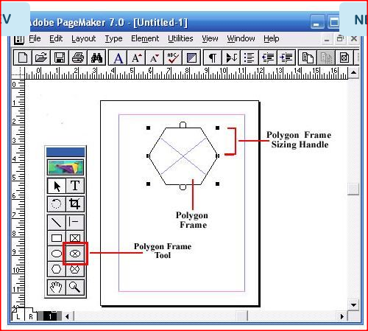
Launching Adobe PageMaker 7.0
PageMaker Screen Layout 14
The polygon frame tool enables you to create a polygonal text box. Select the polygon frame tool, then click on the document. Drag to draw the polygon frame. Select the text tool from the toolbox and click inside the frame. Type in your text. The text will be confined within the text box.
polygon frame tool
polygon frame tool
Notes:
Prepared By: Maurice Nyamoti

Slide 25
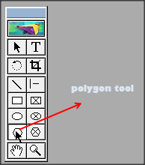
Launching Adobe PageMaker 7.0
PageMaker Screen Layout 14
The polygon tool enables you to create a shape that has more than four sides. Select the circular frame tool, then click on the document. Drag to draw the polygonal shape. To modify the polygonal shape, click on Element and then select Polygon Settings from the drop down menu.
polygon tool
Polygon tool
Notes:
Prepared By: Maurice Nyamoti

Slide 26
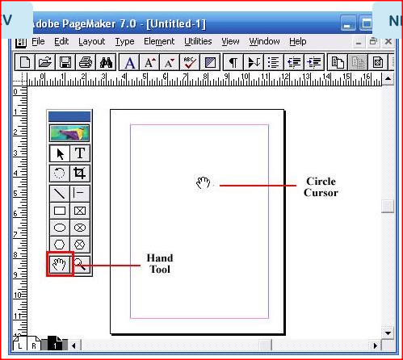
Launching Adobe PageMaker 7.0
PageMaker Screen Layout 15
The hand tool enables you to reposition a page on your screen for optimal view. It is especially useful when you are working with a large document and need to navigate a large page. Select the hand tool and click on the page. Drag to navigate from one part of the page to another.
The Hand Tool
The Hand Tool
Notes:
Prepared By: Maurice Nyamoti

Slide 27
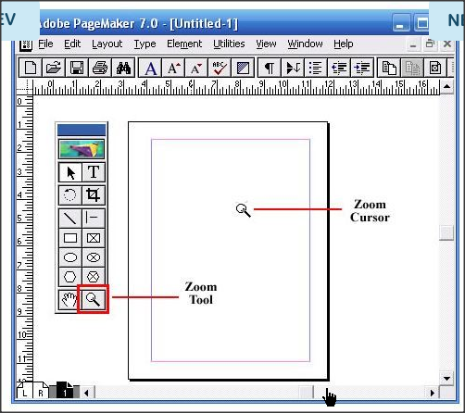
Launching Adobe PageMaker 7.0
PageMaker Screen Layout 16
The zoom tool enables you to magnify or shrink the area of the page on your screen.
zoom tool
zoom tool
Notes:
Prepared By: Maurice Nyamoti

Slide 28
Creating a new document
There are two ways of creating a new document namely.
  Use a built-in PageMaker template
  Use the Document Setup dialog box
/*In our tutorial, we will focus mostly on the use of the document setup dialog box*/
Notes:
Prepared By: Maurice Nyamoti

Slide 29
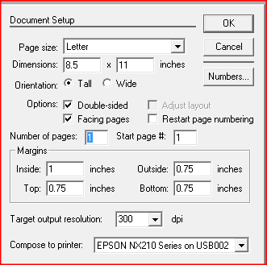
Creating a new document
Using the Document Setup dialog box
From file menu of an open Adobe PageMaker 7.0 window click new –a document dialog box will appear.
Notes:
Prepared By: Maurice Nyamoti

Slide 30
Creating a new document
Using the Document Setup Dialog Box
The Document Setup dialog box enables you to customize your document design. It provides a range of options that you can use to select your page size, specify the document's orientation, print a double-sided document, rotate your document, enlarge or reduce your printout, as well as adjusting the printable area.
Notes:
Prepared By: Maurice Nyamoti

Slide 31
Creating a new document
Setting Page Size
PageMaker provides a number of standard page sizes that you can choose from. You can customize a standard page size to fit your needs under Dimensions.
Notes:
Prepared By: Maurice Nyamoti

Slide 32
Creating a new document
Setting Page Dimensions
The default page dimensions differ based on the Page Size that you select. For example, the default for a Letter size paper is are 8.5"x11" while the default for an A4 size paper is 8.268"x 11.693"You can, however, adjust the dimensions of your selected paper size by typing in new values into the two page dimension boxes.
Notes:
Prepared By: Maurice Nyamoti

Slide 33
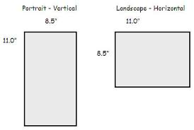
Creating a new document
Page Orientation
Select your page orientation to be Tall- for portrait or Wide –for landscape.
Notes:
Prepared By: Maurice Nyamoti

Slide 34
Creating a new document
Selecting Options For Single and Multiple Pages
Your selections in the Options section will determine how PageMaker will handle a document that has multiple pages.
Single-sided
Select this option by un-checking the Double-sided box. The single-sided option creates a publication that will print on only one side of each page. Only one master page will be created.
Notes:
Prepared By: Maurice Nyamoti

Slide 35
Creating a new document
Selecting Options For Single and Multiple Pages
Double-sided
Select this option for a publication that will print on both sides of each page. The pages will still be displayed one at a time on your screen. However, two master pages will be created.
Facing Pages
Select this option to display two pages at a time on your screen (all except page 1, which is typically displayed alone). This is the appropriate option if you are working on a booklet or magazine, which will have their pages set up to face each other, much like a book's. You cannot have facing pages unless they are double sided.
Notes:
Prepared By: Maurice Nyamoti

Slide 36
Creating a new document
Selecting Options For Single and Multiple Pages
Adjust Layout
Select this option if you want to change your document's properties after it has been created. The Adjust Layout option forces PageMaker to re-arrange your document to fit new settings.
Notes:
Prepared By: Maurice Nyamoti

Slide 37
Creating a new document
Number of Pages
Use this option to change the total number of pages that you want to have in your document. Type the desired number into the Number of pages textbox. Change the number of pages by typing the appropriate number in the Number of pages text box.
Notes:
Prepared By: Maurice Nyamoti

Slide 38
Creating a new document
Restart page numbering
PageMaker will, by default, begin all numbered pages from page 1. Select the "Restart page numbering" option if you are working with numbered pages, and want your document to start with a page number other than 1. Check the Restart page numbering and then type the desired starting number into the Start page# text box.
Notes:
Prepared By: Maurice Nyamoti

Slide 39
Creating a new document
Setting Your Margins
Select the margins for your document in this section. A margin refers to the space between your text or image and the edge of your page. Margins are defined as Inside and Outside, or Right and Left.
*When you set up your document for double-sided printing, your margins will be defined as Inside and Outside. The Inside margin is in the inner side of the page, where the document binding will be.
*When you set up your document for single-sided printing, your margins will be defined as Right and Left.
Notes:
Prepared By: Maurice Nyamoti

Slide 40
Creating a new document
Other Document Options
Target Output Resolution
Use this section to select the resolution for your final document. If you intend to print your document, select the default resolution of 300 dpi.
Compose to Printer
Use this section to specify the printer that you will use to print the document. If your computer is part of a network that has more than one printer, use the drop-down box to select the particular one you want to print to. PageMaker uses your selection to determine the available fonts, printable area and other settings.
Numbers
Click on the Numbers button to select the style of page numbers for your document. Click on OK to save your selection.
Notes:
Prepared By: Maurice Nyamoti

Slide 41
Creating a new document
Saving Your Documents
PageMaker gives you two options for saving your documents:
Use the Save command
  To save a new document
  To save any modifications that you make to an existing document
Use the Save As command
  To re-name an existing file
  To save as a template
  To save in a PageMaker 6.5 format
  To compact a large file
Notes:
Prepared By: Maurice Nyamoti

Slide 42
Creating a new document
Saving Your Documents
How to Use the "Save" Command
Use the Save command to save a new document as well as any additional changes you make to a document that you have previously saved. Here's how to save your document using this command:
  Click on File and then select Save from the drop-down menu. Clicking this option will open the Save Publication dialog box.
  Use the Save in drop-down list and the navigation window to navigate to the folder where you want to save your document.
  In the File name text box, type in the name of your file. For a new document, this replaces the document's default name from Untitled.
  In the Save as type drop-down list, select the desired file type: Publication, Template or A copy in 6.5 format.
  When you are done, click the SAVE button. PageMaker will save all modifications you have made since the last save.
Notes:
Prepared By: Maurice Nyamoti

Slide 43
Creating a new document
Saving Your Documents
How to Use the "Save As..." Command
Re-naming an Existing File
  When you use the Save As command to re-name an existing file, PageMaker saves a copy of the document under the new name, leaving the original-titled file unchanged from the last time it was saved. The new file name will now appear in the title bar, and any further modifications will be saved to the new file.
Saving as a Template
  You can save the formatting in a particular document by saving it as a template. This template can then be used in subsequent documents, and this saves you time by not having to format all over again.
Notes:
Prepared By: Maurice Nyamoti

Slide 44
Creating a new document
Saving Your Documents
How to Use the "Save As..." Command
Saving in a PageMaker 6.5 format
  Saving your document in the earlier 6.5 formats makes it possible to share your documents with users who don't have Adobe PageMaker 7.0
Compacting a Large File
  If you have a large document that is hogging disk space, you can use the Save As command to compact it to take up much less disc space.
    Open the File menu and select the Save As option
    Do not change the file name. Click on the Save button
    Click Yes when prompted whether you want to replace the existing file.
    Once you click Yes, PageMaker will reorganize and save the file to take up less disc space on your drive.
Notes:
Prepared By: Maurice Nyamoti

Slide 45
Practical Test –Group Work
Using Adobe PageMaker, design a facing pages, A3, Tall with 4 pages school magazine that has following details
  Give it an attractive and appropriate title that you borrow from the name of your school (page 1)
  The magazine should have the following headings: (Use columns to separate sections)
    Heading of breaking news (page 1)
    Academic news (page 1 & 2)
    Administrative news (page 2)
    Teacher’s news (page 2 & 3)
    student’s welfare (page 3 & 4)
    Sports News (page 4)
  Fill each heading with relevant information
  Print and bind it using your school’s facilities (25 mks)

