Slide 1

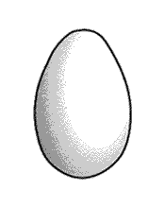
Who's Hatching?
?
By Alison Friend

Slide 2
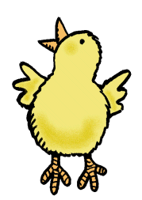
Hi, I am Peep. I am inside this egg. I want to come out and meet you. Please help me hatch from my egg. Follow the Table of Contents to learn everything you need to know about hatching an egg.
TABLE OF CONTENTS
KWL
Needs
Incubator
Temperature
  Comparing Temperatures
  Graphing Temperature
How Many Days
Inside an Egg
  Diagram
  Candling an Egg
Sequencing
Hatching an Egg Experiment
Hatching Video
Calendar Countdown
Caring for a Baby Chick
Cycle of an Egg
Standards

Slide 3

How do you hatch an egg?

Slide 4
What do I need?
Help me hatch!
Warmth
Water
Incubator
Caretaker

Slide 5
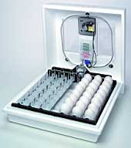
How will I stay warm?
An incubator is a way to keep me warm. I can stay there with all my brothers and sisters.

Slide 6
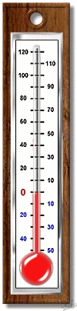
Is the temperature right for me?
You will need a thermometer to make sure the temperature is just right for me. I like it to be between 99º-101º. Make sure warm air does not escape the incubator. Click on the thermometer and use this recording sheet to compare temperatures.

Slide 7
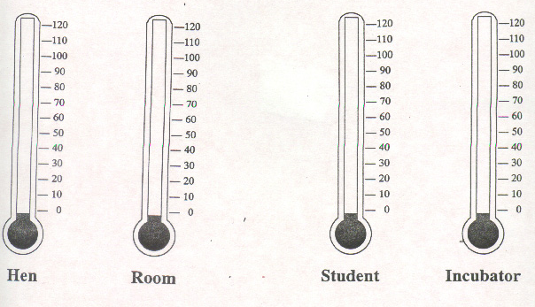

Comparing Temperatures Recording Sheet

Slide 8
What is the temperature?
Every Friday read and graph the temperature in the incubator and in the room.

Slide 9
How many days will it take us to hatch?
Egg Number | Predict how many days it will take us to hatch…
One (ME!)
Two
Three
Four
Five
Six
Seven

Slide 10
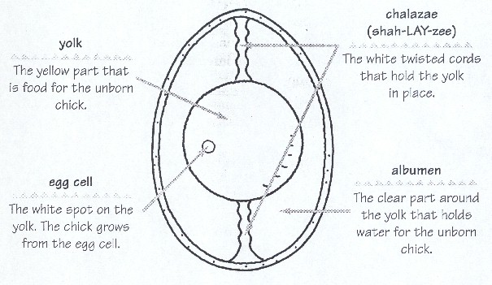

What does my egg look like?
Chalazae
Yolk
Albumen
Egg Cell
Air Sac
CLICK the egg to learn more.
Then click the labels for more information.

Slide 11
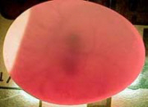
How do you candle my egg?
Here I am! Click on me!
Candling an Egg
You will need:
A dark room
A flashlight
ME!
Carefully take me out of the incubator.
Hold my egg up to the light.
What do you see?
This is my air sac.

Slide 12
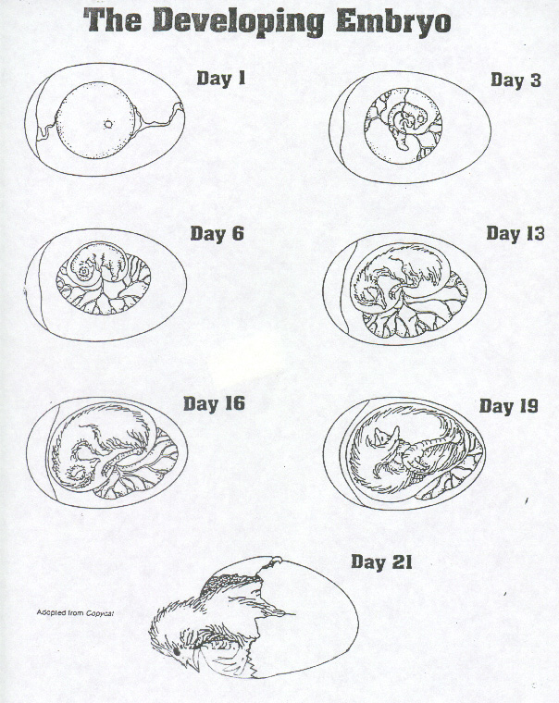

What do you see?

Slide 13
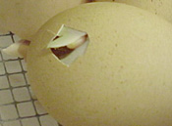
Can you crack an egg?
Materials: opened paper clip, recording sheet, pencil, raw egg, paper plate, timer and paper towels.
Directions: You will use a raw egg and the tip of an opened paper clip to find out how many pecks it takes to crack the shell and how long it takes. Make a prediction first! Have a partner keep count for you.
TASK |  | Prediction | Actual
How many pecks?
How long did it take?
 | Here’s how I peck through my shell. What connections did you make? What do you think about my tough job?

Slide 14
How does a chick hatch?
What do you see?
Click on the egg to watch a video.

Slide 15
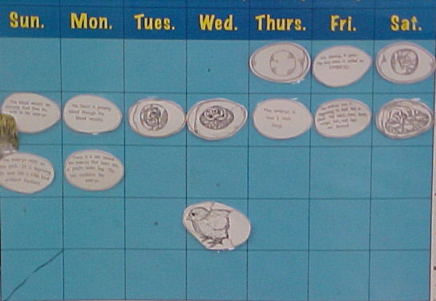
How many days are left?
Make sure to keep a count of how many days are left until I hatch.

Slide 16
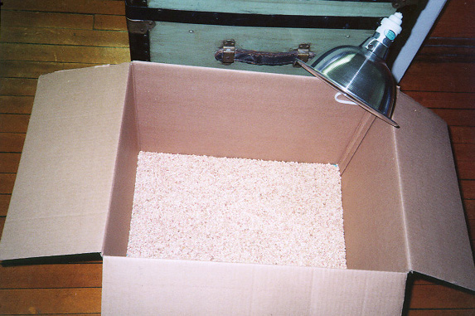
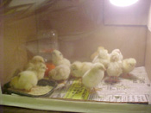

Are you my mother?
Once I am born and dry, I will need a brooder. A brooder is a warm home for me. What else will I need?
MOMMY!
A cardboard box makes a great brooder!

Slide 17
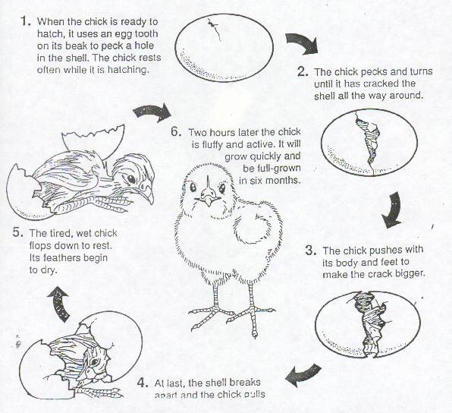
Can you put it in order?
?
?
?
Click on me to check!
?
?
?

Slide 18
How did you do?
1
2
6
5
3
4

Slide 19

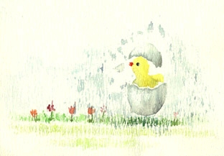
When were we born?
Now that we are born your class will need to make birth announcements.
We are egg-cited to announce the birth of our baby chick!
Name _____________________
Birth Date ________
Time of Birth ________
Weight ________
Height ________
Proud parents in Mrs. Friend’s Class!

Slide 20


You did it!
Click here for a special treat.

Slide 21
Standards
S.1.1.1 Inquiry: Methods/Scientific/Use
The learner will be able to ask questions, make predictions, record observations, and communicate with others.
S.1.1.2 Investigations: Conducting
The learner will be able to engage in learning process via hands-on/minds-on science activities and experiences.
S.1.5.1 Animals: Compare/Contrast
The learner will be able to compare and describe different animals such as tadpoles, caterpillars, puppies, chicks, snakes, and opossums in the ways they look, grow, and move using sorting activities with pictures or models.
M.1.2.1 Graphs: Create/Basic/Physical
The learner will be able to construct simple graphs using concrete objects or representations of objects such as blocks, counters, or pictures.
M.1.3.1 Tools: Use/Determine Measures
The learner will be able to use a variety of tools to measure, standard (ruler, balance, clock, thermometer) and non-standard (cubes, pencil lengths, shoes, blocks).
M.1.3.2 Length: Measure/Compare
The learner will be able to compare, order, and measure length using inches or centimeters
M.1.3.4 Tools: Choose/Suitable
The learner will be able to select appropriate tool for determining the specified measurement of height, weight, capacity, and temperature.
M.1.3.6 Time: Units/Select
The learner will be able to select appropriate units (minutes, hours, days, weeks, months) and appropriate tools (clocks/watch, calendar, sun/moon) for determining a specified time.
Links to websites used in this PowerPoint
http://www.ikeepbookmarks.com/browse.asp?folder=1346126

