Slide 1
Unit
Animal Science

Slide 2
Problem Area
Growth and Development of Animals

Slide 3
Lesson
Hatching and Brooding Chicks

Slide 4
Student Learning Objectives
1. Describe the embryonic development of a chicken.
2. Discuss factors affecting hatchability of eggs.
3. Describe the ideal environment for incubating eggs artificially.
4. Prepare eggs for hatching and care for young birds during brooding.

Slide 5
Terms
Allantois
Amnion
Brooding
Chorion
Egg candler
Fertility
Gastrulation
Hatchability
Hatcher
Setter

Slide 6
What are the various stages in the embryonic development of a chicken?
A. The blastoderm spreads over the yolk.
  1. The blastoderm differentiates into two layers, known as the ectoderm and entoderm, by a process known as gastrulation.
  2. The ectoderm, forming first, creates the skin, feathers, beak, claws, nervous system, eye lens and retina, and linings of both mouth and vent.
  3. The entoderm, forming second, creates the linings of the digestive tract, as well as the respiratory and secretory organs.
  4. A third layer, the mesoderm, finally gives rise to bones, muscles, blood, and reproductive and excretory organs.

Slide 7
B. Membranes cover the developing embryo for protection and aid in development.
  1. The chorion is a membrane that surrounds the yolk sac and amnion during chick development.
  2. A transparent sac, known as the amnion, is full of colorless liquid that surrounds the embryo. The amnion serves as a cushion and provides protection for the developing embryo.
  3. The allantois is a sac connected to the abdomen of the developing chick that makes respiration possible it stores excretions, absorbs albumen for food, and gets calcium from the shell for the structural needs of the embryo.

Slide 8

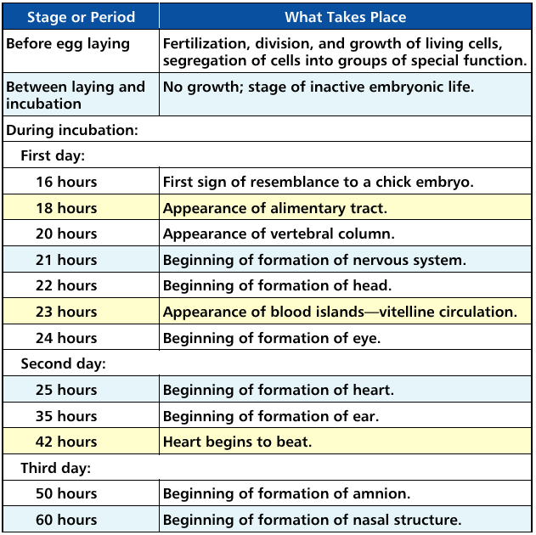

Slide 9
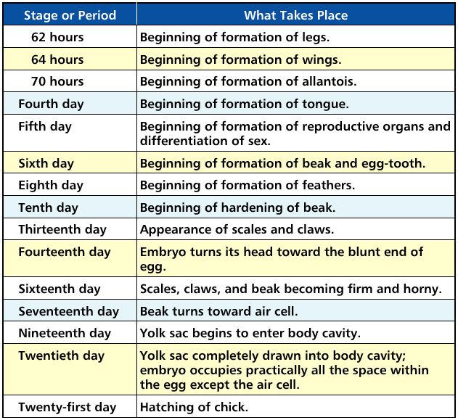

Slide 10
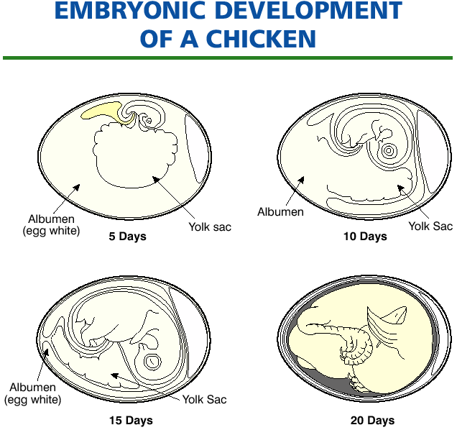

Slide 11
What factors will affect the hatchability of eggs?
Hatchability refers to the percentage of fertilized eggs that hatch.
A. Factors that affect hatchability include:
  1. Fertility, the capacity to reproduce, is affected by:
    a. number of females mated to a single male.
    b. age of breeding animals.
    c. length of time between breedings.
    d. management practices.

Slide 12
  2. Genetics, or genetic makeup of the bird, is affected by:
    a. inbreeding
    b. crossbreeding
    c. lethal genes
    d. heritable traits (ex. egg production)
  3. Nutrients, available to the developing chick, are affected by:
    a. rations fed to breeding hens.
    b. amount of vitamins and minerals in hen rations.

Slide 13
  4. Diseases of breeding stock.
  5. Egg Selection. Certain physical characteristics can affect hatchability.
    a. Size. Extremely large or small eggs do not hatch well.
    b. Shape. Unnaturally shaped eggs do not hatch well.
    c. Shell quality. Strong shells hatch better than weak shells.
    d. Interior quality. Upon candling, better interior quality eggs tend to hatch better.

Slide 14
  6. Handling of fertilized eggs. Good management practices include:
    a. Gathering eggs frequently.
    b. Clean soiled eggs.
    c. Sanitizing eggs.
    d. Hold, or prolong start of incubation, for a minimum amount of time.
    e. Hold eggs at a temperature of 65 degrees F.
    f. Keep eggs at a relative humidity of 75 to 80%.
    g. Position eggs with large end up.
    h. Turn eggs if they are held for more than 7 days.

Slide 15
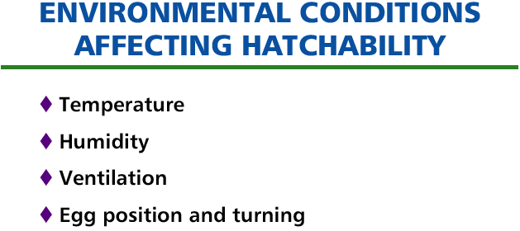

Slide 16
What is the ideal environment for incubating eggs artificially?
A. Temperature. Optimum temperature for hatching chickens is between 99 and 100 degrees F.
B. Humidity. Eggs lose moisture during development and low humidity causes an increased loss. High humidity can prevent the correct evaporation of water. Humidity levels should be around 60% for the first 18 days, followed by 70% for the remaining days.

Slide 17
C. Ventilation. Proper circulation is critical to assure a fresh supply of oxygen and removal of carbon dioxide.
D. Position and turning of eggs. The head of the chick must face the large end of the egg for proper hatching. Eggs should be incubated large end up, and turned three to five times daily to prevent the developing embryo from attaching to the shell membrane.

Slide 18
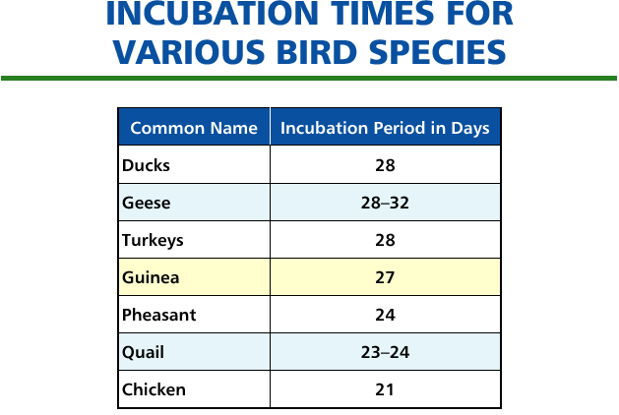

Slide 19
How do we prepare eggs for hatching and care for young birds during brooding?
Fertility of eggs can be determined by a process known as candling.
A. Eggs held up to an egg candler, a device for shining a light beam into an egg. Eggs will look different depending on fertilization or lack of fertizilation. Fertile eggs will appear darker as the developing embryo begins to form. Infertile eggs can be detected after 15 to 18 hours of incubation. A second fertility test can be made 14 to 16 days after incubation.
B. A 75 watt bulb is recommended for use in an egg candler.

Slide 20
C. In commercial hatcheries, two separate incubators are used for hatching.
  1. Incubation of the chick from day 1 through day 19 is done in an incubator known as the setter. The setter has the environmental conditions discussed earlier.
  2. Days 19 through 21 are usually spent in an incubator known as the hatcher. The hatchers have slightly lower temperatures (98 degrees) and have chick holding trays that cut down on the debris from hatching eggs that may cause disturbances to other eggs.
  3. Incubation times depend on the species of bird being hatched.

Slide 21
D. Brooding refers to the care of young poultry from the time of hatching through eight to ten weeks of age.
  1. Certain environmental conditions are needed for proper brooding.
    a. Temperature—When chicks are one day old, the temperature should be between 90 and 95 degrees F. The temperature is generally lowered five degrees per week until a temperature of 70 to 75 degrees is reached, or until the chicks are fully feathered.
    b. Ventilation—Proper ventilation provides fresh oxygen, removes carbon dioxide, carbon monoxide, ammonia, and keeps bedding dry.
    c. Moisture—50 to 60% relative humidity is recommended for good feathering.
    d. Space requirements—Each chick needs 7 to 10 inches of space under the brooder. More brooder space may be required during colder weather.

Slide 22
Review/Summary
What are the various stages in the embryonic development of a chicken?
What factors will affect the hatchability of eggs?
What is the ideal environment for incubating eggs artificially?
How do we prepare eggs for hatching and care for young birds during brooding?

