Slide 1
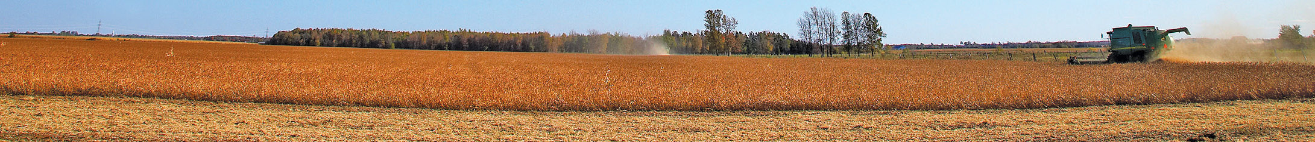

FARM ENERGY
Tractor Maintenance
to Conserve Energy
Farm Energy PM 2089L
Notes:
Today we would like to share some information about on-farm energy efficiency. “Tractor maintenance to conserve energy” (PM 2089L) is available from the ISU Farm Energy Conservation & Efficiency Initiative. This project is brought to you by ISU Extension and sponsored by the Iowa Energy Center. Google us or find us on Twitter at “ISU Farm Energy.” [A friendly reminder to presenters: Please remember to properly attribute this and other content published by Iowa State University Extension.]

Slide 2
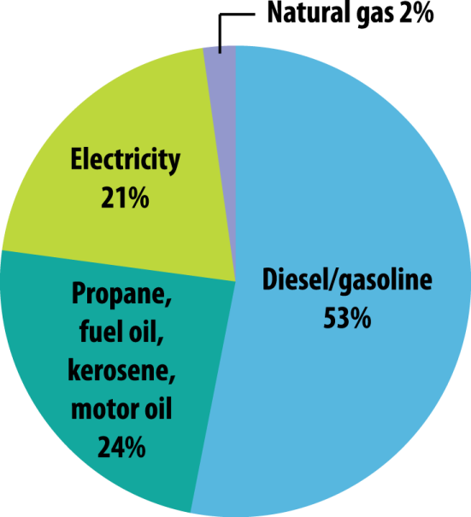
FARM ENERGY
(USDA Census of
Agriculture, 2007)
PM 2089L
Notes:
Conserving fuel with a few simple management techniques can help your bottom line, especially when fuel prices are high. Data from the USDA Census of Agriculture shows the distribution of annual energy costs for Iowa producers. As you can see, diesel and gasoline represent the largest direct energy purchase for Iowa farms each year (fertilizer is considered an indirect energy expense).

Slide 3
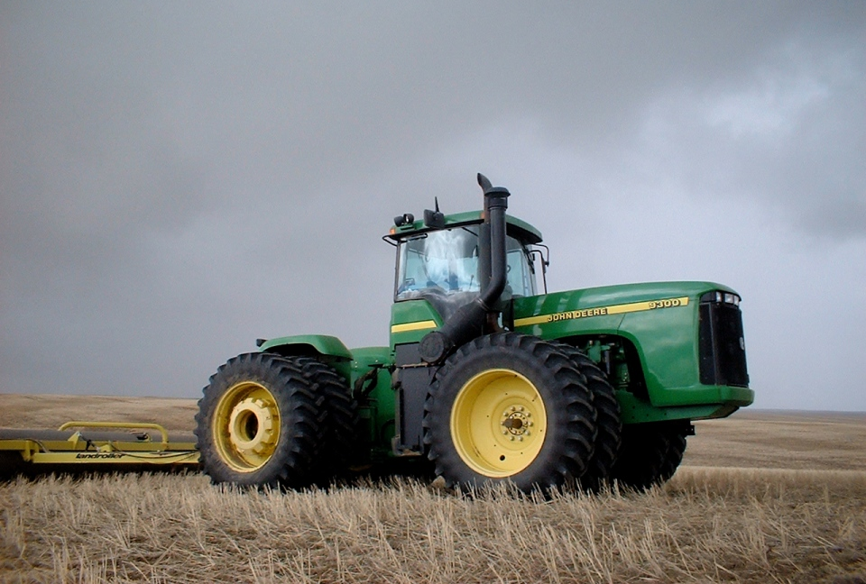
FARM ENERGY
PM 2089L
Notes:
Machinery represents a significant portion of capital costs in many farming operations. A well-kept fleet of machinery improves the ability to respond to changing weather, field conditions and seasonal needs. Replacing engine fuel and air filters at consistent intervals improves fuel savings.

Slide 4
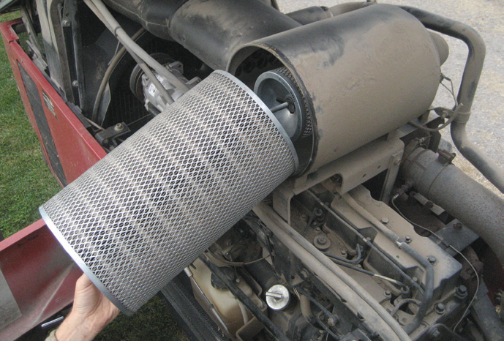
FARM ENERGY
PM 2089L
Notes:
Fuel efficiency and engine power are directly affected by the combustion of fuel and air inside the tractor’s engine. Filters, usually both primary and secondary, protect the engine by collecting small particles and impurities. Filters must be replaced periodically as restricted flow begins to reduce combustion efficiency and fuel efficiency.

Slide 5
FARM ENERGY
PM 2089L
Notes:
In a previous study by Missouri ag engineers, tractor horsepower was tested on 99 tractors before and after changing the fuel and air filters. After clean filters were installed, the tractors delivered an average of 3.5% more engine power. The operator can thereby reduce the throttle setting and burn less fuel while harnessing the same power output from the engine.

Slide 6
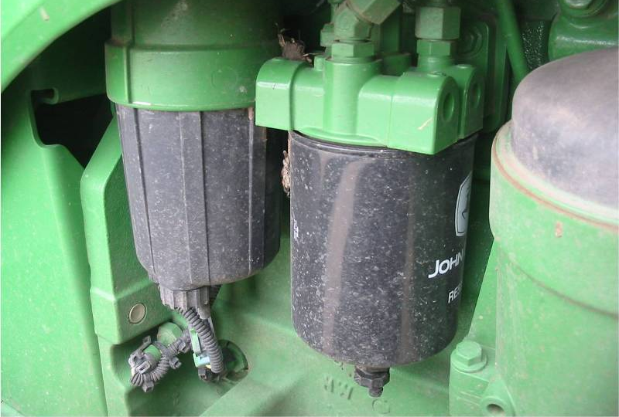
FARM ENERGY
PM 2089L
Notes:
Consistent filter replacement maintains the tractor’s power output, which is noteworthy since a new tractor currently costs
approximately $700 per horsepower depending on its size and options. Making an additional 3.5% of power available on a 200 hp tractor is equivalent to adding 7 hp—a value of nearly $5000 when considering the initial cost of a new replacement tractor.

Slide 7
FARM ENERGY
Tractor idling time:
Assume 200 hp for the idling tractor
Idle fuel use (from tractor test) = 3.67 gal/hr
  Idling for an extra 10 minutes = 0.61 gal or
  $2.44 @ $4/gal
  50 “long” idles per year = $125/year
Notes:
Regarding day-to-day use, letting a diesel tractor engine idle for a few minutes following hard work allows circulation of cooling oil. However, modern diesel engines cool quickly without excessive idling time. Check the operator’s manual: newer tractors may require 3–5 minutes of idling or less. Ten minutes of excess idling consumes a half gallon of fuel or more on large tractors!

Slide 8
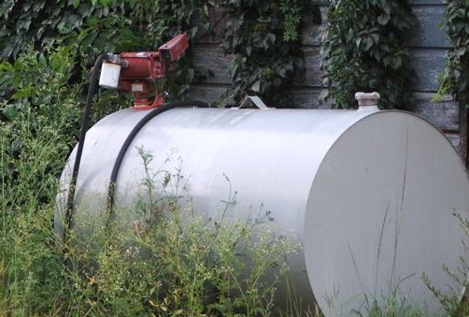
FARM ENERGY
PM 2089L
Notes:
To reduce evaporation losses, store farm fuel in white or aluminum-colored above-ground fuel storage tanks unless another color is required by local fire code. Shade or paint that reflects solar radiation also reduces evaporation. Use a vacuum and pressure-relief valve on large fuel supply tanks to reduce evaporation loss due to pressure changes inside the tank.

Slide 9
FARM ENERGY
Summary:
  Save 3 – 4% fuel with consistent fuel and air filter replacement.
  Observe engine temperature and air filter/pressure indicators during operation for any significant changes that may affect fuel economy.
  Avoid excessive idling to cool the engine.
  Use timers with engine block heaters to save electricity.
  Shade and/or paint fuel storage tanks to reduce fuel losses due to evaporation.
PM 2089L

Slide 10
FARM ENERGY
For More Information:
  Google “ISU farm energy” or visit us online at
  http://farmenergy.exnet.iastate.edu
  Download ISU Farm Energy publications at no charge
  Follow us on Twitter @ISU_Farm_Energy for updates
  Ask your local utility provider to contact us!
http://farmenergy.exnet.iastate.edu

Slide 11
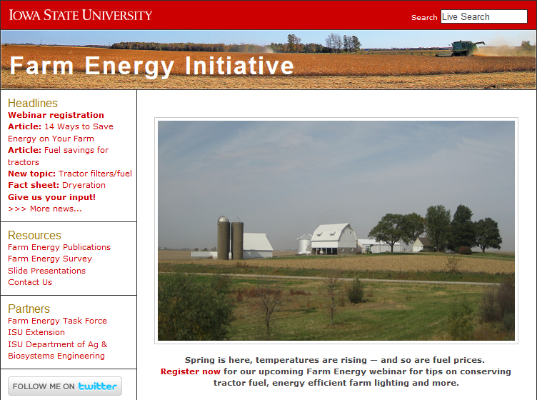
FARM ENERGY
http://farmenergy.exnet.iastate.edu

