Slide 1
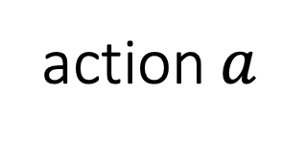
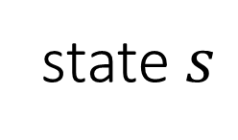

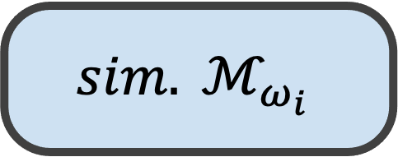
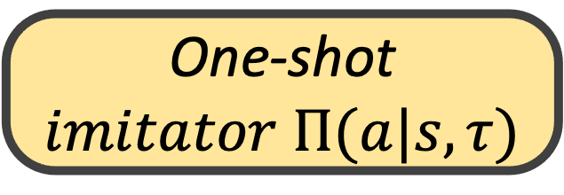
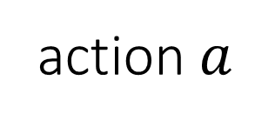
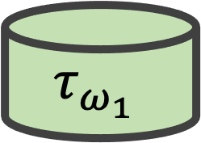
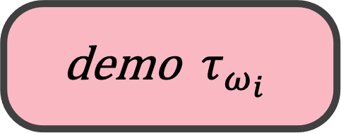
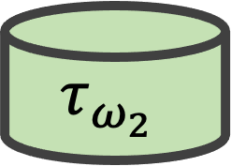
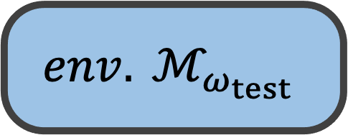
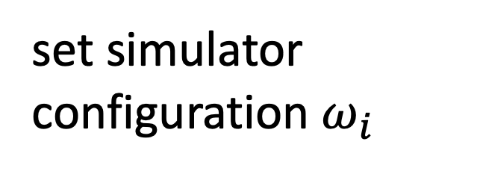
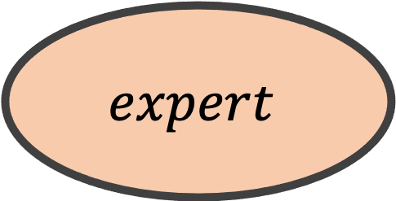
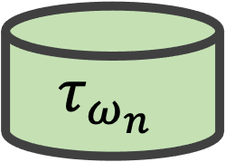
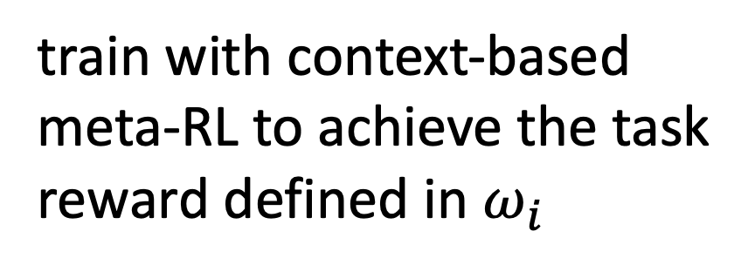
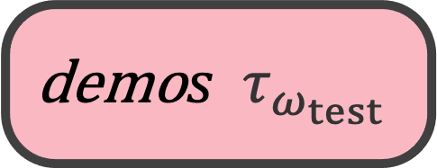
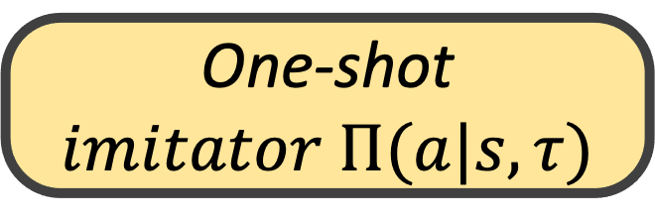
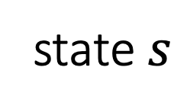

action$a$
set simulator
configuration $ω_{i}$
train with context-based meta-RL to achieve the task reward defined in $ω_{i}$
(2) deploy without further fine-tuning
$$sim. ℳ_{ω_{i}}$$
$$expert$$
$$env. ℳ_{ω_{test}}$$
$$τ_{ω_{1}}$$
state$s$
action$a$
$$τ_{ω_{2}}$$
$$τ_{ω_{i}}$$
One-shot $imitator Π(a|s,τ)$
$$⋯$$
sample demos
(1) collect a expert demo
state$s$
$$τ_{ω_{n}}$$
$$\text{demo} { τ}_{ω_{i}}$$
$$\text{demo}s τ_{ω_{test}}$$
One-shot $imitator Π(a|s,τ)$
demonstrations
(a) train: learn a general model to imitate in all tasks
(b) deploy: adapt to the target task presented by a demo

