Slide 1
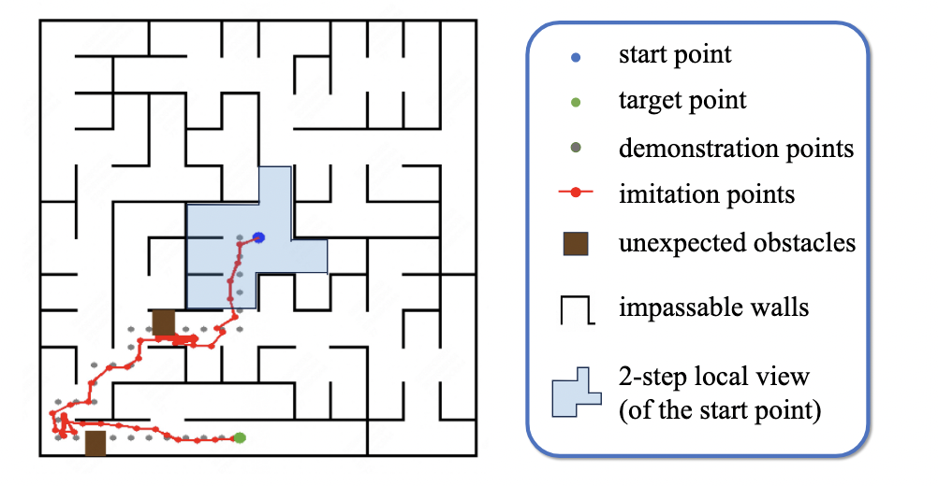
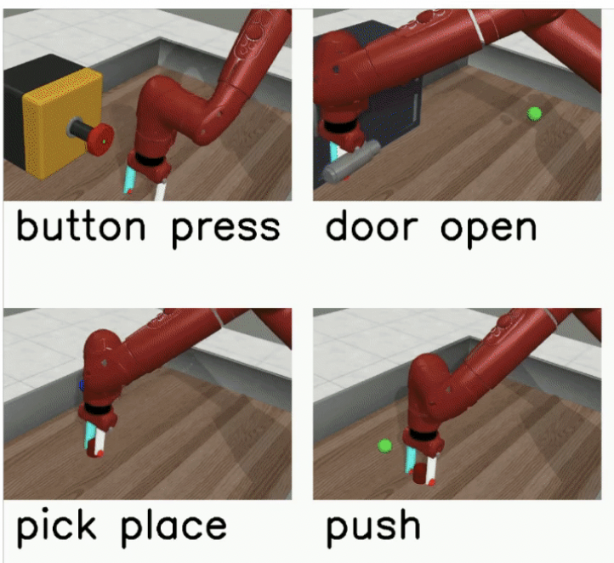
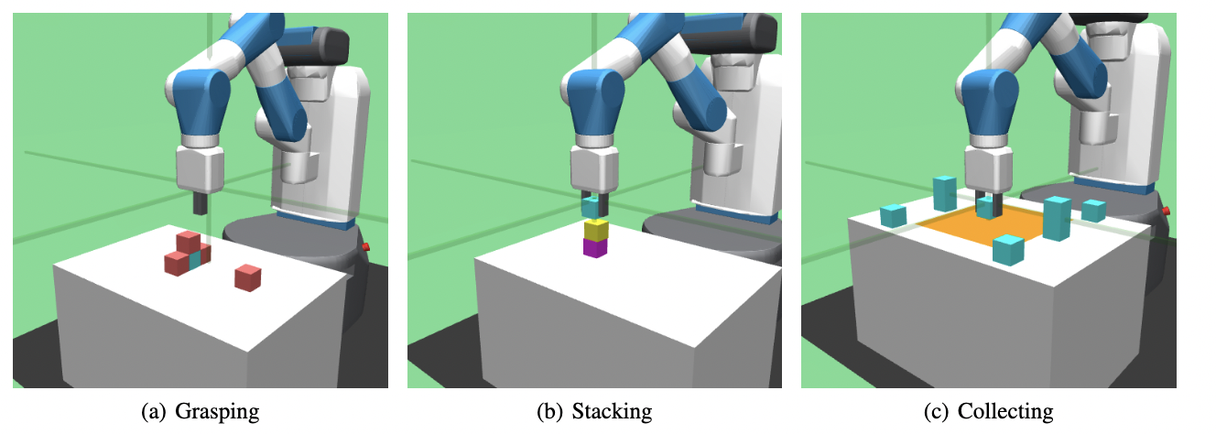
(A) Valet Parking Assist in Maze (VPAM)
(B) Meta-World
(C) Complex Planning Tasks of Robot Manipulation

