Slide 1
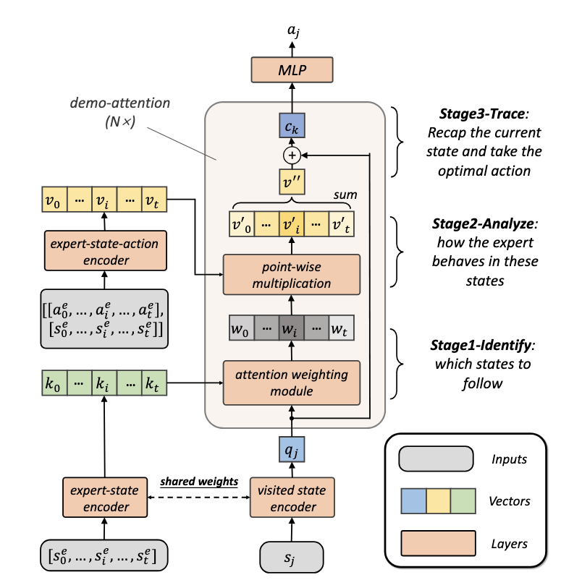
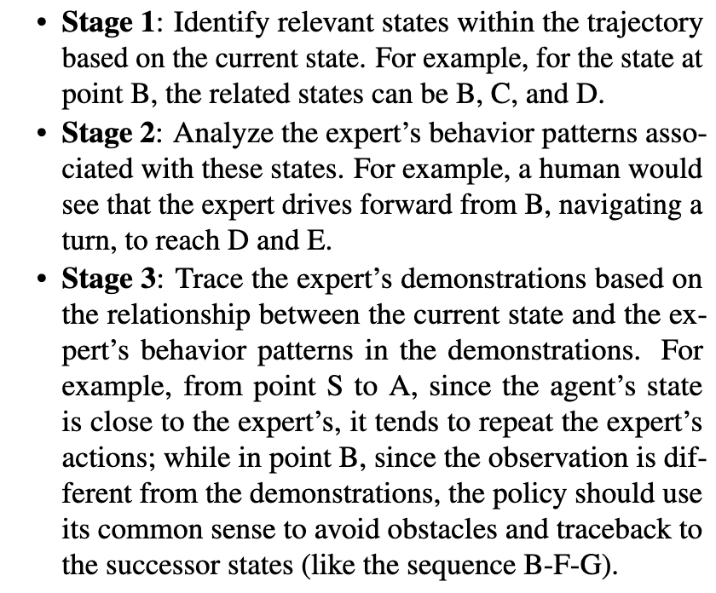
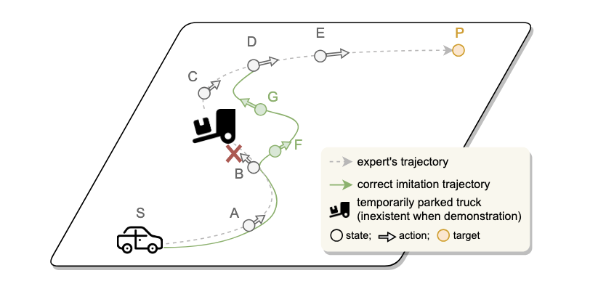
(a) A general principle of human imitation: 3-Stage Demonstration Tracing
(b) Demonstration Transformer
Introduce Inductive Biases of Demonstration Tracing for OSIL

