Slide 1
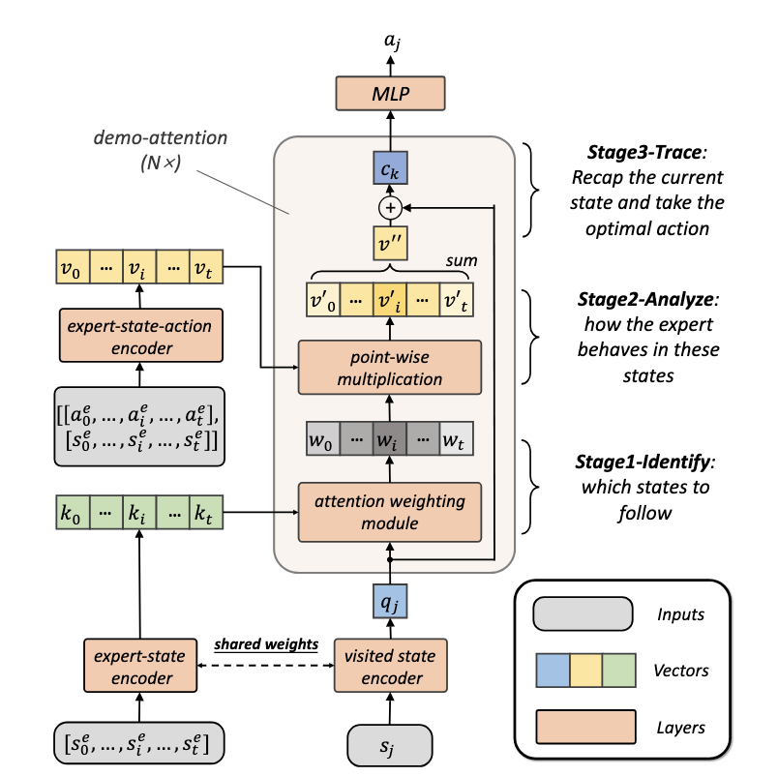
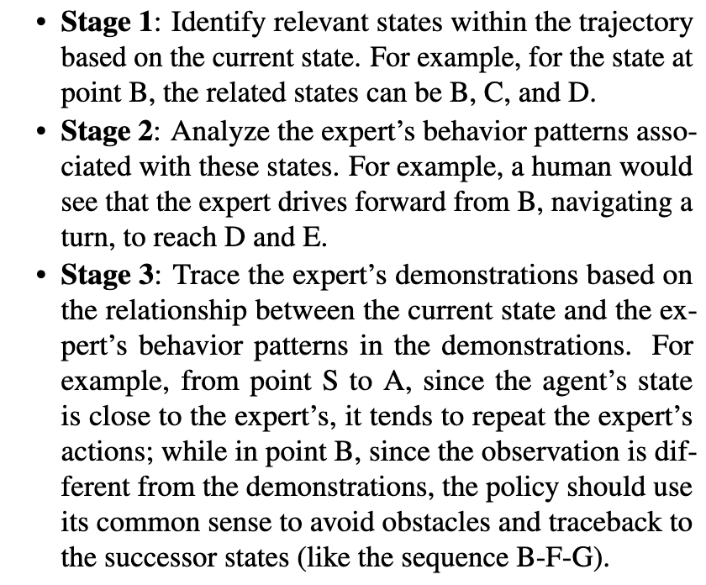
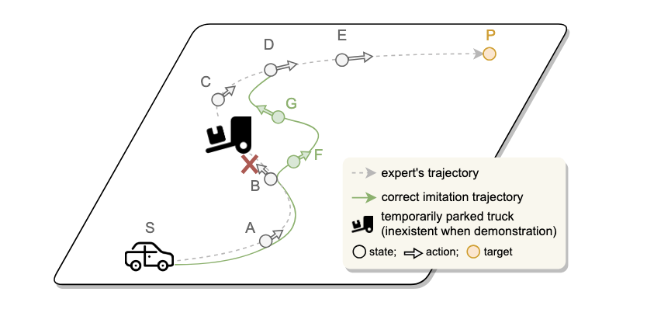
(a) Motivation--A general Principle of Human Imitation: 3-Stage Demonstration Tracing
(b) Demonstration Transformer
Introduce Inductive Biases of Demonstration Tracing for OSIL

