Slide 1
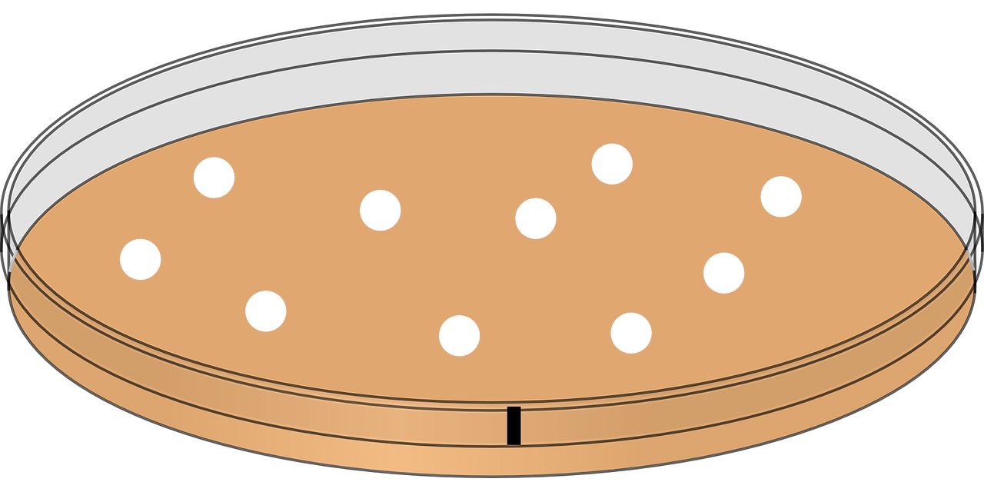

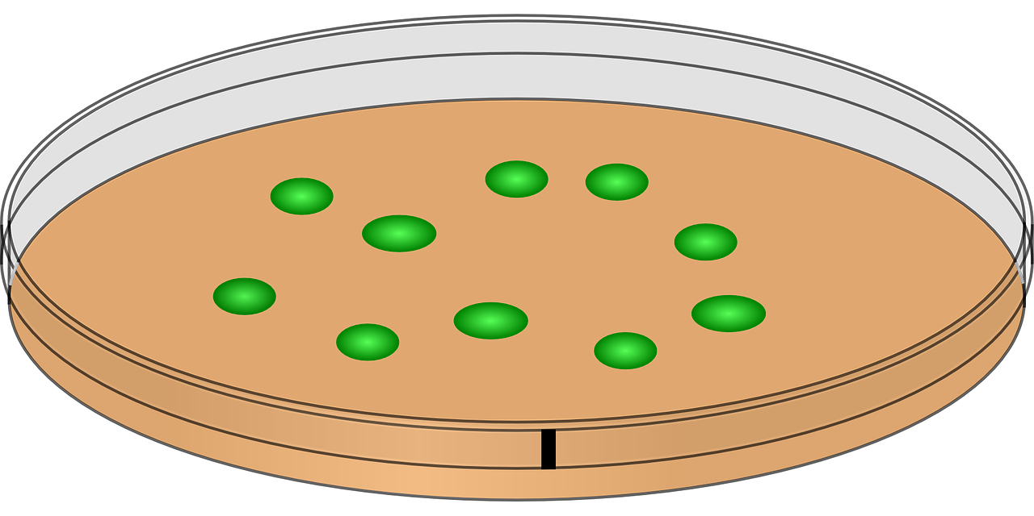
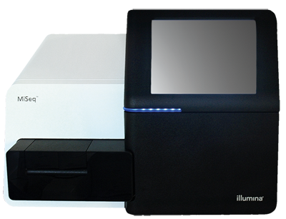
DNA reads (ancestor )
DNA reads (evolved line)
Quality control
Quality
control
Filtered DNA reads
Filtered DNA reads
Genome assembly
Read mapping
Genome scaffold
Mapped DNA reads
Unmapped DNA reads
Genome annotation
Taxonomic
Investigation
Variant calling
Genes on genome scaffold
Genome variants
Investigate taxa
Identification of VOI
Variants of interest

