Slide 1
Introducing C# 6

Slide 2
Contents
C# 6
New language features and enhancements
References

Slide 3
C# 6
C# 6 is the next iteration of C# language which is available in the .NET Framework 4.6 and Visual studio 2015.
C# 6 brings few features that brings more readability to the code as well as few enhancements.
We have used Visual Studio 2015 CTP 6 for our exploration.
All finding are based on Preview technology so it could change at later phase.

Slide 4
New language features and enhancements
nameof operator
String interpolation
Null conditional operator
Exception filters
Static using
Auto-property initializers
Expression-bodied members

Slide 5
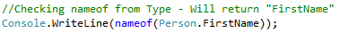
nameof operator
The nameof operation allows to find the name of the given expression.
In some occasions we require the name of the given expression for example in case of raising PropertyChanged event you require name of property.
Usage :
Demo : NameOfExpressions

Slide 6
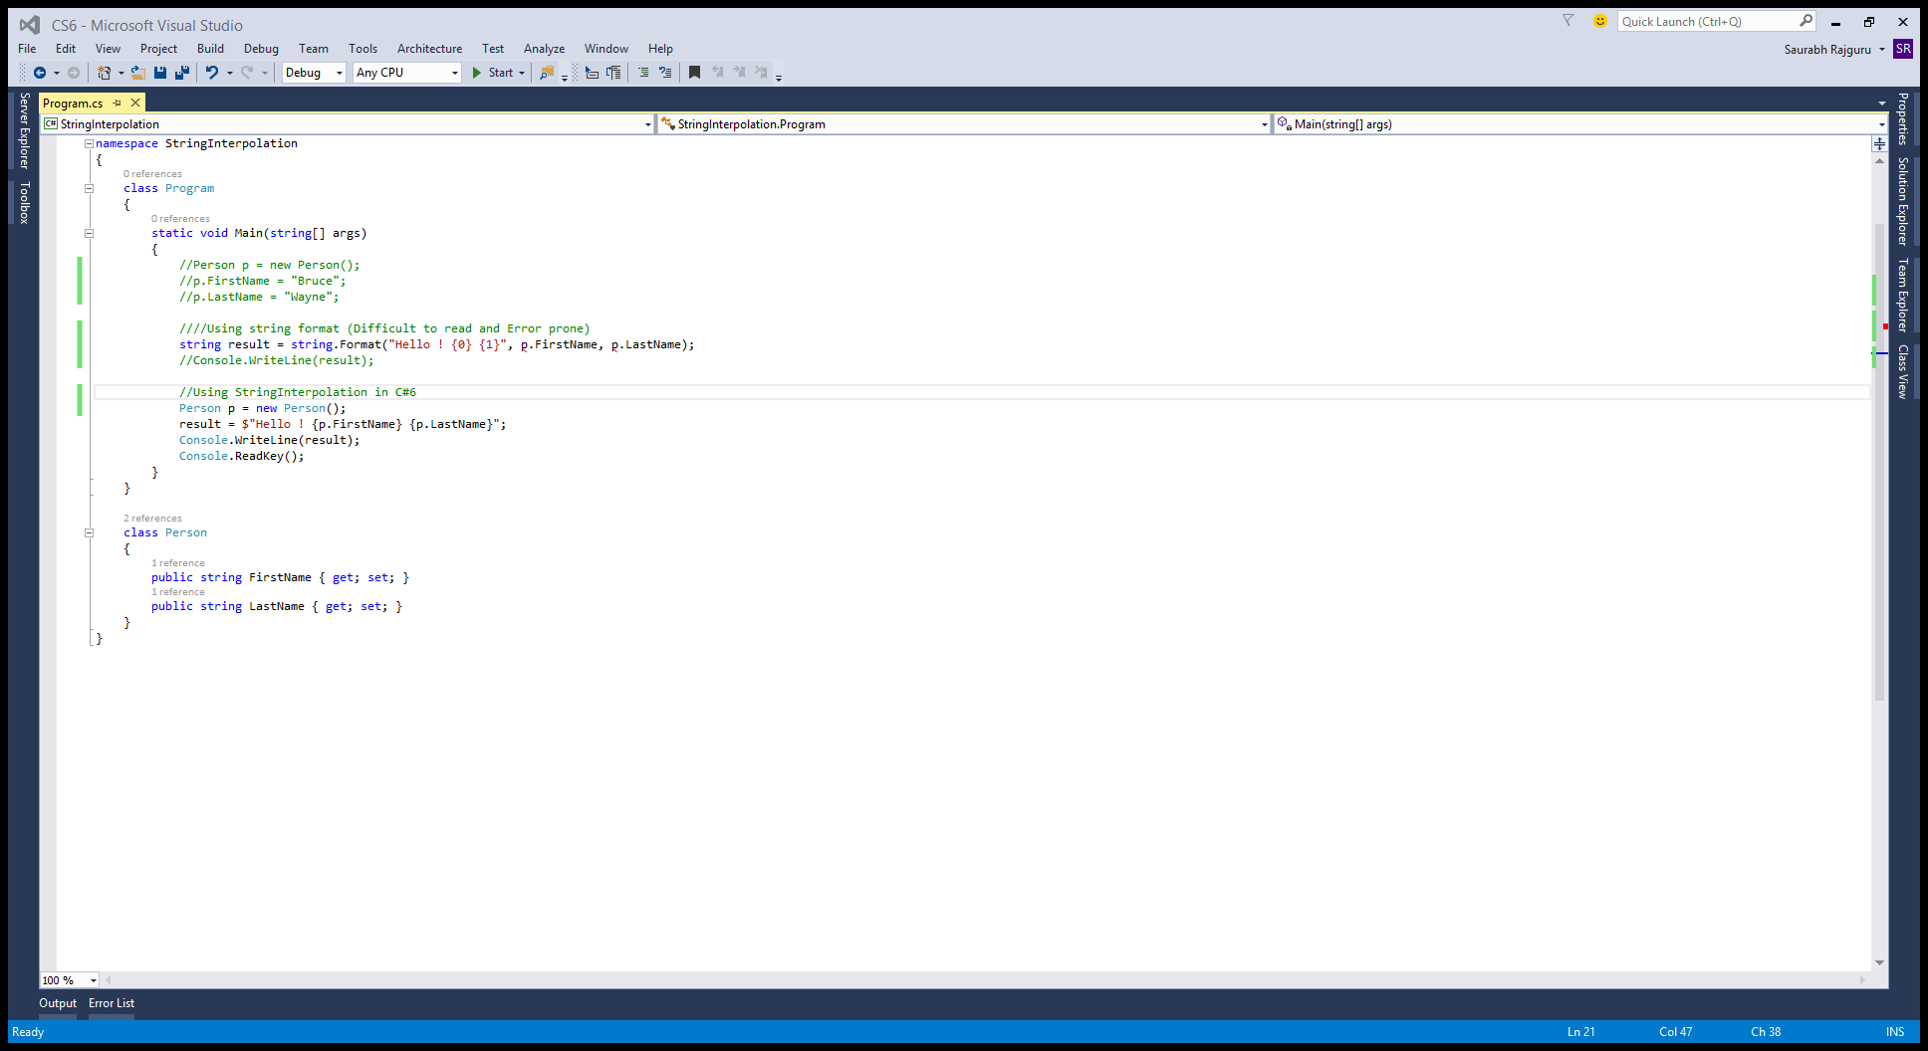
String interpolation
String interpolation lets you easily format the string.
Prior to C# we have used string.Format which is difficult to read and also error prone.
Usage:
Demo : StringInterpolation

Slide 7
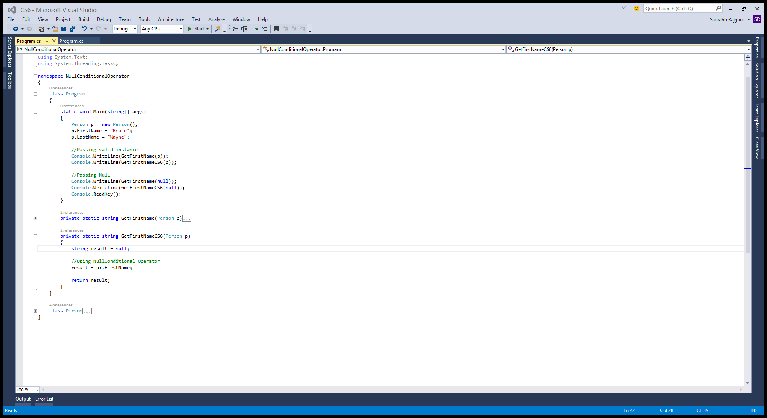
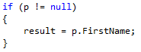
Null conditional operator
Null conditional operator simplifies the situation where big amount of code is drilled down for null checking.
The simplified syntax with Null conditional operator aids to better code readability.
Usage :
Demo : NullConditionalOperator
Is Equivalent to

Slide 8
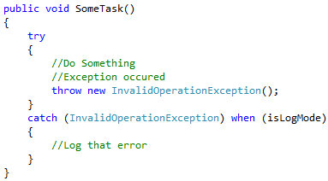
Exception filters
Exception filter allows you to filter any given exception according to provided criteria.
Exception filters are preferable to catching and rethrowing because they leave the stack unharmed.
When operator is used to provide the criteria.
Usage :
Demo : ExceptionFilters

Slide 9
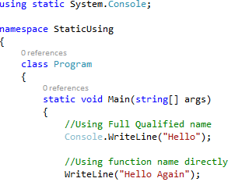
Static using
Static using allows to import the static members of the given class into scope.
Useful when you have a set of functions related to a certain domain that you use all the time.
Usage :
Demo : StaticUsing

Slide 10
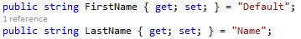
Auto-property initializers
Auto-property initializers are similar to field initializers.
The initializer directly initializes the backing field; it doesn’t work through the setter of the auto-property.
Usage:
Demo : AutoPropInitializer

Slide 11
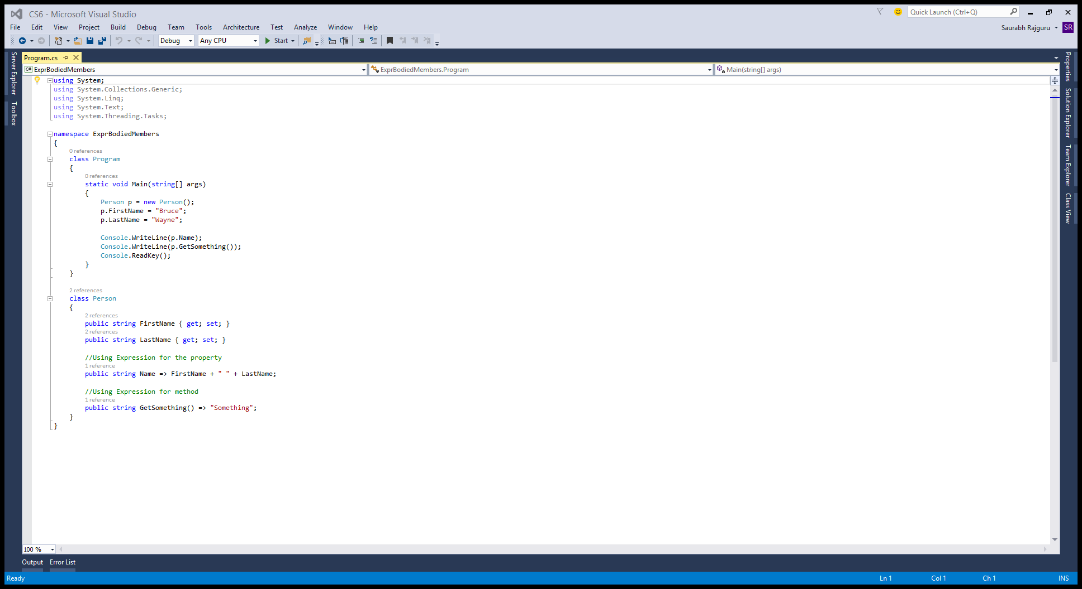
Expression-bodied members
Expression-bodied members allow methods and properties to have bodies that are expressions instead of statement blocks.
It makes code readable when we have only few lines in the method body.
Usage :
Demo : ExprBodiedMembers

Slide 12
Misc.
Await in catch/finally : Now you can use await in the catch and finally block.
Index initializer : allows you to set values to keys through any indexer that the object has
var numbers = new Dictionary<int, string> {
[7] = "seven",
[9] = "nine",
[13] = "thirteen"
};

Slide 13
References
Source code is available at : https://github.com/saurabhrajguru/CS6Demos
Details of Language features in C#6 : https://github.com/dotnet/roslyn/wiki/Languages-features-in-C%23-6-and-VB-14

Slide 14
Thank You ☺

