Slide 1
PowerEnJoy
Requirements Analysis and Specification Document
Nardo Loris – Osio Alberto Software Engineering II – 16/11/2016
Politecnico di Milano

Slide 2
Summary
Domain assumptions and model
Goals definition
Scenarios
Use Case definition
Requirements definition
Model verification with alloy

Slide 3
Domain assumptions
Domain assumptions
Domain model
Scenarios and use cases identification
Requirements definition
Goals definition
Model verification
[D1] Driving license number can be checked by an external service
[D2] There exists an external service for processing payments
[D3] An external service is available to get the geographical coordinates of an address
[D4] Each car has a display capable of showing the current bill amount
[D5] Car can communicate with the system via mobile internet connection
[D6] Car position is detected using GPS
[D7] The level of charge of the battery is detected by the system
[D8] The number of people in the car is detected by the system
[D9] The system knows whether a car has been plugged for recharge or not
[D10] The system knows whether the engine is ignited or not
[D11] If the system unlocks a car, anyone can enter the car
[D12] If the system locks a car, nobody can enter the car
[D13] The user position is detected using GPS
[D14] A user interacting with the system has an internet connection
[D15] Geographical regions do not overlap
[D16] Safe areas do not overlap
[D17] Each employee has its own username and password (different from those used to reserve cars)
[D18] The system is able to detect whether the doors of a car are opened or closed
[D19] Car plates are unique
[D20] Driving licence are unique
[D21] Cars are managed via an external system, that the company already owns

Slide 4
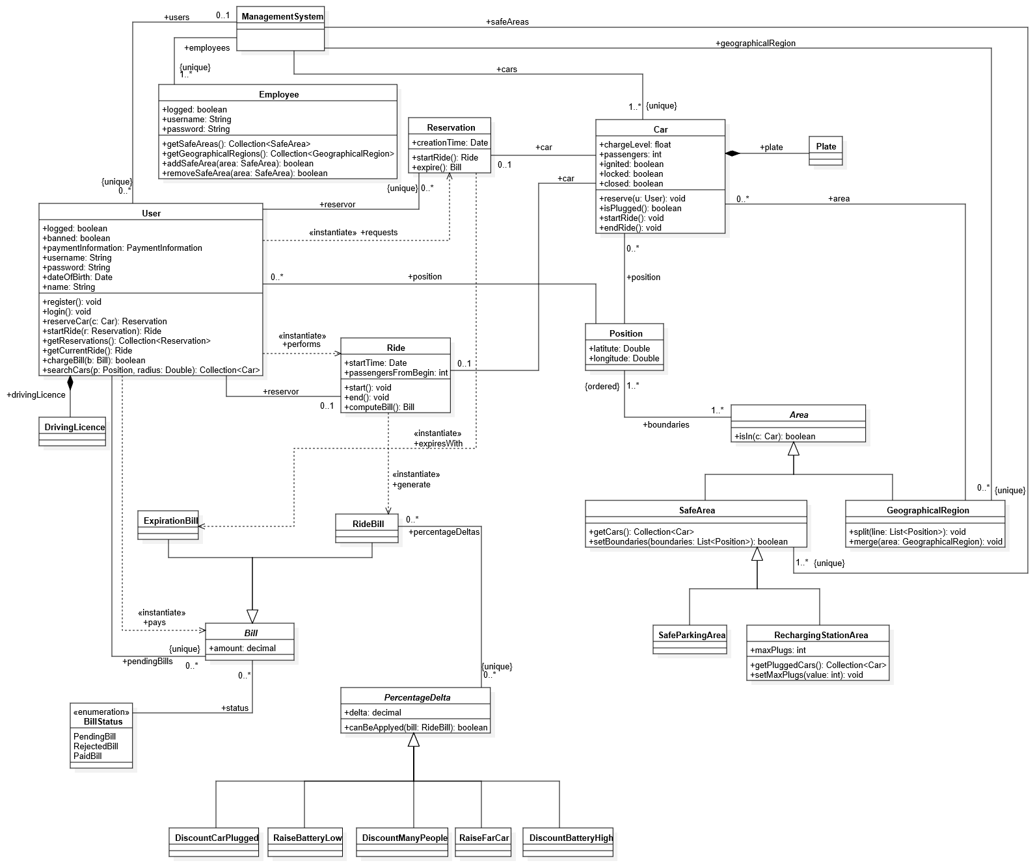
Domain model
Domain assumptions
Domain model
Scenarios and use cases identification
Requirements definition
Goals definition
Model verification

Slide 5
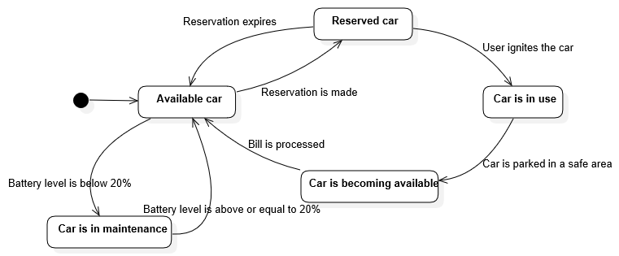
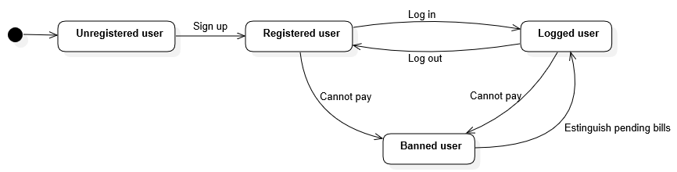
Domain model
Domain assumptions
Domain model
Scenarios and use cases identification
Requirements definition
Goals definition
Model verification

Slide 6
Goals (user)
Domain assumptions
Domain model
Scenarios and use cases identification
Requirements definition
Goals definition
Model verification
[G1] Users must be able to sign up to the system entering their name, birth date, address, credit card
information and a valid driving license number, in addition to username and password[G2] Only registered users and employee must be able to log in to the system
[G3] Logged users must be able to find the location and the level of the battery of available cars within
a user defined distance from his current location
[G4] Logged users must be able to find the location and the level of the battery of available cars within
a user defined distance from a user defined address
[G5] Logged users must be able to reserve for each geographical region at most one car among the
available ones
[G6] The reservation of a car expires after one hour
[G7] Only the reservor user must be able to unlock the car he has a reservation for
[G8] When a user ignites the engine of a car, the system starts computing the bill
[G9] As long as a car remains in use, the amount of the bill of the reservor user of that car is increased
for a percar defined amount of money per minute
[G10] Car drivers are notified of the current bill through a screen on the car
[G11] When a car is becoming available, then the bill can be charged to the reservor user
[G12] The system must incentivize the virtuous behaviors of the users
[G13] After being used by its reservor user, a car will be available for a new reservation after the system
has charged that user with the bill corresponding to his ride
[G14] A user that cannot pay his bill is banned until the bill is estinguished
[G15] Logged users must be able to find all their reservation that are still valid

Slide 7
Goals (employee)
Domain assumptions
Domain model
Scenarios and use cases identification
Requirements definition
Goals definition
Model verification
[G16] Logged employees are able to view all the geographical regions
[G17] Logged employees are able to split geographical regions
[G18] Logged employees are able to merge geographical regions
[G19] Logged employees are able to view all the safe areas
[G20] Logged employees are able to remove a safe area
[G21] Logged employees are able to add a new safe area
[G22] Logged employees are able to update the information of a safe area
[G23] Logged employees can view all the cars which are in mantainace and are not plugged into a power grid

Slide 8
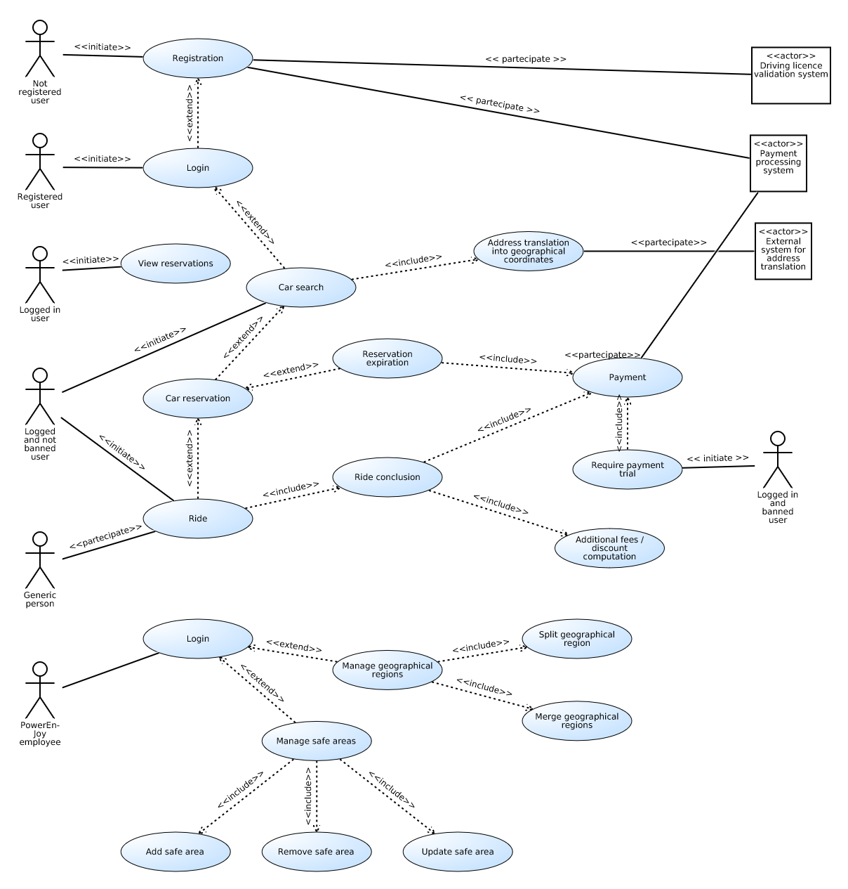
Use case definition
Domain assumptions
Domain model
Scenarios and use cases identification
Requirements definition
Goals definition
Model verification

Slide 9
Requirements definition Car search
Domain assumptions
Domain model
Scenarios and use cases identification
Requirements definition
Goals definition
Model verification
GOAL
Logged users must be able to find the location and the level of the battery of available cars within a user defined distance from his current location
REQUIREMENTS
The system only allows the logged in user who is not banned to insert the search radius
The system is capable of finding all available cars within the inserted distance from the user’s position
The system is able to show to a user a list of cars with their position and battery level
DOMAIN ASSUMPTIONS
Car can communicate with the system via mobile internet connection
Car position is detected using GPS
The level of charge of the battery is detected by the system
The user position is detected using GPS
A user interacting with the system has an internet connection

Slide 10
Requirements definition Car reservation
Domain assumptions
Domain model
Scenarios and use cases identification
Requirements definition
Goals definition
Model verification
GOAL
Logged users must be able to reserve for each geographical region at most one car among the available ones
REQUIREMENTS
The system only allows the logged in user who is not banned to reserve an available car
The system is able to get the geographical region from the car geographical coordinates
The system only reserves a car if the logged in user that requests it has no other reservation for the same geographical area in which the car is located
DOMAIN ASSUMPTIONS
Car can communicate with the system via mobile internet connection
Car position is detected using GPS
The level of charge of the battery is detected by the system
A user interacting with the system has an internet connection
Geographical regions do not overlap

Slide 11
Requirements definition Incentivize virtuous behaviours
Domain assumptions
Domain model
Scenarios and use cases identification
Requirements definition
Goals definition
Model verification
GOAL
The system must incentivize the virtuous behaviors of the users
REQUIREMENTS
When a car is becoming available, if the system detects that this car has had at least two passengers (not including the driver) for all the time of the ride when the engine was ignited, then the system applies a discount of 10% on the bill of the reservor user
When a car is becoming available, if its battery level is greater or equal to the 50% of the total battery level, the system applies a discount of 20% on the bill of the reservor user
When a car is becoming available, if it is parked in a recharging station area and it is plugged to the power grid, the system applies a discount of 30% on the bill of the reservoir user and the 5 minute window terminates
When a car is becoming available, if the battery level is less than 20% of the total battery level, the system applies a raise of 30% on the bill of the reservor user
When a car is becoming available, if it is left more than 3Km away from the nearest recharging station, the system applies a raise of 30% on the bill of the reservor user
DOMAIN ASSUMPTIONS
Car can communicate with the system via mobile internet connection
Car position is detected using GPS
The level of charge of the battery is detected by the system
The number of people in the car is detected by the system
The system knows whether a car has been plugged for recharge or not
The system knows whether the engine is ignited or not
Safe areas do not overlap
The system is able to detect whether the doors of a car are opened or closed

Slide 12
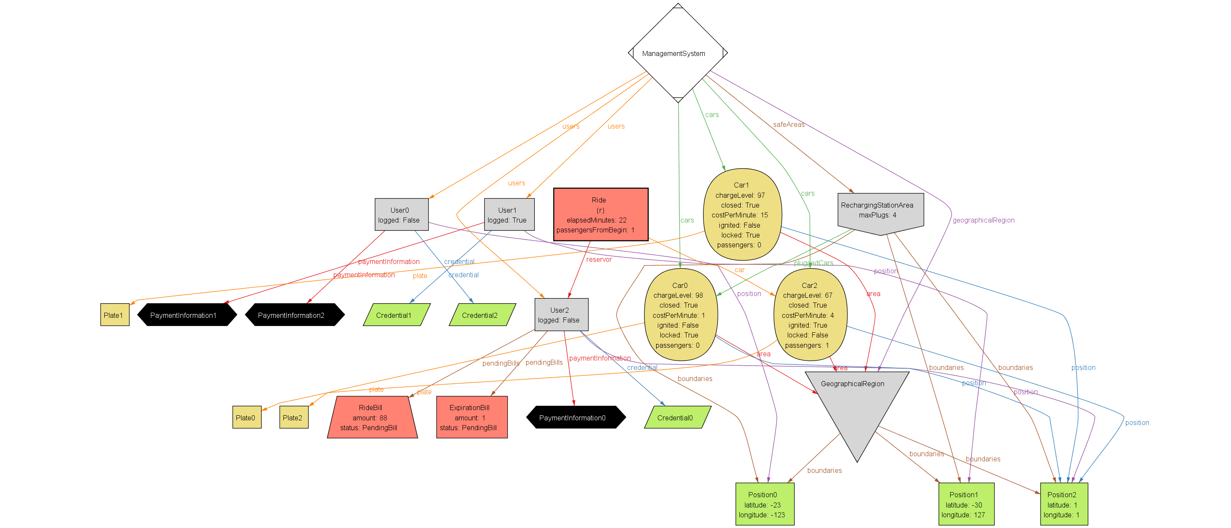
Model verification with alloy
Domain assumptions
Domain model
Scenarios and use cases identification
Requirements definition
Goals definition
Model verification

