Slide 1
SEII – PowerEnJoy Design Document
Nardo Loris
Osio Alberto
14/12/2016

Slide 2
Table of contents
Overall architecture
Database schema
Detailed architecture
Component interfaces
Deployment
Runtime views
User interface design

Slide 3
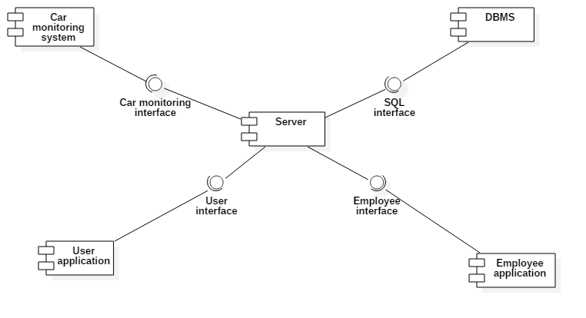
Overall architecture

Slide 4
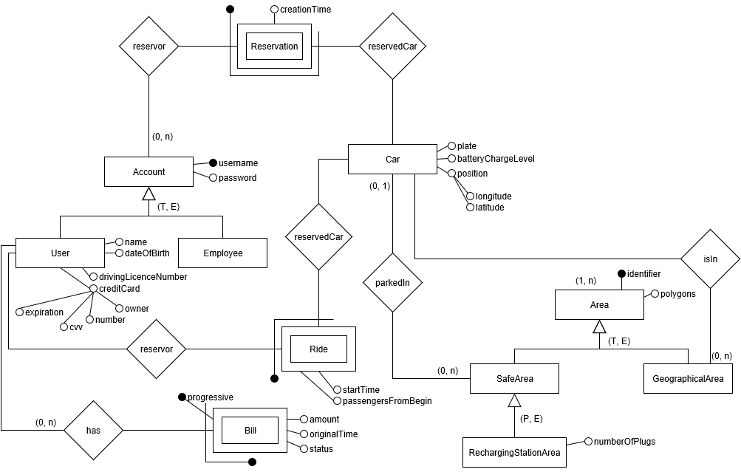
Database schema

Slide 5
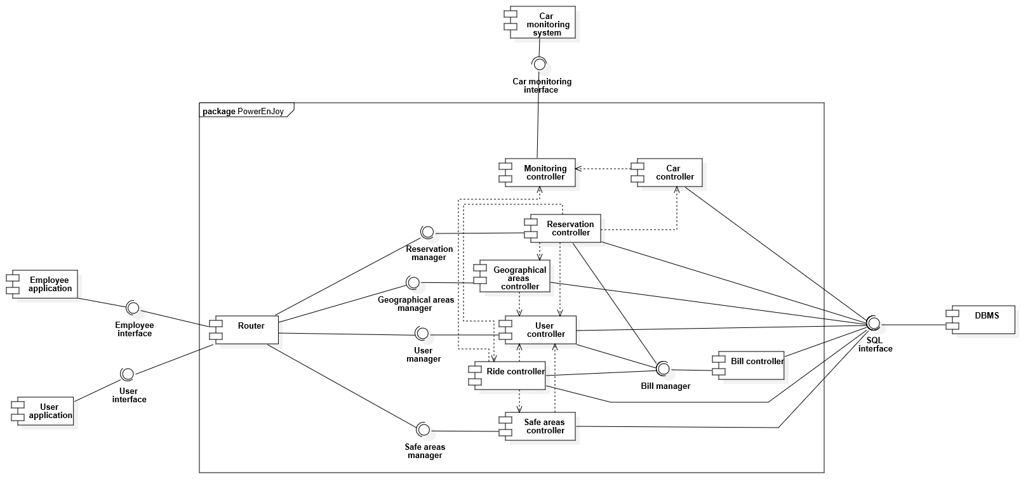
Detailed architecture

Slide 6
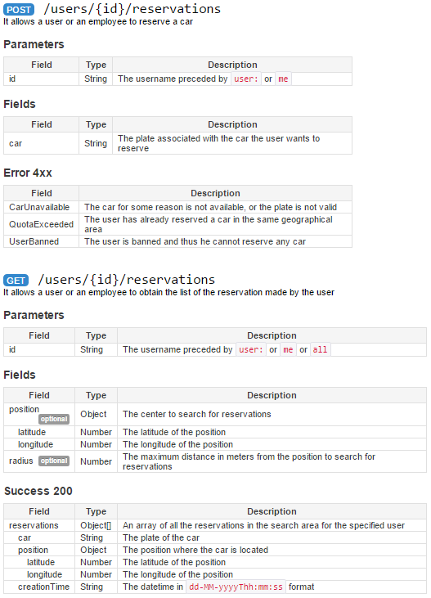
Component interfaces
RESTful APIs
Messages
Messages are exchanged using a protocol based on TCP TLS.
Unlock
This message is sent by management system to the car system in order to unlock the car. This message has no parameters
StatusReport
This message is sent by the car system, to communicate variations of the car status. It is sent immediately after the status or the number of passengers change or the batteryLevel drops more than 5% or the batteryLevel reaches its minimum or maximum value, or every 15 minutes if the batteryLevel changes by less than 5% and nothing else happens in the meantime.
Field | Type
batteryLevel | Float
status | CarStatus
passengers | Integer
position | Position

Slide 7
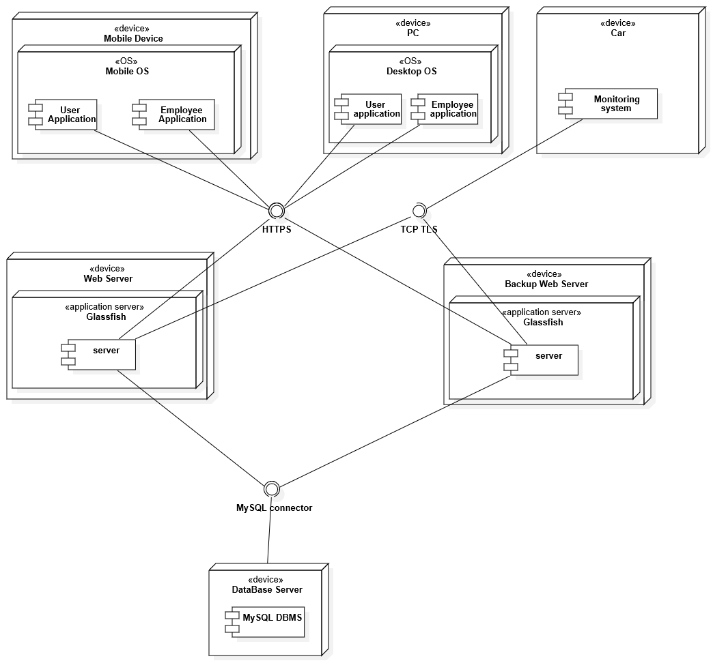
Deployment

Slide 8
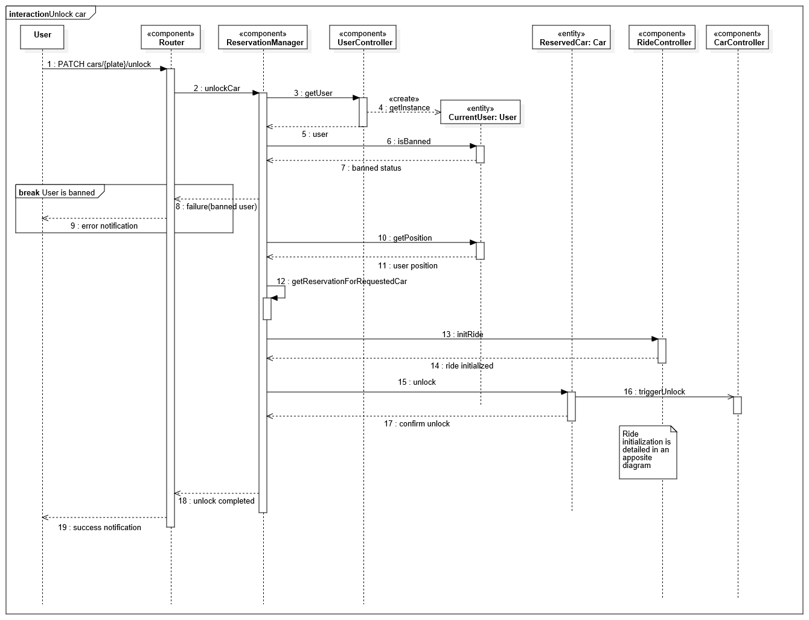
Sequence diagram - Car unlock

Slide 9
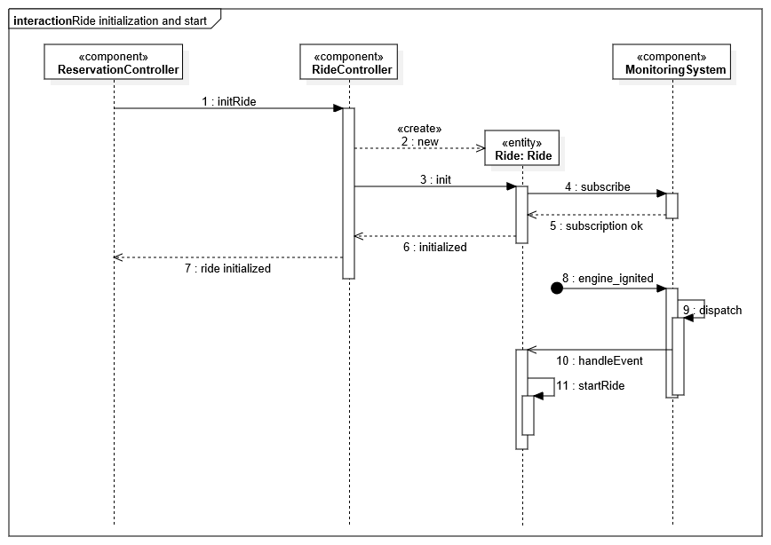
Sequence diagram Ride initialization

Slide 10
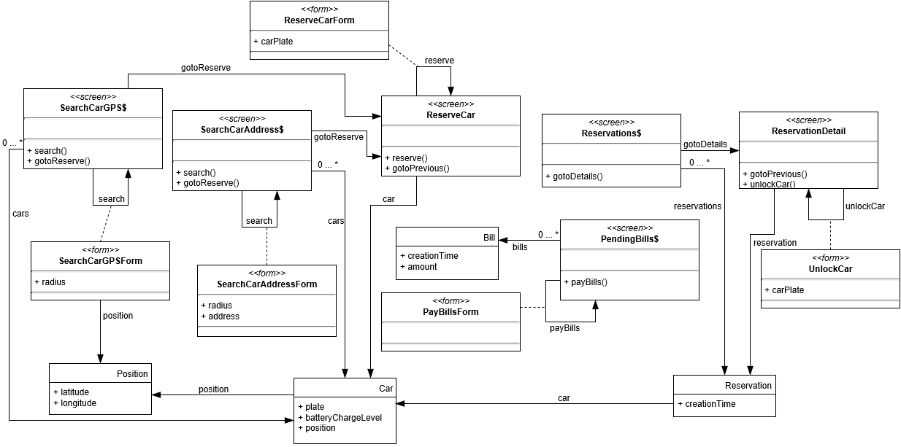
User interface design

