Slide 1
Genetic drift. Population structure. Admixture.
Katya Osipova
7.5.2023

Slide 2
Plan:
Genetic drift simulation
Fst
Admixture

Slide 3
Plan:
Genetic drift simulation
Fst
Admixture

Slide 4
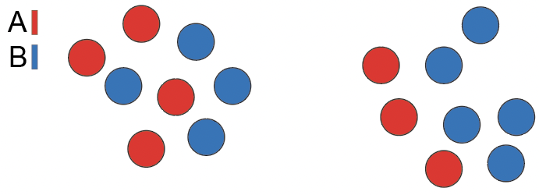
Genetic drift simulation
generation 1
X generations
. . .
N size = constant
no migration
no selection
no mutation
10111000
1110000

Slide 5
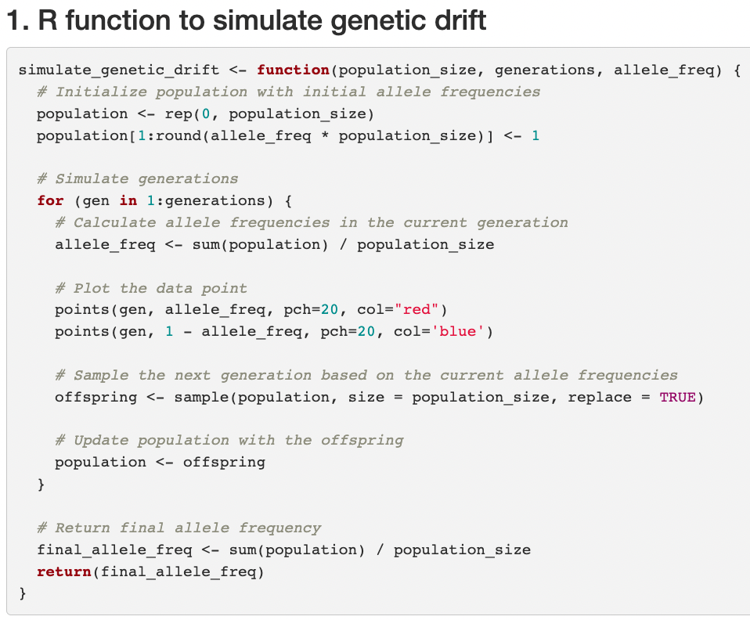
Simulations of genetic drift

Slide 6
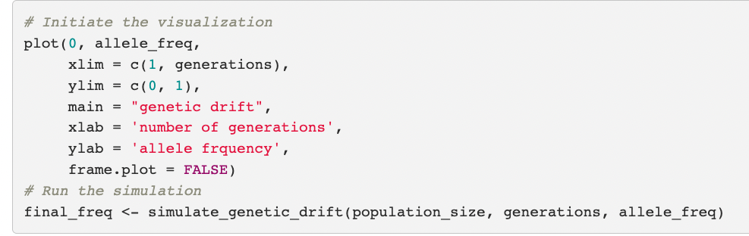
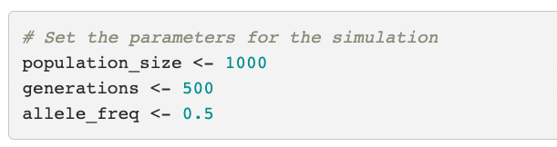
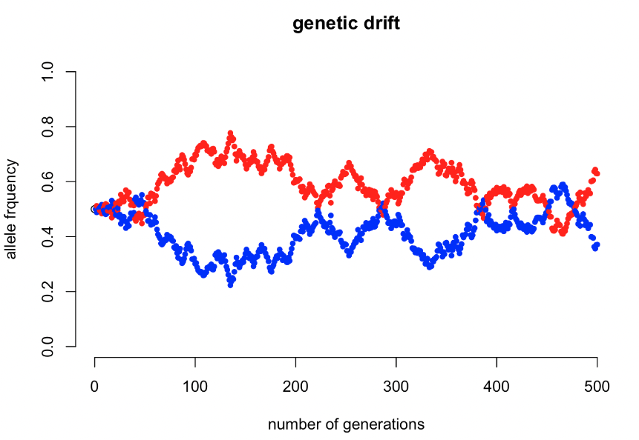
Genetic drift in large populations

Slide 7
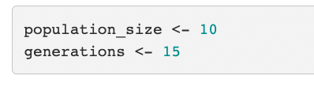

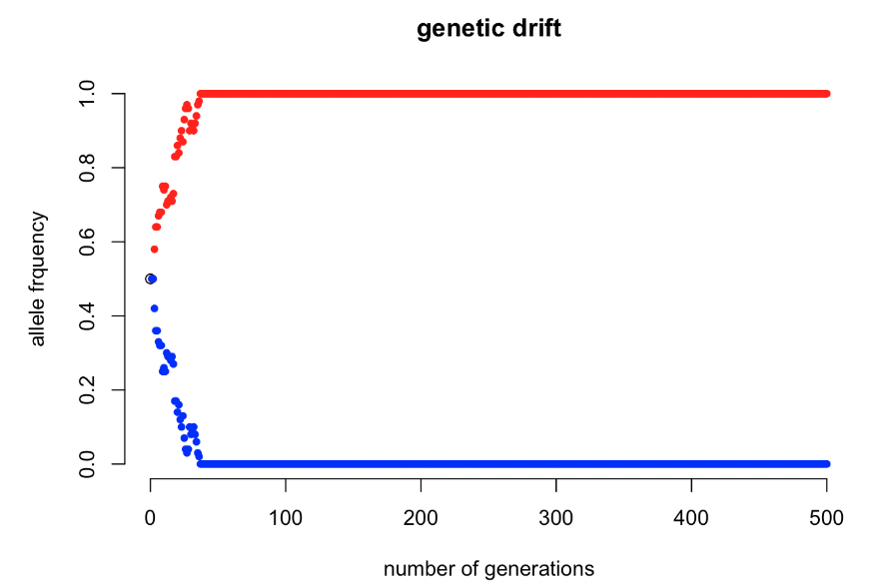
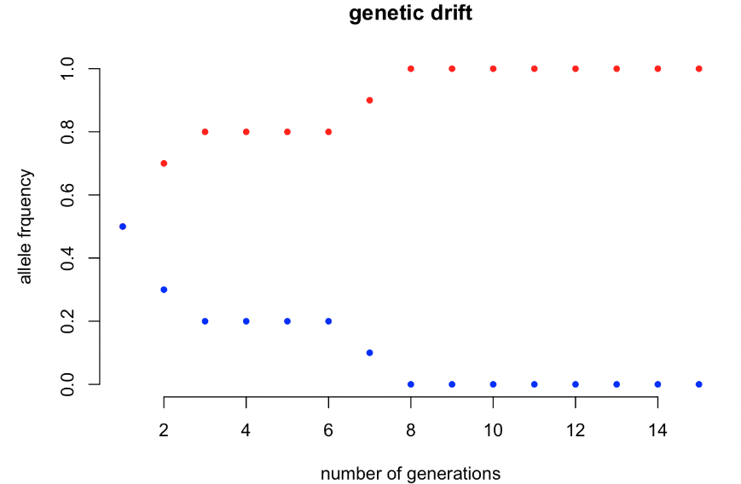
Genetic drift in small populations

Slide 8
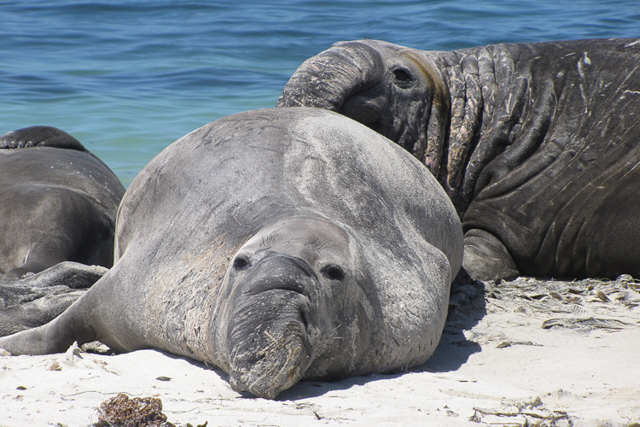
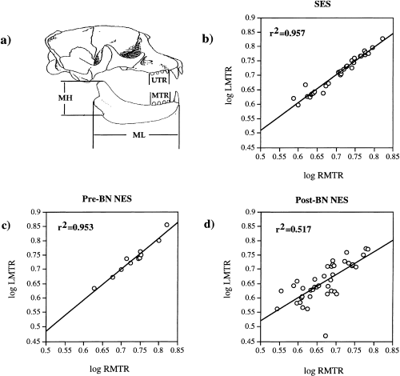
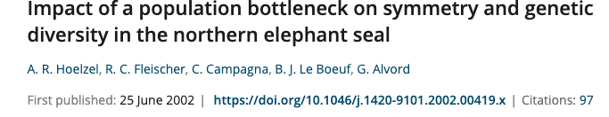
Population bottlenecks decrease genetic diversity
northern elephant seal
19th century: N = 10-20
today: N ~ 200,000
southern elephant seal
northern elephant seal
low genetic diversity!
low fitness

Slide 9
Plan:
Genetic drift simulation
Fst
Admixture

Slide 10
Fst describes genetic divergence in populations
F_{st} = $\frac{variation between − variation within}{variation between}$
population 1
population 2
A A A A
A A A A
B B B B
A A A A
A A A A
B B B B
F_{st} = 0
A A A A
A A A A
A A A A
B B B B
B B B B
B B B B
F_{st} = 1

Slide 11
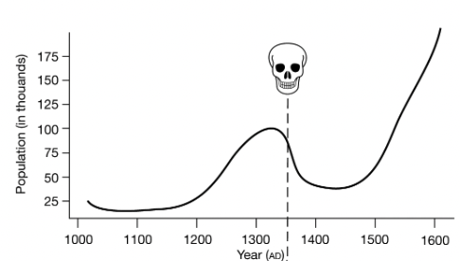
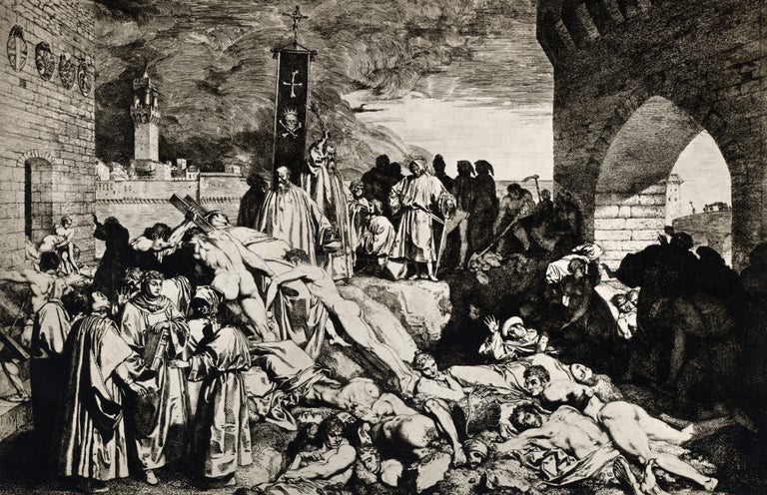
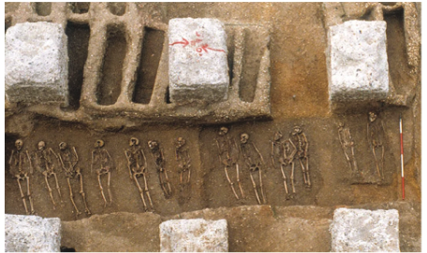
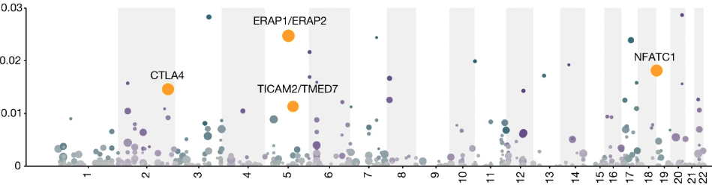
The Black Death put selective pressure on immune genes
Klunk et al, 2022. Nature
1346-1350 AD killed 75-200 million people
London
Denmark
variant near ERAP2:
protective against Y.pestis
higher risk of autoimmune diseases
Fst
chromosome

Slide 12
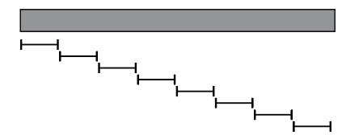
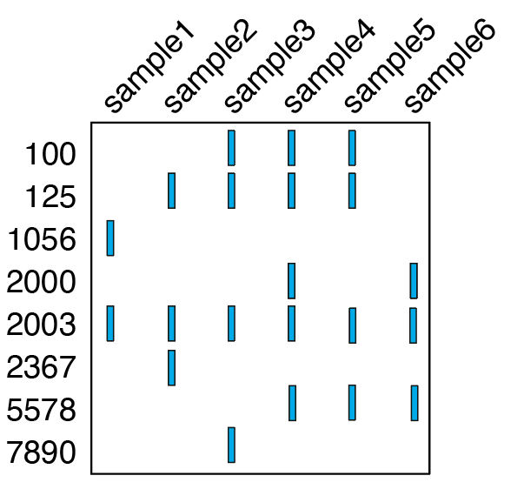
How we will compute Fst for the populations before and after the Black Death
VCF : Variant Call Format
chr 5
before
after
position
window
Fst before vs after
vcftools
-- VCF
-- before.lst
-- after.lst
-- window
-- out

Slide 13
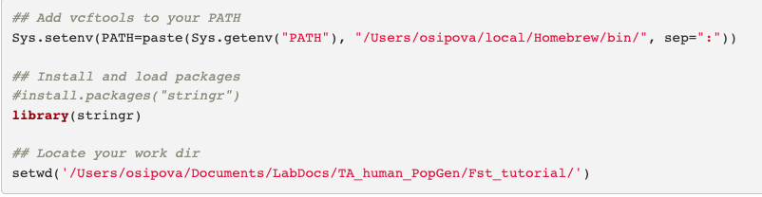
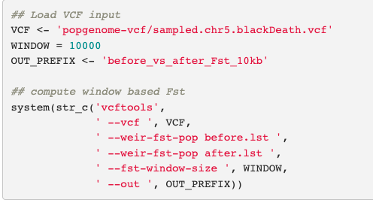
R script to compute window based Fst

Slide 14

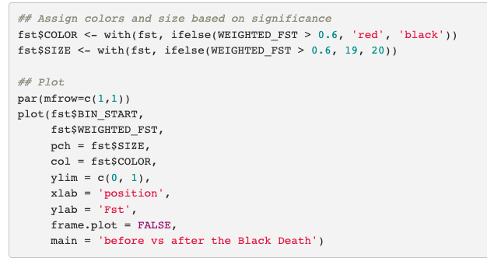
R script to compute window based Fst

Slide 15
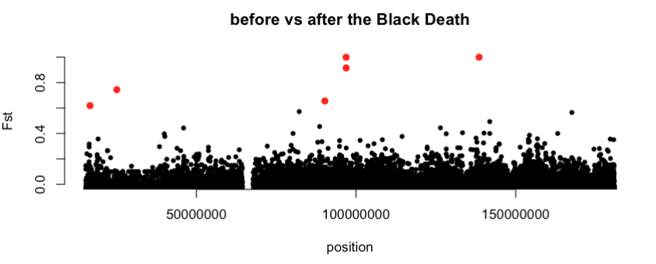
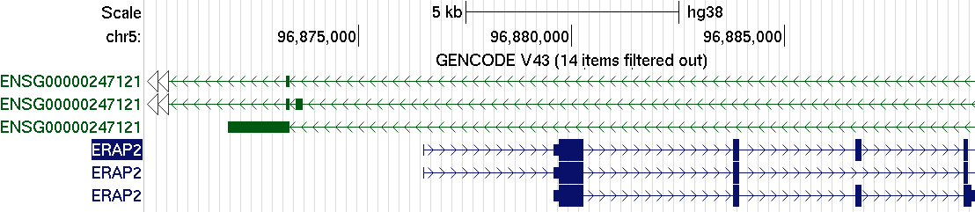
Genomic region with the highest Fst value on chr5
ERAP2

Slide 16
Plan:
Genetic drift simulation
Fst
Admixture

Slide 17
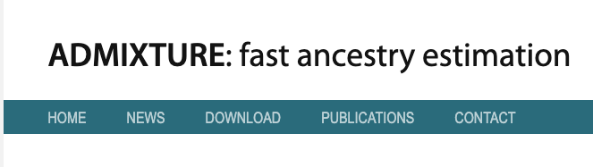
Admixture
- a process: interbreeding of previously separated populations
- a tool
population 1
population 2
% genome
1) identify the number of populations
2) assign individuals to populations
population 3

Slide 18
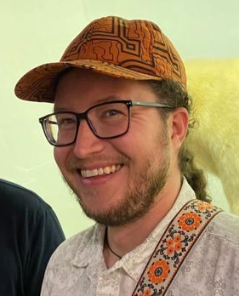
Running admixture
https://zzz.bwh.harvard.edu/plink/res.shtml
Based on tutorial by C. Jonathan Schmitt
Dataset:
270 individuals:
3.96 million SNPs
3.96 million SNPs -> 10,000 SNPs
ADMIXTURE:
Number of populations?
Ancestry of individuals?

Slide 19
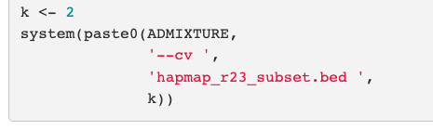
R script to run admixture

Slide 20
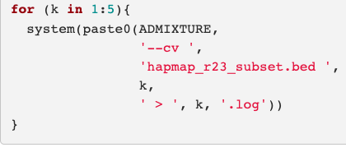
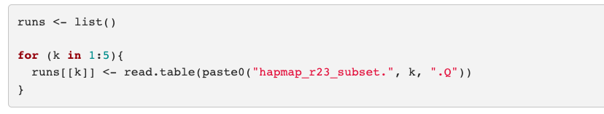
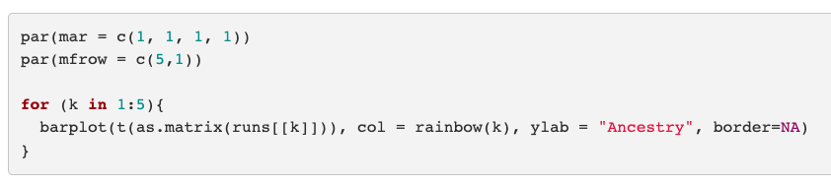
R script to run admixture

Slide 21
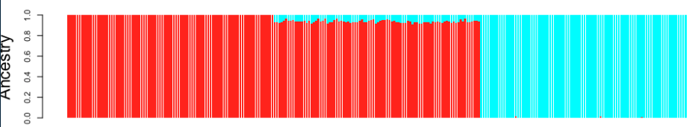
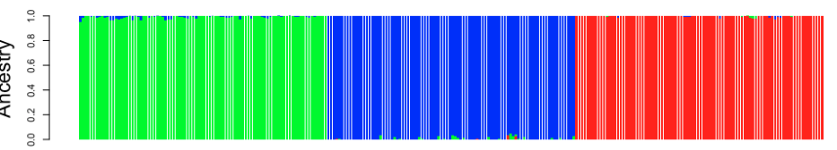
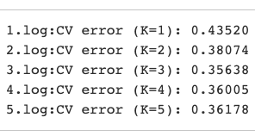
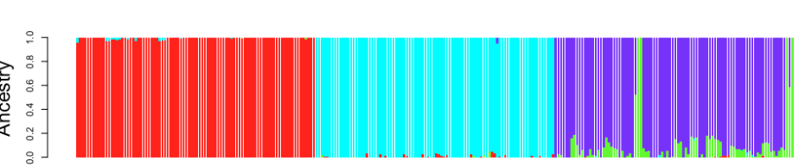
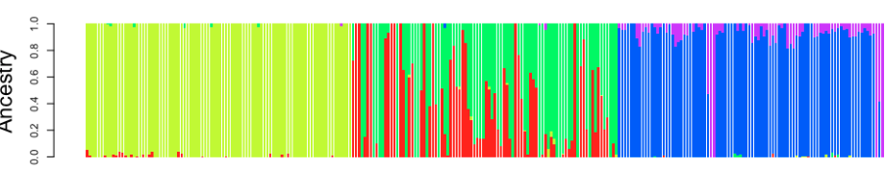
Admixture plots
K = 2
Ancestry
K = 3
Ancestry
Ancestry
K = 4
Ancestry
K = 5

Slide 22
-.-

