Slide 1
Phylogenetic analysis
Katya Osipova
7.19.2023

Slide 2
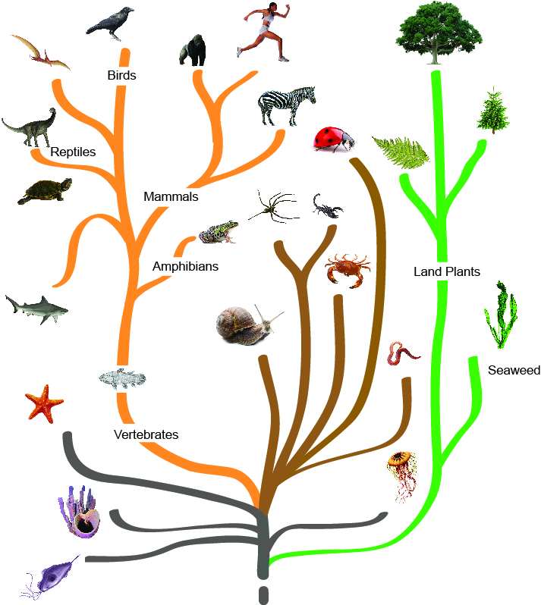
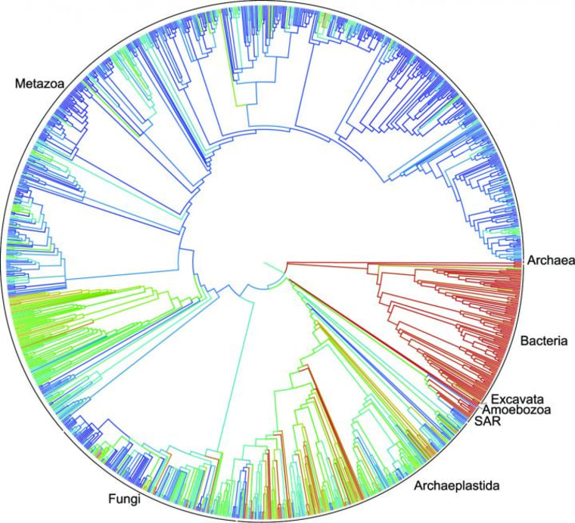
Phylogenies represent evolutionary relationships
Open Tree of Life
> 2.3 million species

Slide 3
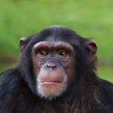
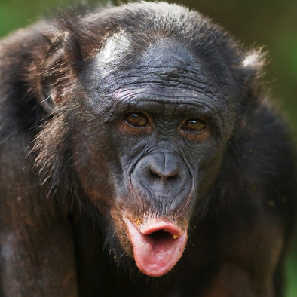

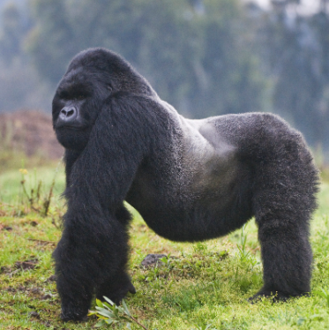
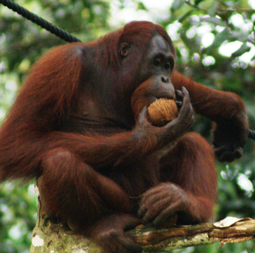
Basic tree terminology
common ancestor
chimpanzee
bonobo
root
human
gorilla
orangutan

Slide 4
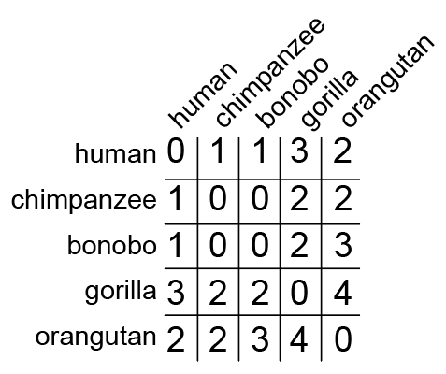
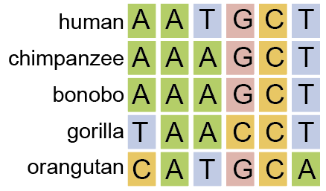
Phylogenetic reconstruction algorithms
1. Distance algorithms:
a) Neighbor-Joining
b) UPGMA (unweighted pair group method with arithmetic mean)
1) alignment
2) distance matrix

Slide 5
Phylogenetic reconstruction algorithms
2. Maximum parsimony
1) alignment
A
A
C
A
A
OR
A
C
C
A
C

Slide 6


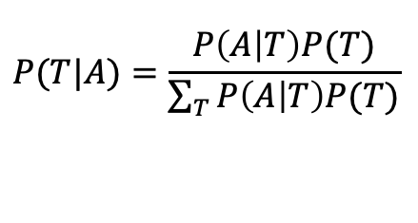
Phylogenetic reconstruction algorithms
3. Likelihood algorithms:
a) Max Likelihood
b) Bayesian
1) alignment
likelihood
$$P(A|T)$$
Bayes theorem
$$P(T|A)=\frac{P\left(A | T\right)P(T)}{\sum_{T}{P\left(A | T\right)P(T)}}$$
$$A=alignment$$
$$T=tree$$

Slide 7
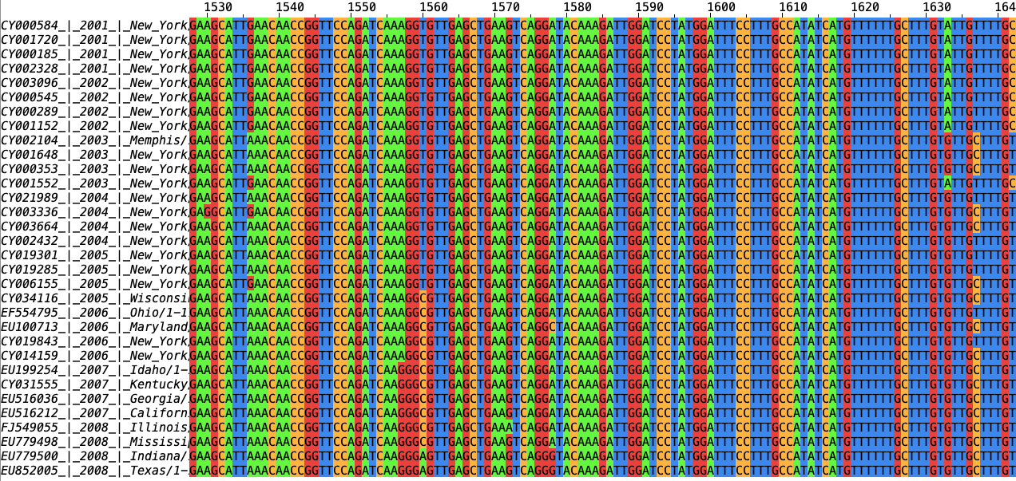
Influenza virus strains from the US. 2001 – 2008
32 influenza viruses (H3N2) (source: geneBank)

Slide 8
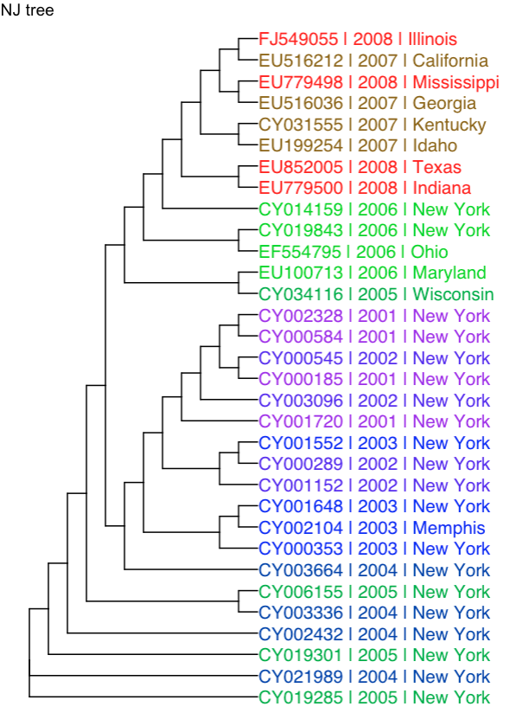
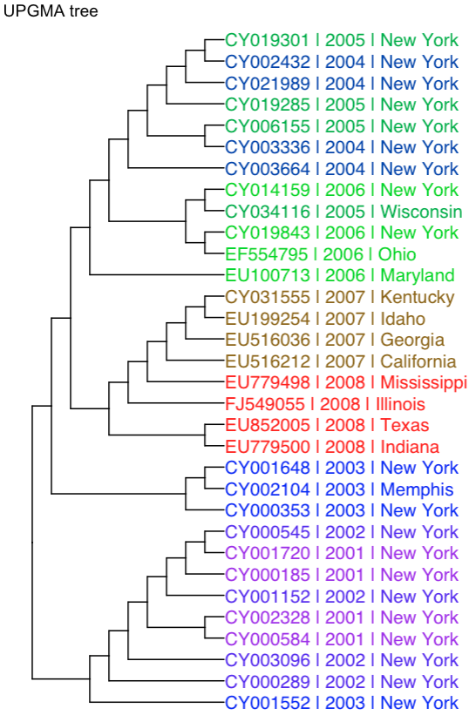
NJ vs UPGMA trees

Slide 9
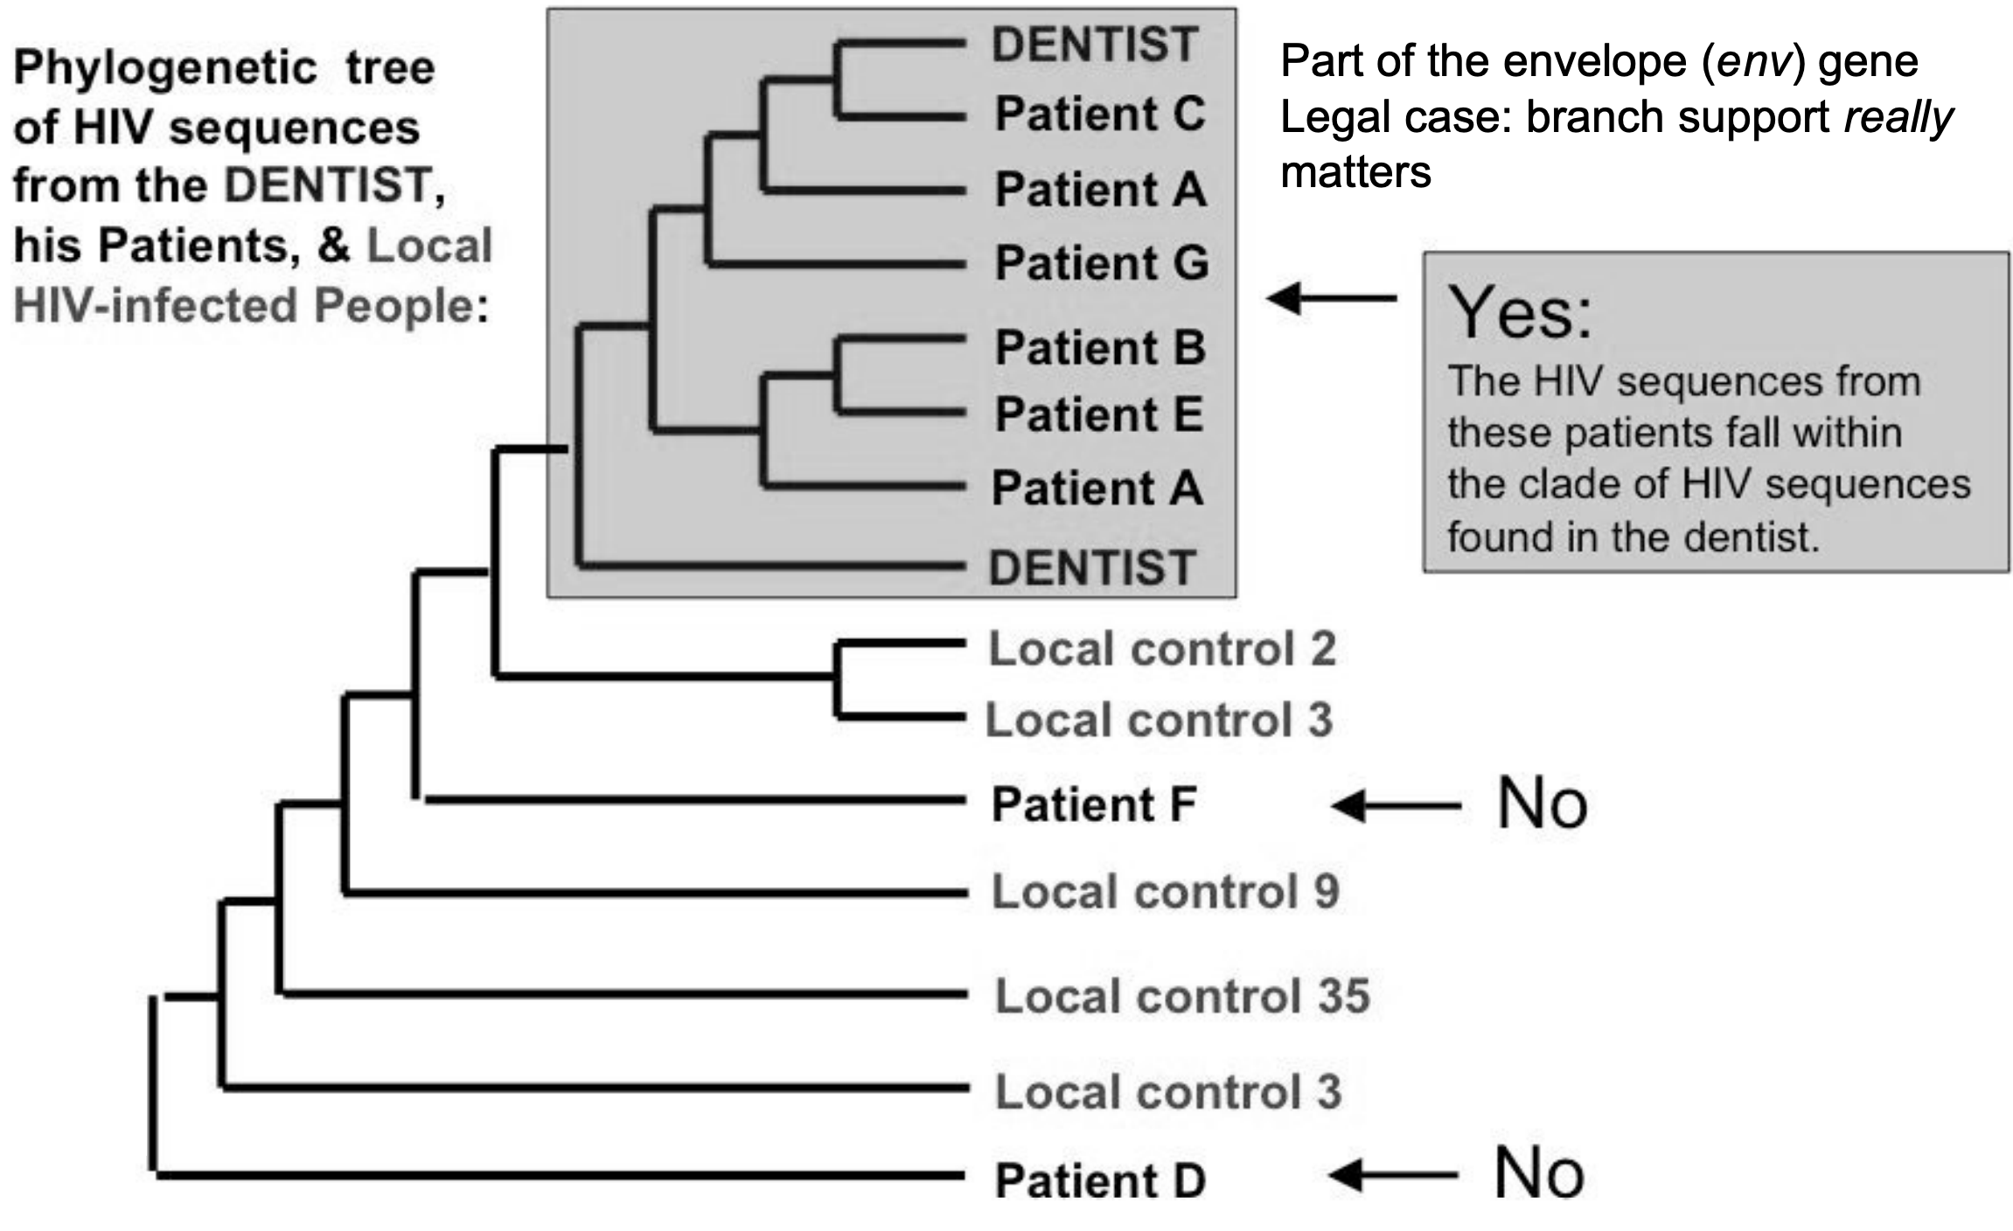
Applications. Support for dental HIV transmission

Slide 10
Summary
Phylogenies represent evolutionary relationships
genomic data -> phylogenies
Different algorithms
R: infer phylogenies & plot trees!

Slide 11
-.-

