Slide 1
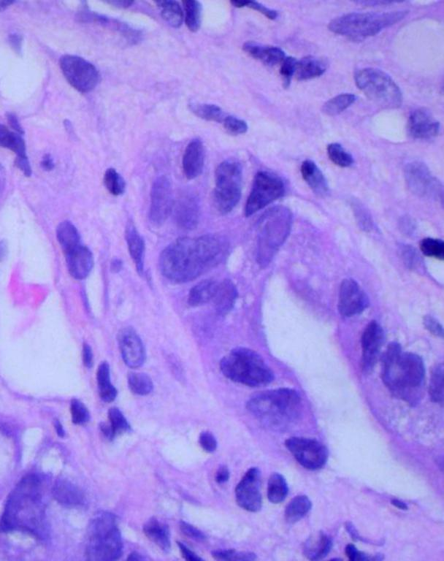
HistoPrompt
Model-aware prompting for pathology review
2026 Ashby Prize Hackathon
Built on PathGen, four NCSA pathology models, Delta, and Lumen
Research prototype
Notes:
Project repository: https://github.com/osirais/histoprompt
Hackathon challenge and criteria: https://cancer.illinois.edu/2026-ashby-prize-in-computational-science-hackathon/
Cover image: public LC25000 sample stored in benchmarks/diagnosis-11/images with source and checksum metadata.

Slide 2
Five disciplines, one pathology workflow
Our team combines quantitative science, software, biomedical engineering, and domain-oriented evaluation.
ASTRONOMY · BIOENGINEERING · COMPUTING · PHYSICS · MATHEMATICS
Aditya Arunachalam
David Wang
Orlando Sirais
Astronomy Department
Department of Bioengineering
Siebel School of Computing and Data Science
Department of Bioengineering
ASTRONOMY
BIOENGINEERING
COMPUTING + BIOENGINEERING
Jaidev Balaji
Karthik Sista
Department of Physics
Department of Mathematics
PHYSICS
MATHEMATICS
Together, we built and evaluated a single clinician-facing system.
University of Illinois Urbana-Champaign
02
Notes:
Team affiliations supplied by the user on 2026-10-19.

Slide 3
What Lumen changes for each candidate
The baseline names the diagnosis. The enhanced version adds a short, visually discriminative morphology phrase.
BASELINE PROMPT
LUMEN + RETRIEVED EVIDENCE
a histopathology image showing
colon adenocarcinoma
colon adenocarcinoma with irregular glandular structures, cribriform patterns, desmoplastic response
→
1
Read case context
2
Retrieve local evidence
3
Generate eight prompts
The report and differential define what needs to be distinguished.
The system supplies relevant morphology and diagnostic context.
Every candidate keeps its exact label and receives a concise feature phrase.
HistoPrompt measures this transformation and learns which model–organ pairings benefit.
Source: saved case record 4cff975b-adbe-4ecf-9be5-365c715e2305_53792_26368.json
03
Notes:
The quoted baseline and enhanced prompts are reproduced from a saved full-workflow case record.

Slide 4
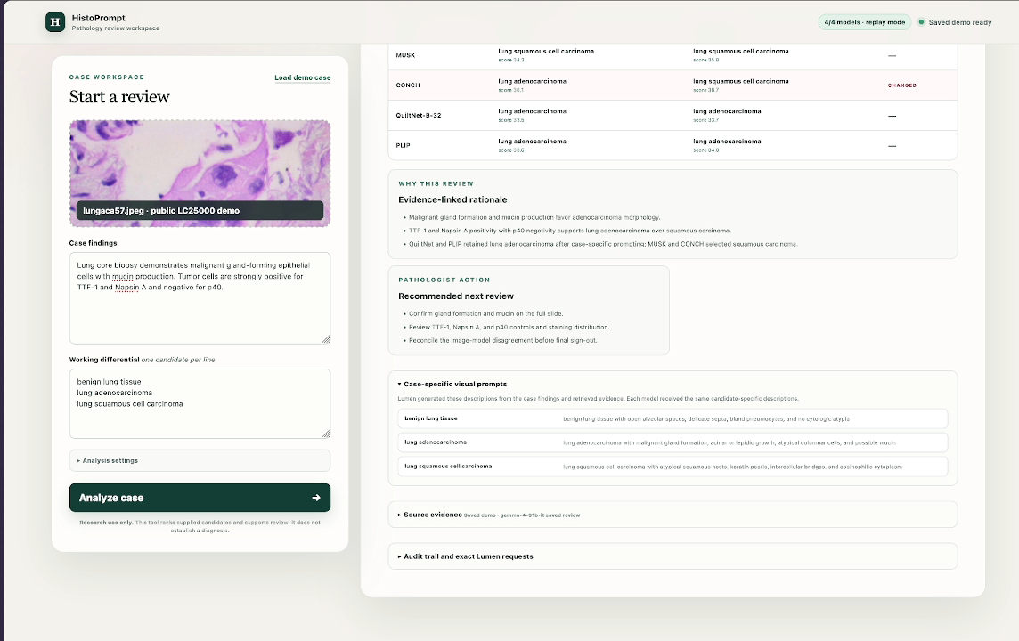
The prototype is organized around a single review
Inputs stay visible while model results, evidence, and next actions are reviewed.
Public saved demo
Source: saved replay in data/demo_replay.json; demo video
04
Notes:
Screenshot extracted from demo/histoprompt-clinician-workflow-demo.mp4.
The saved replay uses a public LC25000 case and makes no NCSA or Lumen requests.

Slide 5
Built on the full hackathon stack
We combined PathGen, RAG, Lumen, four pathology models, and Delta in one working product.
01
02
03
04
PathGen
NCSA models
Delta
RAG + Lumen
2,141 pathology cases
8 TCGA cancer projects
MUSK · CONCH
QuiltNet · PLIP
Hosted inference
parallel model evaluation
Retrieved pathology evidence
case-specific prompts
17,128
17,128
2 hours
candidate-specific prompts
baseline / enhanced decisions
end-to-end benchmark
Source: repository implementation; CCIL hackathon resources
05
Notes:
Every PathGen case produced eight Lumen prompts and eight model decisions: four baseline and four case-specific.

Slide 6
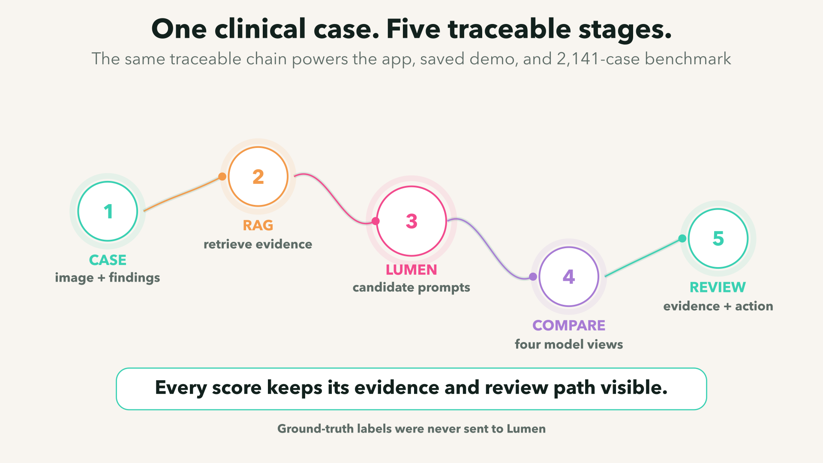
06
Notes:
Visualization authored in Manim Community v0.22.0 from the implemented clinical workflow.

Slide 7
Two days produced a complete, testable system
The project moved beyond a UI mockup into live model integration, scripted evaluation, and portable delivery.
01
Prototype
Clinician case entry and review UI
30
commits
02
Integration
MUSK, CONCH, QuiltNet, PLIP, and Lumen
60
03
Evaluation
Small screens, held-out tuning, and full PathGen workflow
automated tests
1
04
Reproduction
Checksums, resumable runs, saved replay, and reports
saved replay
Everything shown in this document is backed by saved code, data, or replayable artifacts in the private repository.
Source: repository history through f378abc
07
Notes:
Git history: 30 commits on main by two contributors as of 2026-10-19. Test suite: 60 passing tests.

Slide 8
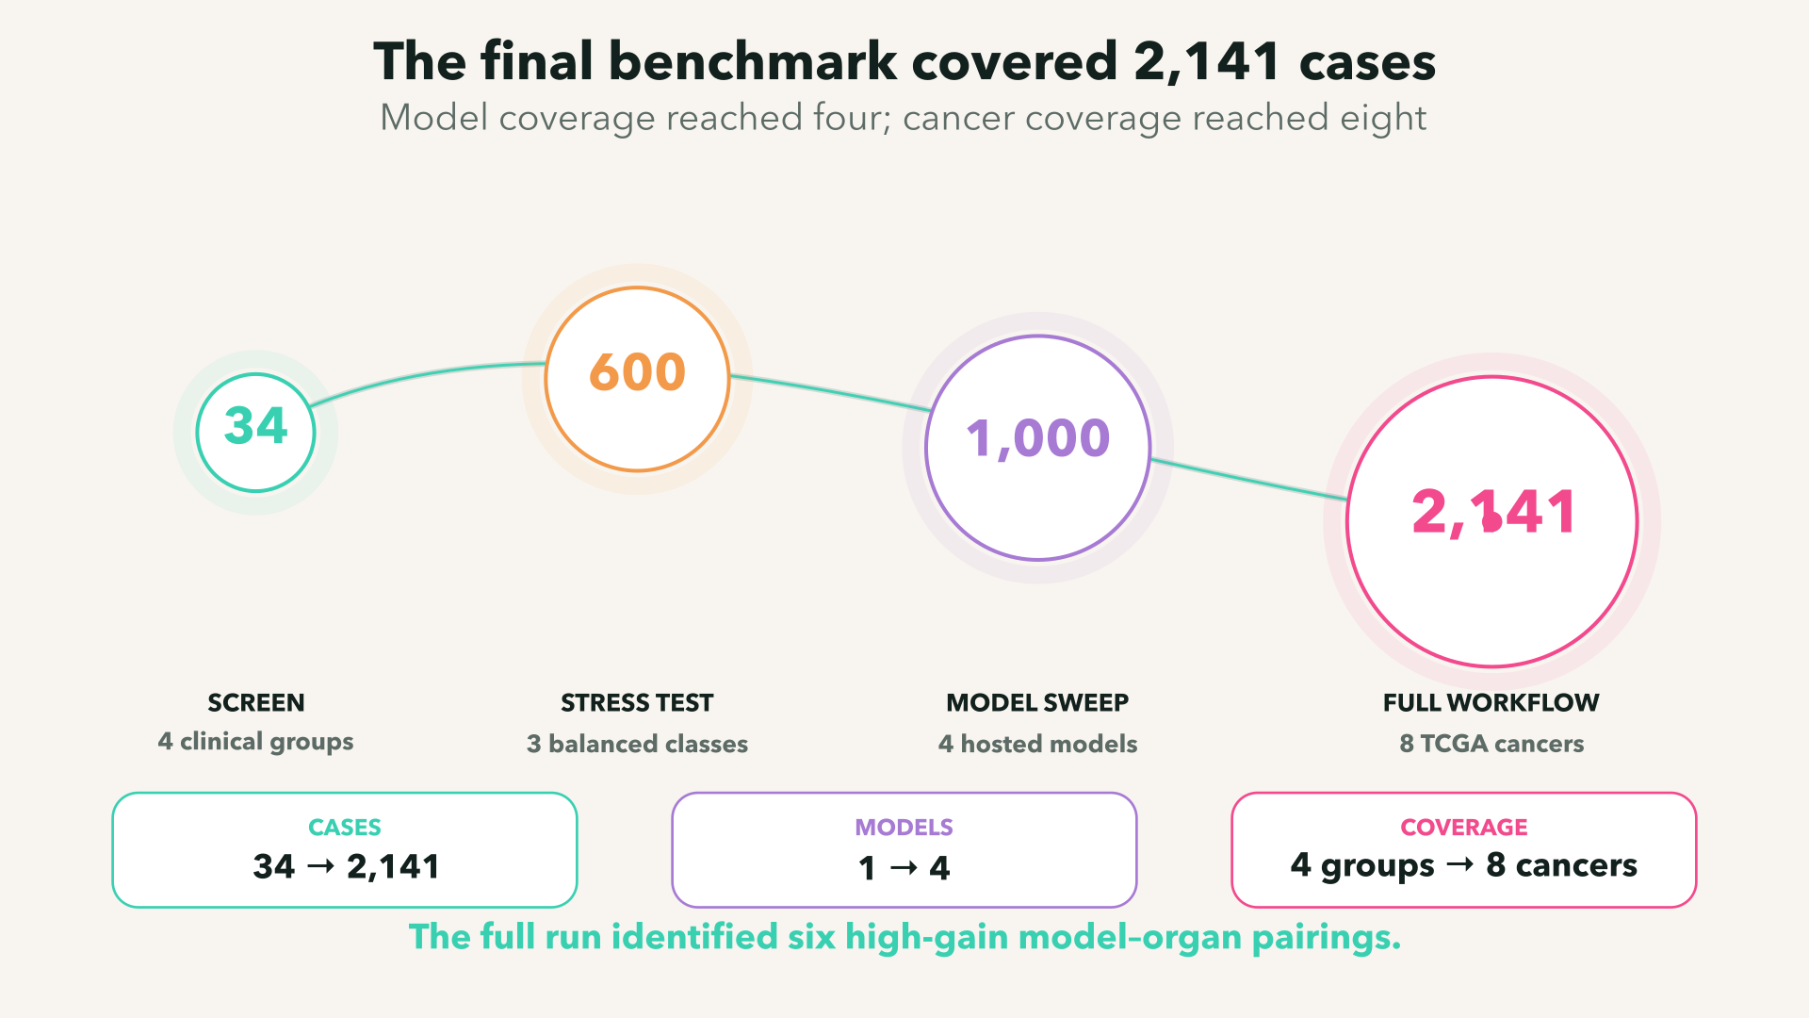
08
Notes:
Visualization authored in Manim Community v0.22.0 from repository benchmark records.

Slide 9
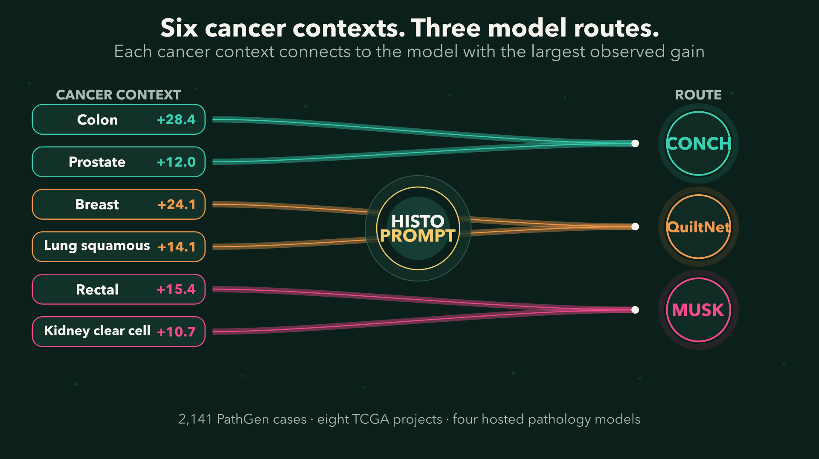
09
Notes:
Visualization authored in Manim Community v0.22.0 from the saved 2,141-case PathGen benchmark.

Slide 10
Colon was the clearest multi-model success
Two independent pathology models improved substantially on the same 422-case PathGen cohort.
+28.4
points · CONCH
+24.6
points · QuiltNet
Both models improve on the same 422-case cohort.
Source: TCGA-COAD subset, pathgen-clinical-workflow results
10
Notes:
CONCH: 77/422 to 197/422. QuiltNet: 15/422 to 119/422.

Slide 11
Breast showed gains across three models
QuiltNet delivered the largest improvement, with CONCH and PLIP moving in the same direction.
+24.1
QuiltNet points
+8.8
CONCH points
+4.2
PLIP points
Source: TCGA-BRCA subset, pathgen-clinical-workflow results
11
Notes:
QuiltNet: 25/216 to 77/216. CONCH: 56/216 to 75/216. PLIP: 2/216 to 11/216.

Slide 12
MUSK reached 71.2% on rectal adenocarcinoma
Case-specific prompting added 24 correct classifications on the 156-case cohort.
+15.4
percentage points
87 → 111
correct cases
Source: TCGA-READ subset, pathgen-clinical-workflow results
12
Notes:
MUSK exact result: 87/156 baseline to 111/156 case-specific.

Slide 13
The routing pattern repeated in kidney and lung squamous
Kidney selected MUSK; lung squamous selected QuiltNet.
Kidney clear cell
Lung squamous
MUSK
QuiltNet
20.3%
→
31.1%
2.3%
→
16.3%
+10.7
+14.1
points
points
89 → 136 correct
6 → 43 correct
Source: TCGA-KIRC and TCGA-LUSC subsets
13
Notes:
Kidney MUSK: 89/438 to 136/438. Lung squamous QuiltNet: 6/263 to 43/263.

Slide 14
CONCH crossed 72% on prostate adenocarcinoma
The case-specific prompt improved accuracy by 12 points across 208 PathGen cases.
+12.0
percentage points
125 → 150
correct cases
Source: TCGA-PRAD subset, pathgen-clinical-workflow results
14
Notes:
CONCH exact result: 125/208 baseline to 150/208 case-specific.

Slide 15
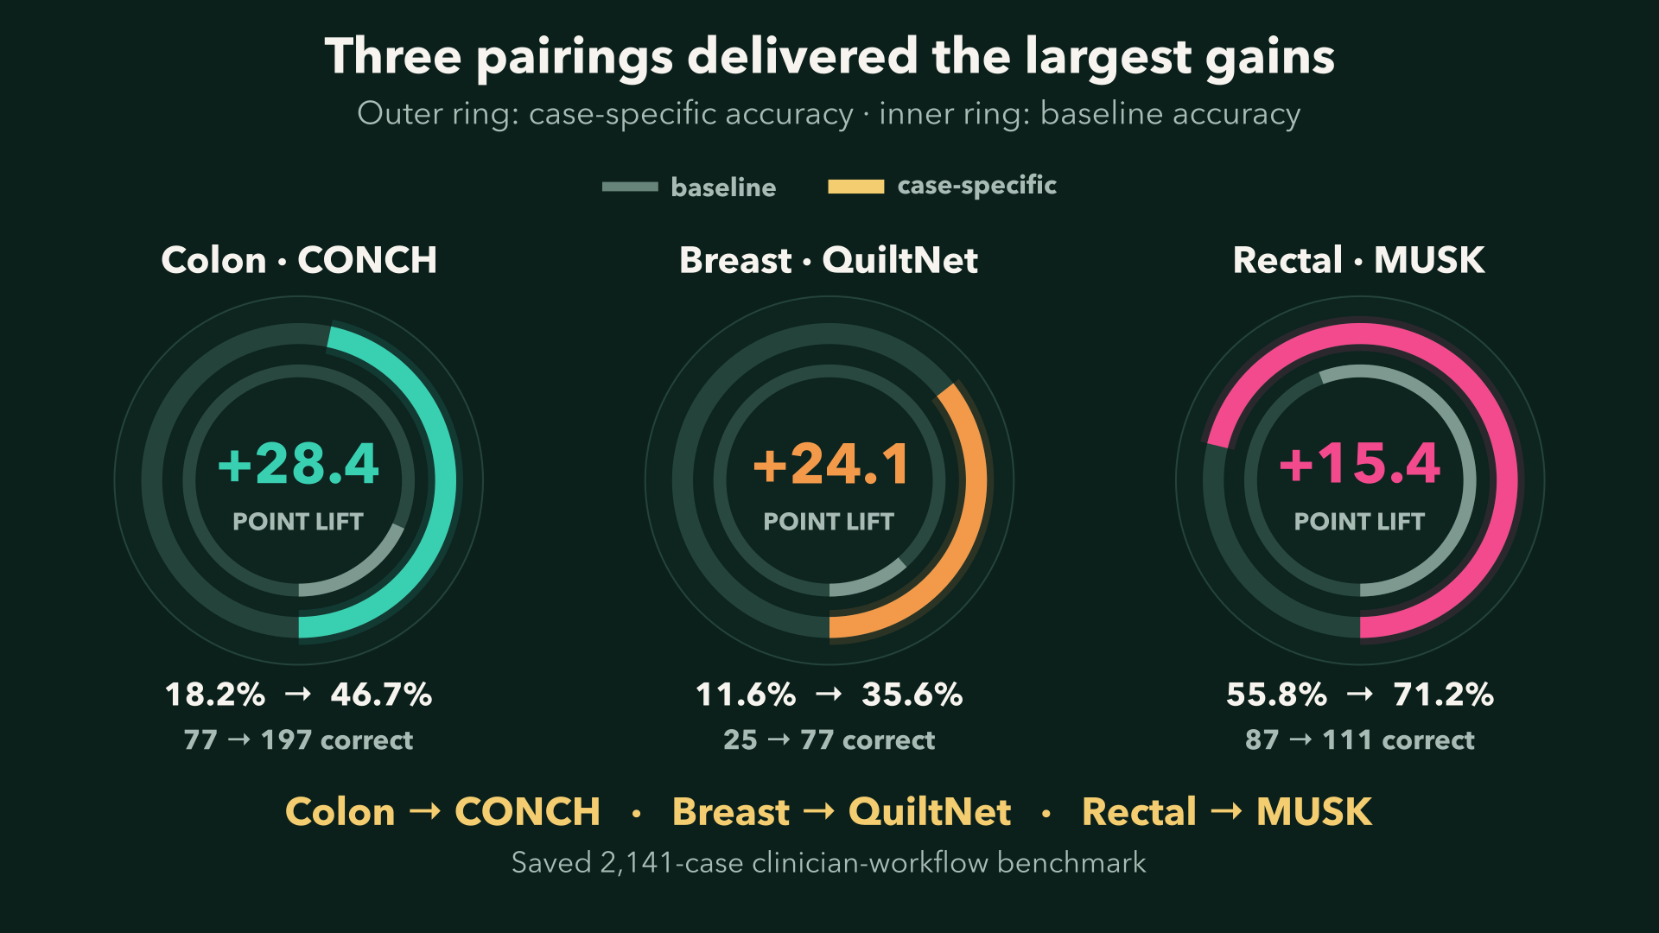
15
Notes:
Visualization authored in Manim Community v0.22.0. Exact values come from the saved PathGen clinician-workflow benchmark.

Slide 16
Independent tuning added 4.4 points for two models
The search used a development set, confirmation set, and frozen 450-image held-out lung test for each model.
+20
MUSK correct cases
+20
PLIP correct cases
Each model received its own prompt search.
Source: benchmarks/lc25000-tuning results
16
Notes:
MUSK: 403/450 to 423/450. PLIP: 373/450 to 393/450. Only the two models with held-out gains are shown on this success slide.

Slide 17
One tuned template added 66 correct MUSK predictions
Held-out evaluation covered lung, colon, CRC9 tissue classes, and PatchCamelyon metastasis.
Four tasks
MUSK held-out total
LC25000 lung
LC25000 colon
CRC9 tissue classes
PatchCamelyon metastasis
1,444
→
1,510
baseline correct
tuned correct
+66 correct
CRC9: 319 → 364 correct
Shared structure + task-specific language
Shared structure and task-specific phrases produced the 66-case gain.
Source: origin/validated-prompt-tuning at 5ae7423
17
Notes:
Separate research branch. Complete results in the branch cover MUSK across four tasks; this slide does not attribute the branch result to the other models.

Slide 18
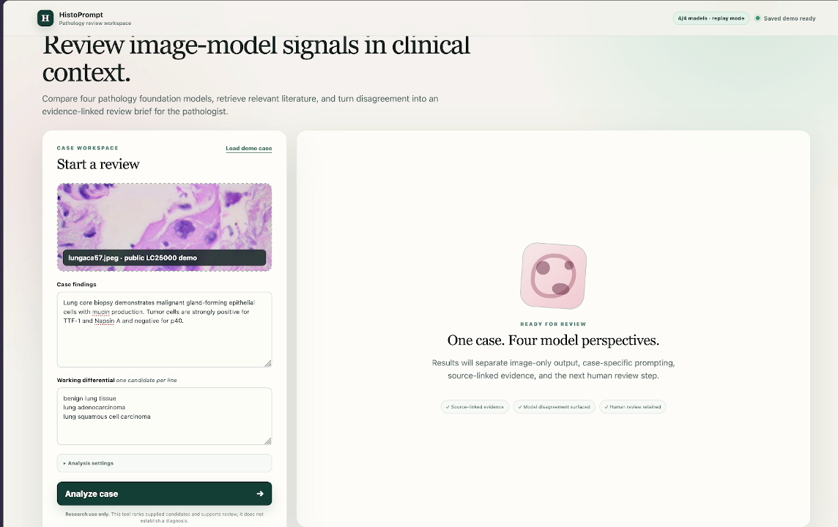
One screen supports a fast clinical review
Inputs, model rankings, evidence, and next actions stay visible.
01
Compare
Four model perspectives on the same differential
02
Trace
Prompts, retrieved evidence, and source passages
03
Act
A concise rationale and next review step
Source: implemented UI and saved demo
18
Notes:
The saved replay supports a reliable judge demo even when temporary event model services are unavailable.

Slide 19
The full benchmark is reproducible
A reusable script preserves the inputs, outputs, checksums, and workflow state.
2,141
SHA-256
1
case records
checksums
fingerprint
Exact report, prompts, model outputs, and review
Images, reports, corpus, and workflow inputs
Models, candidates, retrieval settings, and source
resume
report-only
60
safe reruns
instant summaries
automated tests
Completed matching cases are skipped
No new endpoint calls required
Pipeline, tuning, backends, replay, and setup
One command runs the app. One command rebuilds the benchmark report.
Source: scripts, manifests, case records, workflow fingerprints, tests
19
Notes:
Repository includes setup.sh, run.sh, NCSA tunnel launcher, data manifests, exact benchmark outputs, a saved public replay, and the demo video.

Slide 20
HistoPrompt finds where prompting works
and puts those gains into a usable workflow.
+28.4
+24.1
+15.4
Built with
CONCH · colon
QuiltNet · breast
MUSK · rectal
PathGen
Delta
MUSK
CONCH
QuiltNet
PLIP
Lumen
2,141 cases · 8 cancers · 4 models · 1 reproducible workflow
Next: prospective confirmation of the six model-aware routing targets.
github.com/osirais/histoprompt
Clinician prototype + saved demo + full benchmark
Notes:
Repository: https://github.com/osirais/histoprompt
Primary benchmark: benchmarks/pathgen-clinical-workflow/RESULTS.md
Demo: demo/histoprompt-clinician-workflow-demo.mp4

