Slide 1
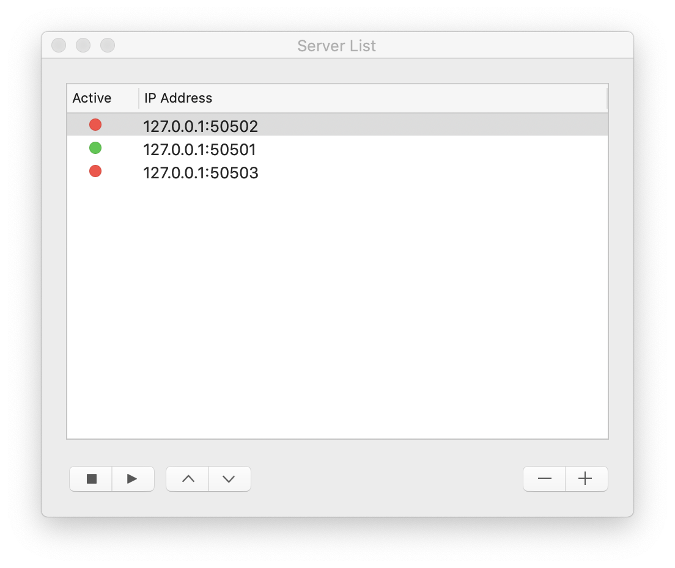
Active server
Inactive server
Remove/add
server
Stop/start
server
Reorder
servers

