Slide 1
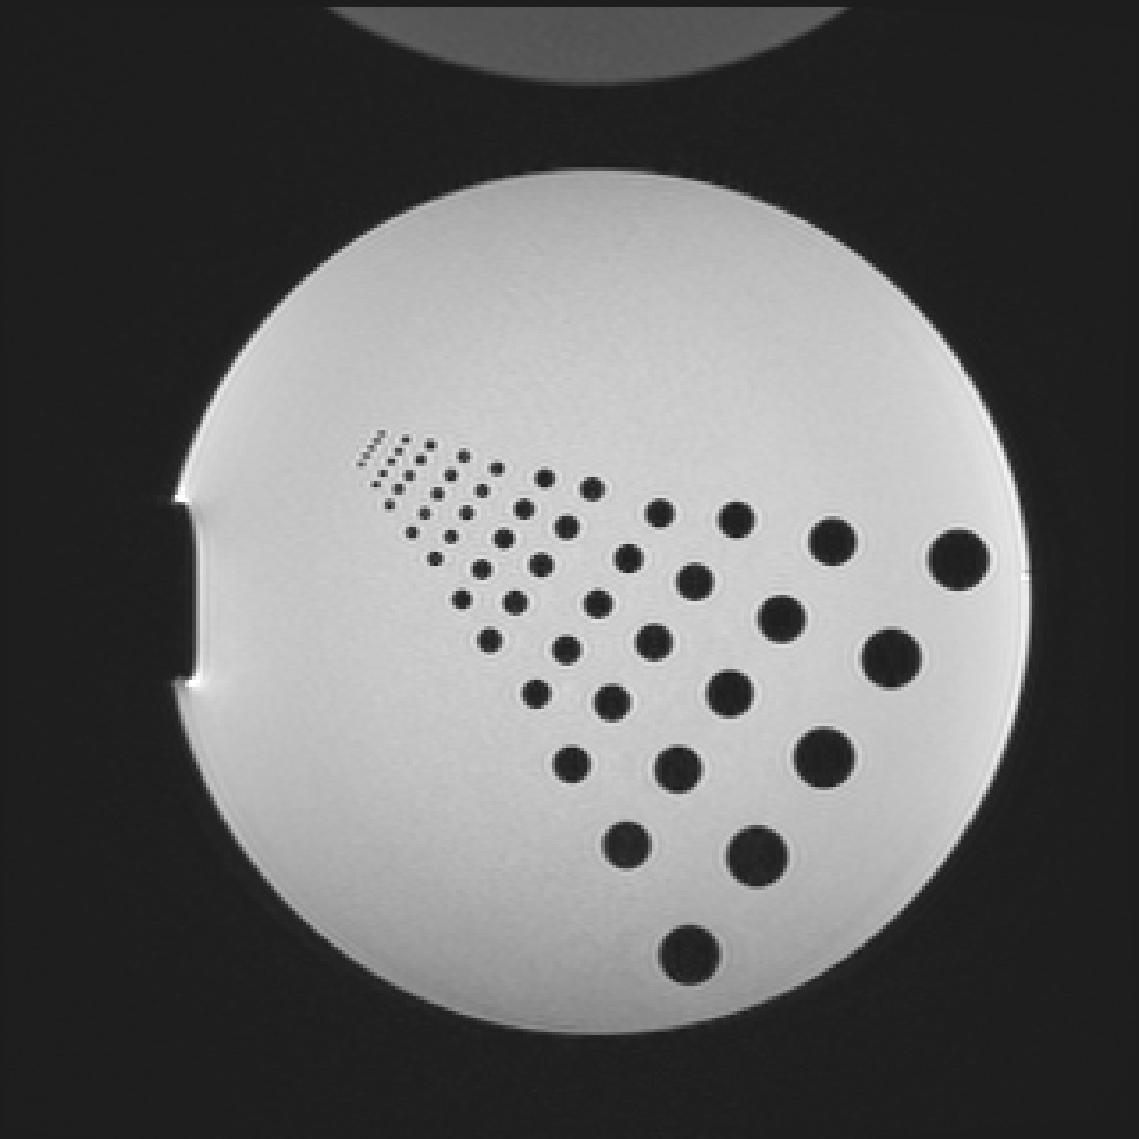

Logo
Right click the image below and hit “Save as Picture…”
Save as “logo.png” in the assets folder of the project documentation.
Research

Slide 2
Favicon
Right click the image below and hit “Save as Picture…”
Save as “favicon.png” in the assets folder of the project documentation.
Run the “create_favicon.py” script as follows:
python create_favicon.py favicon.png favicon.ico
R

Slide 3

README image
Google
An image used for the main README.
Save as “explanation.png” in the assets folder of the project documentation
IP Address
IP Address
DVC
client.py
server.py
gRPC
gRPC

