Slide 1
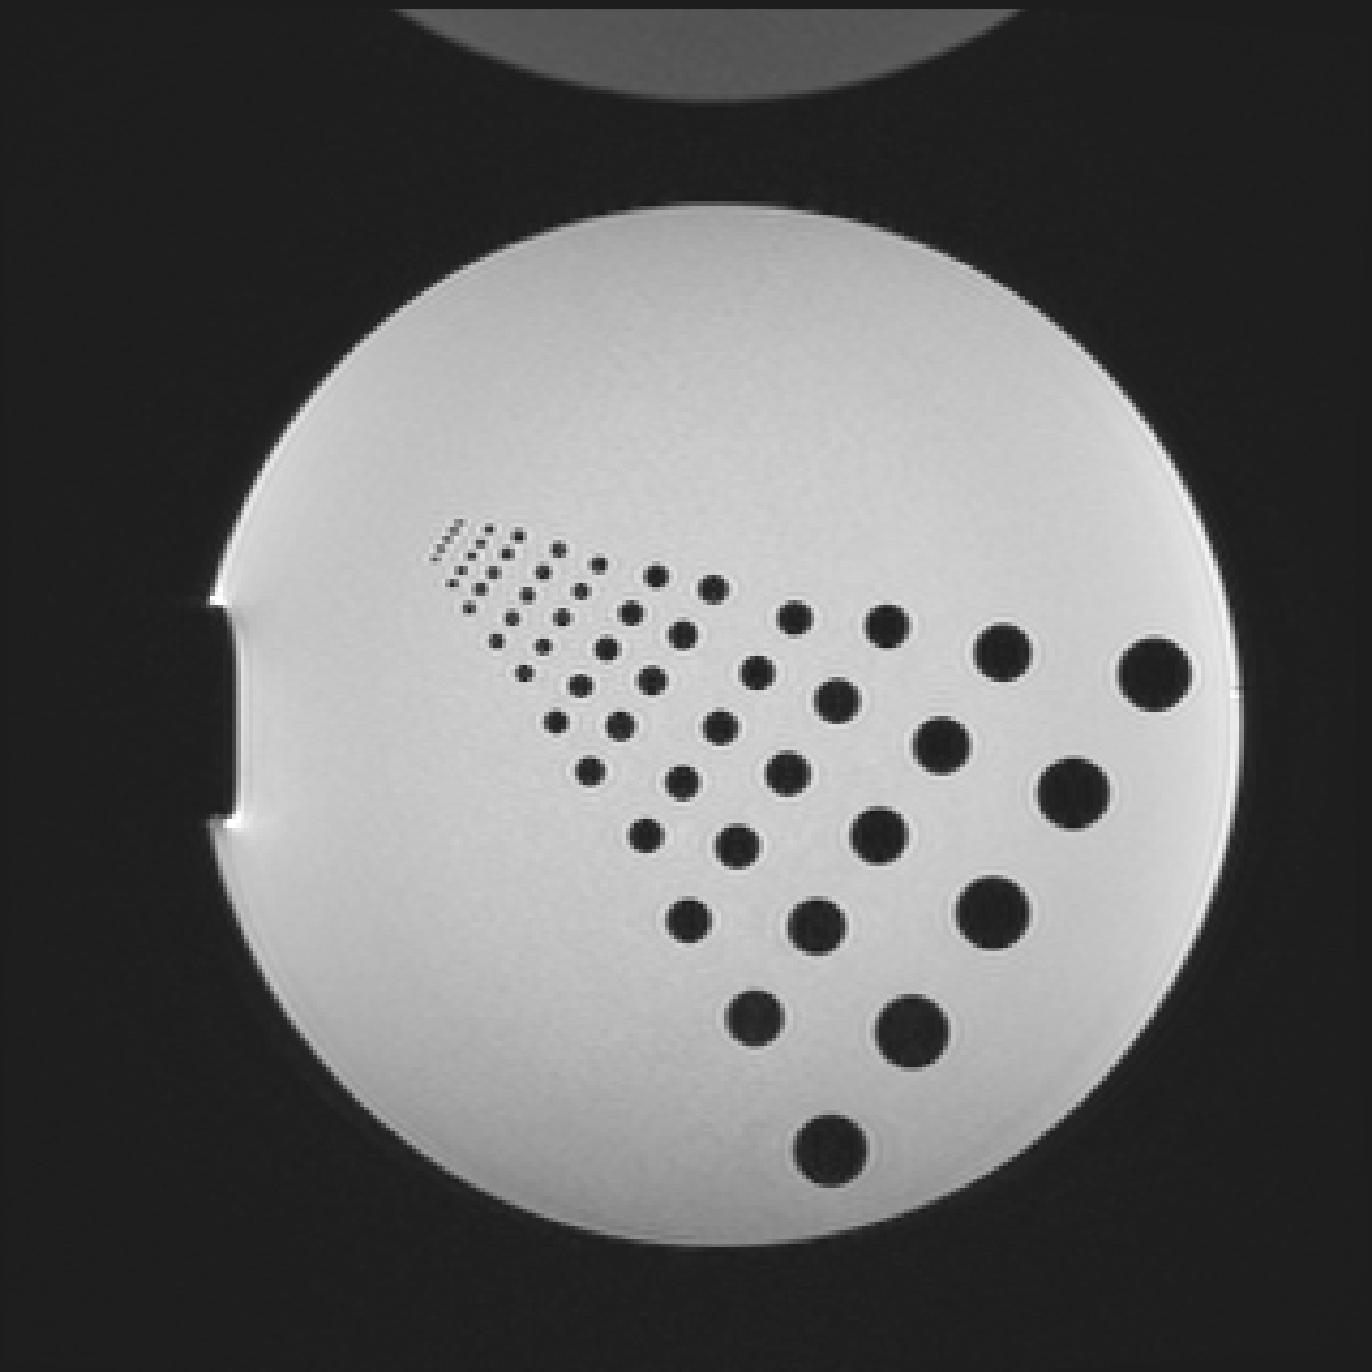

Logo
Right click the image below and hit “Save as Picture…”
Save as “logo.png” in the assets folder of the project documentation.

Slide 2
Favicon
Right click the image below and hit “Save as Picture…”
Save as “favicon.png” in the assets folder of the project documentation.
Run the “create_favicon.py” script as follows:
python create_favicon.py favicon.png favicon.ico
R

