Slide 1
Presentation Outline: Customer Churn Prediction for ConnectTel 1. Introduction 2. Problem Statement 3. Data Overview 4. Exploratory Data Analysis (EDA) 6. Model Development 7. Model TRAINNING & Evaluation 8. Recommendations 9. Conclusion 10. Q&A Session

Slide 2
introduction : overview
ConnectTel is a telecommunications company focused on maintaining business sustainability and growth. However, the company is currently facing challenges in customer retention, which is crucial for its success in the competitive telecom industry. To stay competitive, ConnectTel aims to adopt proactive strategies that enhance customer loyalty and reduce churn.

Slide 3
PROBLEM STATEMENT
Current Challenges
ConnectTel’s existing customer retention strategies are ineffective, leading to the loss of valuable customers to competitors. To address this, the company seeks to develop a robust customer churn prediction system, leveraging advanced analytics and machine learning. This initiative aims to forecast churn accurately and implement targeted retention measures to minimize customer attrition.
Project Aim
Development of a predictive model to forecast churn and enable targeted retention initiatives.

Slide 4
Data Overview
Data sources:
The dataset used for the customer churn prediction project at ConnectTel includes several key types of data about customers. That provide valuable insights into customer behavior, demographics, and interaction with services. Four of the most important features for connectel are monthly charges, payment method, tenure & contract
Data Cleaning:
DATA WAS MAJORLY CLEAN , WITH NO MISSING VALUES

Slide 5
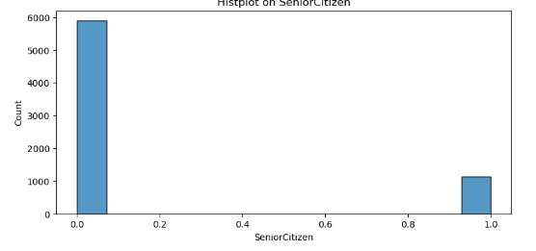
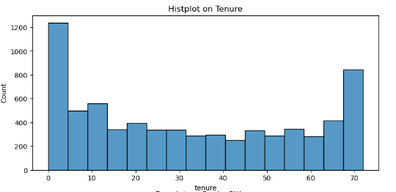
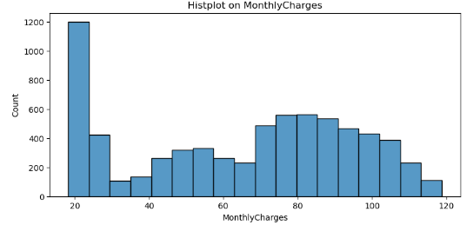
EPLORATORY DATA ANALYSIS(EDA)-NUMERICAL
Univariate Analysis
Naration
Most customers are not senior citizens (about 83.8%); Tenure is quite varied, but mainly skewed to the right, with the majority of customers having between 9 and 55 months of service, Monthly charges vary significantly, but majorly skewed to the left, with most customers paying between 35dollars and 90dollars

Slide 6
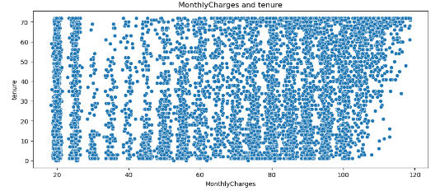
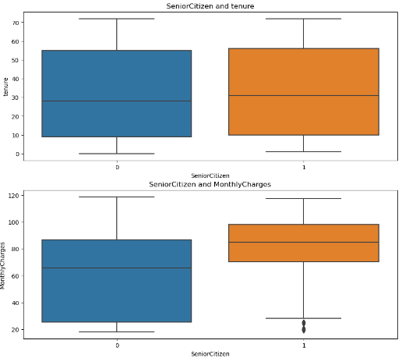
Numerical contd….
Bivariate Analysis
The boxplot[Senior citizen & Tenure], show almost similar patter, however, those of the non-senior citizens are more condensed , meaning that non-senior citizens tend to have shorter tenure in the company . Plot [Senior citizen & Monthly Charges]; indicates that senior citizens generally pay more monthly charges compared to non-senior citizens. there is a wide spread amongst the non-senior citizens - the monthly charges vary, with more people paying fees less than 75dollars. Senior citizens tend to pay more monthly charges, with very few out of the lower range of 25dollars

Slide 7
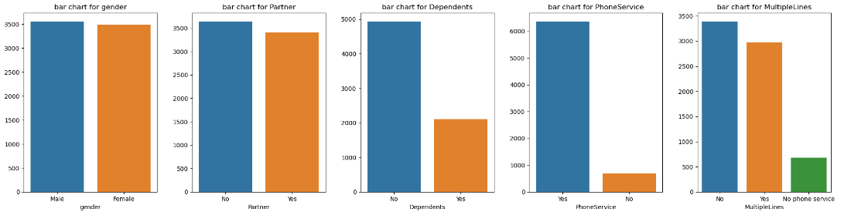
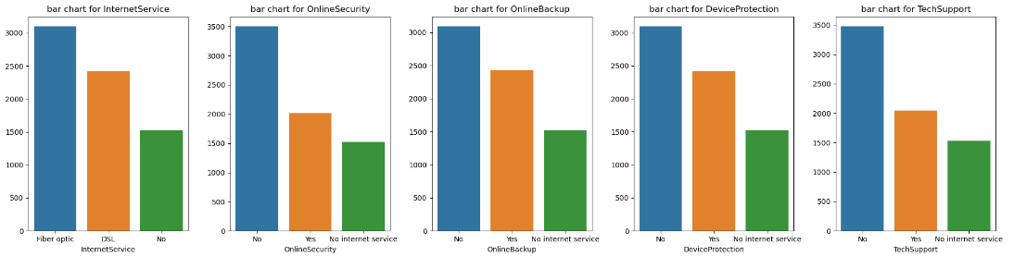
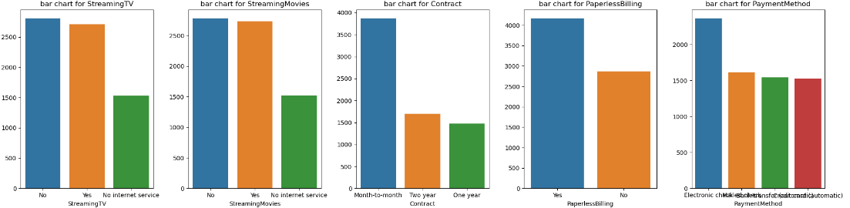
EPLORATORY DATA ANALYSIS(EDA)-categorical(univariate)
There is no pattern for the categorical features, but its observes that there are is no gender imbalance amongst the customers, regardless of if they are senior citizens or not , as the ration of male to female is 50.48% vs 49.52%

Slide 8
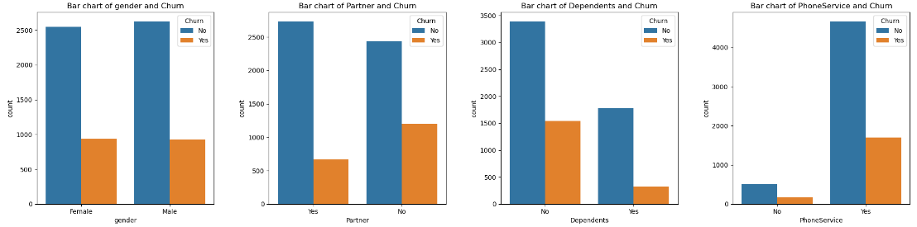
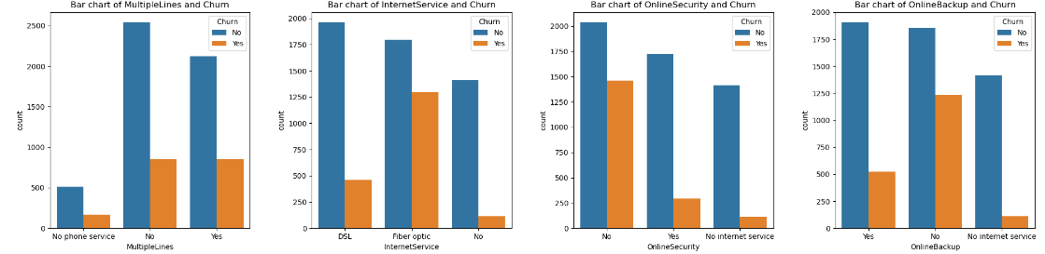
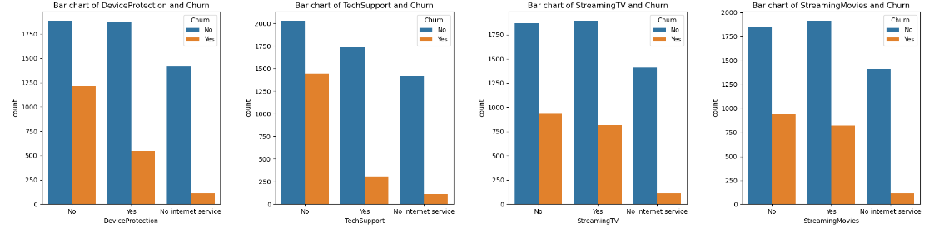
(EDA)-categorical(bivariate)
People with partners are less likely to churn than people without partners. There are more people with partners within connecttel . There is no bias between male and female as it relates to churn
People that get technical support are less likely to churn compared to those that do not
Overall from the analysis, people that receive a variety of service from connecttel are less likely to churn

Slide 9
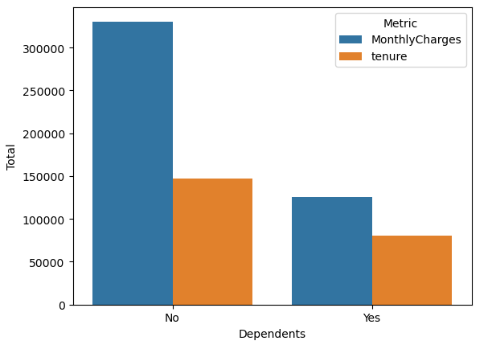
MULTIVARIATE ANALYSIS
Customers with partners have lesser monthly charges and are more than 50% likely to churn ; whereas customers without dependents have higher monthly charges and are less likely to churn

Slide 10
Model Development
# Encode categorical variables
# Assign a label to the 'churn' feature and Dropped the label (this will now be the feature for training the model)
# Split data into Train and Test & Scaled the data ( Using either min-max Scaler OR Standard Scaler)
# Train the model
NB: The codes used to perform the various steps and the results are in the notebook

Slide 11
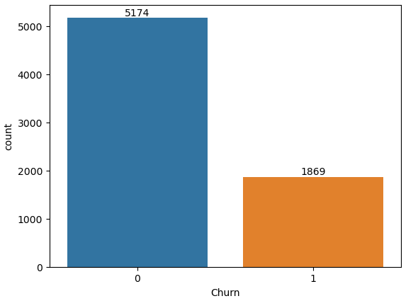
Model TRAINNING & Evaluation
ConnectTel aims to develop a robust customer churn prediction system . The company seeks to accurately forecast customer churn and implement targeted retention initiatives ; By this , it means that the company favors CLASS1 (CHURN)
The plot means that approximately 26% of the customers will churn ; as there is a serious class imbalance. This has to be taken care of in the model, as connecttel seems to want to prevent customer churn . What is important to the company is RECALL
Syntax
ax=sns.countplot(x=df["Churn"], order=df["Churn"].value_counts(ascending=False).index)values=df["Churn"].value_counts(ascending=False).valuesax.bar_label(container=ax.containers[0],labels=values);

Slide 12
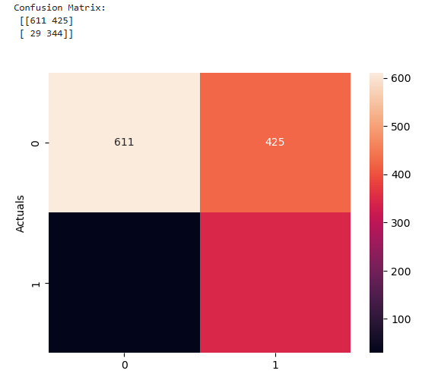
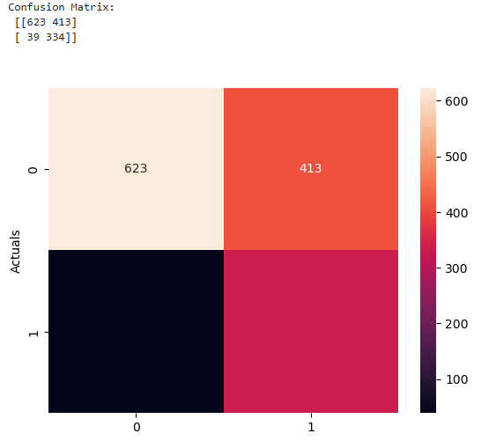
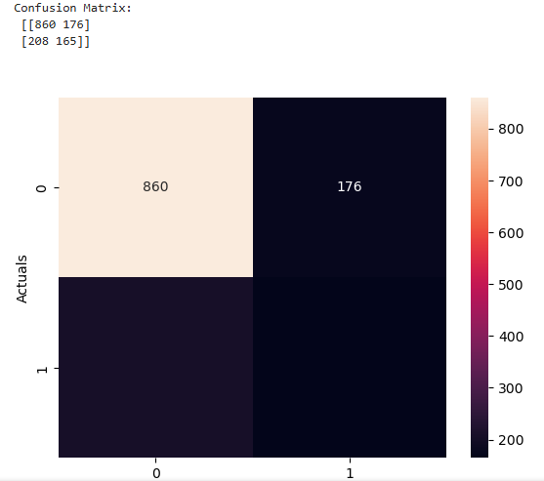
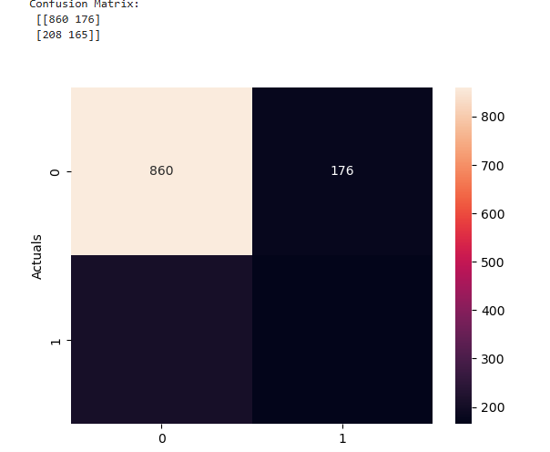
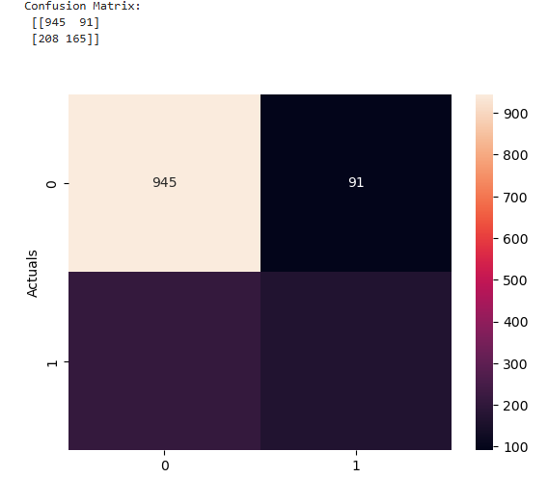
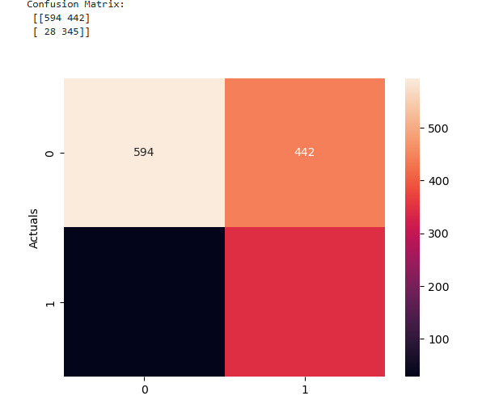
Model TRAINNING & Evaluation…….contd
In all FIVE (5) ml models were trained
Codes in Jupiter notebook
TRAINED MODEL : svc , sgd , logistic regression, RANDOMFOREST, DECISIONTREE.
Logistic Regression
SDGClassifier
Decision Tree
Random Forest
SVC

Slide 13
Model evaluation….
 | Recall | Accuracy | Precision | F1-Score
Logistic Regression | 92% | 68% | 45% | 60%
SVC | 92% | 67% | 44% | 59%
SGD | 90% | 68% | 45% | 60%
NB: These are on CLASS1
Both Logistic Regression and SVC performed similar , however , due to higher percentages of other measures, Logistic Regression was favored.
DEFINITIONS:
Recall= TP/(TP+FN): from all the positive classes, how many we predicted correctly. Recall should be high as possible.¶
Precision= TP/(TP+FP): from all the classes we have predicted as positive, how many are actually positive. Precision should be high as possible.
Accuracy: From all the classes (positive and negative), how many of them we have predicted correctly. Accuracy should be high as possible.

Slide 14
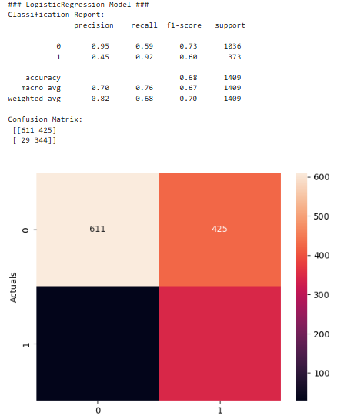
Apply Hyperparameter tuning for Logistic Regression to so see if it gets better
After hyper tunning slightly reduced the nominal value of FN and increased the TP , but still retained Recall value @ 92%
Recommendation will be for connecttel to use Logistic Regression machine learning model to predict customer churn
This is chosen as the number of FN is lowest 7% amongst other models

Slide 15
Recommendations
Provide tailored discounts or incentives to at-risk customers based on their usage patterns.
Regularly gather feedback from at-risk customers to address issues early.
Enhance support quality with faster response times and multiple support channels.
Offer incentives (upgraded devices, discounts) to encourage contract renewals before expiration.
Engage customers with personalized content, usage tips, and exclusive benefits to strengthen relationships.
Offer alternative service plans to customers who over- or under-utilize their current plans.
Implement a loyalty program that rewards long-term customers with exclusive offers and benefits.
Propose relevant upsell opportunities, such as discounted data bundles, to increase engagement.
Targeted Retention Strategies

Slide 16
Question & Answers

