Slide 1
Automated Web Testing With Selenium And WebDriver Using Java

Slide 2


Slide 3
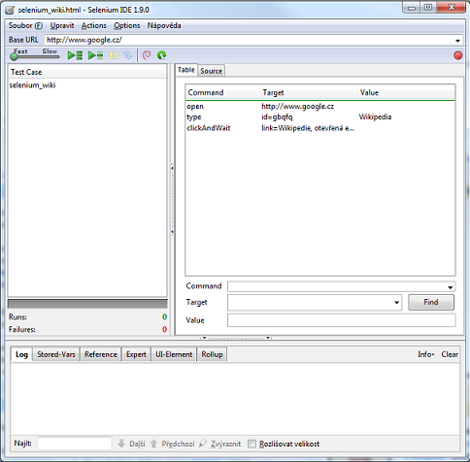
Selenium IDE
Selenium IDE is a Firefox extension that allow us to record our navigatio in a web site

Slide 4
References https://www.seleniumhq.org/ https://www.seleniumhq.org/download/#selenium_ide

Slide 5
Demo: Execution Sample

Slide 6
Automated testing
Why automate testing
It help us to not re-introduce bugs into our code base.
Now a days Is common to develop apps in a concurrent way, so we can just run the automated test in all location.
It test just like an end user does.

Slide 7
Java
Python
C#
Ruby
WebDriver
Chrome
Firefox
IE
Safari

Slide 8
Summary
Selenium Ide
Webdriver
Why?
Architecture

Slide 9
WebDriver

Slide 10
WebDriver
Webdriver is the API we’re going to use to control a web browser through a test script, this uses the http to make that communication between the app and the browser

Slide 11
WebDriver setup
Steps to create and configure the java project
Create new maven project
Add the selenium dependencies
Create a new class file with a main method
Set the system property

Slide 12
WebDriver setup
Also instead of adding the system.setproperty (“…”,”…”)
we can just add the value to the environment system variables

Slide 13
Demo --Chrome -- firefox

Slide 14
Finding elements
ClassName
(unique) if not we can index the resoult
ID
Name
(unique)
TagName
CssSelector
LinkText
PartialLinkText
XPath

Slide 15
Demo Finding elements

Slide 16
Web element org.openqa.Selenium All super-interfaces: searchContext,TakeScreenshot All known implementing Classes: RemoteWebElement
clear
click
findElement
findElements
getAttribute
getCssValue
sendKeys
submit
isDisplayed
isEnabled
getLocation
isSelected
getTagName

Slide 17
Demo interaction with the page elements

Slide 18
Summary
Browsers
WebElements
Navigation
Finding elements
Selectors

Slide 19
Applying advanced web-driver techniques

Slide 20
Demo: Playing around with Radio-buttons
checkboxes
lists elements

Slide 21
Using select class

Slide 22
Getting table data
We have a couple of ways to achieve this, the first one is by forcing the result by nesting the calls to the table elements

Slide 23
Getting table data
The other way we have to achieve this is by making usage of the Xpath selectors.

Slide 24
Demo: Getting elements from lists and tables

Slide 25

Explicit waits

Slide 26
Explicit waits
Implicit wait
Implicit wait sets a global setting for our driver, this means that every single time we select something the driver will wait that preset time (Think of this as a timeout)

Slide 27
Explicit waits
Explicit Wait
With explicit waits we call out when something is dynamic and when something isn’t dynamic and the element should be available.
Implicit Wait
Implicit wait sets a global setting for our driver, this means that every single time we select something the driver will wait that preset time

Slide 28
Demo -- waits

Slide 29
Summary
Radio buttons
Checkboxes
Select items
Xpath
Explicit waits vs implicit waits

Slide 30
Selenium Server
We can take one of our selenium scripts and execute them in a cloud or remote base scenario, to do this we direct our script to a server we had configured, and each test can be configure to execute in a different server or use specified driver.
Sample we can have a UNIX server running chrome driver and we can have another one with IOS running a safari driver

Slide 31
Selenium Server the picture
Drivers
Firefox
Server
Chrome
Safary
IE

Slide 32
Selenium Server Grid mode
Grid mode is very similar to Selenium server and in fact is just a functionality built inside of the server.
This technology allow us to take a test and run it in a numerous of machines which are part of the grid

Slide 33
Selenium Server the picture
Drivers
Firefox
Chrome
Drivers
Safary
HUB
IE
Drivers
Chrome
IE

Slide 34
Demo: Selenium Server

Slide 35
Grid Configuration
For this first what we can do is download the stand alone selenium server from:
Https://www.Seleniumhq.Org/download/
This will download a jar file.
The way we configure this is through console, we have to generate the hub, then we have to register the nodes under that hub.

Slide 36
Demo: Selenium Hub

Slide 37
Parallel processing
When we’re executing into a grid we tend to think that all scripts executes in a parallel way, but this is not the case. In order to do this we’ve manually to set this.
So for parallel executions we’re responsible to handle it.

Slide 38
Grid strategies
Small machines
VM/Hypervisors
Docker instances
Amazon EC2
Cloud Foundry

Slide 39
Summary
Grid
Host vs node
Multiple instances
Parallel processing
strategies

