Slide 1
Automated Web Testing With Selenium And WebDriver Using Java

Slide 2


Slide 3
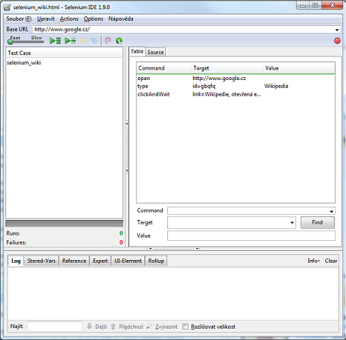
Selenium IDE
Selenium IDE is a Firefox extension that allow us to record our navigatio in a web site

Slide 4
References https://www.seleniumhq.org/ https://www.seleniumhq.org/download/#selenium_ide

Slide 5
Demo: Execution Sample

Slide 6
Automated testing
Why automate testing
It help us to not re-introduce bugs into our code base.
Now a days Is common to develop apps in a concurrent way, so we can just run the automated test in all location.
It test just like an end user does.

Slide 7
Java
Python
C#
Ruby
WebDriver
Chrome
Firefox
IE
Safari

Slide 8
Summary
Selenium Ide
Webdriver
Why?
Architecture

Slide 9
WebDriver

Slide 10
WebDriver
Webdriver is the API we’re going to use to control a web browser through a test script, this uses the http to make that communication between the app and the browser

Slide 11
WebDriver setup
Steps to create and configure the java project
Create new maven project
Add the selenium dependencies
Create a new class file with a main method
Set the system property

Slide 12
WebDriver setup
Also instead of adding the system.setproperty (“…”,”…”)
we can just add the value to the environment system variables

Slide 13
Demo --Chrome -- firefox

Slide 14
Finding elements
ClassName
(unique) if not we can index the resoult
ID
Name
(unique)
TagName
CssSelector
LinkText
PartialLinkText
XPath

Slide 15
Demo Finding elements

Slide 16
Web element org.openqa.Selenium All super-interfaces: searchContext,TakeScreenshot All known implementing Classes: RemoteWebElement
clear
click
findElement
findElements
getAttribute
getCssValue
sendKeys
submit
isDisplayed
isEnabled
getLocation
isSelected
getTagName

Slide 17
Demo interaction with the page elements

Slide 18
Summary
Browsers
WebElements
Navigation
Finding elements
Selectors

Slide 19
Applying advanced webdriver techniques

Slide 20
Demo: Playing around with Radio-buttons
checkboxes
lists elements

Slide 21
Using select class

Slide 22
Getting table data

