Slide 1
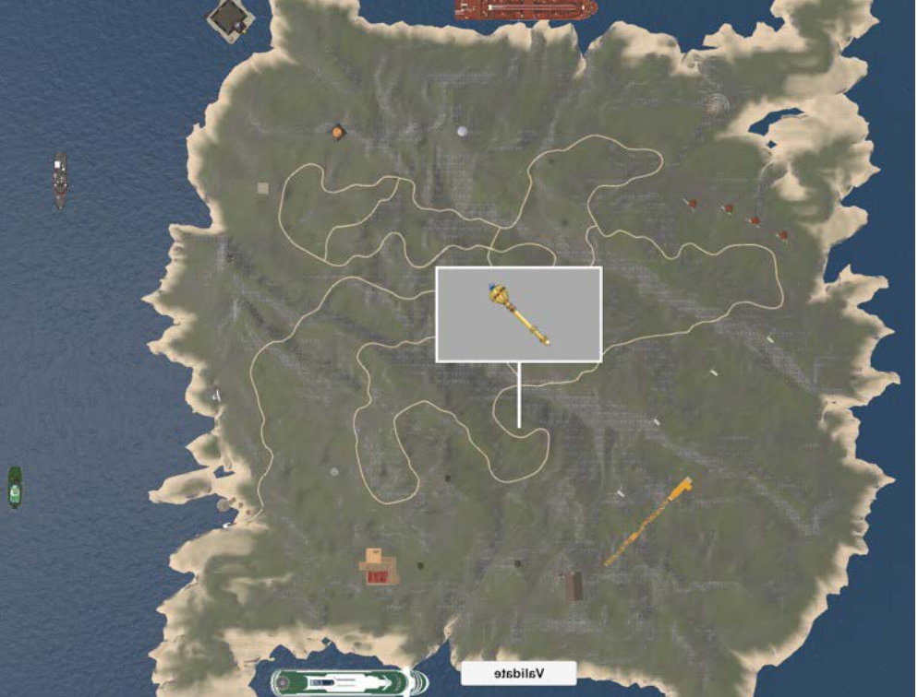
The role of the hippocampus in tracking personal goals
Supervisors: Prof. Dimitri Van De Ville, Dr. Giulia Preti, Dr. Alison Montagrin
Final presentation

Slide 2

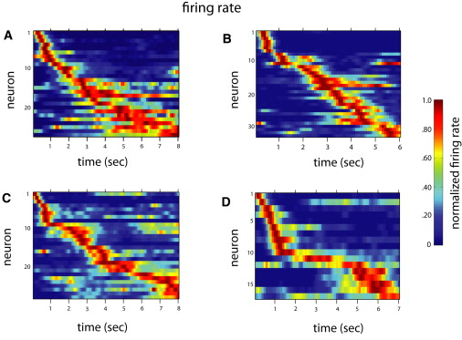
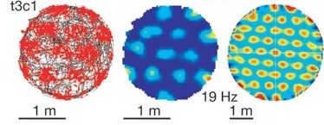
Background
MIP:Lab
Hippocampus
Spatial
Temporal
Place Cells & Grid Cells
Time Cells
O'Keefe et al. 1971, Hafting et al. 2005, MacDonald et al. 2011
Notes:
Place cells focus -> animal -> study this in human

Slide 3
Background
MIP:Lab
Spatial
Place Cells & Grid Cells
O'Keefe et al. 1971, Hafting et al. 2005, MacDonald et al. 2011
Notes:
Place cells focus -> animal -> study this in human

Slide 4
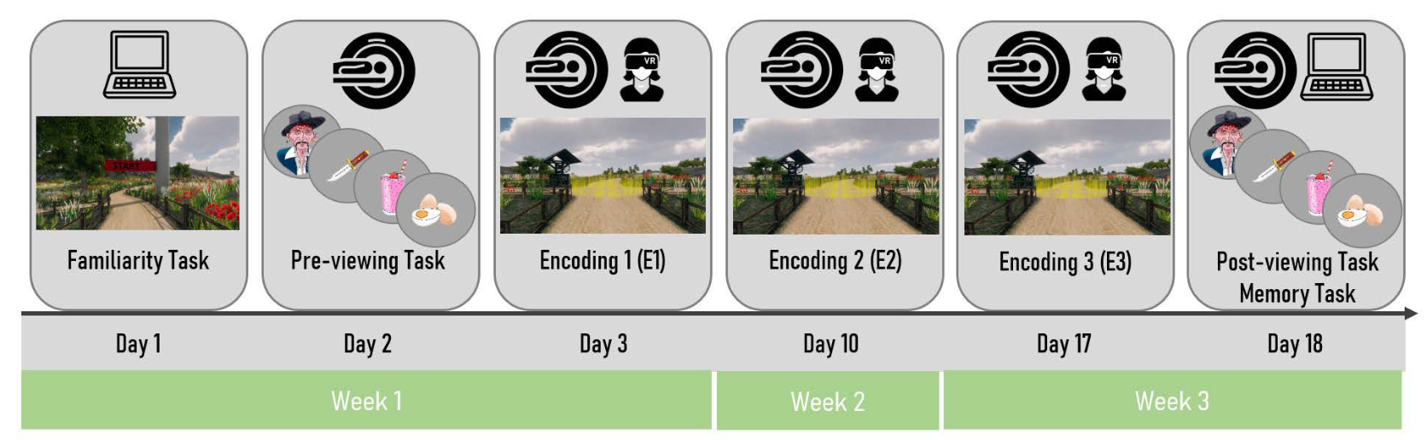
The island Experiment : Intro
MIP:Lab
Notes:
Talk about the memory task outside of fmri -> judgments of distance and temporal
AVOID strong activation hippocampus to new
Relevance allow to select information
USE Task

Slide 5
The island Experiment : Intro
MIP:Lab
64 images
6 repetitions
Different categories
Faces / Objects
Relevant to the task / Irrelevant
Images encountered in the island (old) / new

Slide 6
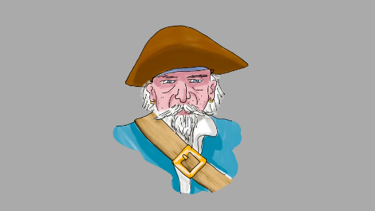
The island Experiment : Intro
MIP:Lab
1. Stimuli Presentation

Slide 7
The island Experiment : Intro
MIP:Lab
1. Stimuli Presentation
2. Ask : « Seen or not Seen »
Seen
Not Seen

Slide 8

The island Experiment : Intro
MIP:Lab
1. Stimuli Presentation
2. Ask : « Seen or not Seen »
3. Ask to place stimuli
If never seen they were asked to place the stimuli in the water
"Stimuli Pos : (-221.7, 88.3, 283.6)"

Slide 9
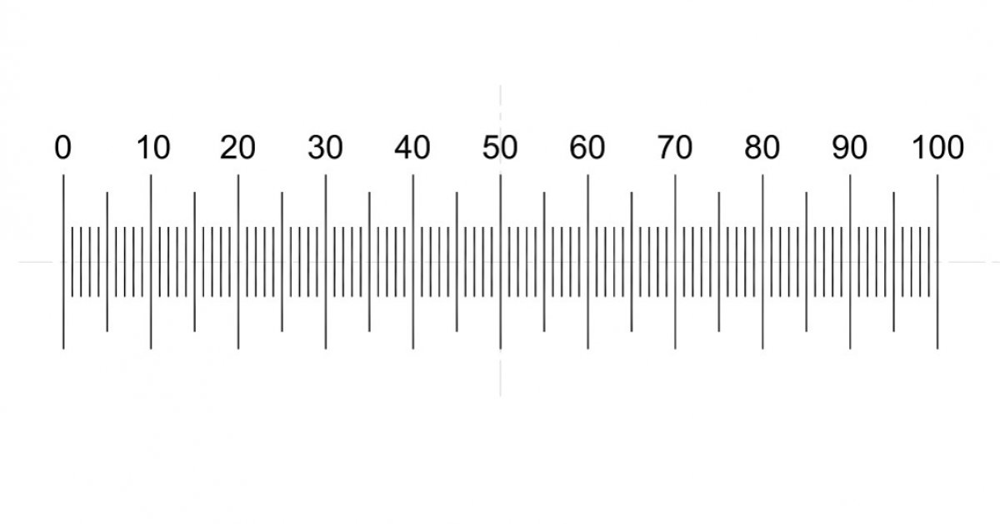
The island Experiment : Intro
MIP:Lab
1. Stimuli Presentation
2. Ask : « Seen or not Seen »
4. Ask to rate placement confidence on a scale from 0 to 100
3. Ask to place stimuli
"23"

Slide 10
The island Experiment : Intro
MIP:Lab
1. Stimuli Presentation
2. Ask : « Seen or not Seen »
3. Ask to place stimuli
4. Ask to rate placement confidence on a scale from 0 to 100
…

Slide 11
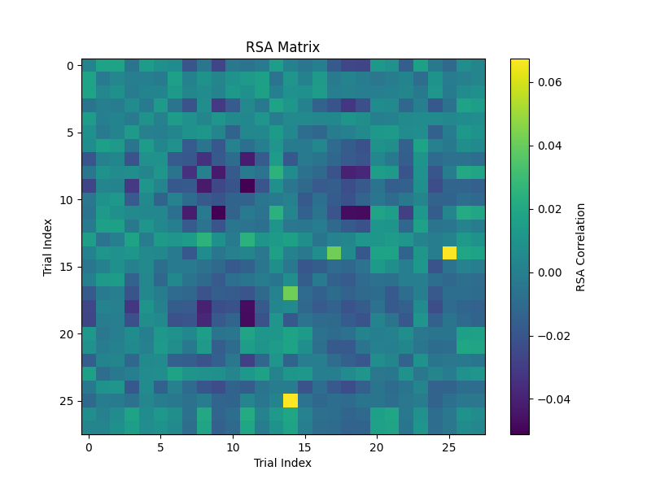
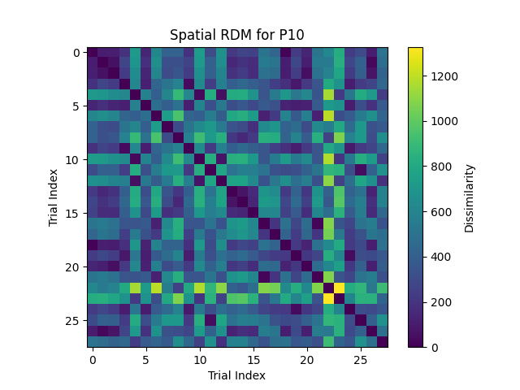
Methods : Deuker et al. RSA
MIP:Lab
Neuronal Matrix
Model Matrix
Notes:
Specify difference in distance judgements

Slide 12
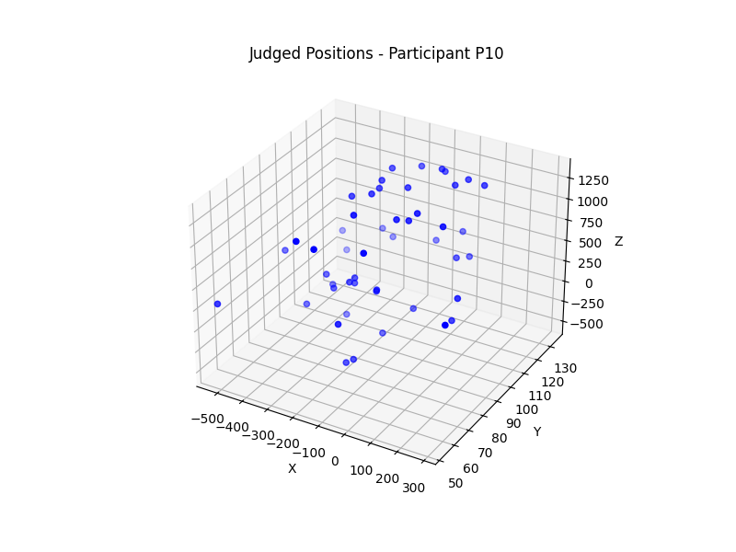
Methods : Model Matrix
MIP:Lab
Distance Calculation
What about Stimuli placed in the Water ? (not seen)
Euclidean distance
All trials were kept regardless of the confidence
Trial Selection
Only old stimuli are of interests
Only True Positive
Discard any trial defined as « unseen » by the patients
17 (35.31%) to 48 (100%), with a mean of 33 (68.75%) images per model RDM
Notes:
# Presentation Plan
## Small Reintroduction
### Focus on memory task -> judgment distances
### Reminder of RSA
## Further Analysis of Old vs. New with derivatives
## Calculation of Judgment distances
### Selection of only True Postive
### Confidence Analysis
## Reproduction Deuker et al results
## Other approaches
### Euclidean distance
### Separation of positive negative
## Conclusions
## Future Directions

Slide 13
Methods : Neuronal Matrix
MIP:Lab
Trial Specific Beta maps for each repetitions (6 X 64 = 384 trials)
GLM Analysis at the Hippocampal level
2. Pearson correlation between flattened beta maps (-1, 1)
Mean across repetitions
Pearson value [-1,1]
Only trials pre-selected for model RDM are kept
[0.002, 0.005, …]
[0.003, - 0.005, …]
No comparison within repetitions

Slide 14
Methods : Deuker et al. RSA
MIP:Lab
Neuronal Matrix
Model Matrix
Post
Post - Pre
Spearman Correlation
Pre
Notes:
Specify difference in distance judgements

Slide 15
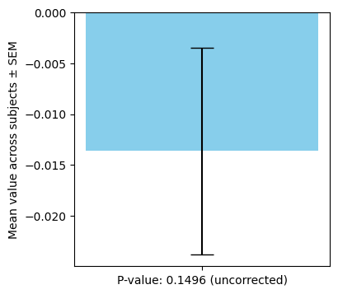
Results
MIP:Lab
Negative correlation (-0.013)
No Significance (p=.1496)
The direction of correlation aligns with literature where neural responses of close memories (in space) are more correlated.
Figure 1. Mean Spearman Correlation coefficiant
Across all subjects. Calculated between pearson neuronal matrix and spatial model matrix
Notes:
Euclidian Distance for RDM

Slide 16
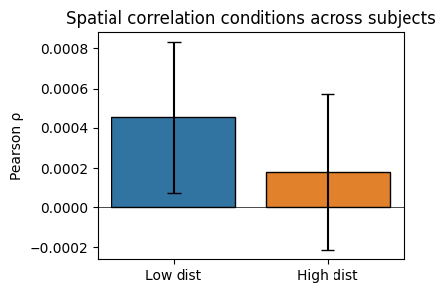
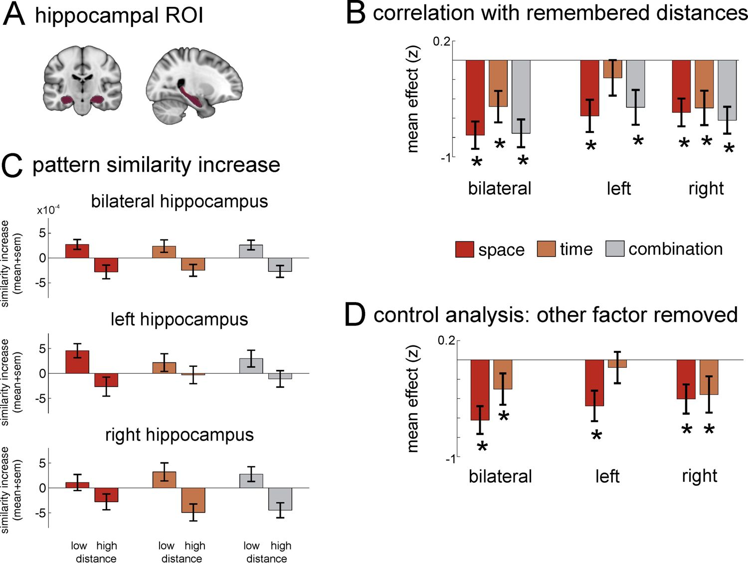
Results : Median Split
MIP:Lab
Divide correlation values by their corresponding distance value (low and high)
Our Results
Deuker et al. Results
Notes:
Euclidian Distance for RDM

Slide 17
Results : Pearson vs euclidean
MIP:Lab
Deuker et al. refer to their metric as a Pattern similarity metric (between low and high values)
Pearson
Euclidean Distance
High similarity
Correlated
High dissimilarity
Vs.
No Correlation
Anti-correlated
Low dissimilarity
Low similarity
Notes:
Euclidian Distance for RDM

Slide 18
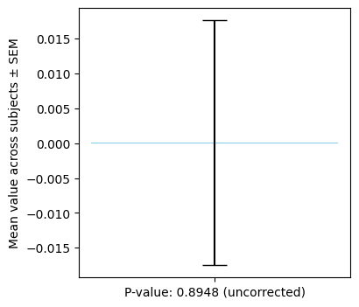
Results : Pearson vs euclidean
MIP:Lab
1. Use euclidean distance as neuronal metric
2. Separative positve and negative pearson’s correlation
Is more anti-correlated [-1,0] treated differently than less correlated [0,1] ?
Correlated
Neuronal Matrix
Model Matrix
No Correlation
Positive [0,1]
Negative [-1,0]
Anti-correlated
Notes:
Euclidian Distance for RDM

Slide 19
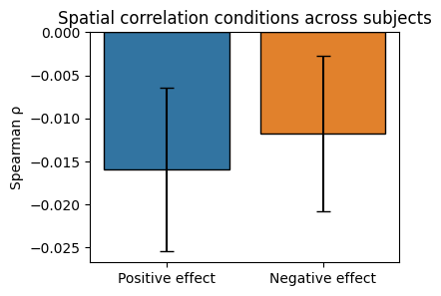
Results : Pearson vs euclidean
MIP:Lab
1. Use euclidean distance as neuronal metric
2. Separative positve and negative pearson’s correlation
Defends the linear aspect of similarity emerging from pearson’s coefficient
Notes:
Euclidian Distance for RDM

Slide 20
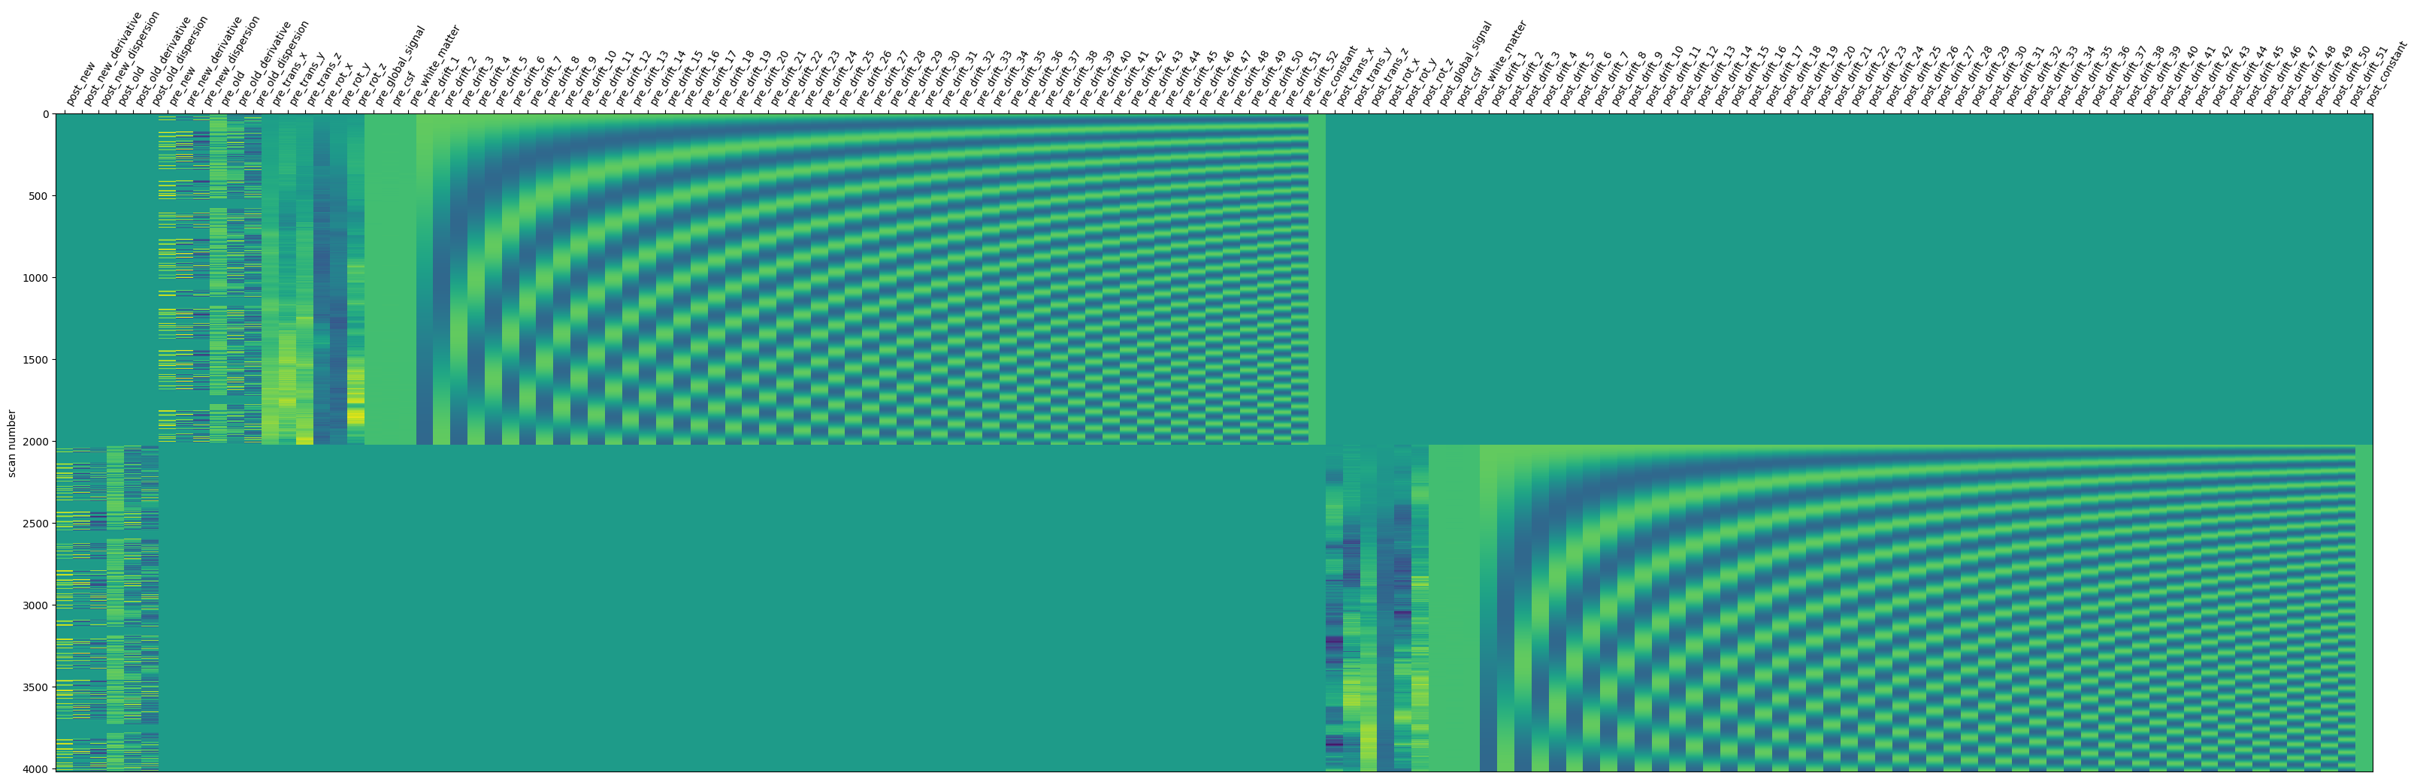
Results : Back to the GLM
MIP:Lab
Correction of the design matrix
Addition of first and second derivatives
Notes:
Euclidian Distance for RDM

Slide 21
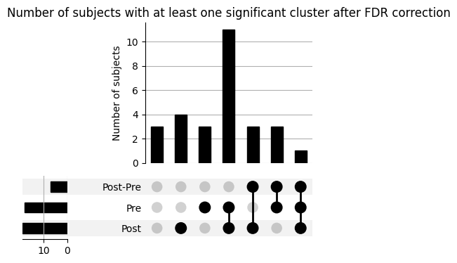
Results : Back to the GLM
MIP:Lab
Old vs. New Contrast
At the group level
At the subject level
No significant cluster for all three pre, post and post-pre sessions after FDR Correction
Notes:
Euclidian Distance for RDM

Slide 22
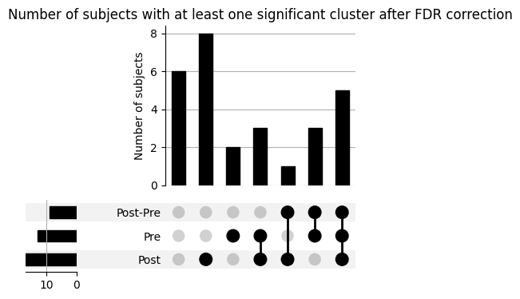
Results : Back to the GLM
MIP:Lab
Random Contrast
Randomly create two groups of trials with equal mean onset time, duration, classes and old vs. new
At the group level
At the subject level
No significant cluster for all three pre, post and post-pre sessions after FDR Correction
Notes:
Euclidian Distance for RDM

Slide 23
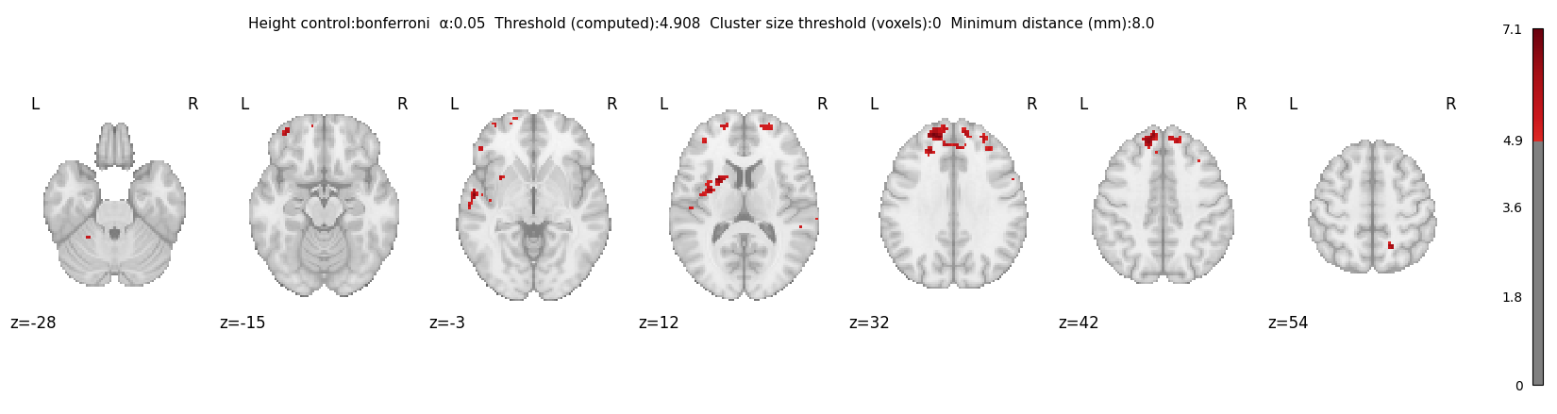
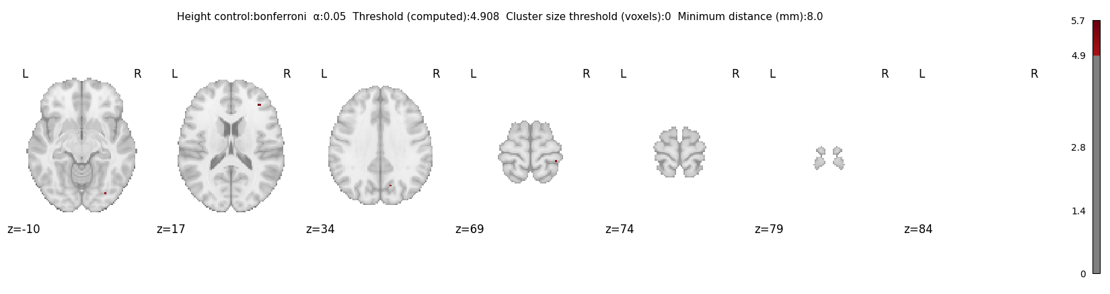
Results : Back to the GLM
MIP:Lab
Old vs. New Contrast
Random Contrast
At the subject level
At the subject level
There still seems to be an effect in some participants
Notes:
Euclidian Distance for RDM

Slide 24
Conclusions
MIP:Lab
More trials to remember (48 vs. 16)
Additional ordering effects and less repetitions (6 against 12 for deuker et al.)
RSA
Different Distance metric as deuker et al.
The data doesn’t show a significant correlation between the subjective spatial map of participants and their hippocampal response
Data preprocessing and GLM analysis
The use of pearson correlation as a similiarty measure is debatable and one should be cautious when drawing conclusions from RSA
GLM
At the group level no significant distinction is observed between new and old stimuli responses, with or without smoothing and at the whole brain level or at the hippocampus level
It is a Picture Viewing Task and not a Memory Task
Although significant distinction between faces and objects is observed
Notes:
Euclidian Distance for RDM

Slide 25


Thank you!
Maria Giulia Preti
Senior Scientist at MIPLAB
Alison Montagrin
Assistant Schwartz Laboratory

Slide 26
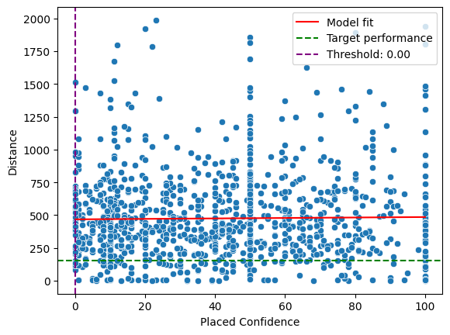
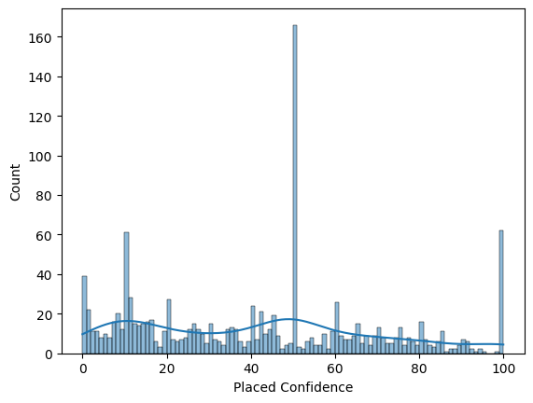
Supplementary Slides

Slide 27
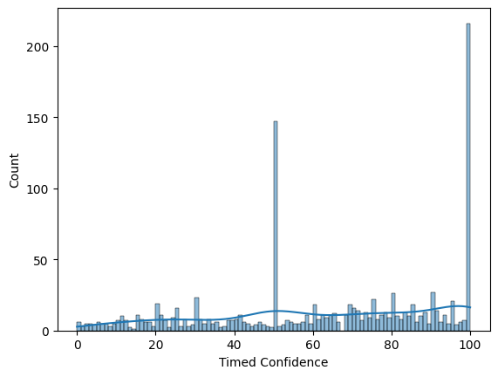
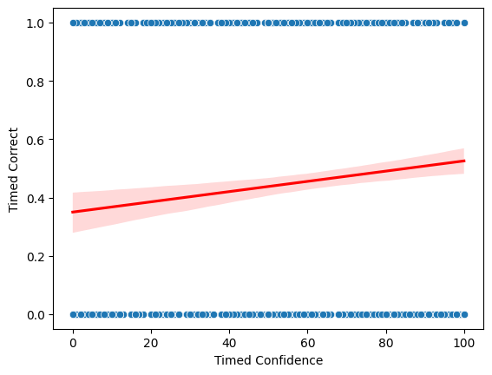
Supplementary Slides

