Slide 1
Force-based layout
of UML class diagrams

Slide 2
Force-based layout of UML class diagrams
Introduction
Background
Improvements
  General improvements
  UML specific improvements
Interactivity
Showcase

Slide 3
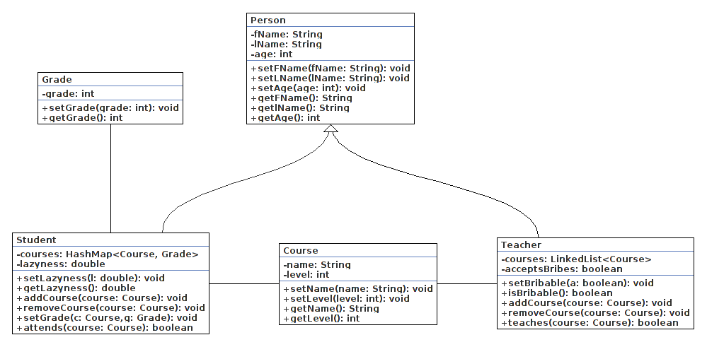
Force-based layout of UML class diagrams

Slide 4
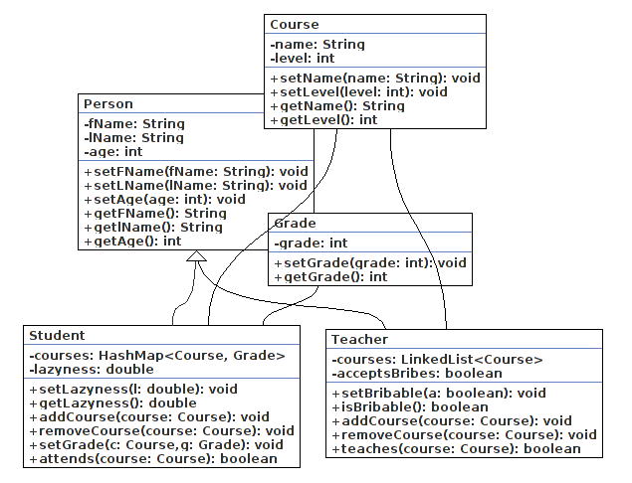
Force-based layout of UML class diagrams

Slide 5
Force-based layout of UML class diagrams

Slide 6
Force-based layout of UML class diagrams
Uses
  Mostly used to on networking graphs

