Slide 1


Geolocation of Swiss Jodel Messages Using Large LMs
Oskar Holm
Norwegian University of Science and Technology

Slide 2
Task Description
Social Media Variety Geolocation
VarDial 2020 and 2021
Input: Jodel/Twitter messages
Output: latitude/longitude pairs
Metric: Median Haversine Distance
Three language areas
Bosnian-Croatian-Montenegrin-Serbian
German
German-speaking Switzerland
Notes:
The task I chose is a shared task from the Workshop on Natural Language Processing for Similar Languages, Varieties, and Dialects (otherwise known as VarDial). The task in question is called “Social Media Variety Geolocation” and was part of the VarDial workshop in both 2020 and 2021.
The task is to predict geolocation, that is, latitude longitude pairs, with Jodel or Twitter messages being the only input. The accuracy metric is Median Haversine distance, with the Haversine formula determining the great-circle distance between two points on a sphere given their longitudes and altitudes.
The shared task includes three subtasks, one for each of these language area:
- Bosnian-Croatian-Montenegrin-Serbian
- German
- German-speaking Switzerland
I decided to focus my efforts on the Swiss subtask, hoping that a model effective for the Swiss dataset could similarly perform well on a Norwegian one, given the comparable richness in dialectal landscapes shared by the two countries.

Slide 3
 | lat | lon | text
0 | 47.22 | 7.43 | Dr Chester Bennington isch tot 😔😔😔 #rip #linki...
1 | 46.86 | 8.21 | Mini Fründin hed Lust uf Doktorspieli gha... ....
2 | 47.39 | 8.18 | Slayer isch besser. Det han ich gescht mini Dr...
3 | 47.37 | 8.78 | gaht au innere stund? bin grad am speck brate ...
4 | 47.39 | 8.04 | sie: thy er: ? sie: thy= thank you er: player ...
Notes:
Here are the first five rows of the training dataset, which in total contains 22600 samples. You have latitudes and longitudes which act as labels, and a text column which serve as input sequences to the models. The development/validation and test datasets both included about 3000 samples.

Slide 4
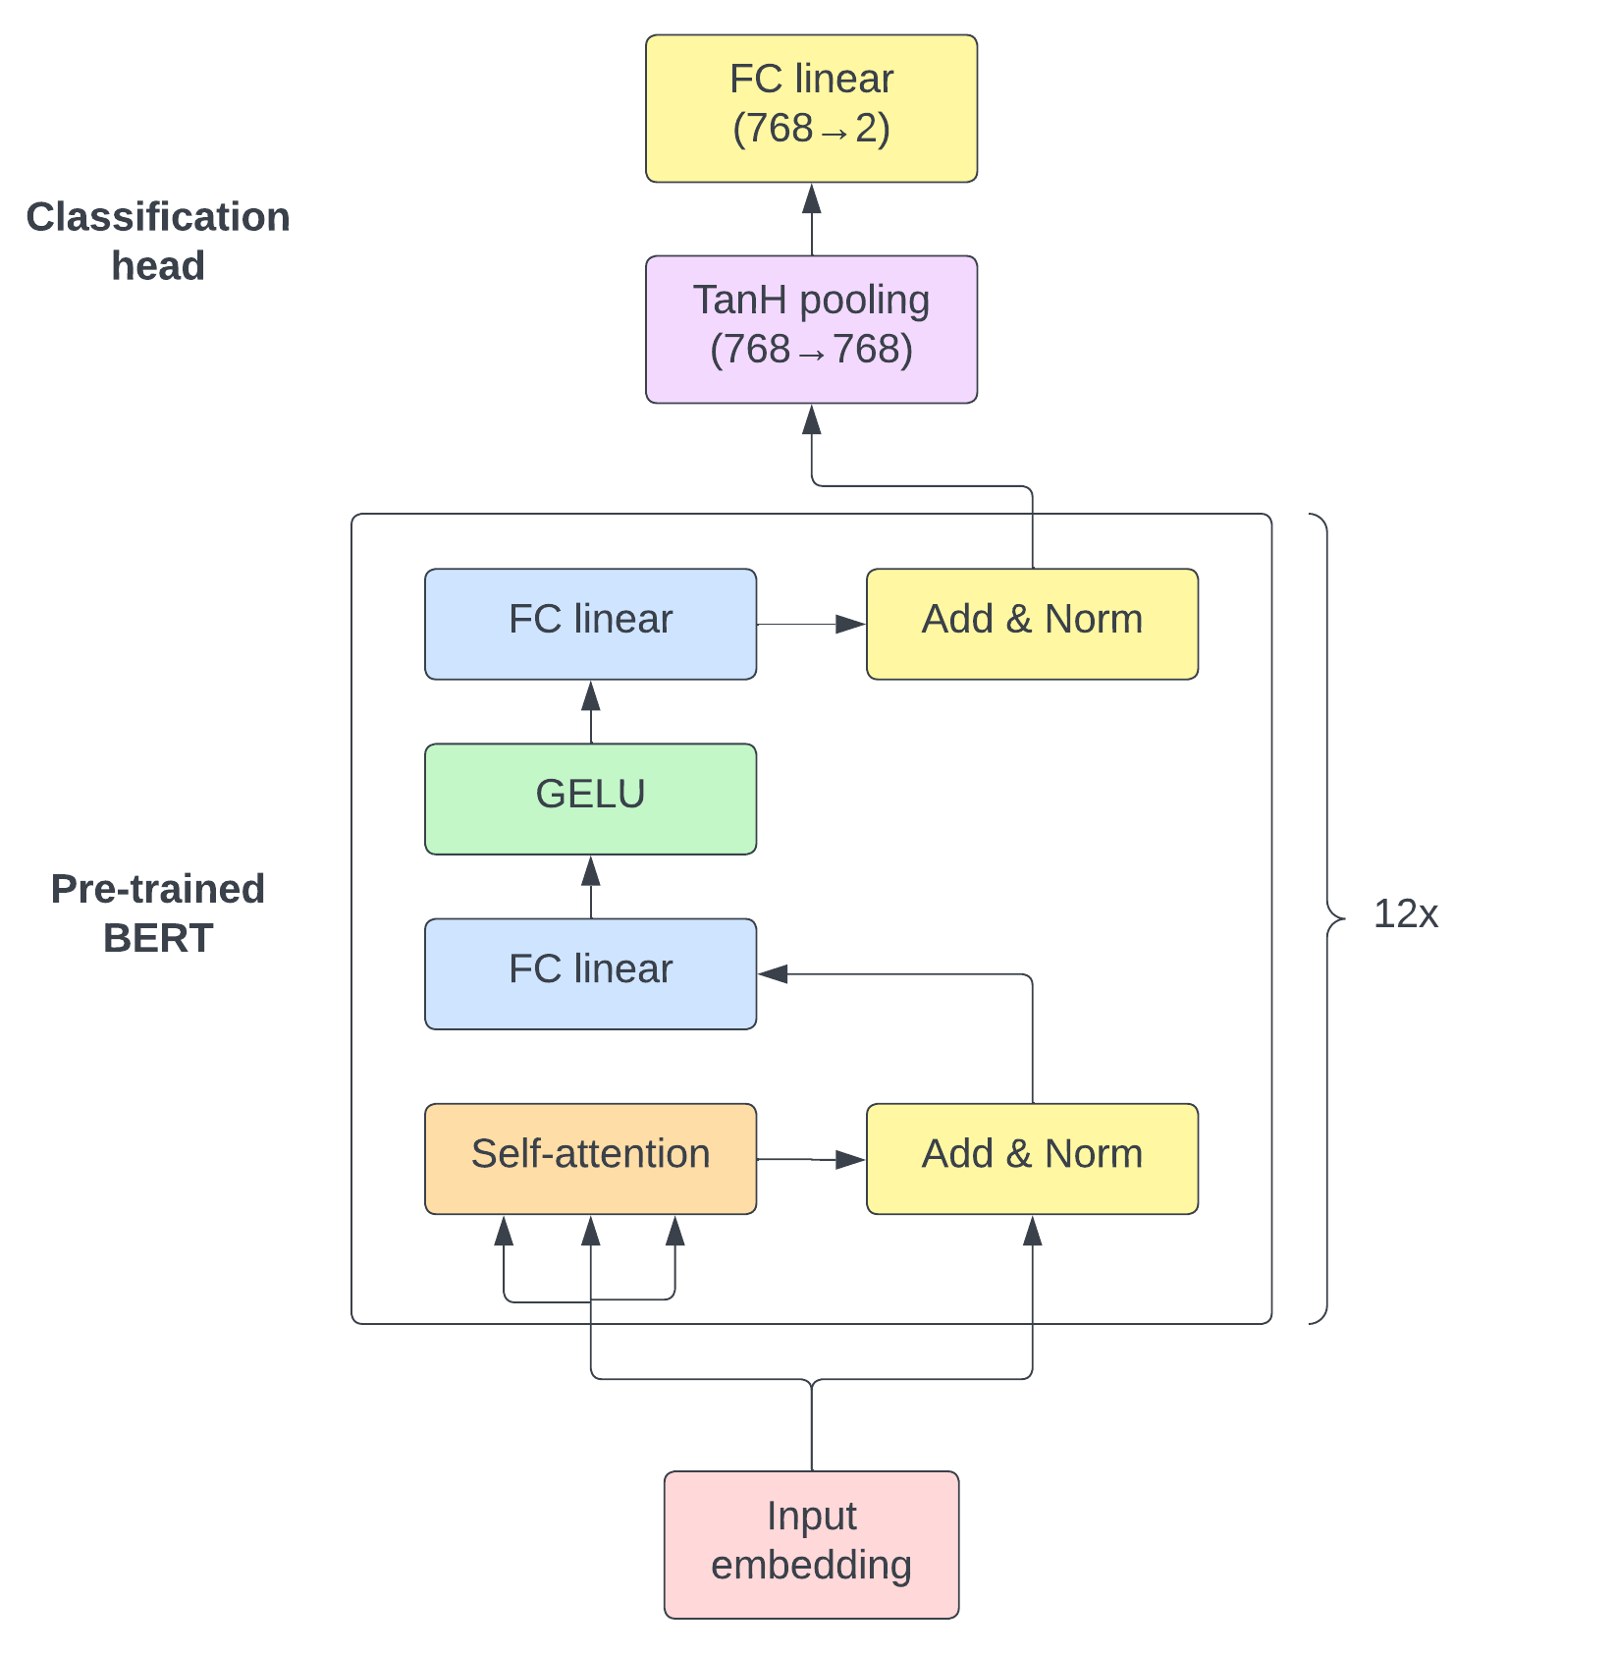
Model Architecture
Pre-trained BERT
Swiss corpora
Fine-tuning
[CLS] token
Linear classification head
Double regression
Notes:
The model consists of a pre-trained BERT model and a classification head. This goes for all the models I trained, except for one where I tried a model based on the multi-lingual X-Mod model. This attempt was not very successful, so I will no talk about it further.
The pre-trained BERT-models are all based on the BERT base model, which is a stack of twelve Transformer encoders, where each encoder output is passed into the next encoder up the stack. This stacking allows the model to learn more complex patterns of different granularities, be it token-level, sentence-level, or document-level.
In order to fine-tune the model for downstream tasks, we use the final layer’s representation of the special [CLS] token as input to a classification head. The [CLS] token serves as an aggregate representation for the entire context of the input sequence and is therefore very useful for downstream tasks. In this case the task is double regression, and so the final fully connected linear layer takes in 768 features, which is the length of the vector representation of the [CLS] token, and outputs a vector with length 2 representing latitude and longitude values.

Slide 5
Method
Pre-trained models
dbmdz/bert-base-german-uncased
statworx/bert-base-german-cased-finetuned-swiss
ZurichNLP/swissbert
Map projections
Latitude/longitude
Metric projections (UTM, LV95)
Learning rates
Fixed
Schedulers
Notes:
When selecting pre-trained models, I was primarily interested in those trained on Swiss corpora. Three different models were tested in this project
- bert-base-german-uncased is a German-language model pre-trained on a Wikipedia dump, EU Bookshop corpus, and more
- bert-base-german-cased-finetuned-swiss is based on bert-base-german-cased and is pre-trained on the Leipzig Corpora Collection (Goldhahn et al., n.d.) and SwissCrawl (Linder et al., 2020, June).
- ZurichNLP/swissbert is based on X-Mod, with adapters trained for German, French, Italian, and Romansh Grishun, which are the four official language of Switzerland
I tried three different ways of representing the coordinates. One method is to change noting and train directly on the raw latitude and longitude coordinates. I also tried using metric projections like UTM and the Swiss-native LV95. Values in UTM and LV95 typically lie in the six-or-seven-figure range, as opposed to latitude and longitude values which range from -90 to 90. and -180 to 180 degrees, respectively. These metric projections are also not spherical representations, unlike the spherical latitude/longitude representation.
I also compared performance between using a low, fixed learning rate, and using a learning rate scheduler like ReduceLROnPlateau.

Slide 6
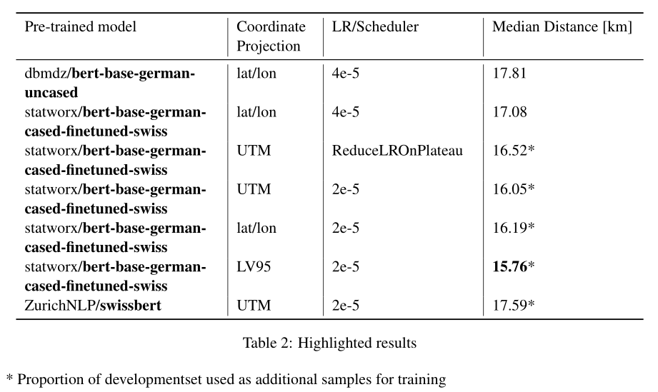
Results
Notes:
I trained a total of 15 models, and here are some highlights.
The best results were achieved when using the bert-base-german-cased-finetuned-swiss pre-trained model with a reduced development/validation dataset, using 1000 samples for validation and the rest for training.
Learning rate schedulers did not prove very efficient for this task, and a low learning rate of 2e-5 yielded the best results instead.
No real difference in performance was observed when using the UTM projection over raw latitude/longitude values, but the Swiss-native LV95 projection gave the model a performance boost into the 15-kilometer range.
The X-Mod based swissbert model did not prove efficient for the task at hand.

Slide 7
Results
Notes:
Here is a map showing the predicted locations of the test samples using the best-performing model. A darker color indicates a better performance, as can be seen on this log scale.
Based on this map, it seems that the model perform best on samples from Basel. Basel is well known for its dialect, which has some unique phonetic characteristics that sets it apart from other Swiss-German dialects. It is also a significant cultural and economic hub, which contributes to the prominence of its dialect.
As you can see, the data is restricted to the Swiss-German speaking parts of Switzerland, which is why there are large areas without any samples.

Slide 8
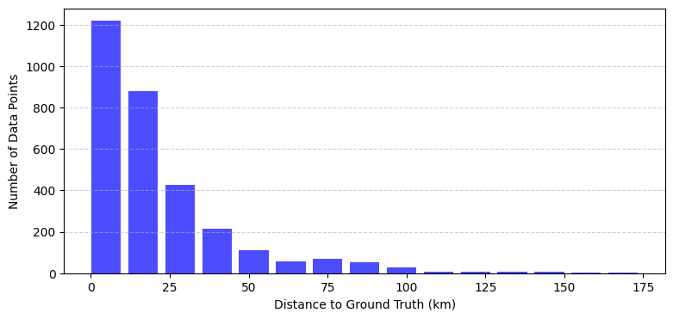
Results
Notes:
Where is a bar chart showing error distribution of the distances from predicted locations to the ground truth.
There are very few predictions which guess the completely wrong region, and the vast majority of predictions predict a location within 50 kilometers of the ground truth.

Slide 9
Conclusion
Results are good but “should” be better
Recent models have more relevant context
Scherrer and Ljubešić (2020) still better
Implementation issue?
Hyperparameters?
Interesting task
Surprisingly accurate
Applicable in Norway?
Scherrer, Y., & Ljubešić, N. (2020). HeLju@VarDial 2020: Social Media Variety Geolocation with BERT Models. Proceedings of the 7th Workshop on NLP for Similar Languages, Varieties and Dialects, 202–211. https://aclanthology.org/2020.vardial-1.19
Notes:
The results are good but “should” probably be better. I have used an approach very similar to that of the winning model of Scherrer and Ljubešić from 2020, trying to recreate and improve upon their results.
Beforehand, I guessed that I would be able to beat their scores by using more recent models with more relevant context but that did not happen. In 2020 there were no available BERT-based model pre-trained on Swiss corpora but today there is. While they did pre-train a model on the so-called SwissCrawl corpora, the model I used was trained on SwissCrawl and the large Leipzig Corpora Collection. Even still, I was unable to reach the same scores consistently.
I speculate that this may be an implementation issue with my implementation, or that there are default hyperparameters in the simpletransformers library (which they used) which were different to the hyperparameters in my PyTorch implementation.
Anyways, I thought it was a very interesting task, and found it surprising how accurate the results could get. I think it could be interesting to use the same approach on a Norwegian dataset seeing as we, like the Swiss, have a wide range of very distinct dialects.

