Slide 1
Finding out what differs between annual riders and casual riders bike usage?
Timeline
Inspection of these 2 groups, differences and similarities
Analysis from 2019 Q2 – 2020 Q1
Staying focused on average bike ride durations and amount of bikerides.
Encountering patterns and trends on the data I analyzed
My conclusions on the subject matter.
Feedabck and questions

Slide 2
Purpose of this analysis and goals
Purpose
find out possible patterns or trends to convert casual riders into annual riders with memberships.
Increase business growth and income.
Find out any business strategies that can be implemented in cohesion with the results.
Stakeholders get informed on the relationships and differences on bike usage between 2 groups
Recommendations on how the company could benefit from this data-analysis and what steps forward could affect business strategy positively.
Everyone are on the same page with the results and analysis after the presentation.
Start the first steps of business decisions where these results and findings are utilized.
Goals

Slide 3
What work has been done
1. The objectives were set and plan was made for action.
2. Availability checked and data sets were imported. Integrity and security checked.
3. Data was cleaned, compressed into one big dataset, and formatted for easier use.
4. Calculations and visualizations were made in order to draw conclusions of the dataset.
5. Data was analyzed more indepthly and considerd from different angles.

Slide 4
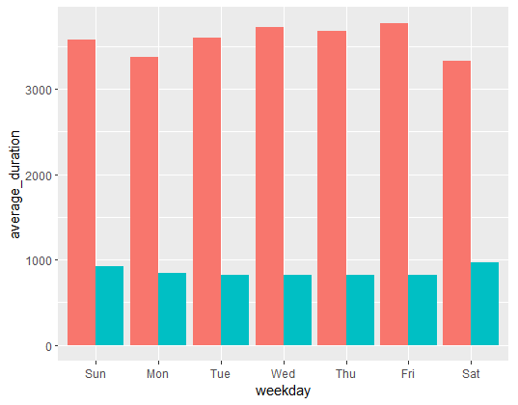
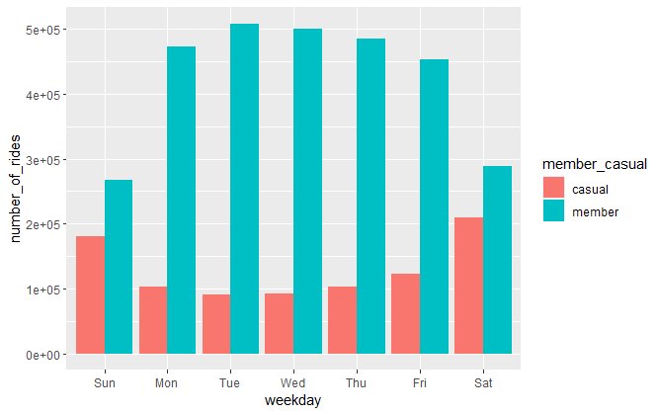
Bike rides for casual and member riders on a weekly basis during 2019 Q2 – 2020 Q1.
Average ride duration on week days
Number of rides on week days
(3000 seconds = 50min)
Notes:
The data indicates to us that casual riders ride 2-3 times longer than members do on average
Members on the other hand do 3-4 times more rides than the casual riders.
Casual riders have a very significant rise in ride average ride duration in January and February, and show 2 times higher averages than any other month.
Members do more rides on weekdays compared to week end and casual riders are the complete opposite of this.

Slide 5
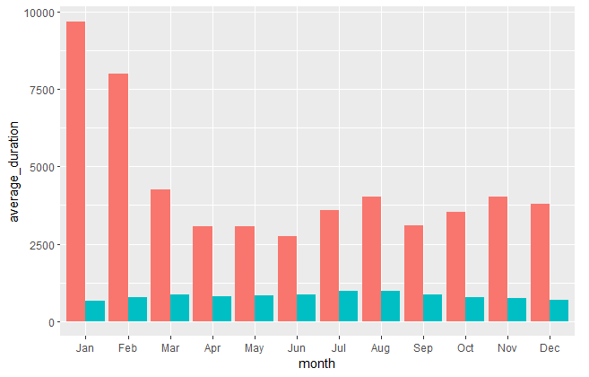
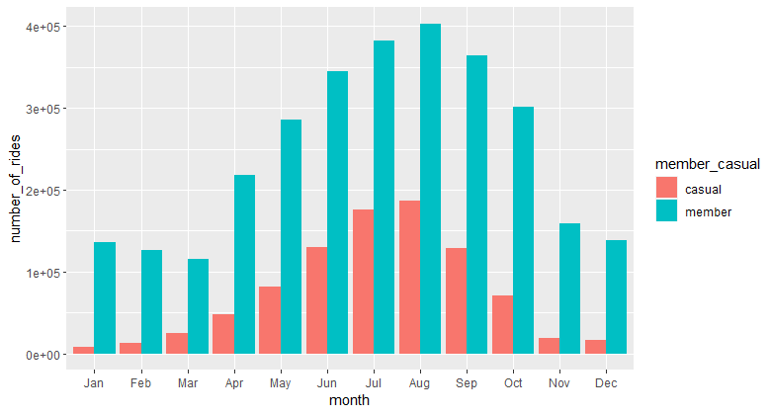
Bike rides for casual and member riders on a monthly basis during 2019 Q2 – 2020 Q1.
Average ride duration every month
Average ride duration every month
(10000 seconds = 2h 46min)
(4e+05 = 400 000)
Notes:
The data indicates to us that casual riders ride 2-3 times longer than members do on average
Members on the other hand do 3-4 times more rides than the casual riders.
Casual riders have a very significant rise in ride average ride duration in January and February, and show 2 times higher averages than any other month.
Members do more rides on weekdays compared to week end and casual riders are the complete opposite of this.

Slide 6
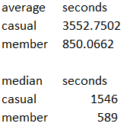
More calculations
Average, median..

Slide 7
Recommendation
Target sales campaings for casual riders at the first 2 months of the year and increase advertising before weekend, when most casual riders tend to ride.
Utilize the spring to early autumn season to get memberships out when all riders are seen to be doing most of the rides out of the year.
Marketing campaign that culminates some way in to ride time rather than individual times of rides made.

Slide 8
Feedback
What more further analysis or inspection could I do on this dataset?
Any questions?

