Slide 1
Oskari for end-users
Introduction to Oskari & possibilities for end-users
Notes:
korosta: kirjautunut vs kirjautumaton käyttäjä

Slide 2
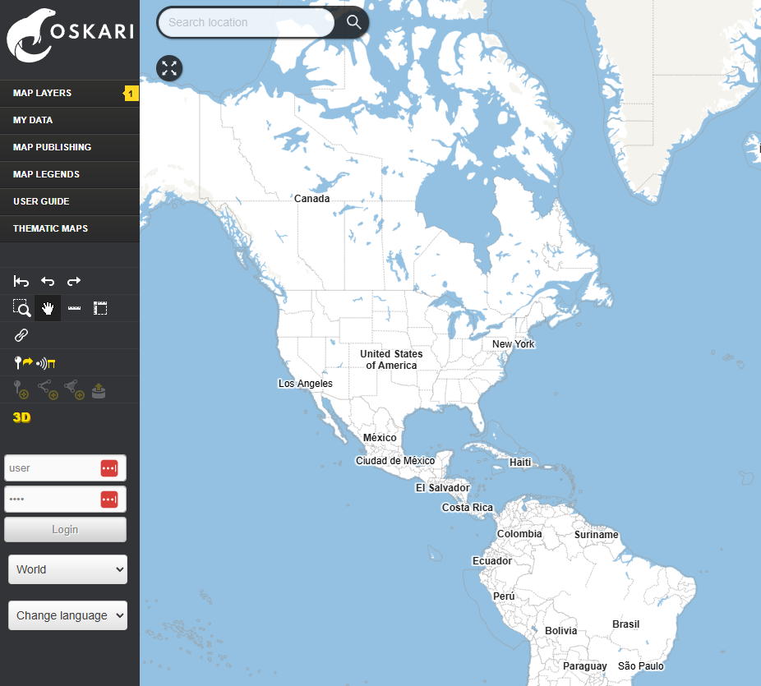
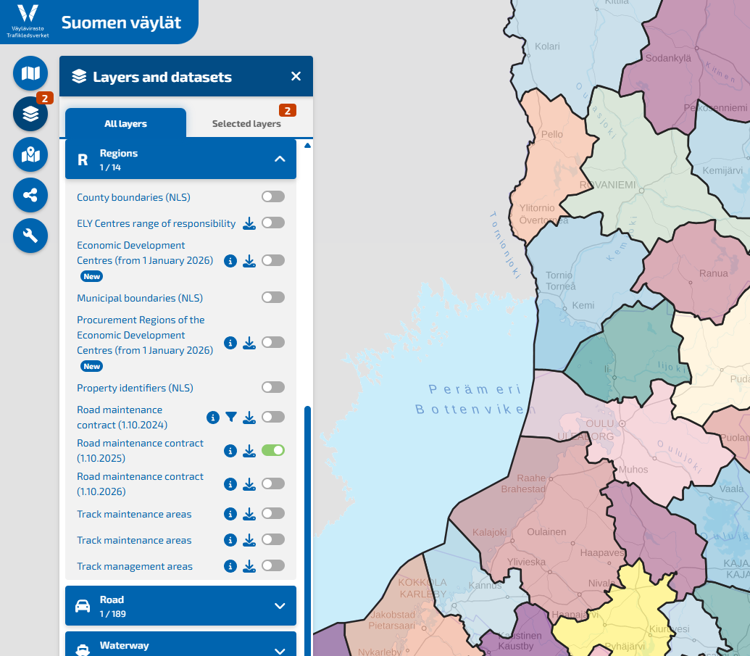
Oskari in a nutshell
An open source map service application developed in Finland
The aim: to help organizations create better map applications for web browser use (desktop + mobile)
Oskari allows you to create a browser-based map service, either as
a standard geoportal or
an extensively customizable map embed
Oskari can be customized:
  Appearance
  User interface
  Usable functionalities
  Creating new functionalities
Notes:
Voisi lisätä vanhan logon?

Slide 3
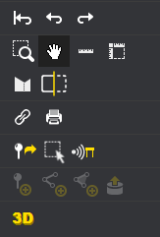
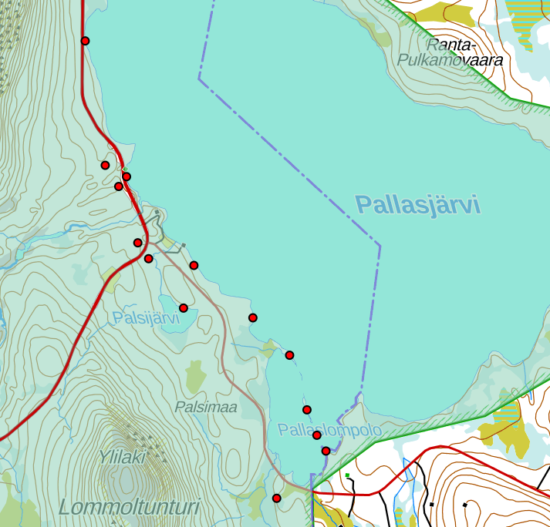
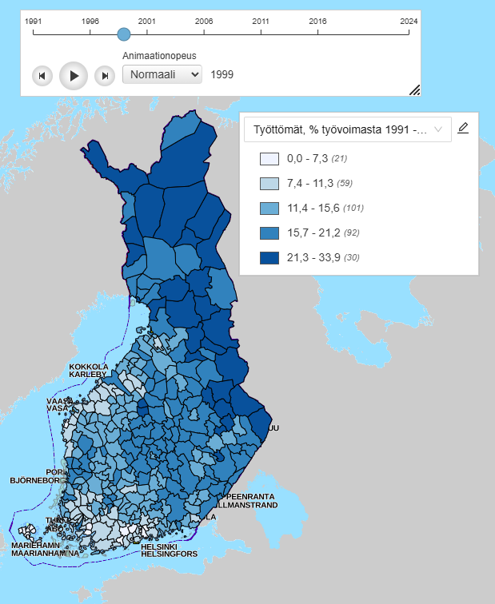


Oskari’s possibilities
Viewing spatial data in a web browser
Combining several different data sources and viewing different map layers simultaneously
Map publishing: embed maps on other websites or create new map services
Manage user roles: who can view or edit data, what functionalities are available to the end user
Thematic maps and time series
Search bar, import and export data, locate the user, view 3D data, measure distances and areas…
Works on mobile devices, too
Notes:
Kiinteät muinaisjäännökset, Valtion omistamat luonnonsuojelualueet, maastokartta, Pallas-Yllästunturin kansallispuisto. Työttömät v. 1999, aikasarja

Slide 4
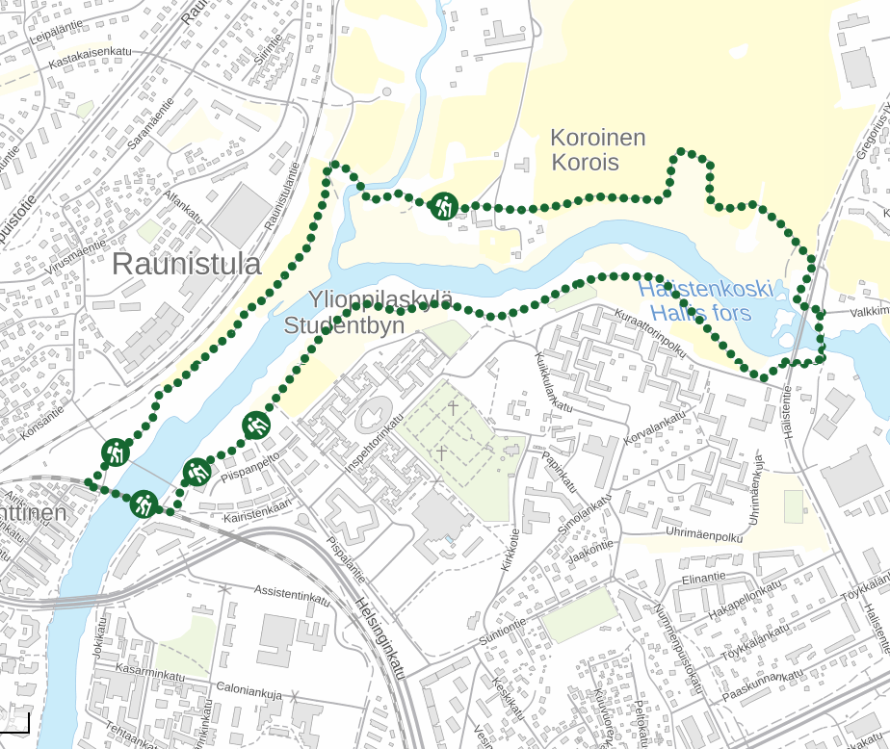
Benefits of Oskari
Ease of use
Makes data easier to find
A view to the spatial data that organisation produces
Comparing different map layers
A geoportal that can be used to publish map embeds either to create a new standalone map service or a simple map embed for an article
Locating and editing features outdoors

Slide 5
Demo
Try out some use cases:
Paikkatietoikkuna - Oskari geoportal
https://kartta.paikkatietoikkuna.fi/?lang=en
Suomen Väylät - a customized map embed
https://suomenvaylat.vayla.fi/?lang=en
kalastusrajoitus.fi (The Fishing Restriction Service) - a map embed
https://kalastusrajoitus.fi/#/kalastusrajoitus
Notes:
About 6-7 minutes here

Slide 6

Thank you!
Website: https://oskari.org/
GitHub: https://github.com/oskariorg/
LinkedIn: Oskari - Open Source
Email: info@oskari.org & juho@gispo.fi

