Slide 1
What is Oskari?
For those who use
or are interested to use
Oskari map service

Slide 2
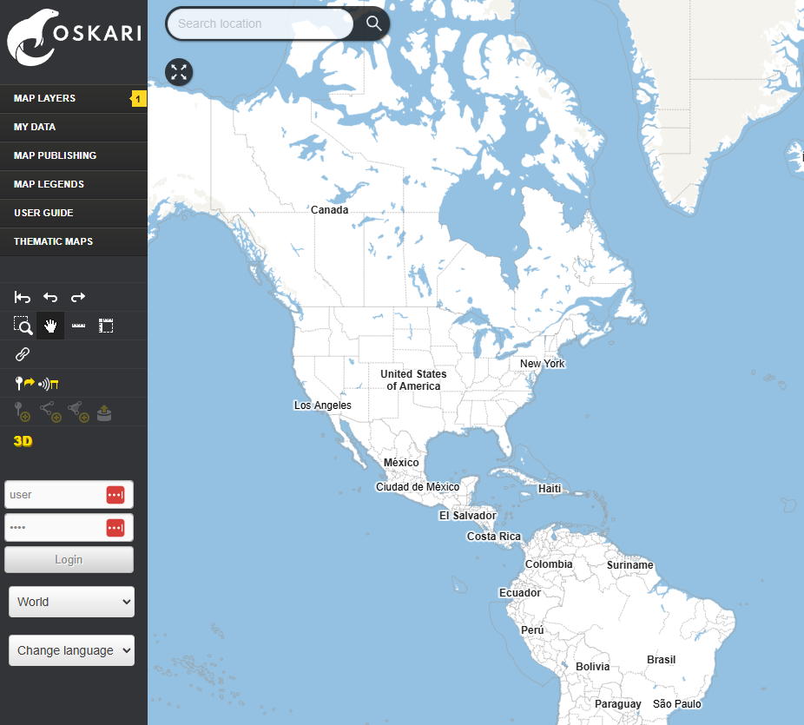
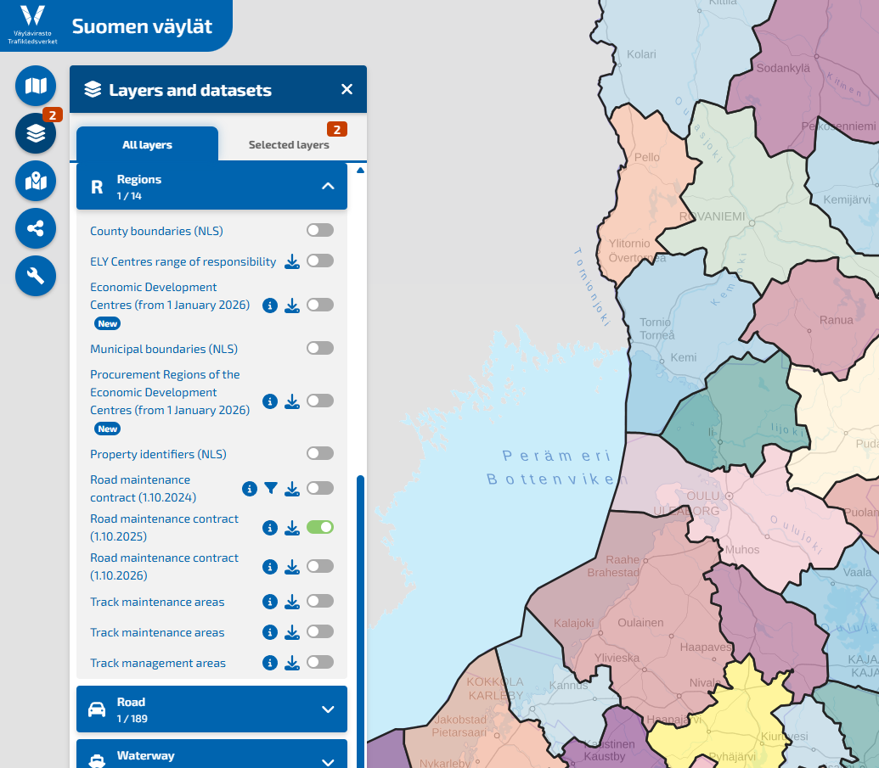
Oskari in a nutshell
An open source map service application developed in Finland
The aim: to help organizations create better map applications for web browser use (desktop + mobile)
Oskari allows you to create a browser-based map service, either as
a standard geoportal or
an extensively customizable map embed
Oskari can be customized:
  Appearance, user interface, usable functionalities, creating new functionalities
Notes:
Voisi lisätä vanhan logon?

Slide 3
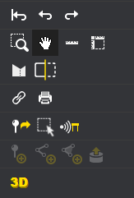
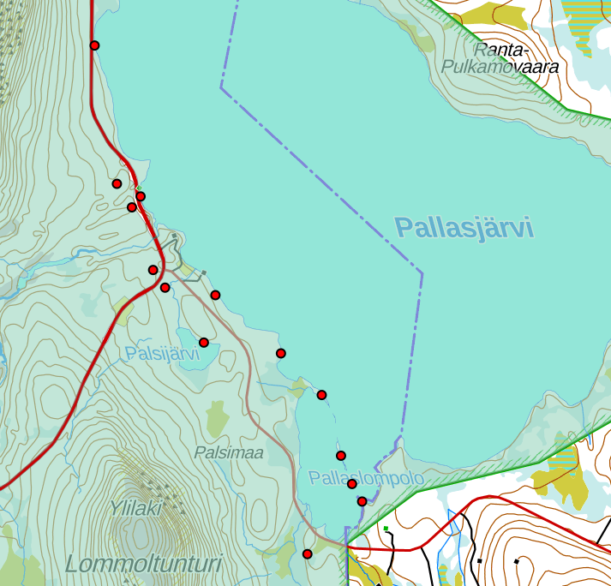
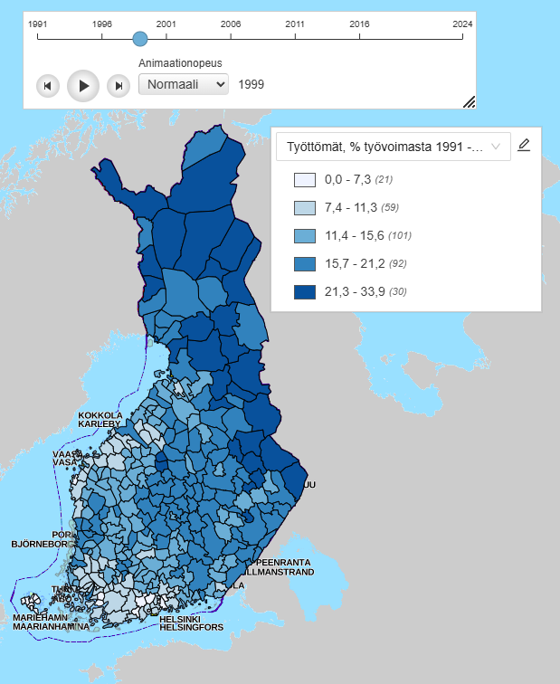


Oskari enables
Viewing spatial data in a web browser
Combining several different data sources and viewing different map layers simultaneously
Sharing your own or other people's maps to other websites as map embeds
Exporting and importing data
Thematic maps, address search, locating the end-user, 3D, user management, granting rights to layers to users with certain roles…
Notes:
Kiinteät muinaisjäännökset, Valtion omistamat luonnonsuojelualueet, maastokartta, Pallas-Yllästunturin kansallispuisto. Työttömät v. 1999, aikasarja

Slide 4
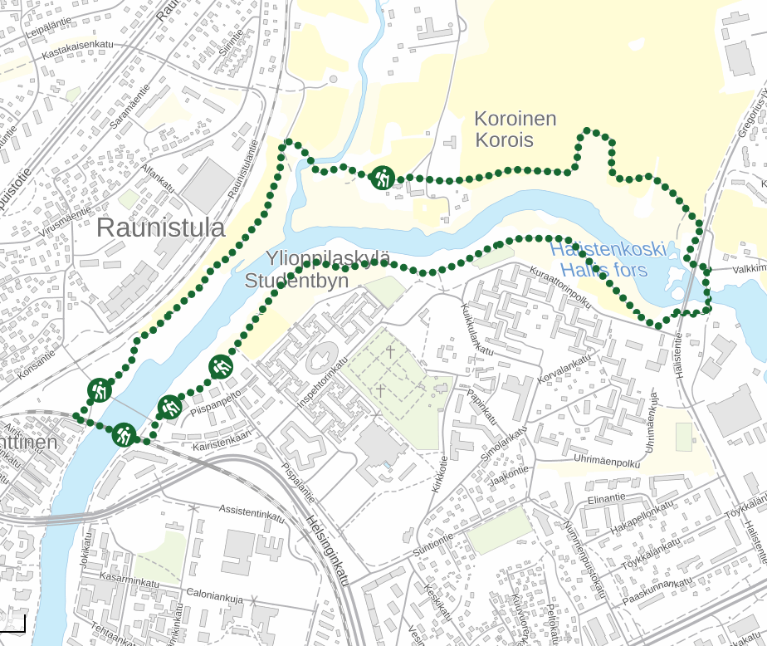
Benefits of Oskari
Ease of use
Makes data easier to find
A view to the spatial data that organisation produces
Comparing different map layers
A geoportal that can be used to publish map embeds either to create a new standalone map service or a simple map embed for an article
Locating and editing features outdoors

Slide 5
Requirements
Necessary:
A server where Oskari is located
Geospatial data that are available via an API
And if needed:
A software (GeoServer, for example) that allows organisation to publish its own data via an API
A database (PostgreSQL + PostGIS extensions, for example) if the organisation wants to allow user the end-users to import their own datasets to the map service

Slide 6

Data flow in Oskari (simplified)
View limited amount of data
View all the data
D
Oskari-based
map service
Geospatial data
Spatial / statistical API
User roles
View and edit

Slide 7
Alternative data flow in Oskari
No access
Choose what to share
Public
Oskari-based
map service
(map embed)
The main
Oskari-based
map service
(intranet)
D
View
Geospatial data
Spatial / statistical API
Admin tools & maintenance in intranet

Slide 8
The Oskari community
Oskari community is coordinated by National Land Survey of Finland
  Product owner, technical coordinator
  Communications coordinator as a consultant service
Oskari Joint development forum
  7 organisations (10/2025): NLS FI, Väylä, DVV, HSY, City of Tampere, City of Joensuu, Ubigu Ltd.
  Meetings on a monthly basis: use cases, needs, co-operation possibilities, what’s new
Project steering committee is responsible for the code
Development, consultation, training, support, maintenance
  Different companies, no vendor lock-in
Oskari community
  Organisations using Oskari: Lounaistieto, Museovirasto, Ruokavirasto…
  About 50 people, from both public and private sectors

Slide 9
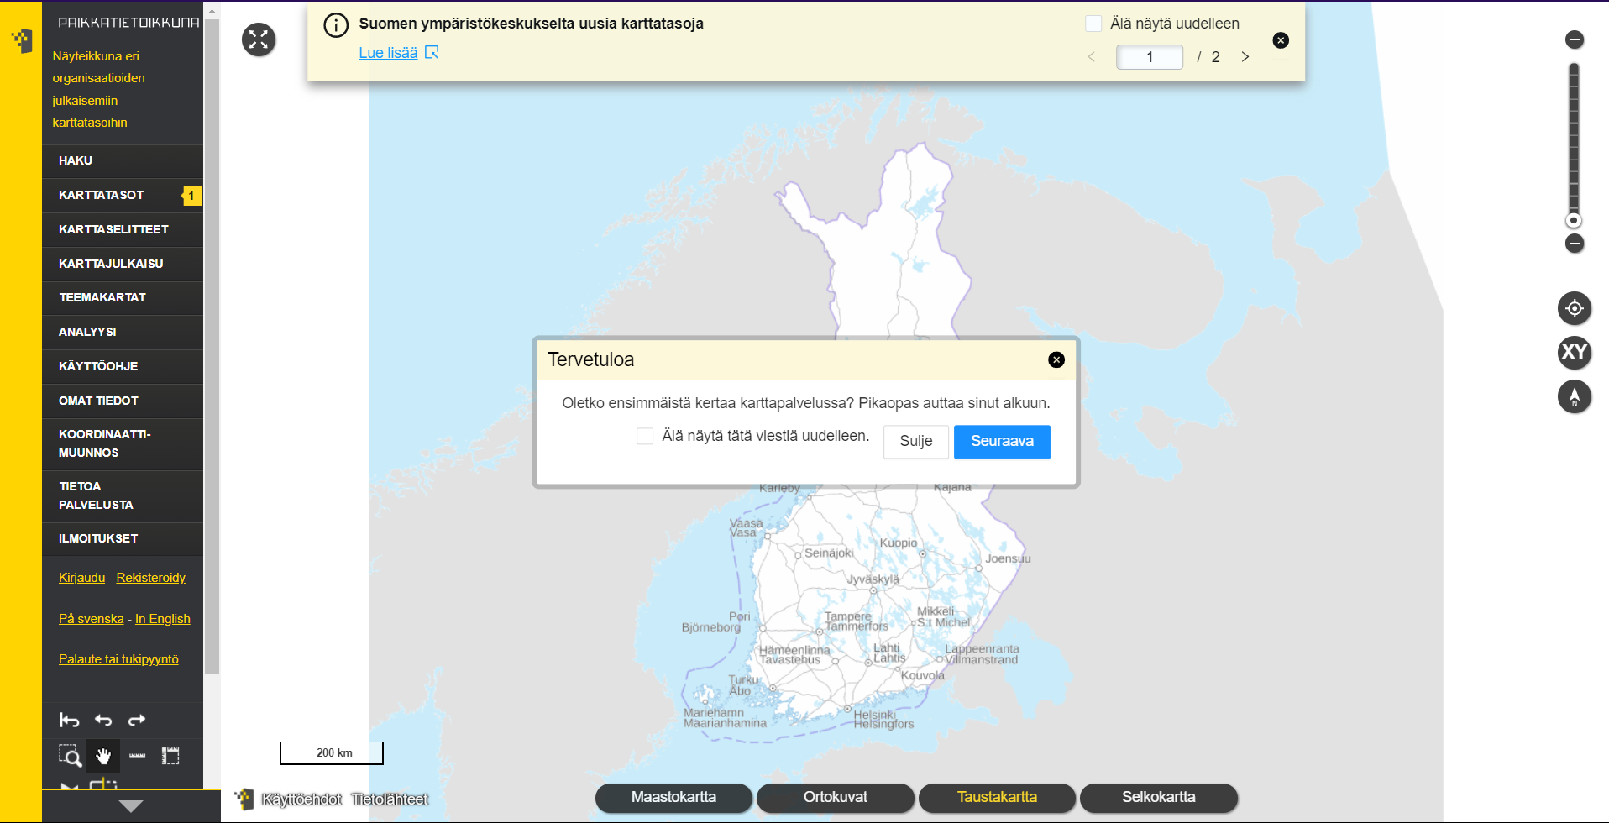
Use case: Paikkatietoikkuna
Released in 2009, Oskari as open source in 2011
The first Oskari implementation
Only data from Finland
  ~60 organisations providing data
  ~4000 map layers
  ~60 000 registered users (6000 active)
  ~ 5000-6000 users every weekday
Used for work and leisure

Slide 10
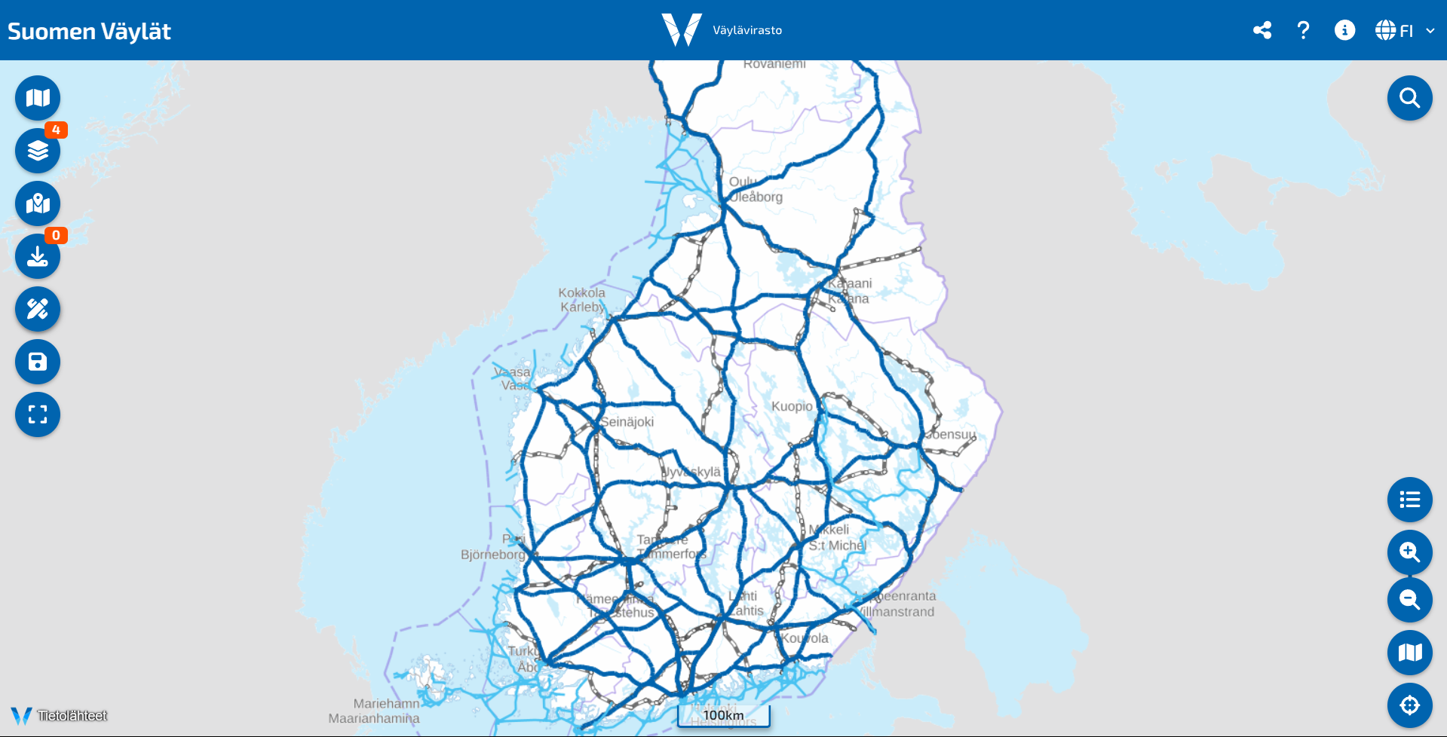
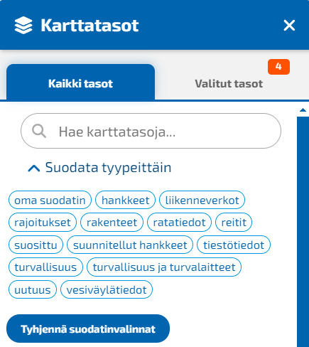
Use case: Väylä
Based on a map embed
Customized user interface
Own functionalities, inc. filtering layers by theme
The maintenance is done in geoportal that is not open for the public

Slide 11

Contact
Website: https://oskari.org/
GitHub: https://github.com/oskariorg/
LinkedIn: Oskari - Open Source
Email: info@oskari.org

