Slide 1
bds Programming Language Scaling over 100,000 CPUs
Pablo Cingolani
Director, NGS Informatics, Oncology
2021-09-22

Slide 2
Motivation
A³: Algorithms, Analytics & AI
Genomic & Imaging data processing
Petabytes of data
Different computing infrastructures: Cloud, Clusters/HPC, Servers, FPGA-accelerators
Sequencing analyses involving thousands of CPUs are routine
Computational Pathology analyses: Deep learning models on hundreds of GPUs

Slide 3
bds
Domain specific language (DSL) for data analysis pipeline orchestration
Design goals
Simple: Easy to learn, solves task coordination
Architecture agnostic: Program on a laptop, run on a cluster, or cloud
Robustness: At large scales, errors manifest
Speedup development: Fast prototyping, cleanup (process & files), reports, logging, command line parsing, strongly typed, testing, etc.

Slide 4
bds: Simple
Trivial to learn: You should be able to start writing pipelines within minutes (the language is intended to be “boring”)
Task: Scaling and parallelism use simple models
Task coordination is solved at language level

Slide 5
bds: Simple
Trivial to learn: You should be able to start writing pipelines within minutes (the language should look boring)
Task: Scaling and parallelism use simple models
Task coordination is solved at language level
for(int i=0 ; i < 3 ; i++) {
println “Hello world $i”
}

Slide 6
bds: Simple
Trivial to learn: You should be able to start writing pipelines within minutes (the language should look boring)
Task: Scaling and parallelism use simple models
Task coordination is solved at language level
for(int i=0 ; i < 3 ; i++) {
task echo “Process $i”
}
wait # Wait for all tasks finish
println “Done”
$ bds z.bds
Process 2
Process 0
Process 1
Done
$

Slide 7
bds: Simple
Trivial to learn: You should be able to start writing pipelines within minutes (the language should look boring)
Task: Scaling and parallelism use simple models
Task coordination is solved at language level
# Align reads for each sample
string[] bams
for(int i=0 ; i < numberSamples ; i++) {
fastq := “fastq_” + i + “.fq”
bam := “aligned_” + i + “.bam”
task(bam <- fastq) {
sys bwa mem hg38 $fastq \
| samtools sort > $bam
}
bams += bam
}
# Joint genotyping
bamsStr := bams.join(‘ ‘)
vcf := “variants.vcf”
task(vcf <- bams) {
sys joint_genotype $ bamsStr > $vcf
}

Slide 8
bds: Architecture agnostic
A bds program runs on different systems without modification.
bds is abstracts underlying infrastructure
Single server / laptop
Cluster: SGE, MOAB, Slurm, Torque, etc.
Cloud
Server farm
bds abstracts execution environments

Slide 9
bds: Architecture agnostic
A bds program runs on different systems without modification.
bds is abstracts underlying infrastructure
Single server / laptop
Cluster: SGE, MOAB, Slurm, Torque, etc.
Cloud
Server farm
bds abstracts execution environments
for(int i=0 ; i < 3 ; i++) {
task echo “Process $i”
}
wait # Wait for all tasks finish
println “Done”
# Execute on my local laptop
$ bds z.bds
Process 0
Process 2
Process 1
Done
$

Slide 10
bds: Architecture agnostic
A bds program runs on different systems without modification.
bds is abstracts underlying infrastructure
Single server / laptop
Cluster: SGE, MOAB, Slurm, Torque, etc.
Cloud
Server farm
bds abstracts execution environments
# Execute on an SGE cluster
$ bds -s sge z.bds
Process 0
Process 2
Process 1
Done
$
# Execute on a SLURM cluster
$ bds -s slurm z.bds
Process 0
Process 1
Process 2
Done
$

Slide 11
bds: Architecture agnostic
A bds program runs on different systems without modification.
bds is abstracts underlying infrastructure
Single server / laptop
Cluster: SGE, MOAB, Slurm, Torque, etc.
Cloud
Server farm
bds abstracts execution environments
# Execute on an SGE cluster
$ bds -s sge z.bds
Process 0
Process 2
Process 1
Done
$
# Execute on a SLURM cluster
$ bds -s slurm z.bds
Process 0
Process 1
Process 2
Done
$
Note: bds invokes the appropriate qsub or sbatch commands, monitors jobs in cluster, collect post-mortem information if the job fails

Slide 12
bds: Architecture agnostic
A bds program runs on different systems without modification.
bds is abstracts underlying infrastructure
Single server / laptop
Cluster: SGE, MOAB, Slurm, Torque, etc.
Cloud
Server farm
bds abstracts execution environments
# Execute on an SGE cluster
$ bds -s aws z.bds
Process 0
Process 2
Process 1
Done
$

Slide 13
bds: Architecture agnostic
A bds program runs on different systems without modification.
bds is abstracts underlying infrastructure
Single server / laptop
Cluster: SGE, MOAB, Slurm, Torque, etc.
Cloud
Server farm
bds abstracts execution environments
# Execute on an SGE cluster
$ bds -s aws z.bds
Process 0
Process 2
Process 1
Done
$
Note: bds will…
Create an instance
Create a start-up script that executes the task
Create a trap in startup script to shut-down on error
Set the instance as ”Terminate on shutdown”
Retries if AWS run instance fails
Create an SQS queue
The instance starts up
Executes the task
Redirect STDOUT / STDERR to SQS queue
Send task’s EXIT code to SQS (when task finishes)
Local bds process
Monitors SQS, shows STDOUT / STDERR messages
Marks task as finished when EXIT code is received

Slide 14
bds: Architecture agnostic
A bds program runs on different systems without modification.
bds is abstracts underlying infrastructure
Single server / laptop
Cluster: SGE, MOAB, Slurm, Torque, etc.
Cloud
Server farm
bds abstracts execution environments
# Execute on a cluster
task(out1 <- in1, system := ‘slurm’) {
sys some_cmd $in1 > $out1
}
# Execute on a Cloud
task(out2 <- in2, system := ‘aws’) {
sys another_cmd $in2 > $out2
}
# Execute as a local process
task(out <- [out1, out2]) {
sys join_outs $out1 $out2 > $out
}

Slide 15
bds: Architecture agnostic
A bds program runs on different systems without modification.
bds is abstracts underlying infrastructure
Single server / laptop
Cluster: SGE, MOAB, Slurm, Torque, etc.
Cloud
Server farm
bds abstracts execution environments
# Execute on a cluster
task(out1 <- in1, system := ‘slurm’) {
sys some_cmd $in1 > $out1
}
# Execute on a Cloud
task(out2 <- in2, system := ‘aws’) {
sys another_cmd $in2 > $out2
}
# Execute as a local process
task(out <- [out1, out2]) {
sys join_outs $out1 $out2 > $out
}
Note: bds coordinates across multiple systems (Slurm, AWS and local)

Slide 16
bds: Architecture agnostic
A bds program runs on different systems without modification.
bds is abstracts underlying infrastructure
Single server / laptop
Cluster: SGE, MOAB, Slurm, Torque, etc.
Cloud
Server farm
bds abstracts execution environments
# Absolute serialization
# Continue execution in AWS
task(out <- in, system := ‘aws’) {
println “This is bds code”
myFunction(in, out)
}
Note: bds will…
Serialize the current VM state
Transfer it to the instance
Continue executing bds code where it left (inside the task statement)

Slide 17
bds: Robust
Lazy processing: Do not re-run tasks if not needed
Automatic re-runs failed tasks
Absolute serialization (‘checkpoint’)
Check program exit code
Check output files exists (and non-empty)
Check jobs that disappeared from clusters
Check Cloud instances are alive
Retry creating Cloud instances

Slide 18
bds: Robust
Lazy processing: Do not re-run tasks if not needed
Automatic re-runs failed tasks
Absolute serialization (‘checkpoint’)
Check program exit code
Check output files exists (and non-empty)
Check jobs that disappeared from clusters
Check Cloud instances are alive
Retry creating Cloud instances
# Lazy processing example
in := “in.txt”
out := “out.txt”
task(out <-in) {
sys echo “Processing $in”
sys cat $in > $out
}
wait
println “Done”
# First time we run task is executed
$ bds z.bds
Processing in.txt
Done
# Run again, task is not executed
$ bds z.bds
Done

Slide 19
bds: Robust
Lazy processing: Do not re-run tasks if not needed
Automatic re-runs failed tasks
Absolute serialization (‘checkpoint’)
Check program exit code
Check output files exists (and non-empty)
Check jobs that disappeared from clusters
Check Cloud instances are alive
Retry creating Cloud instances
# Checkpoint example
for(int i=0 ; i < 10 ; i++) { if(i == 5) {
println "Checkpoint"
checkpoint "my.chp"
} println "Counting $i" }
# Restart execution from checkpoint file $ bds -r my.chp
Counting 5 Counting 6 Counting 7 Counting 8 Counting 9

Slide 20
bds: Robust
Lazy processing: Do not re-run tasks if not needed
Automatic re-runs failed tasks
Absolute serialization (‘checkpoint’)
Check program exit code
Check output files exists (and non-empty)
Check jobs that disappeared from clusters
Check Cloud instances are alive
Retry creating Cloud instances
in := ’in.txt’
out := ‘out.txt’
task(out <- in) sys touch $out
$ bds z.bds
. . .
ERROR: Task failed:
. . .
Output file checks : 'Error: Output file 'out.txt' has zero length.'

Slide 21
bds: Speedup development
Cleanup: Processes, files, instances
Summary reports
Command line parsing & help
Logging
Remote files
Strongly typed
Multithreading: par
Built-in debugger
Built-in unit testing
Dry run
Declarative style: goal
Task resources
Detached tasks

Slide 22
bds: Speedup development
Cleanup: Processes, files, instances
Summary reports
Command line parsing & help
Logging
Remote files
Strongly typed
Multithreading: par
Built-in debugger
Built-in unit testing
Dry run
Declarative style: goal
Task resources
Detached tasks
in := ’in.txt’
out := ‘out.txt’
task(out <- in) sys long_cmd $out
$ bds z.bds
. . .
# Press Ctrl-C will
Note: When you press Ctr-C bds will:
- Delete output file/s
- Kill any processes running a tasks
- Kill any cluster jobs running tasks
- Terminate any instances running tasks
- Delete cloud queues

Slide 23
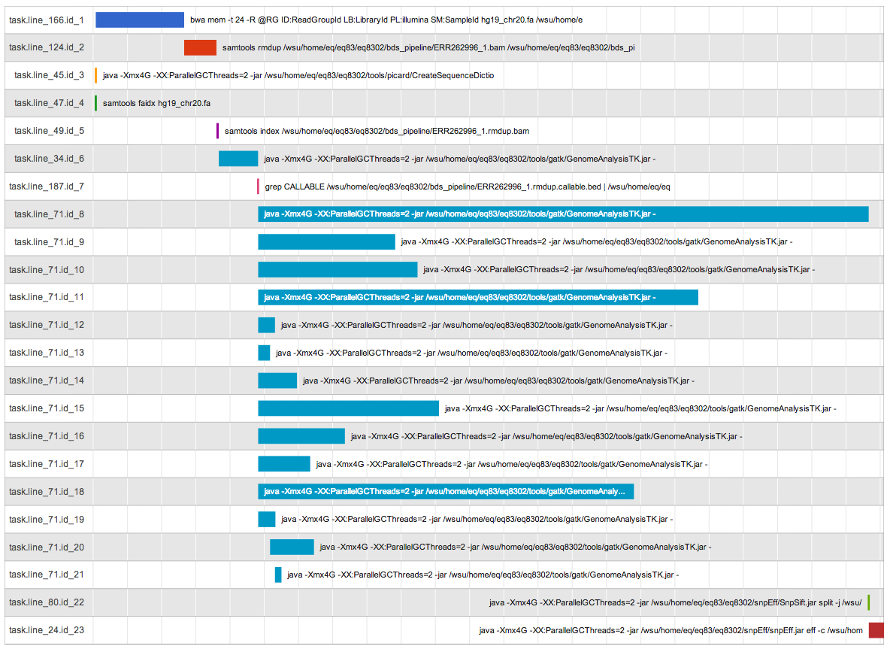
bds: Speedup development
Cleanup: Processes, files, instances
Summary reports
Command line parsing & help
Logging
Remote files
Strongly typed
Multithreading: par
Built-in debugger
Built-in unit testing
Dry run
Declarative style: goal
Task resources
Detached tasks

Slide 24
bds: Speedup development
Cleanup: Processes, files, instances
Summary reports
Command line parsing & help
Logging
Remote files
Strongly typed
Multithreading: par
Built-in debugger
Built-in unit testing
Dry run
Declarative style: goal
Task resources
Detached tasks
in := ’in.txt’ help Input file name
println “Input is: $in”
$ bds z.bds –h
Command line options 'z.bds' :
-in <string> : Input file name
$ bds z.bds -in my_file
Input is: my_file

Slide 25
bds: Speedup development
Cleanup: Processes, files, instances
Summary reports
Command line parsing & help
Logging
Remote files
Strongly typed
Multithreading: par
Built-in debugger
Built-in unit testing
Dry run
Declarative style: goal
Task resources
Detached tasks
in := ’s3://my_bucket/in.txt’
out := ‘out.txt’
task(out <- in) sys cat $in > $out
$ bds z.bds
Note: bds will
- Check the remote file in S3
- Compare timestamps against ‘out.txt’
- Download the S3 file
- Change ‘cat’ command (downloaded file)
- Execute the task

Slide 26
Conclusions
bds is a Domain Specific Language (DSL) for data analysis pipeline orchestration
bds is mature and well tested
bds allows to scale data analysis pipelines to thousands of CPUs & GPUs
Design goals: Simple, Architecture agnostic, Robustness, Speedup development

Slide 27
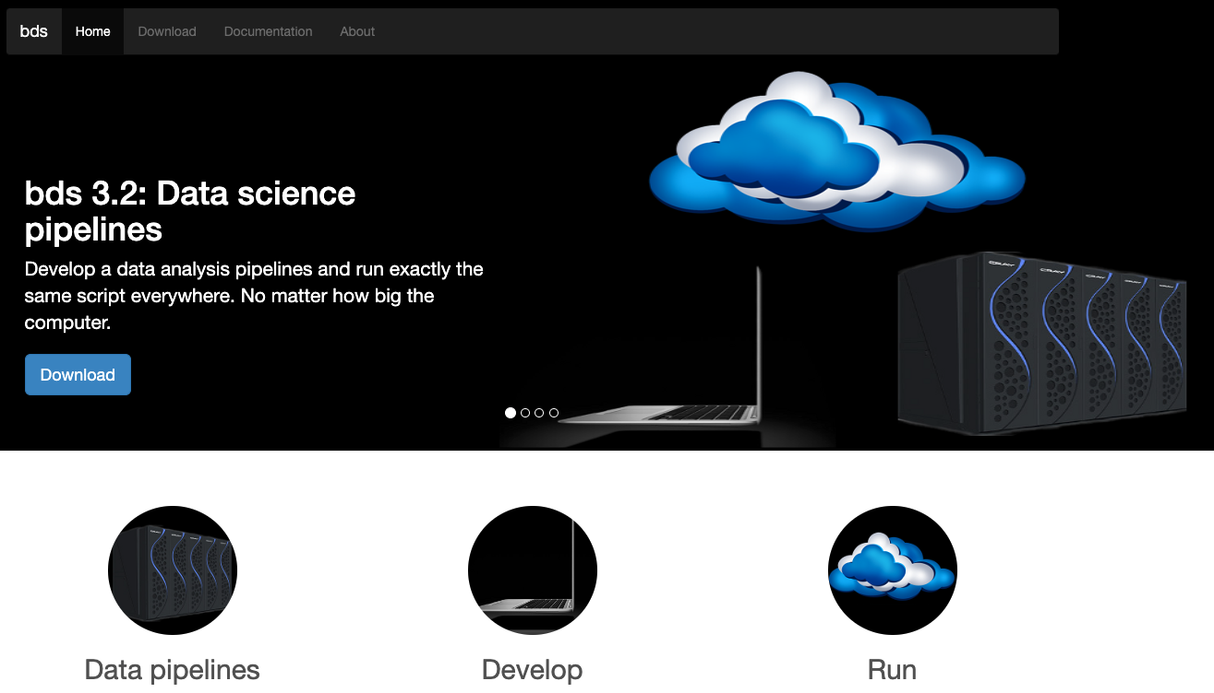

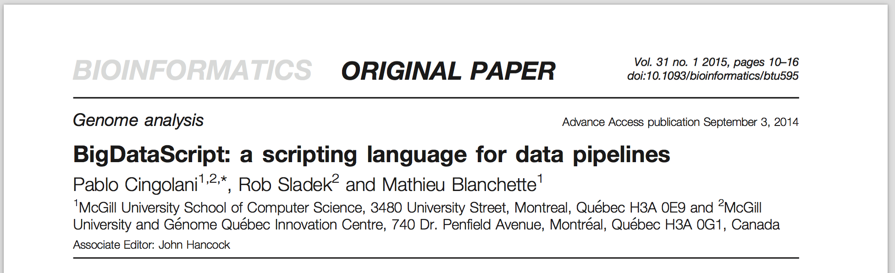
bds: Web, Docs, GitHub, Paper
https://github.com/pcingola/bds

Slide 28
Thank you!

