Slide 1

Speckles
Oskar Petr, T4

Slide 2
Speckles
e-shop s digitálními assety
grafika/design

Slide 3
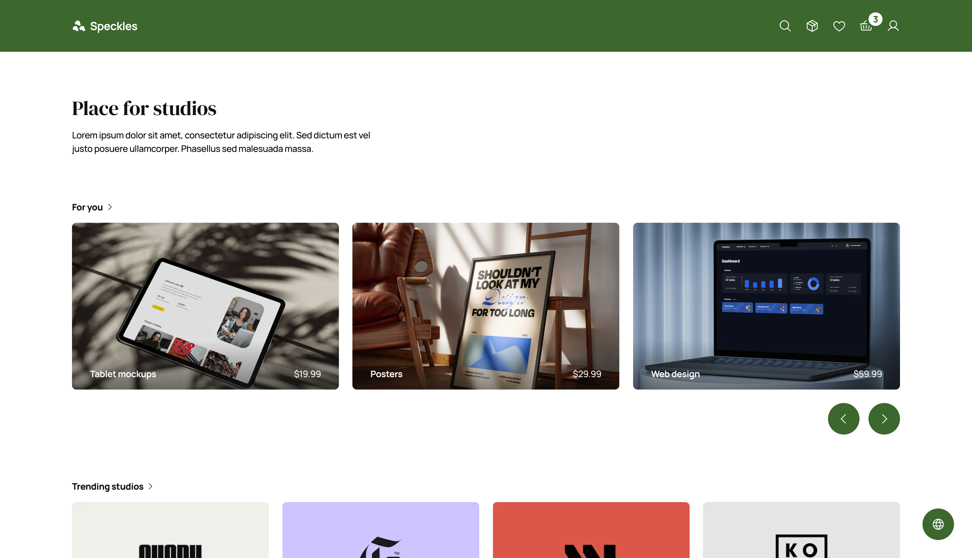

Slide 4
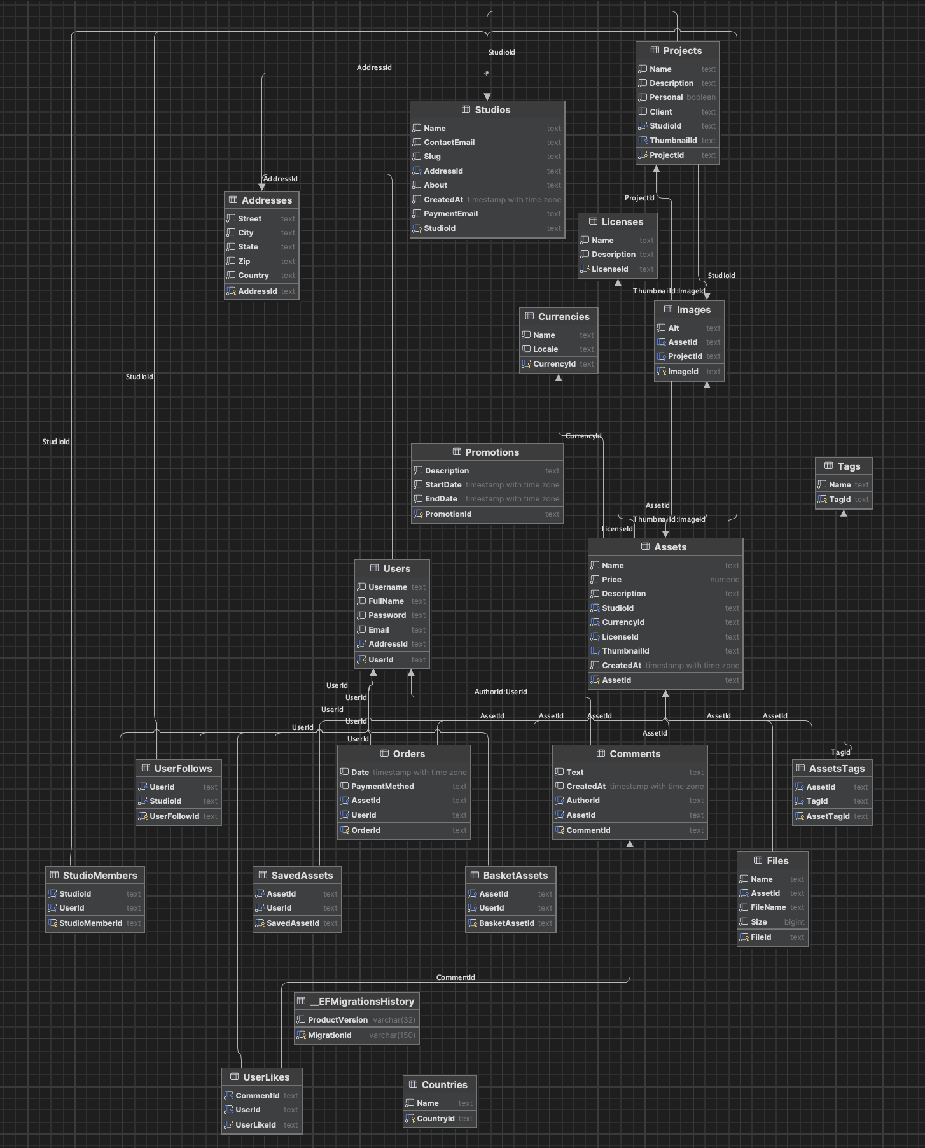
Database
21 tables
40 endpoints
+ uploading enpoints

Slide 5
API
https://app.diagrams.net/#G18SNSAv57WiA7ywepfTFYrK6hFHh7wYTY#%7B%22pageId%22%3A%22KBdDOpyRzBoyZ1stb8Gf%22%7D

Slide 6
Libraries
TanStack React Query
Framer Motion
Tailwind CSS
next-auth
bcrypt
zustand / store2
recharts
formik
html2pdf

Slide 7
Local storage
Promo kódy
Už se promo zobrazilo?
Měna
Už se měna nastavila?
Košík
Uložené assety
Sledování

Slide 8
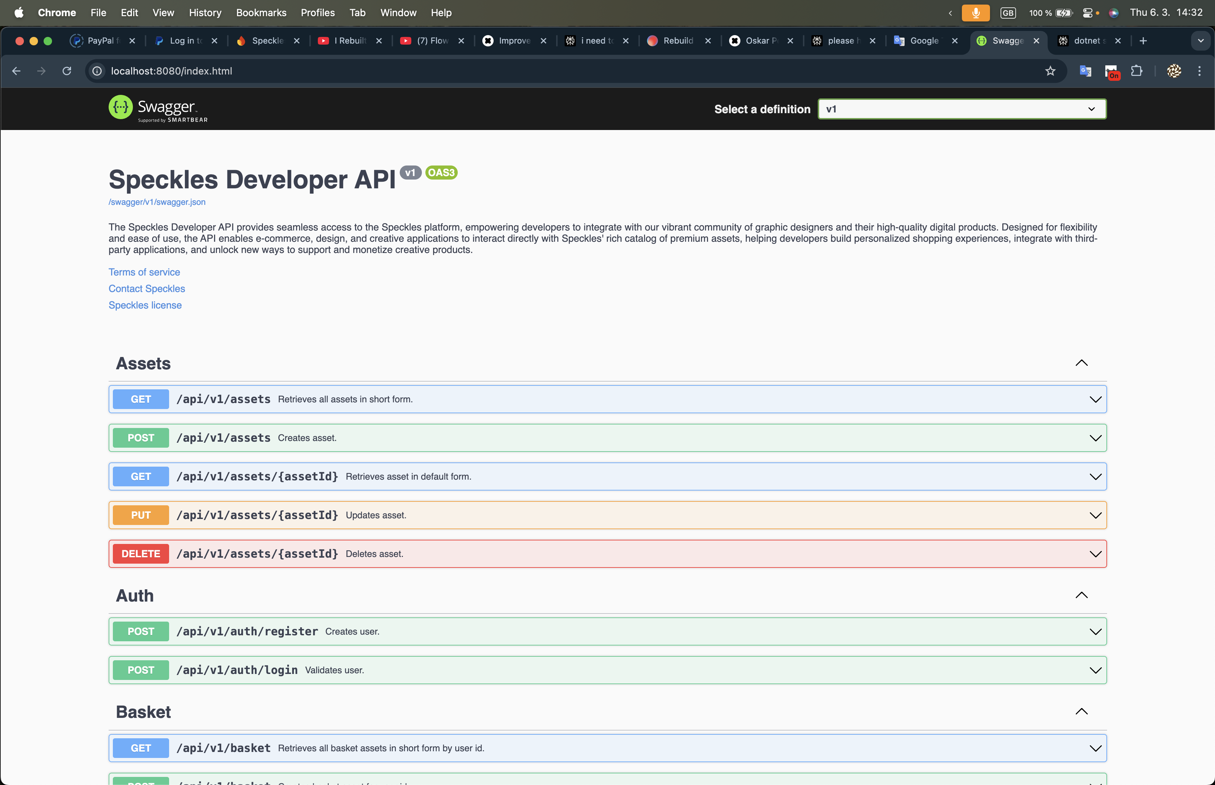
Developer API

Slide 9
Price distribution
Customer
PayPal API
Speckles
PayPal Payout API
Studio
Studio
Studio

Slide 10
App design
Frontend
API
Database
PayPal API

Slide 11
Legal side
Terms and Conditions
Privacy Policy (in progress)
Cookie Policy (in progress)

