Slide 1
Music Production
Oskar Rotman

Slide 2
What is Music Production?
Process of creating, recording, and editing music
Combination of technology & creativity
Goal: Finished song or track

Slide 3
Steps of Music Production
Composition: Melodies, chords, rhythm
Sound Design: Synthesizers, samplers, effects
Recording: Capturing vocals, instruments
Mixing: Balancing volumes, effects, EQ
Mastering: Final refinement for streaming or CD

Slide 4
DAWs
Digital Audio Workstations
Software for music production
Includes sequencer, mixer, effects & plugins
Popular DAWs
FL Studio
Ableton Live
Logic Pro
Cubase
Pro Tools
Reaper

Slide 5
FL Studio - Key Features
Channel Rack: Managing samples, instruments
Playlist: Arranging patterns & clips
Mixer: Effects, volume control, routing
Piano Roll: Drawing melodies & chords

Slide 6
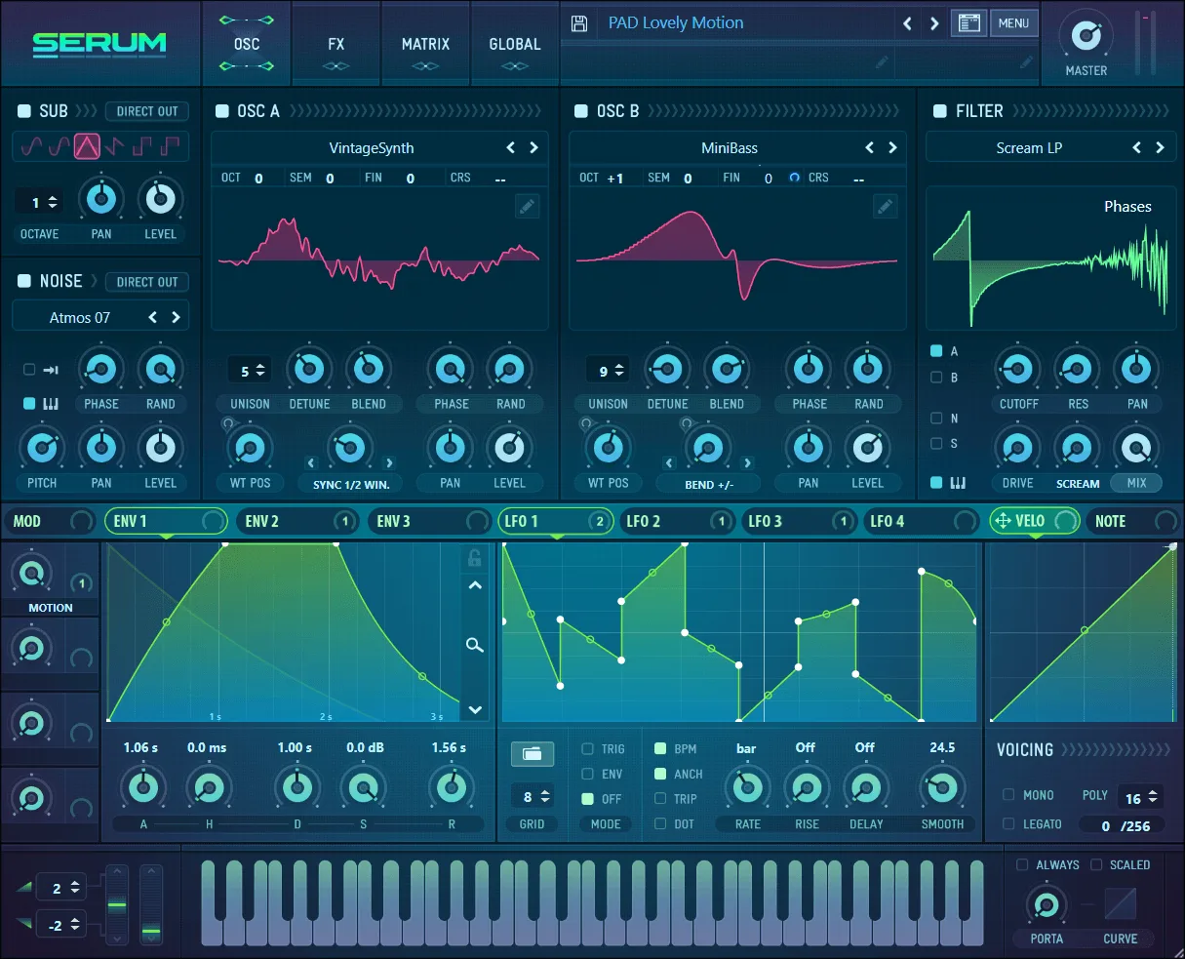

Slide 12
Thank you

