Slide 1

Buyond
Beyond B2B Buying – The Smart Platform for Fashion & Design Brands

Slide 2
What is Buyond
Modular B2B sales platform
- Clean UX, fast onboarding
- Smart order management + BI
- Fashion-focused with customizable tools

Slide 3
The Problem
Current B2B platforms are:
- Expensive and rigid
- Complicated UX
- Poor integration with ERP/systems
- Lack of intelligent tools (budgeting, analytics)

Slide 4
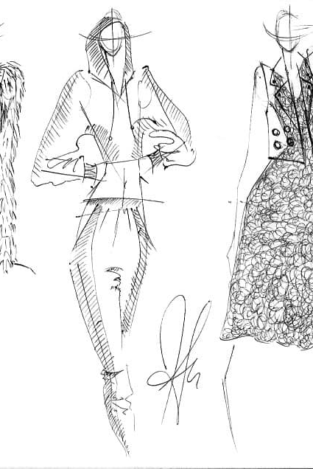
The Opportunity
€XXB market in B2B fashion buying
- Acceleration of digital buying
- Need for agile, modular, cost-efficient solutions
- Brands want control, buyers want simplicity

Slide 5
Key Features – Buyer Side
Visual catalog browsing
- Forecasting tool (set & adjust budgets per client)
- Smart cart with suggestions
- Easy ordering & order history access

Slide 6
Key Features – Brand Side
Catalog upload (Excel/API)
- Client-specific price lists & discounts by seasonality
- Real-time order tracking & reports
- Embedded mini-CRM

Slide 7
Shoppable Looks
Brands can create curated sections featuring full campaign looks.
For each product, wholesale and MSRP prices (mbothulti-currency) are displayed.
With one click, buyers can add the entire look to their cart, simplifying the buying process and bringing storytelling.

Slide 8
Smart Budgeting
Import client sales history
- Set budget per season/client/store/gender
- Tool Calculator for budgets
- Visual progress tracking

Slide 9
Analytics & BI Module
Personalized dashboard
- KPI visualizations: top products, budget spent, seasonal trend
- Exportable reports + embedded insights

Slide 10
Integration Ready
Connectors for Shopify, SAP, Salesforce
- API-first architecture
- Excel & CSV import/export

Slide 11
Business Model
- Monthly subscription per brand (tiered by features)
- Add-on fees: integrations, advanced analytics
- White-label options for agencies/distributors

Slide 12
Why Buyond Stands Out
Feature | Buyond | JOOR | Pepperi | Le New Black
Modern UX | ✅ | ✅ | ❌ | ✅
Budgeting | ✅ | ❌ | ❌ | ❌
Modular pricing | ✅ | ❌ | ❌ | ❌
Embedded BI | ✅ | ✅ | ✅ | ❌
Easy onboarding | ✅ | ❌ | ❌ | ❌

Slide 13
Why We Win
Beautiful, mobile-first UX
- Fully modular pricing
- Built for fashion & design brands
- BI + budgeting features not found in competitors

Slide 14
Roadmap (6-12 months)
- 0-3 months: MVP, core modules (catalog, orders, CRM)
- 6-9 months: BI, budgeting,connectors
- 9-12 months: AR showroom, full mobile app

