Slide 1
PROTOTYPES INHERITANCE CHAINING
by Ostap Kovbasiuk

Slide 2
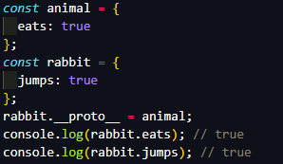
WHAT IS A PROTOTYPE
JavaScript is prototype-based. Each object has a private property which holds a link to another object called its prototype. When we want to read a property from object, and it’s missing, JavaScript automatically takes it from the prototype. In programming, such thing is called “prototypal inheritance”.

Slide 3
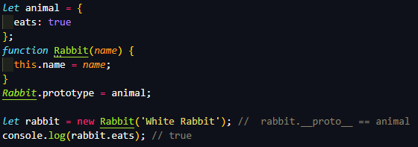
FUNCTION PROTOTYPE
As we can see, if we have something in our Rabbit.prototype the __proto__ of new instance is retrieved from it.

Slide 4
PROTOTYPE CHAIN
JavaScript objects have a link to a prototype object. When trying to access a property of an object, the property will not only be sought on the object but on the prototype of the object, the prototype of the prototype, and so on until either a property with a matching name is found or the end of the prototype chain is reached.

Slide 5
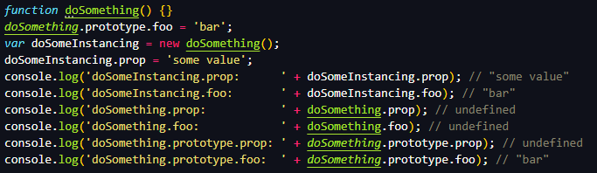
DEALING WITH PROTOTYPE

Slide 6

DEALING WITH PROTOTYPE
To access or set the prototype of an object we have a special functions:
Object.getPrototypeOf(object)
Object.setPrototypeOf(object, prototypeObject)

Slide 7
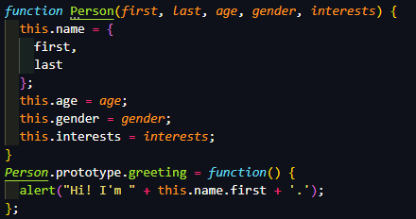

PROTOTYPE INHERITANCE

Slide 8
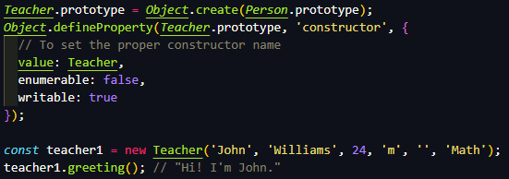
PROTOTYPE INHERITANCE

Slide 9
USED LINKS
https://developer.mozilla.org/en-US/docs/Web/JavaScript/Inheritance_and_the_prototype_chain
https://javascript.info/prototype-inheritance
https://learn.javascript.ru/new-prototype

Slide 10
THANKS FOR ATTENTION

